Slide 1

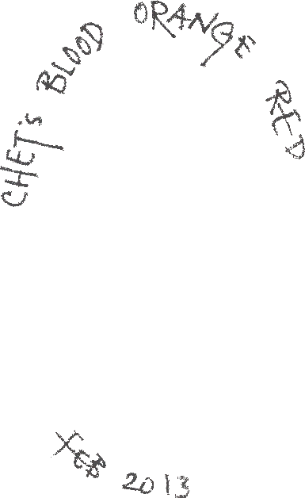
Misfitbrew.org/recipes/chetsblood
Misfitbrew.org/recipes/chetsblood
Chet's Blood Orange Red
Misfit.open.source.brew
Malts
½ lb cara red
1 lb honey malt
½ lb victory
½ lb med brit crystal
½ lb dark brit crystal
¼ lb roast b
½ lb cara vienne
¼ lb special b
Steep at 165 for 35min
7lbs Light extract.
Half 60 min, the rest 5 min
Hops
1 oz sterling 60 min
1 oz styrian golding 15 min
Additions
1/2oz coriander seed 15 min
5 lbs blood oranges 5 min
1 oz blood orange zest 5 min
whirlfloc tablet 5 min
Yeast
Milquetoast yeast cake (or S05)
Chet's Blood Orange Red
Misfit.open.source.brew
Malts
½ lb cara red
1 lb honey malt
½ lb victory
½ lb med brit crystal
½ lb dark brit crystal
¼ lb roast b
½ lb cara vienne
¼ lb special b
Steep at 165 for 35min
7lbs Light extract.
Half 60 min, the rest 5 min
Hops
1 oz sterling 60 min
1 oz styrian golding 15 min
Additions
1/2oz coriander seed 15 min
5 lbs blood oranges 5 min
1 oz blood orange zest 5 min
whirlfloc tablet 5 min
Yeast
Milquetoast yeast cake (or S05)

