Slide 1
AI RESUME & COVER LETTER GENERATOR
Presented By: Simran Giri

Slide 2
Introduction
- Resumes and cover letters are essential tools in job applications.
- Manual creation is time-consuming and often lacks personalization.
- AI offers a smart solution by generating role-specific and skill-based content quickly.

Slide 3
objective
- To develop a web-based tool that uses AI to automatically generate professional resumes and cover letters.
- Allow users to input details like skills, job role, and experience.

Slide 4
Technology used
Component | Technology / Library | Purpose
🧠 Language Model | transformers >= 4.28 | Generate text using pre-trained models (e.g., GPT-2, Falcon)
🔧 Deep Learning | torch >= 1.9 | Backend computation for LLM inference
🧱 Tokenizer | tokenizers >= 0.13.3, sentencepiece >= 0.1.95 | Efficient tokenization for model input/output
📦 Serialization | protobuf >= 3.20.0 | Handles serialized model data (required by some transformer models)
🌐 Web UI | Gradio | Easy-to-use frontend for users to interact with the AI
📁 (Optional) PDF Export | reportlab / weasyprint | Convert generated text into downloadable resumes/letters

Slide 5
features
Role-specific resume generation.
Professional formatting.
Cover letter customization.
Export as PDF/DOCX.

Slide 6
Working/methodology
User selects job role.
Inputs skills, experience, goals.
AI processes prompt and generates text.
- Preview & download options provided.

Slide 7
Scope of the project
Web app that collects user input and generates content.
Uses LLMs for personalized results.
- Output can be previewed and downloaded in PDF or DOCX.

Slide 8
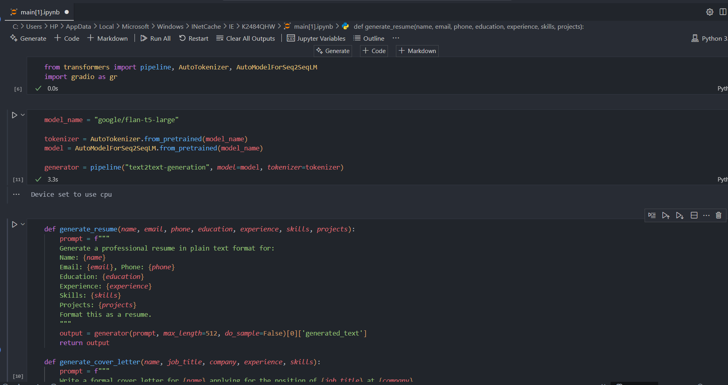
Ui screenshots/demo

Slide 9
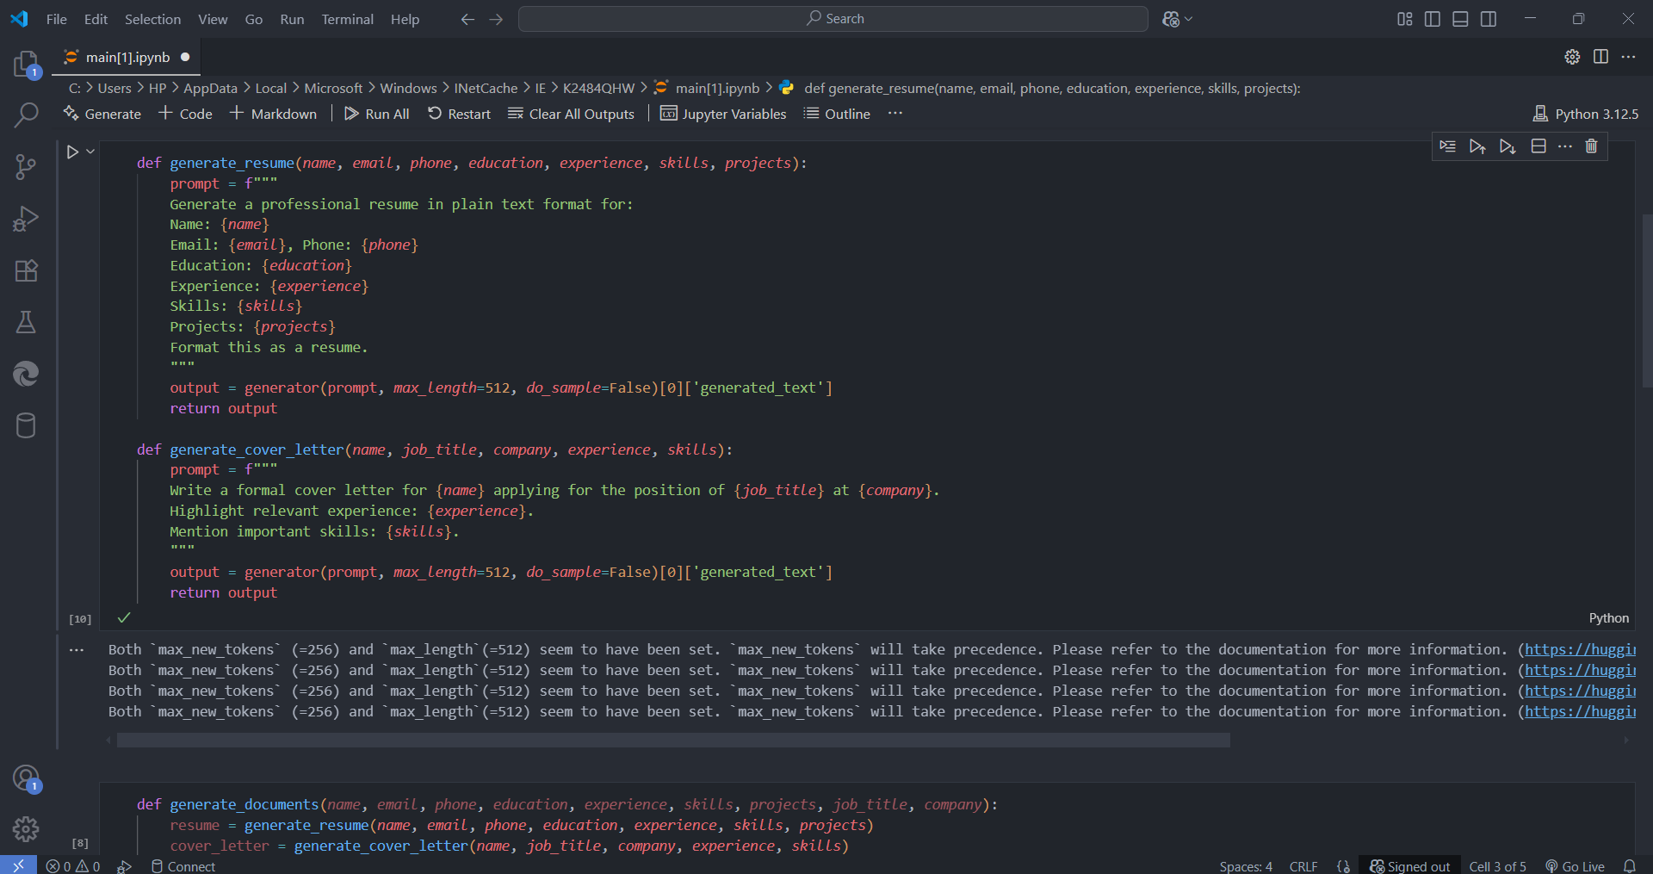

Slide 10
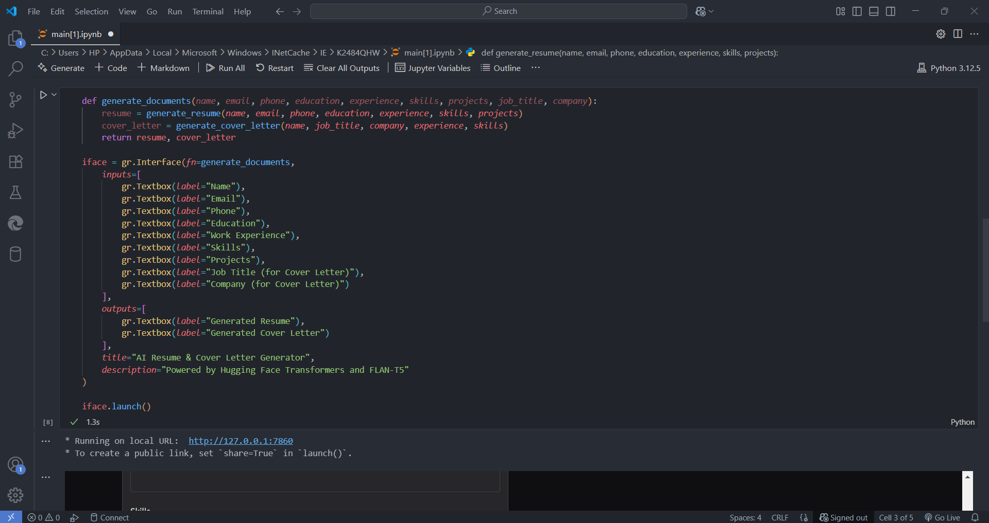

Slide 11
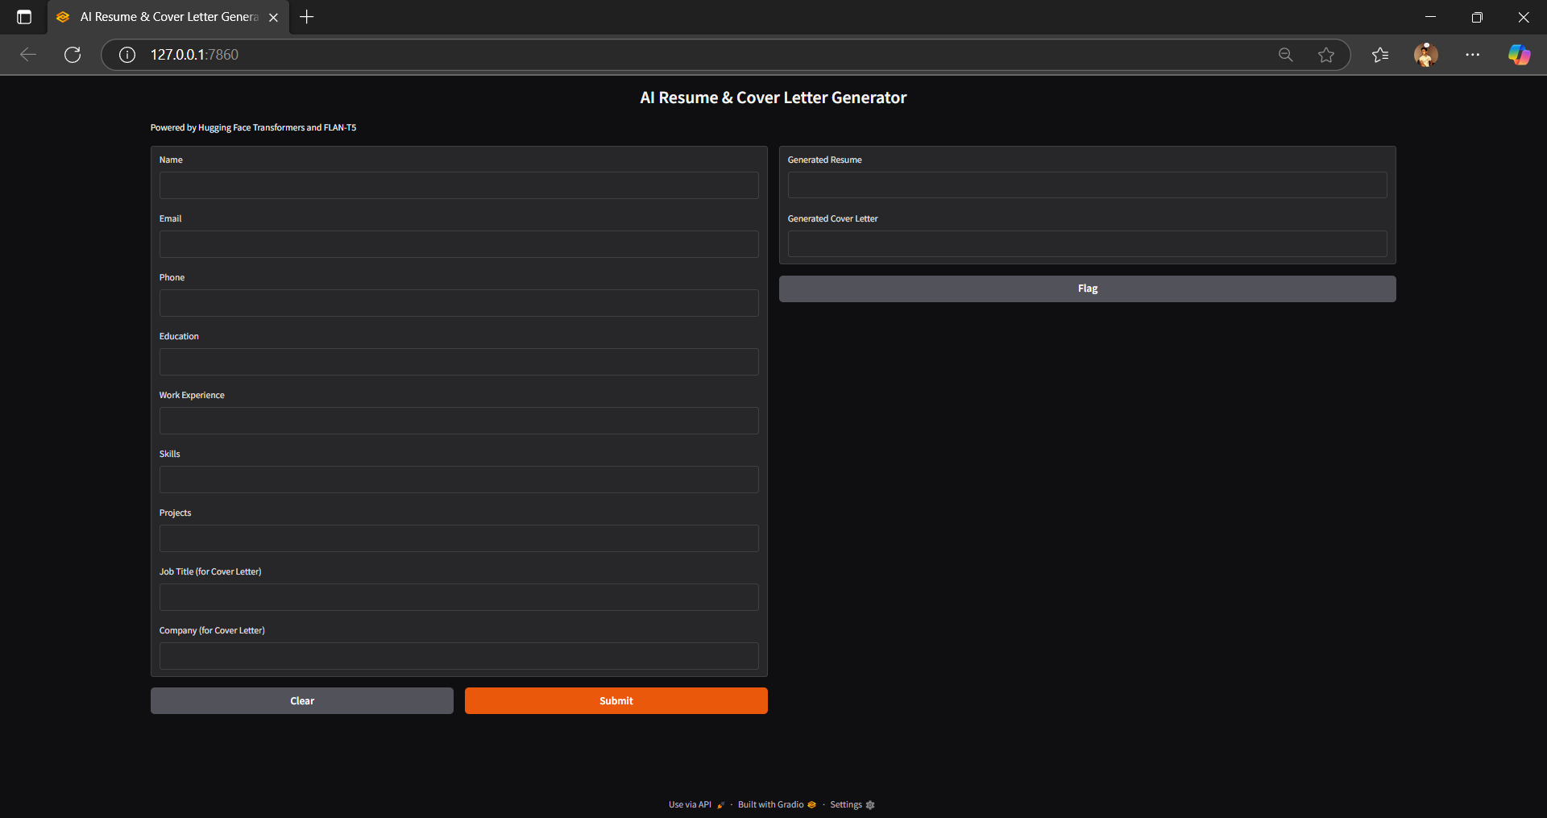

Slide 12
Problem Statement
- Job seekers struggle with writing effective resumes and cover letters.
- Existing tools are either too generic or complicated.
- Lack of AI-driven personalization limits impact.

Slide 13
Challenges Faced
Prompt accuracy and output formatting.
Maintaining context and grammar.
- Handling diverse user input.

Slide 14
Solutions to Challenges
Improved prompt engineering.
Pre-defined templates and formatting logic.
Extensive testing for various roles and profiles.

Slide 15
Testing & Results
Tested with different user profiles.
Output quality validated with feedback.
- High user satisfaction and usability.

Slide 16
Conclusion
AI-driven resume & cover letter tool saves time and improves quality.
- Useful for students, professionals, job seekers.

Slide 17
Future Scope
Multilingual support.
LinkedIn and ATS integration.
- Voice-based input and smart recommendations.

Slide 18
References & bibliography
Hugging Face Transformers.
Gradio / Streamlit Documentation.
- Research on LLMs and resume optimization.

Slide 19
Thank you !!!

