Slide 1


Real Estate Prediction Model
Submitted by:- Simranh Kaur Bhasin

Slide 2

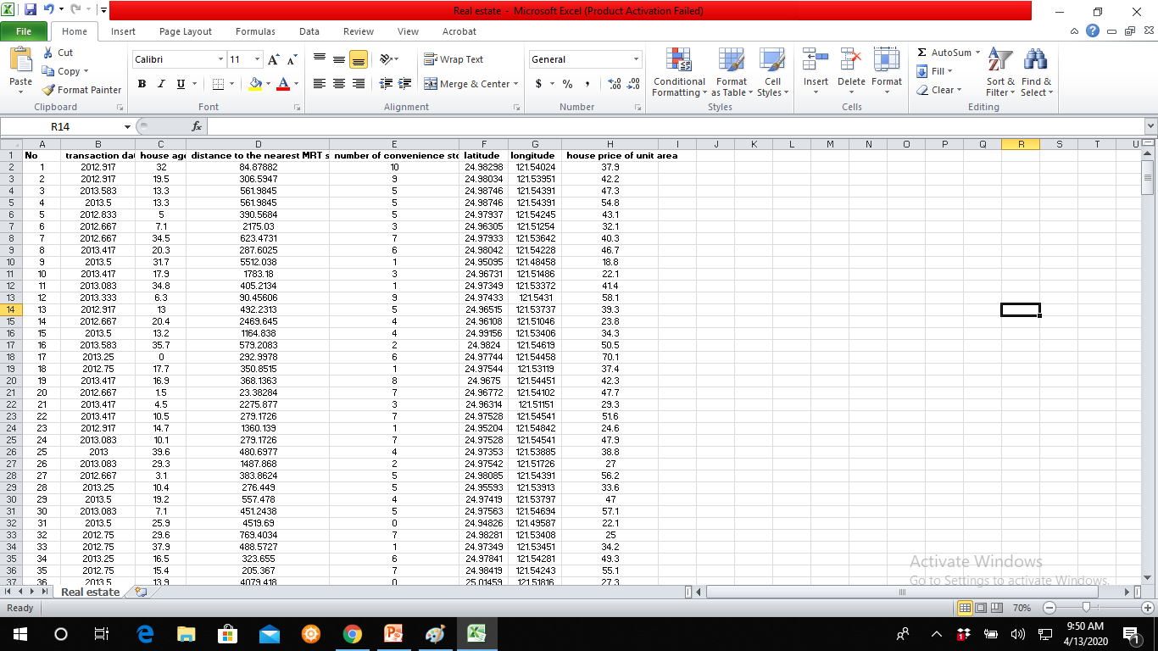
THE DATASET
The dataset on which our prediction model has been applied contains information of or relating to real estate. It includes the date of purchase, house age, location, distance to nearest MRT station, and house price of unit area that constitute 8 columns and 413 rows. It was found out that the dataset is clean and tidy as it did not contain any missing values or inconsistent data. A sample of the data can be seen below:-

Slide 3
SOURCES OF THE DATASET
The dataset was found on https://www.kaggle.com/.
The complete dataset can be found on the Github link:-
https://github.com/simranhbhasin/data-science-project

Slide 4
RESEARCH PROBLEM
The dataset that was chosen sparked some inquisitiveness in me. I was curious to know how does this data account for the prices of properties.
I was of the belief that the physical features of a house has the maximum weightage in determining the price of the house. However the data that was selected presented a contradiction. So on some research I understood that a property's physical structure tends to depreciate over time, while the land it sits on typically appreciates in value.
Moreover, Not all spots within a given area are considered equal. A home by a calm street is usually in higher demand than a home situated near a busy roadway.

Slide 5
It was found out that these prices also depend on the centrality of a property within a city. If it is surrounded by a well functioning neighborhood that has a good network of roads and transportation facilities it is rated higher. The geography also plays a huge role in this aspect.
Thus based on these findings I built my research problem. It states that:
This prediction model and the research around it is done in an attempt to determine exactly which factors play the most important role in deciding the price of a house. It will also be ascertained whether we can accurately estimate and predict this value if we perform our entire research on these few determinants or other factors need to be considered as well.

Slide 6
PREDICTION MODEL
(LINEAR REGRESSION)
Predictive models are extremely useful for forecasting future outcomes and estimating metrics. The model used here is known as linear regression. Linear regression is used to predict the value of an outcome variable Y based on one or more input predictor variables X. The aim is to establish a linear relationship (a mathematical formula) between the predictor variable(s) and the response variable, so that, we can use this formula to estimate the value of the response Y, when only the predictors’ (Xs) values are known.
Linear regression has been chosen because the selected dataset doesn’t contain any categorical data.

Slide 7
HOW TO IMPLEMENT THE PREDICTION MODEL?
As stated by the research problem it is known that the price of the house needs to be estimated and therefore it will serve as the dependent variable, ‘Y’.
Thus, now we are required to decide which attributes will serve as the predictor variables. In order to do that we will be making a plot using ggpairs() present in the Ggally package. The plot will help us visualize the dataset, depict the relationship between the different attributes present in it and execute exploratory data analysis.

Slide 8
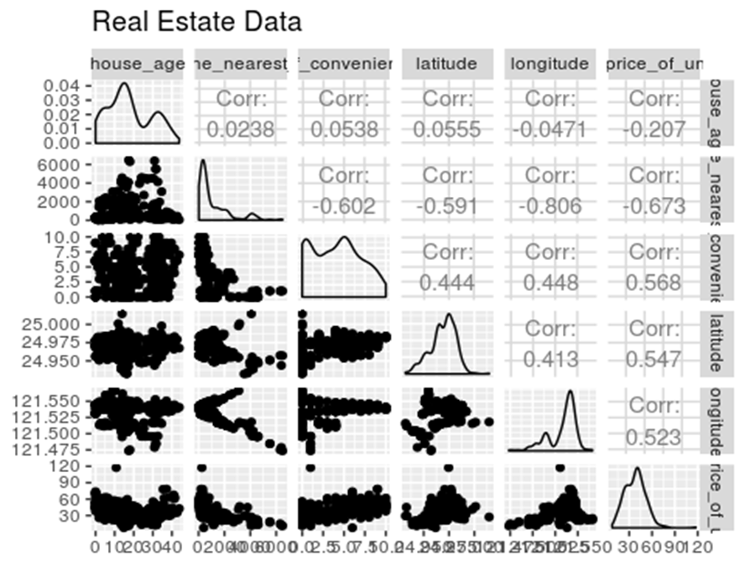

Slide 9
The plot matrix gives us scatter plots for each variable combination, as well as density plots for each variable and the strength of correlations between variables. The correlation coefficients provide information about how close the variables are to having a relationship; the closer the correlation coefficient is to 1, the stronger the relationship is. The scatter plots let us visualize the relationships between pairs of variables.
Thus the top 4 variables that seem to have a strong relationship with our dependent variable i.e. house per unit area are:-
Number of convenience stores
Latitude
Longitude
House Age
These variables will be the ‘Xs’ according to our definition of linear regression and will be used to predict the price per unit area of a house.

Slide 10
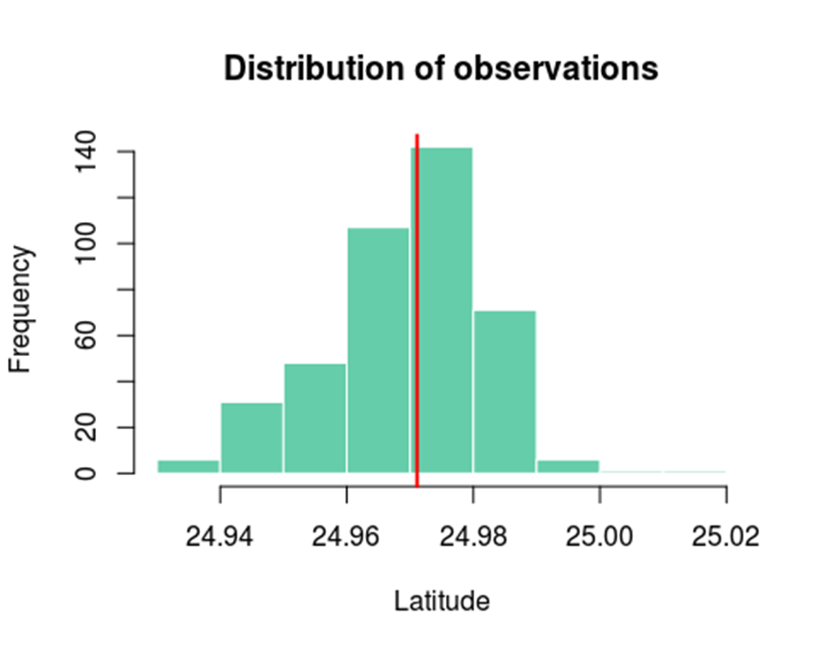
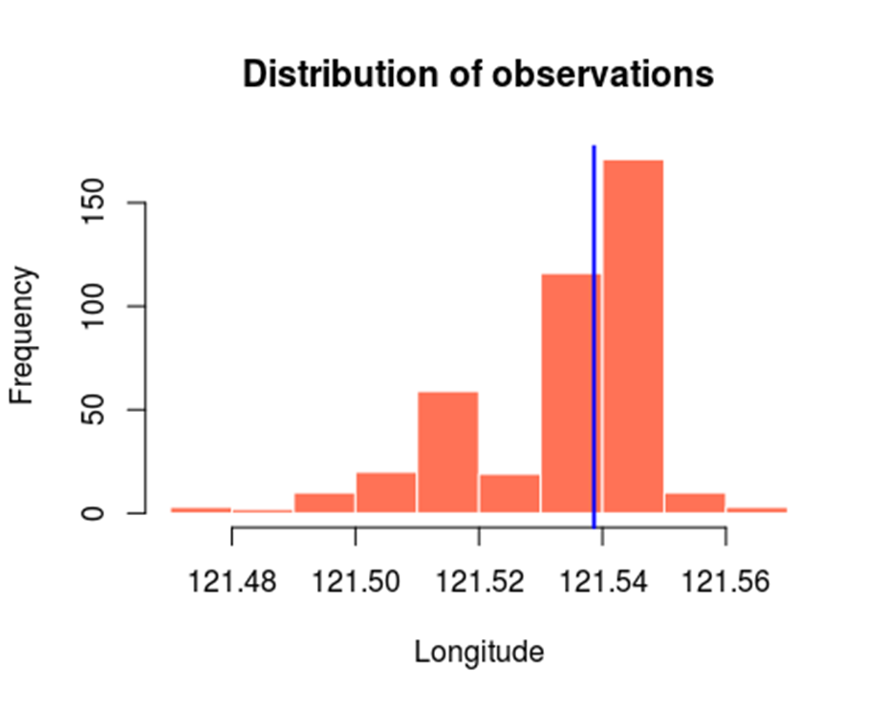
To further carry out data analysis and judge the data distribution of these four attributes that will work as the predictor variables we will plot histograms. To visualize, the line for the median of these observations is also plotted.

Slide 11
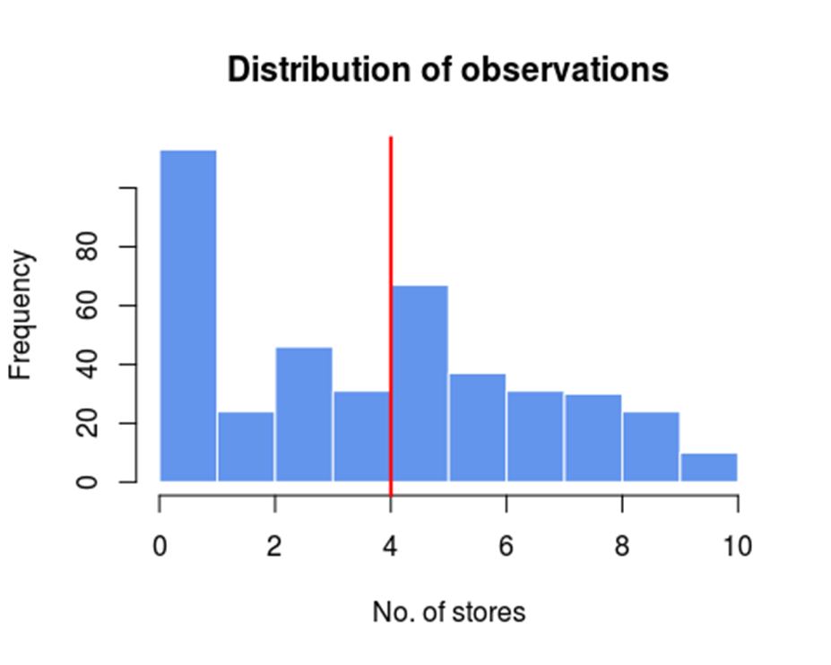
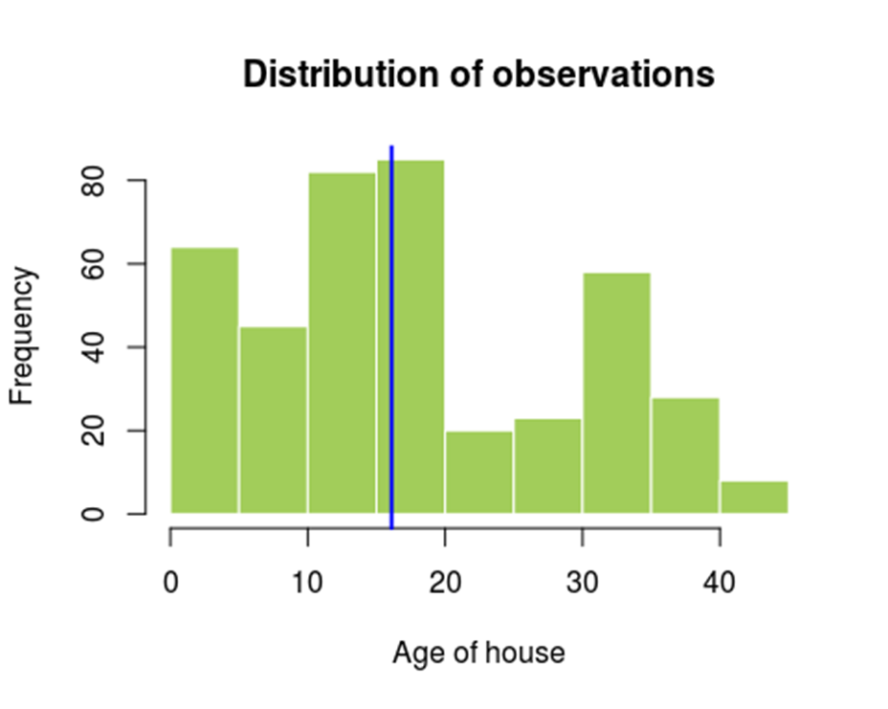
The height of the histogram indicates the number of observations in that interval. These distribution plots give us a point to point univariate analysis of the raw data.

Slide 12
VISUALIZING THE LINEAR REGRESSION MODEL
The lm() function fits a line to our data that is as close as possible to all of our observations. More specifically, it fits the line in such a way that the sum of the squared difference between the points and the line is minimized; this method is known as “minimizing least squares.” Even when a linear regression model fits data very well, the fit isn’t perfect. The distances between our observations and their model-predicted value are called residuals.
When the regression line was fit to the scatterplot of our data using ggplot(), we obtained the graphs:

Slide 13
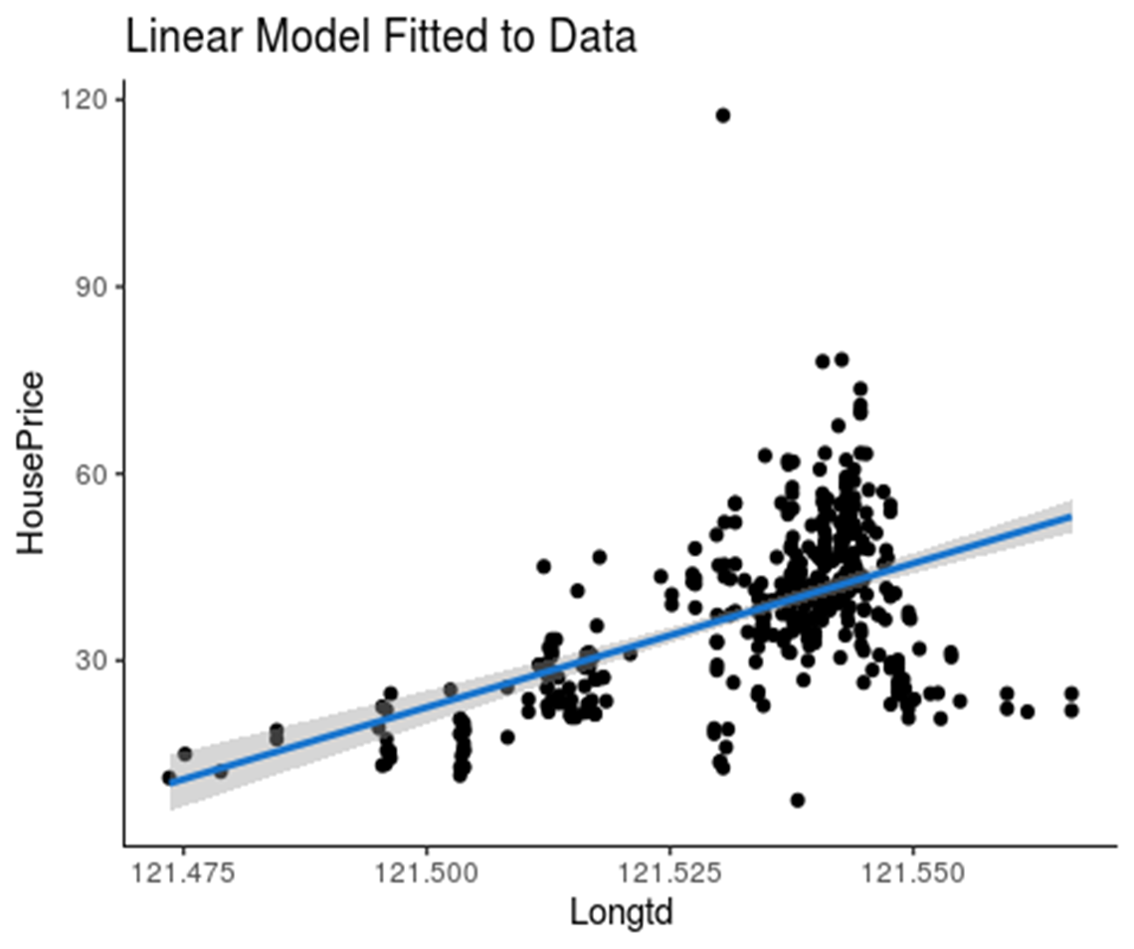
}
This space represents what X cannot tell us about Y
This blue line represents what X tells us about Y

Slide 14
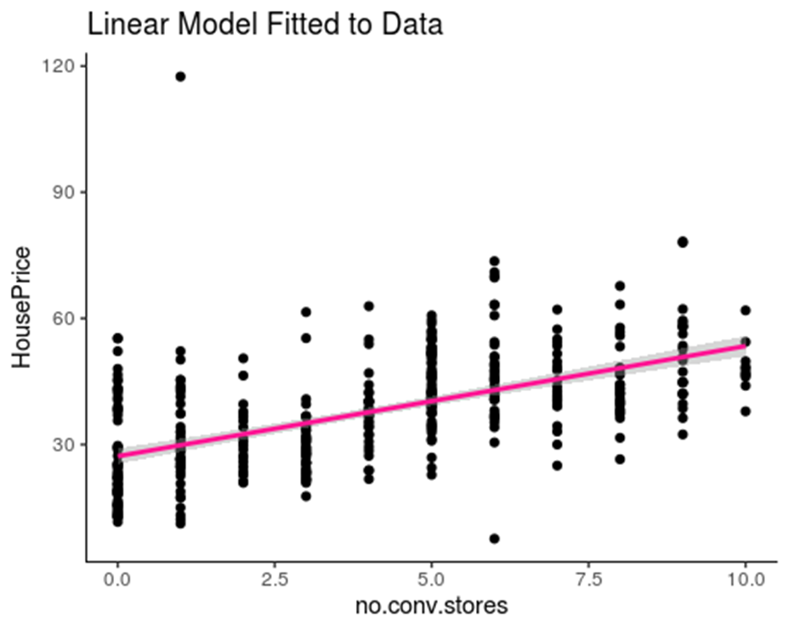

Slide 15
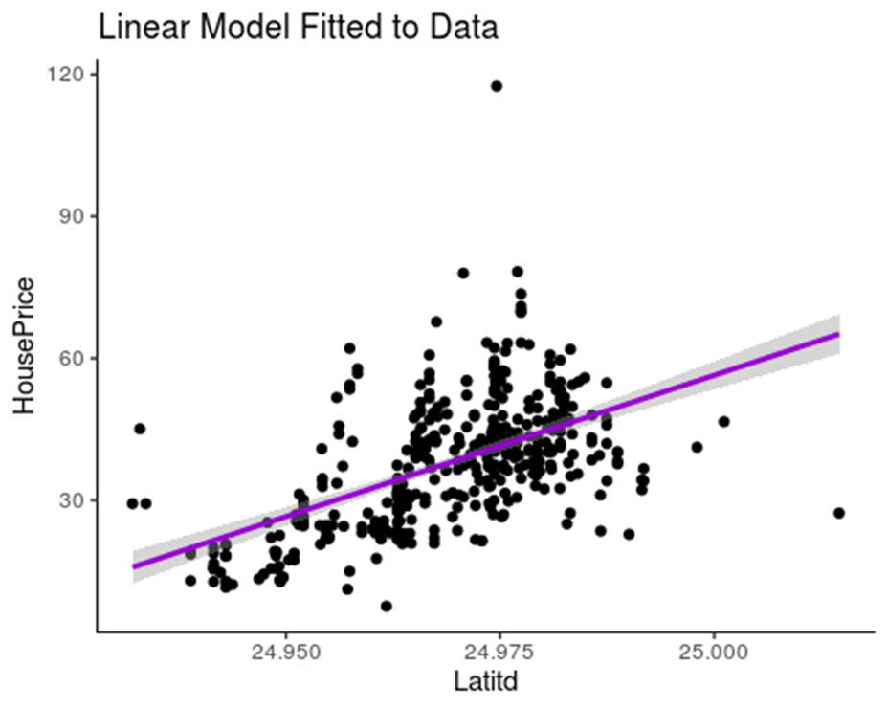
At this point the predicted value of Y lies on this line
This is the residual
But the actual value lies over here.

Slide 16
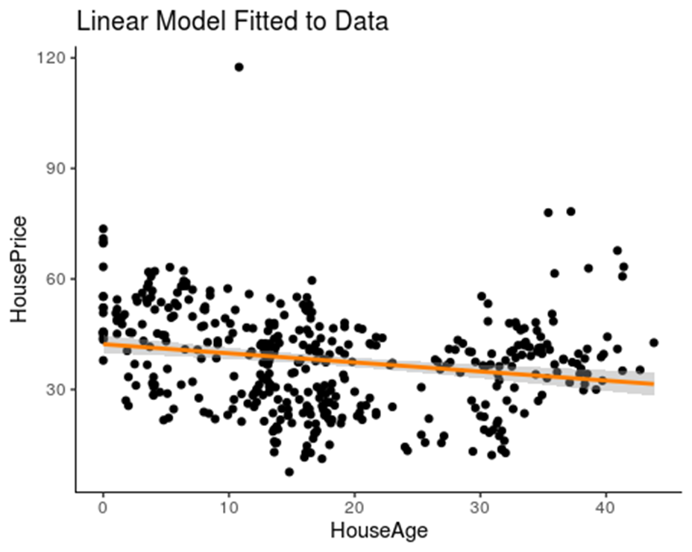
This depicts the slope of the line

Slide 17
Mathematically we can interpret linear regression for our dataset as:
But it can be noticed from the graphs that the regression line is unable to account for many observations and gives high residuals. We will need to fit the regression model more accurately so as to attain the targeted values of the response variable.
To do this we will be applying polynomial regression. Polynomial Regression is a form of linear regression in which the relationship between the independent variable X and dependent variable Y is modeled as an nth degree polynomial. Polynomial regression fits a nonlinear relationship between the value of X and the corresponding conditional mean of Y.
House Price/unit area ≈ Intercept + Slope(Latitude Longitude No. of convenience stores House Age) + Error

Slide 18
trainIndex=createDataPartition(rs_data$No, p=0.7,list=FALSE) training=rs_data[trainIndex,] testing=rs_data[-trainIndex,]
We will also need to split our data into 2 sets namely testing and training. The training dataset will contain 70% of the original data and it will be modeled. The testing dataset will contain 30% of the data and it will be used to cross validate the observations generated by the predictions made by the implementation of the model.

Slide 19
We will hypothesize the relationship between the predictor and response variables to be curvilinear and thus we will include some polynomial terms to our previously made linear hypothesis. The tests that will be conducted thereafter will prove this hypothesis.
So now the regression model can be implemented as:
The degrees are decided based on the correlations and to avoid under-fitting or over-fitting as far as possible. Now, the graph plots will depict how accurately the regression model fits our data
linearMod=lm(HousePrice ~ I(Longtd^2) + I(Latitd^3) + I(no.conv.stores^5) + HouseAge, data=training)

Slide 20
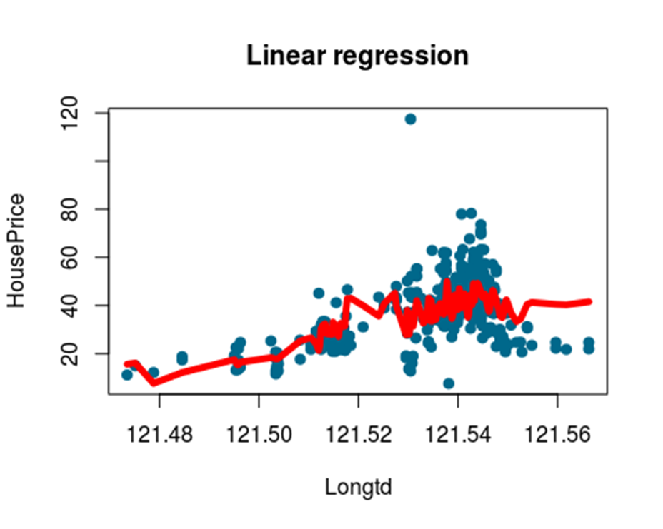

Slide 21
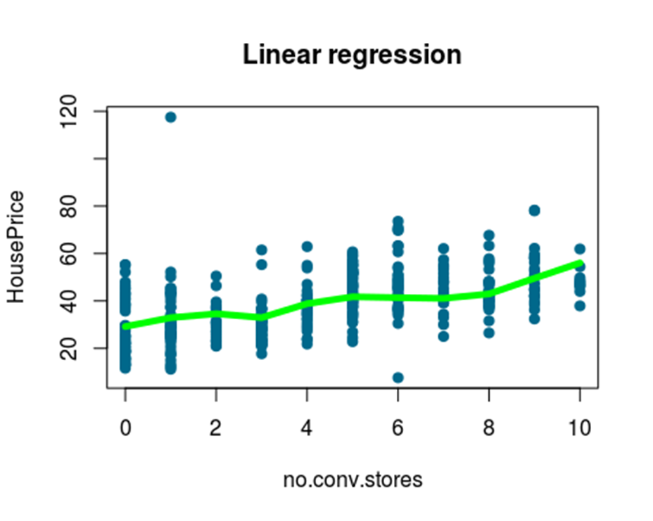

Slide 22
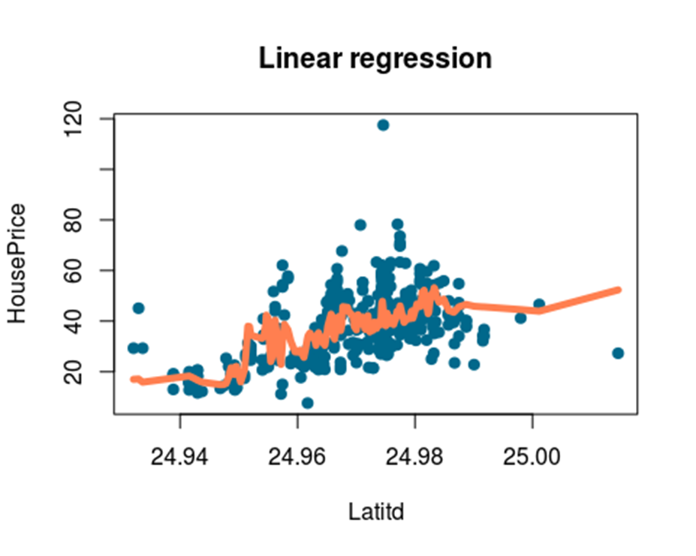

Slide 23
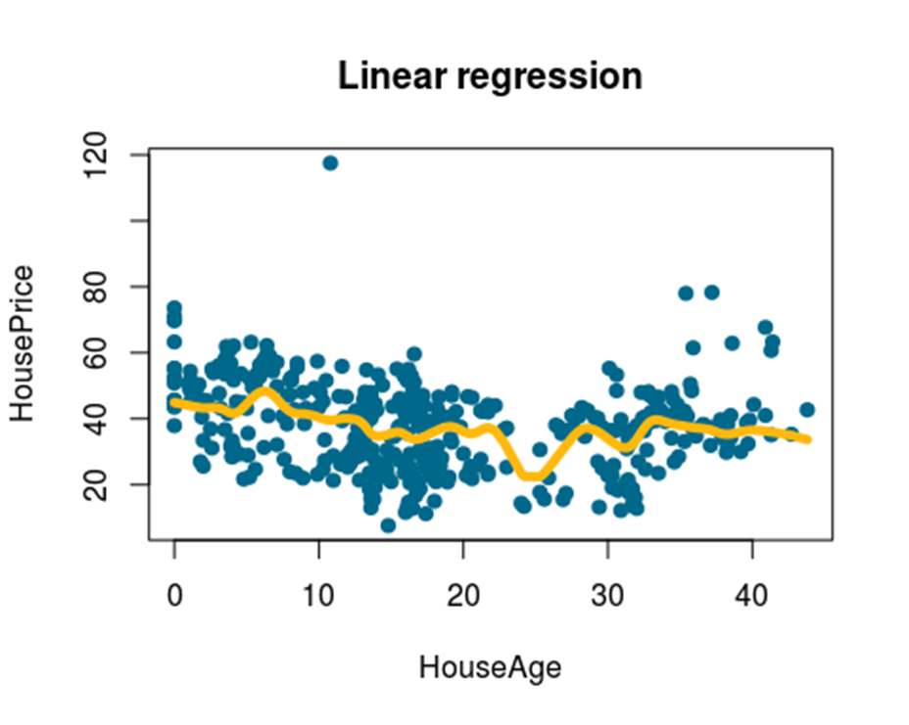

Slide 24
The visual interpretation of our regression model does depict a better fit now. We can further affirm this conclusion by elucidating the results of the summary of the regression model and by applying the p-test and t-test to it.
ANALYSIS OF THE REGRESSION MODEL
summary(linearMod)
##
## Call:
## lm(formula = HousePrice ~ I(Longtd^2) + I(Latitd^3) + I(no.conv.stores^5) +
## HouseAge, data = training)
##
## Residuals:
## Min 1Q Median 3Q Max
## -29.007 -5.805 -0.681 4.961 77.584

Slide 25
This portion of the summary tells us if the hypothesis is supported or not.
The intercept is the expected house price if the value of the predictor variables was zero.
The coefficient standard errors tell us the average variation of the estimated coefficients from the actual average of our response variable.
## Coefficients:
## Estimate Std. Error t value Pr(>|t|)
## (Intercept) -1.967e+04 2.017e+03 -9.752 < 2e-16 ***
## I(Longtd^2) 1.103e+00 1.437e-01 7.675 1.23e-13 ***
## I(Latitd^3) 2.198e-01 2.320e-02 9.473 < 2e-16 ***
## I(no.conv.stores^5) 1.336e-04 2.442e-05 5.473 7.73e-08 ***
## HouseAge -2.769e-01 4.252e-02 -6.511 2.20e-10 ***
## ---
## Signif. codes: 0 '***' 0.001 '**' 0.01 '*' 0.05 '.' 0.1 ' ' 1
##

Slide 26
Significance:
Test of significance shows that there is a strong evidence of a polynomial relationship between the predictor and response variables. This is visually interpreted by the significance stars (***) at the end of the row. This level is a threshold that is used to indicate real findings, and not the ones by chance alone. For each estimated regression coefficient, the variable’s p-Value Pr(>|t|) provides an estimate of the probability that the true coefficient is zero given the value of the estimate. More the number of stars near the p-Value are, more significant is the variable. With the presence of the p-value, there is a test of hypothesis associated with it. In Linear Regression, the Null Hypothesis is that the coefficient associated with the variables is equal to zero. Instead, the alternative hypothesis is that the coefficient is not equal to zero and there exists a relationship between the independent variable and the dependent variable.
So, if p-values are less than the significance level (ideally p-value < 0.05 ), null hypothesis can be safely rejected. In the current case, p-values are well below the 0.05 threshold, so the model is statistically significant.

Slide 27
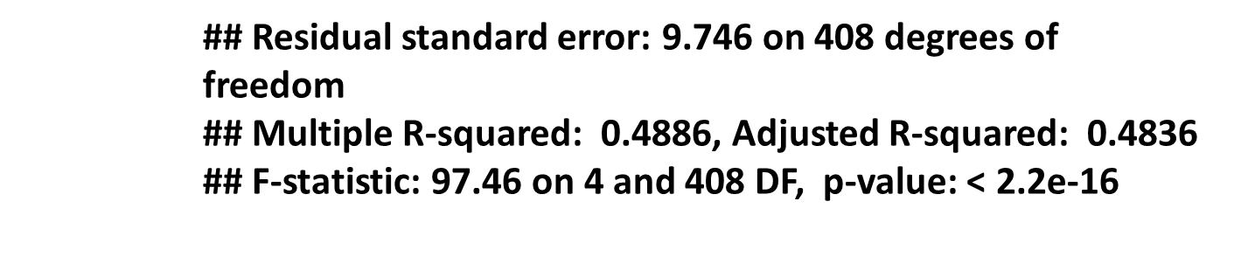
T-statistic
It is the measure of likelihood that the actual value of the parameter is not zero. A larger t-value indicates that it is less likely that the coefficient is not equal to zero purely by chance. The t-statistic value should be greater than 1.96 and we see that the variables with high correlation values do show a high t-static value.
We have therefore proved the statistical significance of the model. Now we will determine how well our model fits our data.

Slide 28
R-squared
For simple linear regression, R-squared is the square of the correlation between two variables. Its value can vary between 0 and 1: a value close to 0 means that the regression model does not explain the variance in the response variable, while a number close to 1 indicates that the observed variance in the response variable is well explained. In the current case, R-squared suggests the linear model fit explains approximately 50% of the variance observed in the data.
High value of R-squared does not necessarily indicate if a regression model provides an adequate fit to data. A good model could show a low R-squared value, while, on the other hand, a biased model could have a high R-squared value.
F-statistics
F statistic defines the collective effect of all predictor variables on the response variable. In this model, F=97.46 which is far greater than 1.
Ideally, greater the value of F statistic (higher than 1) , better the fit is (so, this statistic can be intended as a measure of goodness of fit).

Slide 29
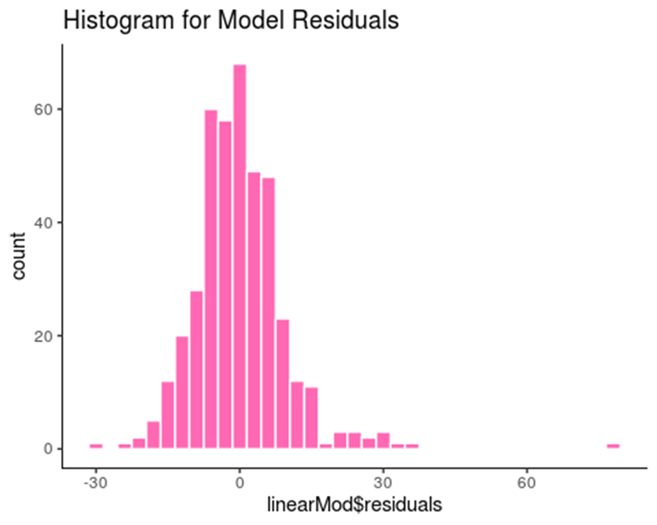
Residuals
Residuals show if the predicted response values are close or not to the response values that the model predicts. The residuals should have a symmetrical distribution around zero. Generally, it is required for the residuals to be normally distributed around zero.
To visualize this we will make a histogram using ggplot2.
The graph depicts that the residuals are in fact normally distributed around zero and thus gives a clear picture about the accuracy of the model.

Slide 30
To do a direct comparison of the forecasted and original values and to estimate the accuracy we will predict our model using the testing dataset and then we will put all the data into a dataframe. Further we will be finding the minimum-maximum accuracy and the mean absolute percentage error.
HOW ACCURATE ARE THE PREDICTED VALUES
pred=predict(linearMod,testing)
actual_pred=data.frame(cbind(actuals=testing$house_price_of_unit_area,predicteds=pred))
min_max_accuracy=mean(apply(actual_pred,1,min)/apply(actual_pred,1,max))
min_max_accuracy
## [1] 0.7211614
MAPE=mean(abs((actual_pred$predicteds - actual_pred$actuals)) / actual_pred$actuals) MAPE #mean absolute percentage error
## [1] 0.3950446

Slide 31
Min-Max Accuracy
It is a metric that indicates how close the actual and predicted values are to one another. It is calculated by considering the average between the minimum and the maximum prediction. It can be seen that our model presents an accuracy in the range of 70-73% which is fairly good.
Mean Absolute Percentage Error
This metric gives the percentage of error compared to the actual value. It gives a standardized error measure. When applied to the predictions made by our model, this metric gives a result in the range 0.39-0.44.

Slide 32
CONCLUSION AND FUTURE SCOPE
The in depth analysis of our prediction model suggests that the geography, location and age of the house are essential factors that dictate the cost of a house.
However as indicated by the accuracy and error values, it may be helpful to incorporate other factors such as physical features etc. to determine the exact pricing.
This regression model that has been further used for prediction can be considered to be a simple yet efficient and effective method for evaluation of costs of not just houses but any land or property in general that needs to be utilized for personal or commercial purposes. Various websites such as www.magicbricks.com/ and https://housing.com/ can amalgamate such models into their procedures of evaluation of selling or re-selling prices of properties.

Slide 33
FIN.

