Slide 1
How Does a Bike-Share Navigate Speedy Success?
Presented by:Simranjeet Kaur
Last Updated:June 10th,2023

Slide 2
Agenda
Introduction
Project overview and goals
Data and analysis
Recommendation
Questions

Slide 3
Purpose
The company’s future success depends on maximizing the number of annual memberships. The aim of this project is to help us identify how casual riders and annual members use Cyclistic bikes differently. The results will help us to target the marketing campaign to casual riders to convert them into yearly members.

Slide 4
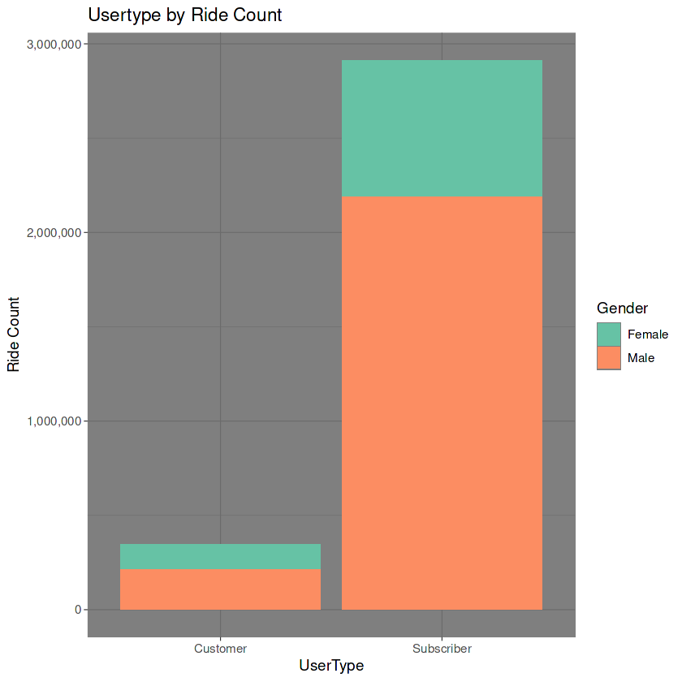
The number of subscribers is almost 8 times the number of casual customers
Only about 26% of the riders are females and the rest are males

Slide 5
Summary Statistics
 | Customers |  |  | Subscribers
 | Count | Mean Age | Mean Ride Duration | Count | Mean Age | Mean Ride Duration
Female | 131425 | 30.1 | 3157.7 | 726428 | 34.1 | 965.2
Male | 212714 | 31.5 | 2691.1 | 2187036 | 35.8 | 821.8
Total | 344139 | 30.9 | 2869.3 | 2913464 | 35.4 | 857.5

Slide 6
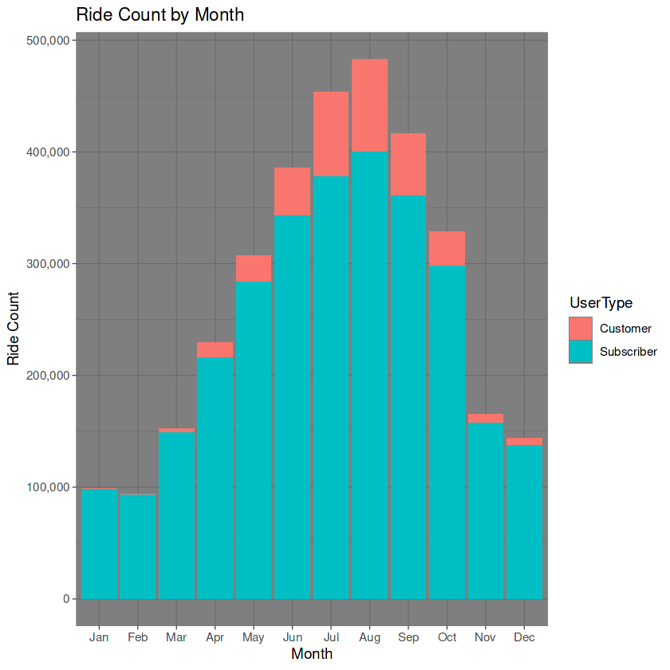
Summer season is the most busy season in terms of both kind of users
Almost negligible use of bikes is seen in winter season by casual riders
Clearly casual riders are using the Cyclists services for leisure activities

Slide 7
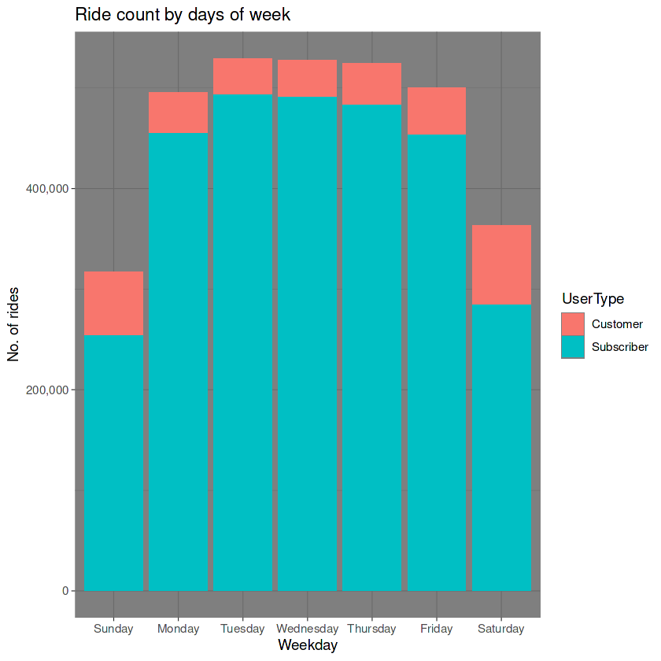
Casual riders use the bikes most on weekends
Annual subscribers are mostly using bikes on the weekdays

Slide 8
Recommendations
Offer benefits or discounts for weekends with the annual subscription plan.
2. *Promote riding bikes to work to encourage riders to use bikes on weekdays too.
3. Encourage and attract more women riders as they have the potential to maximise profits
*Futher analysis required to understand why casual riders do not use bikes to work

Slide 9
Questions!

