Slide 1
SYRIATEL CUSTOMER CHURN ANALYSIS
SIMRAN KAUR
JAN 2023

Slide 2
Table of Contents
Data
Churn Analysis
Modeling Analysis
Modeling Results
Suggestions

Slide 3
Data
Outliers were dropped.
Features with a correlation 0.9 or greater were dropped.
One-hot encoding performed on categorical features.
Numerical features were scaled.
SMOTE applied to resolve class imbalance.

Slide 4
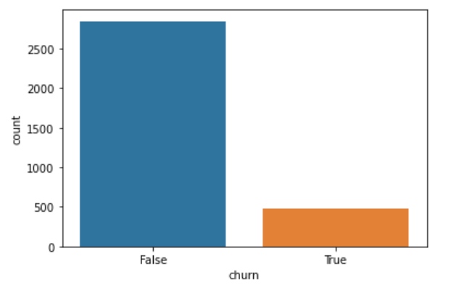
Churn analysis
Dataset with information on approximately 3,300 customers.
14.5% of customers have churned. They have left SyriaTel and taken their business elsewhere.

Slide 5
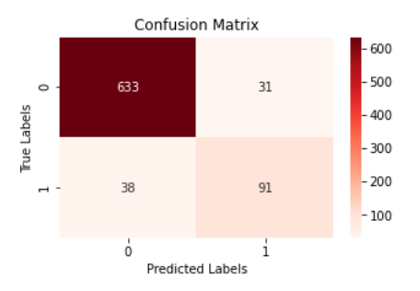
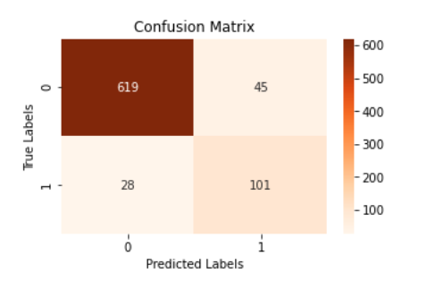
Modeling Analysis
Original Model
Hyperparameter Tuned Model
Precision Score | 0.781
Precision Score | 0.706

Slide 6
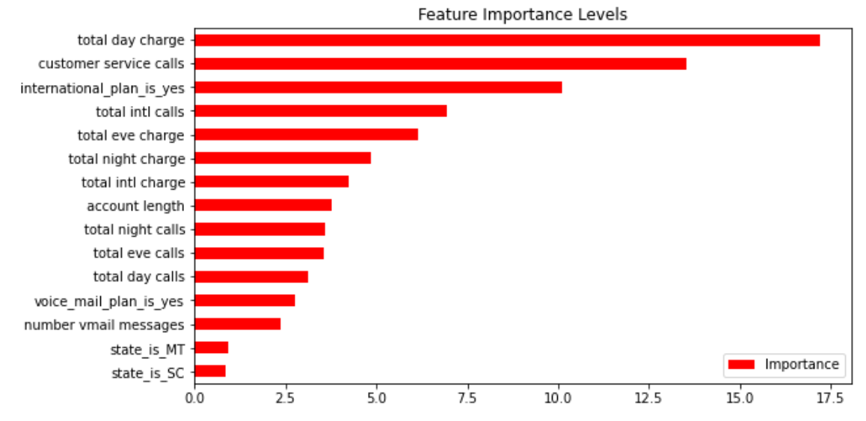
Modeling Results

Slide 7
suggestions
Offer a discount to customers who have made more than 2 phone calls within 6 months.
Start an internal forum where customer service representatives document the common reasons customer call Syriatel. Next step is to have conversations on strategic solutions that can resolve those issues.
Start SyriaTel Sundays. A rewards program in which the company partners with external vendors and offers treats/discounts to customers.

