Slide 1
Deep Learning Tutorial
李宏毅
Hung-yi Lee
Notes:
Not memtion
DT v.s. Deep!!!!!

Slide 2
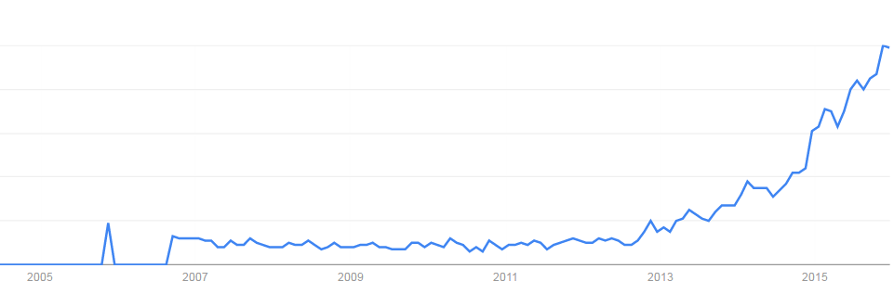
Deep learning attracts lots of attention.
Google Trends
Deep learning obtains many exciting results.
The talks in this afternoon
This talk will focus on the technical part.
2007
2009
2011
2013
2015

Slide 3
Outline
Part III: Tips for Training Deep Neural Network
Part IV: Neural Network with Memory
Part I: Introduction of Deep Learning
Part II: Why Deep?
Notes:
What people already knew in 1980s

Slide 4
Part I: Introduction of Deep Learning
What people already knew in 1980s
Notes:
Three questions:
Model
Cost
Train

Slide 5
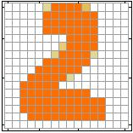
Example Application
Handwriting Digit Recognition
Machine
“2”
Notes:
“Hello world” for deep learning
Data: http://yann.lecun.com/exdb/mnist/

Slide 6
Handwriting Digit Recognition
Input
Output
y₁
is 1
0.1
y₂
is 2
0.7
The image is “2”
……
……
……
y₁₀
0.2
is 0
16 x 16 = 256
Ink → 1
No ink → 0
Each dimension represents the confidence of a digit.
Notes:
The same for even more complex tasks.

Slide 7
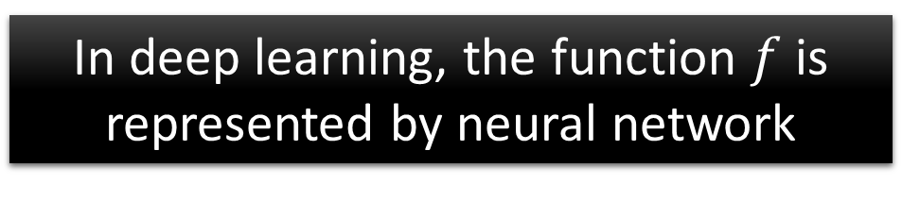

Example Application
Handwriting Digit Recognition
y₁
Machine
y₂
“2”
……
……
y₁₀
$$f:R^{256}→R^{10}$$
In deep learning, the function $f$ is represented by neural network

Slide 8

Element of Neural Network
Neuron
$$f:R^{K}→R$$
…
Activation function
weights
bias
Notes:
sigmoid

Slide 9
Neural Network
neuron
Input
Layer 1
Layer 2
Layer L
Output
……
y₁
……
y₂
……
……
……
……
……
……
y_{M}
Input Layer
Output Layer
Hidden Layers
Deep means many hidden layers
Notes:
Fully Connected Feedforward Network
You can always connect the neurons in your own way.
“+” is ignored
Each dimension corresponds to a digit (10 dimension is needed)

Slide 10
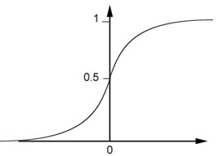
Example of Neural Network
1
4
0.98
1
-2
1
-1
-2
0.12
-1
1
0
Sigmoid Function
Notes:
Ignore +

Slide 11
Example of Neural Network
1
4
0.98
2
0.86
3
0.62
1
-2
-1
-1
1
0
-2
-1
-2
0.12
-2
0.11
-1
0.83
-1
1
-1
4
0
0
2

Slide 12
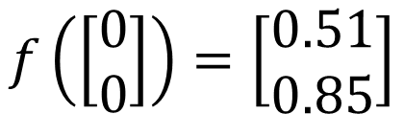

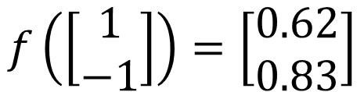
Example of Neural Network
1
0.73
2
0.72
3
0.51
0
-2
-1
-1
1
0
-2
-1
0.5
-2
0.12
-1
0.85
0
1
-1
4
0
0
2
$$f:R^{2}→R^{2}$$
$$f\left(\left[\begin{matrix}1 \\ −1\end{matrix}\right]\right)=\left[\begin{matrix}0.62 \\ 0.83\end{matrix}\right]$$
$$f\left(\left[\begin{matrix}0 \\ 0\end{matrix}\right]\right)=\left[\begin{matrix}0.51 \\ 0.85\end{matrix}\right]$$
Different parameters define different function
Notes:
For example, if we modify “1” to “2”, then we have another function

Slide 13
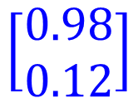


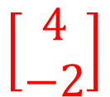

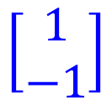

Matrix Operation
1
4
0.98
1
-2
1
-1
-2
0.12
-1
1
0
$$\left[\begin{matrix}1 & −2 \\ −1 & 1\end{matrix}\right]$$
$$\left[\begin{matrix}1 \\ −1\end{matrix}\right]$$
$$\left[\begin{matrix}1 \\ 0\end{matrix}\right]$$
$$=$$
$$\left[\begin{matrix}0.98 \\ 0.12\end{matrix}\right]$$
$$σ\left( \right)$$
$$+$$
$$\left[\begin{matrix}4 \\ −2\end{matrix}\right]$$
Notes:
Make sure you know how to do it
author: Adam Coates, Baidu, Inc.
Deep Learning (hopefully faster)
http://videolectures.net/deeplearning2015_coates_deep_learning/

Slide 14



Neural Network
……
y₁
W¹
W²
W^{L}
……
y₂
b¹
b²
b^{L}
……
……
……
……
……
x
a¹
a²
y
……
y_{M}
W¹
x
b¹
+
$$σ\left( \right)$$
a¹
b²
W²
+
$$σ\left( \right)$$
W^{L}
b^{L}
a^{L-1}
+
$$σ\left( \right)$$
Notes:
Draw it?

Slide 15


Neural Network
……
y₁
W¹
W²
W^{L}
……
y₂
b¹
b²
b^{L}
……
……
……
……
……
x
a¹
a²
y
……
y_{M}
y
x
Using parallel computing techniques to speed up matrix operation
$$=f\left( \right)$$
W^{L}
…
W²
W¹
x
b¹
b²
…
b^{L}
+
+
+
$$σ\left( \right)$$
$$=σ\left( \right)$$
$$σ\left( \right)$$
x
Notes:
Draw it?

Slide 16
Softmax
Softmax layer as the output layer
Ordinary Layer
In general, the output of network can be any value.
May not be easy to interpret
Notes:
Original output layer is local

Slide 17
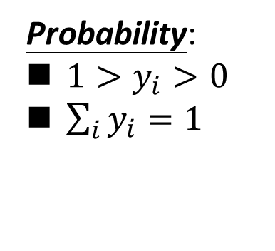
Softmax
Probability:
$1>y_{i}>0$
$\sum_{i}{y_{i}=1}$
Softmax layer as the output layer
Softmax Layer
3
20
0.88
1
2.7
0.12
-3
0.05
≈0
Notes:
Why it is name soft max?
Monotonicity of softmax
Non-locality of softmax

Slide 18


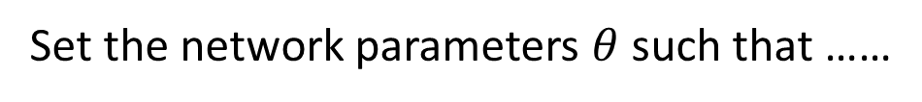
How to set network parameters
$$θ=\left\{W^{1},b^{1},W^{2},b^{2},⋯W^{L},b^{L}\right\}$$
……
y₁
is 1
0.1
……
y₂
0.7
is 2
Softmax
……
……
……
……
y₁₀
is 0
0.2
16 x 16 = 256
Ink → 1
No ink → 0
Set the network parameters $θ$ such that ……
Input:
How to let the neural network achieve this
y₁ has the maximum value
Input:
y₂ has the maximum value

Slide 19








Training Data
Preparing training data: images and their labels
“5”
“0”
“4”
“1”
“9”
“2”
“1”
“3”
Using the training data to find the network parameters.

Slide 20

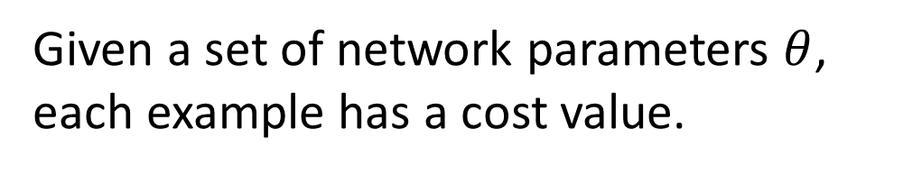
Cost
Given a set of network parameters $θ$, each example has a cost value.
“1”
……
y₁
0.2
1
……
y₂
0
0.3
……
……
……
Cost
……
……
……
y₁₀
$$L(θ)$$
0
0.5
target
Cost can be Euclidean distance or cross entropy of the network output and target
Notes:
With softmax, the summation of all the ouputs would be one.
Can be considered as probability if you want ……

Slide 21
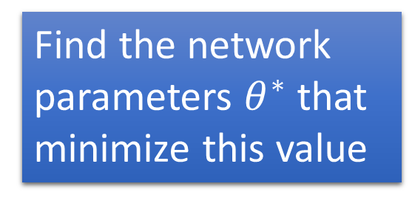


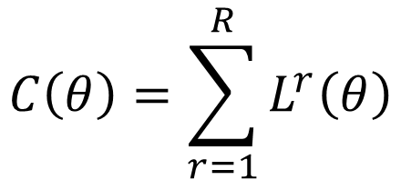






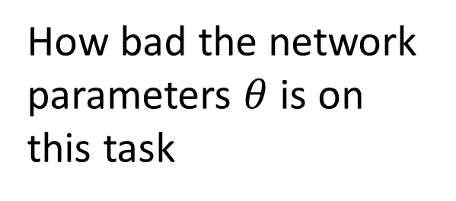
Total Cost
For all training data …
Total Cost:
NN
$$C\left(θ\right)=\sum_{r=1}^{R}{L^{r}\left(θ\right)}$$
x¹
y¹
$${\hat{y}}^{1}$$
$$L^{1}\left(θ\right)$$
x²
NN
y²
$${\hat{y}}^{2}$$
How bad the network parameters $θ$ is on this task
$$L^{2}\left(θ\right)$$
x³
NN
y³
$${\hat{y}}^{3}$$
$$L^{3}\left(θ\right)$$
……
……
……
……
Find the network parameters $θ^{∗}$ that minimize this value
x^{R}
NN
y^{R}
$${\hat{y}}^{R}$$
$$L^{R}\left(θ\right)$$
Notes:
Randomly picked one
Two approaches update the parameters towards the same direction, but stochastic is faster!
Better!

Slide 22









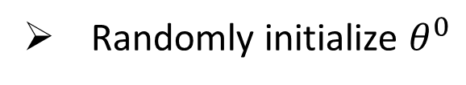



Mini-batch
Randomly initialize $θ^{0}$
x¹
NN
y¹
Pick the 1st batch
$${\hat{y}}^{1}$$
$$L^{1}$$
$$C=L^{1}+L^{31}+⋯$$
Mini-batch
NN
x³¹
y³¹
$${\hat{y}}^{31}$$
$$θ^{1}←θ^{0}−η∇C\left(θ^{0}\right)$$
$$L^{31}$$
Pick the 2nd batch
……
$$C=L^{2}+L^{16}+⋯$$
NN
$$θ^{2}←θ^{1}−η∇C\left(θ^{1}\right)$$
x²
y²
$${\hat{y}}^{2}$$
$$L^{2}$$
…
Mini-batch
C is different each time when we update parameters!
x¹⁶
NN
y¹⁶
$${\hat{y}}^{16}$$
$$L^{16}$$
……
Notes:
Each time we update paramters, we have different target -> 不安
Shuffle data, and repeat above process

Slide 23






Mini-batch
Faster
Better!
Randomly initialize $θ^{0}$
x¹
NN
y¹
Pick the 1st batch
$${\hat{y}}^{1}$$
$$C^{1}$$
$$C=C^{1}+C^{31}+⋯$$
Mini-batch
NN
x³¹
y³¹
$${\hat{y}}^{31}$$
$$θ^{1}←θ^{0}−η∇C\left(θ^{0}\right)$$
$$C^{31}$$
Pick the 2nd batch
……
$$C=C^{2}+C^{16}+⋯$$
NN
$$θ^{2}←θ^{1}−η∇C\left(θ^{1}\right)$$
x²
y²
$${\hat{y}}^{2}$$
$$C^{2}$$
…
Until all mini-batches have been picked
Mini-batch
x¹⁶
NN
y¹⁶
$${\hat{y}}^{16}$$
$$C^{16}$$
one epoch
……
Repeat the above process
Notes:
Ｉｎ ｏｐｅｎ ｅｐｏｃｈ， ｕｐｄａｔｅ ｍａｎｙ ｔｉｍｅｓ
Shuffle data, and repeat above process

Slide 24
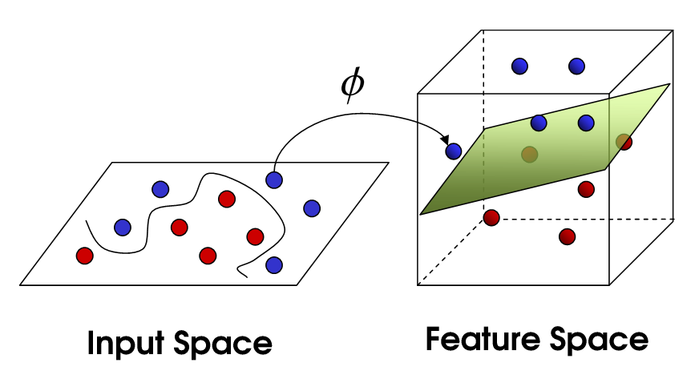


Hand-crafted
kernel function
SVM
Apply simple classifier
Source of image: http://www.gipsa-lab.grenoble-inp.fr/transfert/seminaire/455_Kadri2013Gipsa-lab.pdf
Deep Learning
simple classifier
Learnable kernel
$$φ\left(x\right)$$
……
y₁
$$x$$
……
y₂
…
…
…
…
…
……
y_{M}

Slide 25
Part III: Tips for Training DNN
Notes:
The techniques people did not know in 1980s.

Slide 26
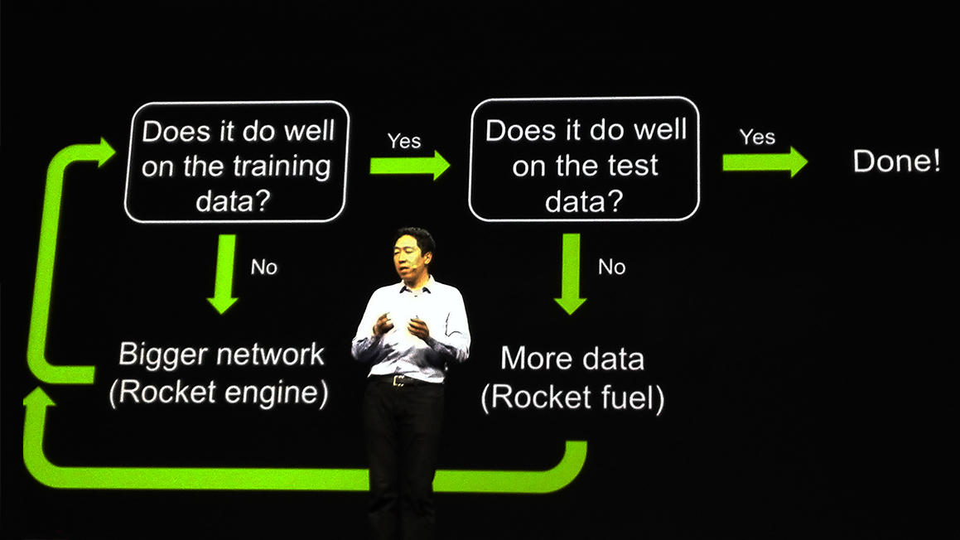
Recipe for Learning
http://www.gizmodo.com.au/2015/04/the-basic-recipe-for-machine-learning-explained-in-a-single-powerpoint-slide/
Notes:
今年四月的 GTC

Slide 27
Recipe for Learning
Don’t forget!
overfitting
Modify the Network
Preventing
Overfitting
Better optimization Strategy
http://www.gizmodo.com.au/2015/04/the-basic-recipe-for-machine-learning-explained-in-a-single-powerpoint-slide/
Notes:
Last one is on training set
Sometimes students ask

Slide 28
Recipe for Learning
Modify the Network
Better optimization Strategy
Prevent Overfitting
New activation functions, for example, ReLU or Maxout
Adaptive learning rates
Dropout
Only use this approach when you already obtained good results on the training data.

