Slide 1
Natural Language Processing
CDAC - workshop
Simran K

Slide 2
Natural Language Processing (NLP) is a branch of AI that helps computers to understand, interpret and manipulate human language.
NLP is a way of computers to analyze, understand and derive meaning from a human languages such as English, Spanish, Hindi, etc.
How NLP works?
Man is to woman as king is to __________?
Meaning (king) – meaning (man) + meaning ( woman)=?
The answer is- queen

Slide 3
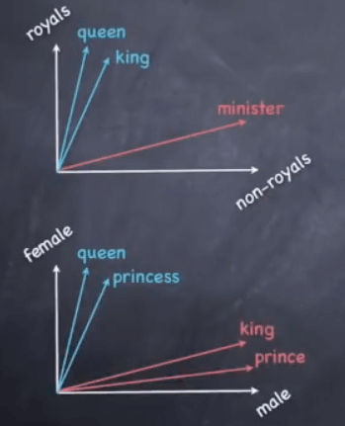
Meaning (king) – meaning (man) + meaning (woman)=?
Vector (king) – vector (man) + vector (woman) = vector(?)

Slide 4
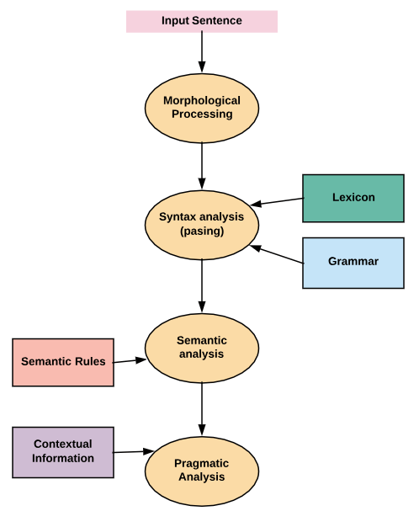
Main Component of NLP
Notes:
colorless green idea.
Discourse Integration: He wanted that
close the window?

Slide 5
Applications of NLP
Information Retrieval and Web Search
Grammar Correction
Text Summarization
Machine Translation
Intelligent Chatbot

Slide 6
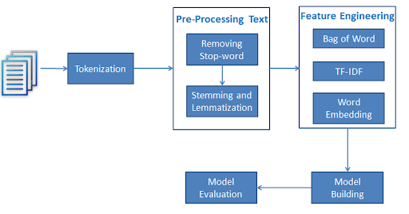

Slide 7
NLTK

Slide 8
Text preprocessing
Tokenization
PoS (Part-of-Speech) Tagging
Chunking
Stemming (general operation)
Lemmatization (intelligent operation)
Stopwords

Slide 9
Tokenization
The process by which big quantity of text is divided into smaller parts called tokens
Example : “ CDAC workshop is on 5th and 6th july.”
Output: [ ‘CDAC’ , ’workshop’ , ‘is’ , ’on’ , ’5th’ , ‘and’ , ’6th’ , ’july’ , ’.’ ]
PoS Tagging
Parts of speech Tagging is responsible for reading the text in a language and assigning some specific token (Parts of Speech) to each word.
Example : “CDAC workshop is on 5th and 6th july.”
Output: [('CDAC', 'NNP'), ('workshop', 'NN'), ('is', 'VBZ'), ('on', 'IN'), ('5th', 'CD'), ('and', 'CC'), ('6th', 'CD'), ('july.', 'NN')]

Slide 10
Chunking
Selecting the subsets of tokens
Example : “learn machine learning and NLP. ”
Output: S learn/JJ (S machine/NN learning/NN) and/CC NLP/NNP ./.
Stemming
Stemming is a kind of normalization for words.
Example : eat, eats, eating ,eaten
Output: eat, eat, eat, eat

Slide 11
Lemmatization
Intelligent operation
Base dictionary word
Example: “Studies”
Output: Study
Stop words
Noise in the text
Words like is, the, a, an, this etc.

Slide 12
Feature Engineering

Slide 13
Text representation
It aims to numerically represent the unstructured text documents to make them mathematically computable.
Identical text must have the same representation and distance of zero (maximum similarity).
When we have multiple texts, t1, t2, and t3, we want to have the ability to say that t1 is more similar to t2 than t3.
Similarity/Distance should express the semantic comparison between texts, and text length should have little effect.

Slide 14
Text representations
One-hot encoding
Bag-of-words (BoW)
Term document matrix (TDM)
Term-frequency inverse document frequency (TFIDF)
Word embedding (Skip gram, CBOW)
Doc2vec
Keras embedding

Slide 15
One - hot encoding
Performs “binarization” of the category
Example:
[[1],[ 2], [3]] [[ 1. 0. 0.],
[ 0. 1. 0.],
[ 0. 0. 1.]]
Sparse matrix
Cannot represent any new words like 4

Slide 16
Bag-of-words (BOW)
It converts text into the matrix of occurrence of words within a document.
Simplest way - does counting.
Example: This is the first document. This document is the second document. And this is the third one. Is this the first document?
[[0 1 1 1 0 0 1 0 1]
[0 2 0 1 0 1 1 0 1]
[1 0 0 1 1 0 1 1 1]
[0 1 1 1 0 0 1 0 1]]
No information about the word or order of the word
Cannot represent any new words

Slide 17
Term document matrix (TDM)
Matrix of document and words by counting the occurrence of words in the given document.
Example:
This is the first document. This document is the second document. And this is the third one. Is this the first document?
[[0 1 1 1 0 0 1 0 1]
[0 2 0 1 0 1 1 0 1]
[1 0 0 1 1 0 1 1 1]
[0 1 1 1 0 0 1 0 1]]
N-grams: Unigram, bi-gram, tri-gram.
Sequence of occurences of words.

Slide 18
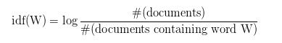
Term-frequency inverse document frequency (TF-IDF)
Most frequently used words are given most importance.
IDF - measures the amount of information a given word provides across the document.
Example: This is a sample. This is another sample.
[[0. 0.57735027 0.57735027 0.57735027]
[0.63009934 0.44832087 0.44832087 0.44832087]]

Slide 19
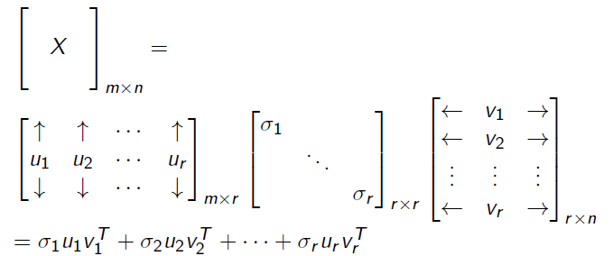
Singular value decomposition (SVD)
To convert sparse matrix into dense representation.
Reduced dimensional representation.

Slide 20
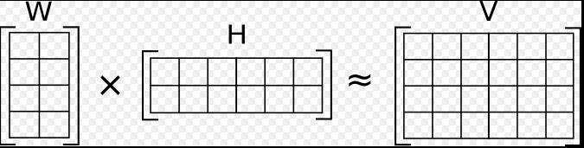
Non-negative matrix factorization (NMF)
Useful when there are many attributes and the attributes are ambiguous or have weak predictability.
By combining attributes, NMF can produce meaningful patterns, topics, or themes.
Each feature is a linear combination of the original attribute set
The coefficients of these linear combinations are non-negative.

Slide 21
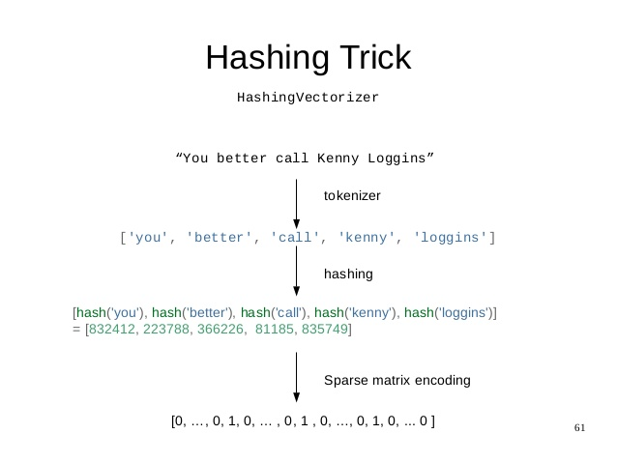
Hashingvectorizer
Very low memory scalable to large datasets
No need to store a vocabulary dictionary in memory
Faster
Distinct tokens can be mapped to the same feature index.

Slide 22
Word2vec
Convert words into dense vector representations.
Created using two algorithms
Continuous Bag-of-Words model (CBOW)
Skip-Gram model
Continuous bag of words
Given a sliding window and surrounding words. It tries to predict the center word.
Example : slide 2 _ _ [] _ _

Slide 23
Skip-Gram model
One word to predict all surrounding words “context”.
Slower than CBOW
Considered more accurate
Example: Suppose features are Royal, Female, Male.
King = [ 0.9, 0.1, 0.9 ], Queen = [ 0.9, 0.9, 0.1 ]
Men = [ 0.1, 0.1, 0.9 ], Women = [ 0.1, 0.9, 0.1 ]
King - Man = [ 0.9, 0.1, 0.9 ] - [ 0.1, 0.1, 0.9 ] = [ 0.8, 0.0, 0.0 ]
[ 0.8, 0.0, 0.0 ] + women = [ 0.9, 0.9, 0.1 ] (Queen)

Slide 24
FastText
Each word is represented as a bag of character n-grams in addition to the word itself.
Preserves the meaning of shorter words .
N-grams can be controlled.
Example: Matter
n = 3,
Character 3-gram is:
<ma, mat, att, tte, ter, er>
word <mat> is part of the vocabulary

Slide 25
Doc2vec
Suppose the documents are D1, D2, D3
D1: 3 sentences D2: 5 sentences D3: 10 sentences.
So zero padding is used at the end of D1 and D2 to make the sizes same.
Better option is Doc2vec
It converts documents into vectors
Decreases the number of zeros to be padded.

Slide 26
Keras embedding
Keras offers an Embedding layer that can be used for neural networks on text data.
Each word is represented by a unique integer
The Embedding layer
Initialized with random weights and will learn an embedding for all of the words in the training dataset.
Defined as the first hidden layer of a network
Flexible layer
Used alone to learn a word embedding - saved - Another model
Used as part of a deep learning model where the embedding is learned along with the model itself.
Used to load a pre-trained word embedding model (transfer learning).

Slide 27
Thank you

