Slide 1
Fatal police shootings
Abigail Ward, Simran Kota

Slide 2
Goal:
Assess the impact various factors such as age, race, mental illness and gender have on the distribution of the population of people in the United States who have been fatally shot by the police.

Slide 3
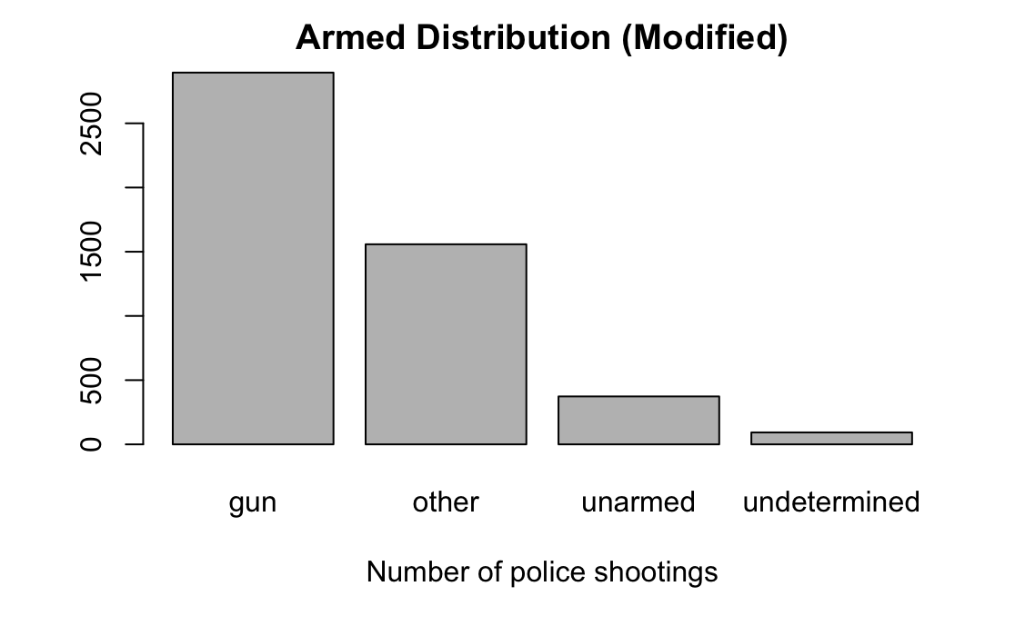
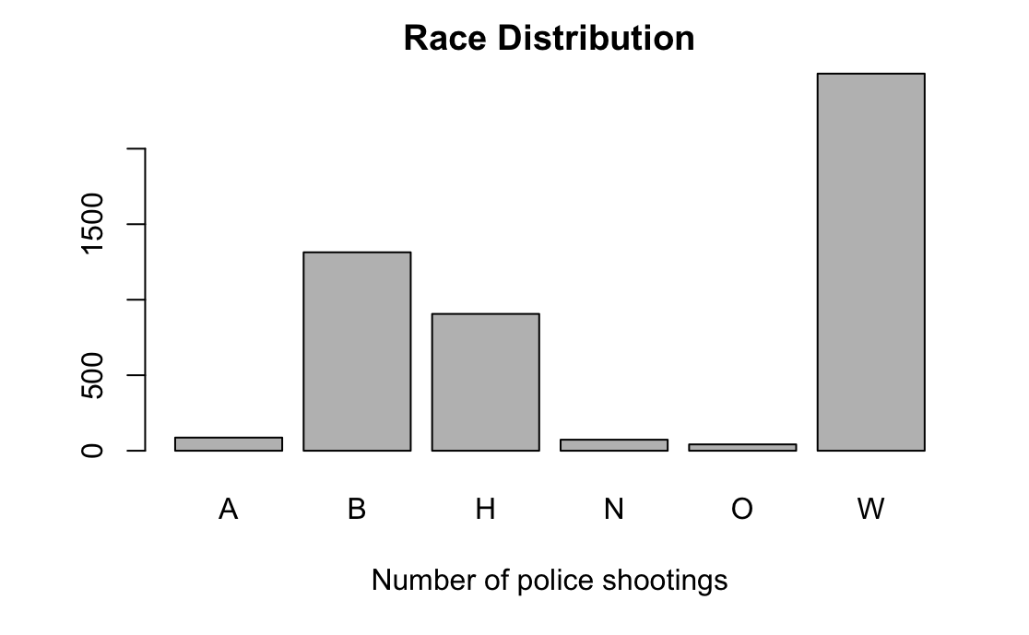
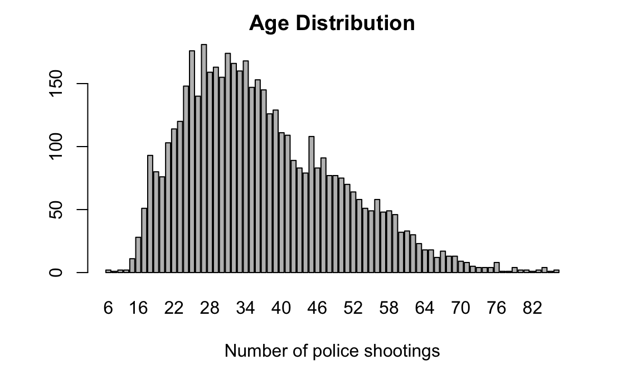
Initial exploration of the data

Slide 4
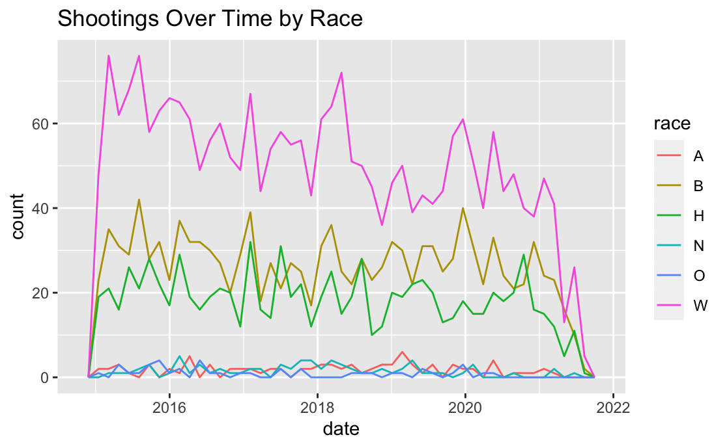
Shootings Over Time by Race A Asian B Black or African American H Hispanic N American Native or Alaskan Native O Unknown/Other/Two or More W White

Slide 5
Statistical Model

Slide 6
Chi-squared and fisher tests for independence

Slide 7
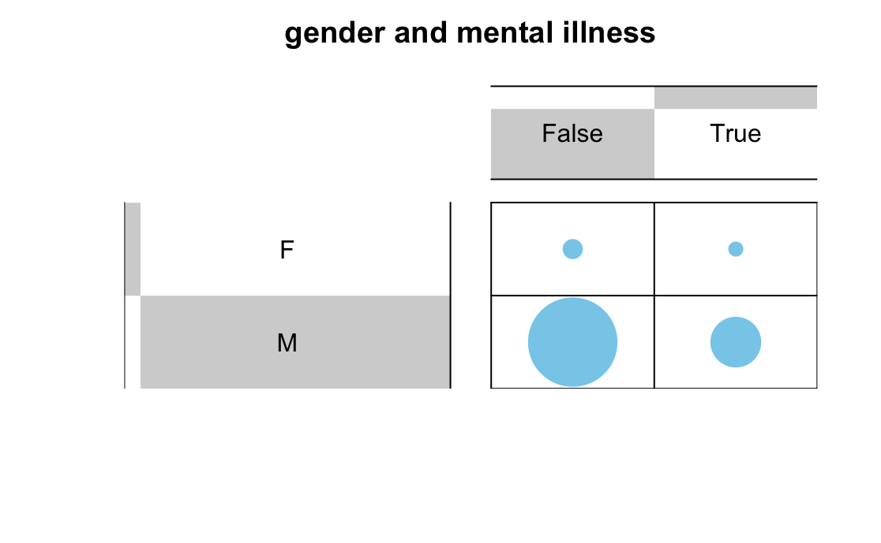
p-value = 0.0002213

Slide 8
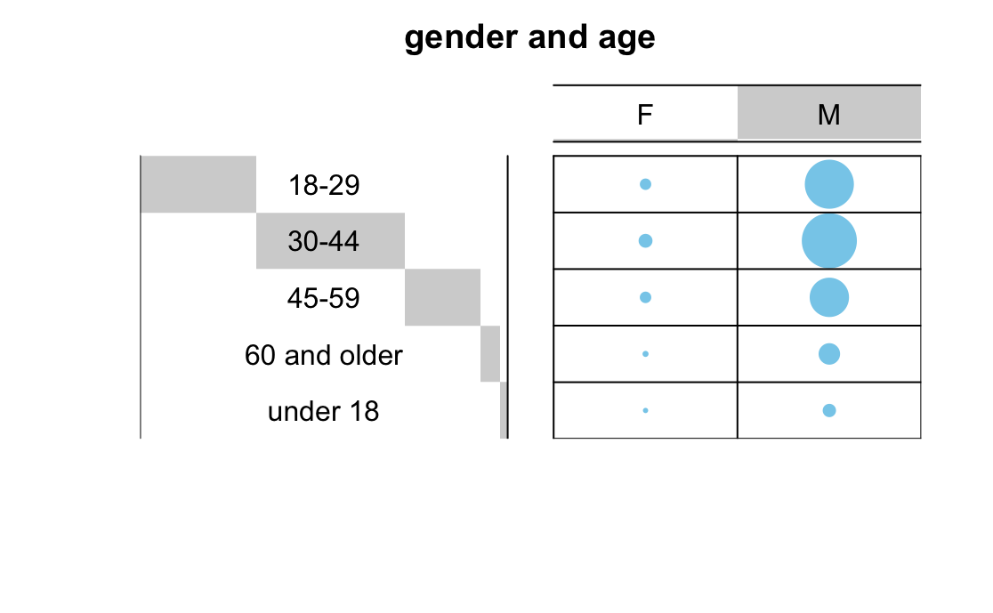
p-value = 0.05697

Slide 9
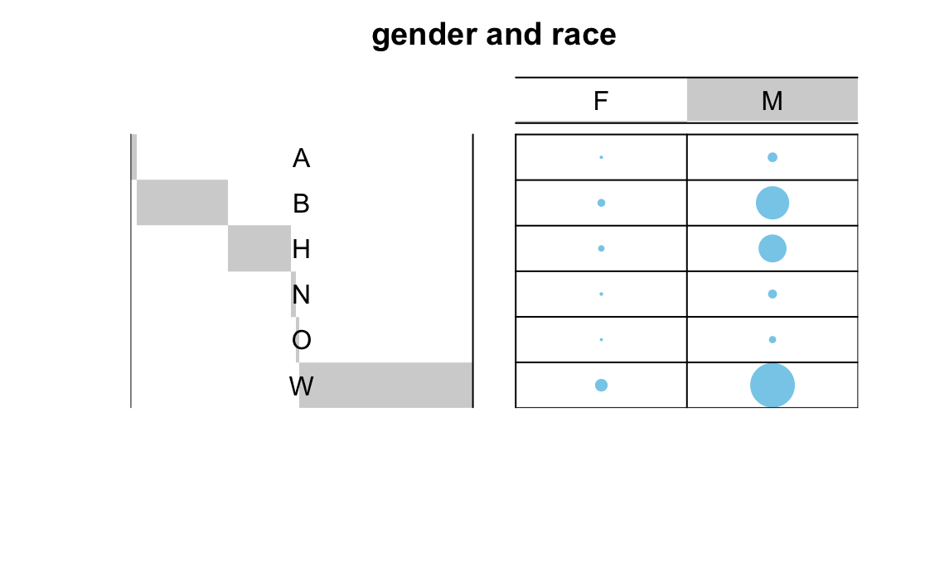
p-value = 0.0009995

Slide 10
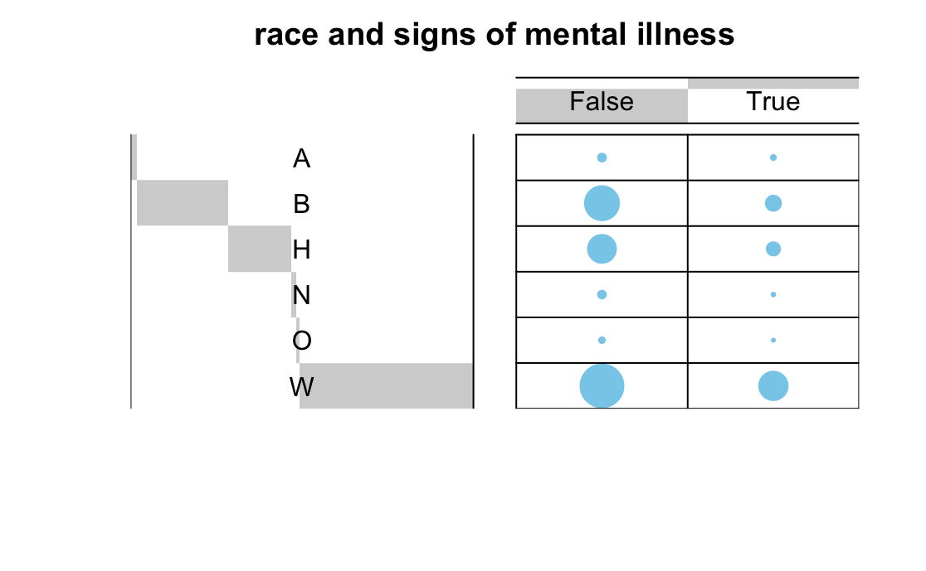
p-value = 0.0004998

Slide 11
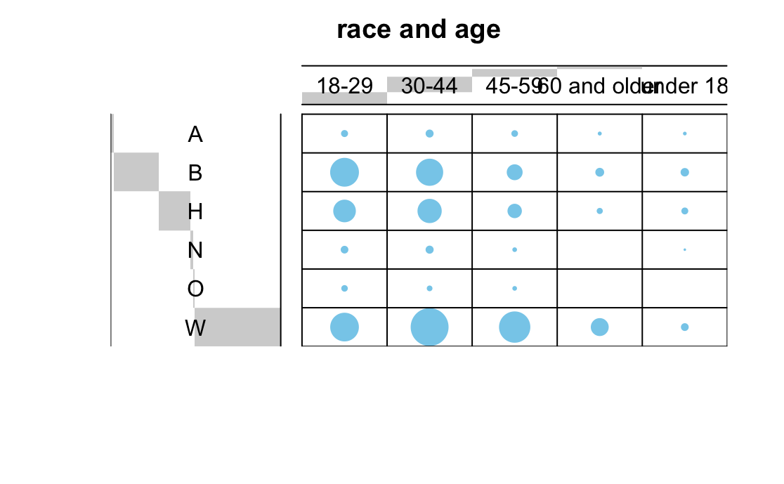
p-value = 0.0004998

Slide 12
Two sample tests

Slide 13
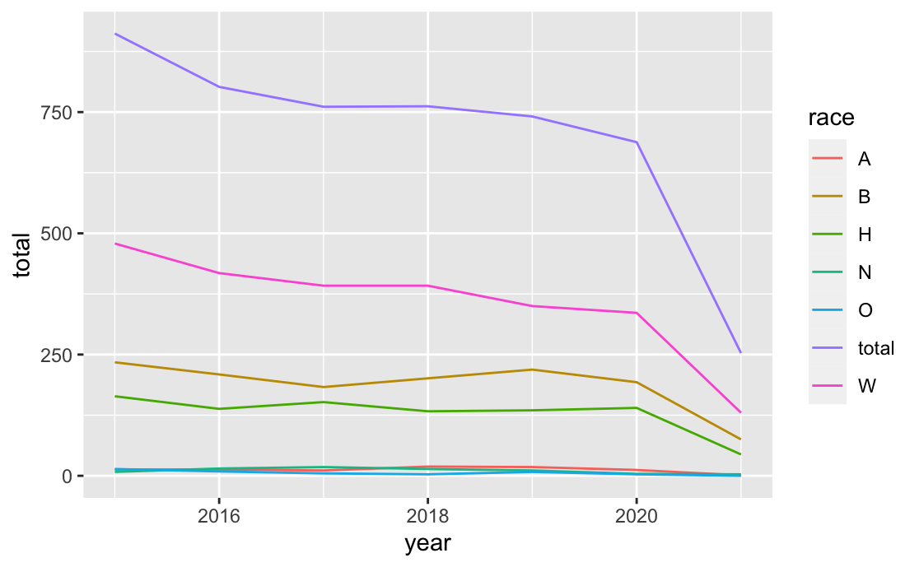

Slide 14
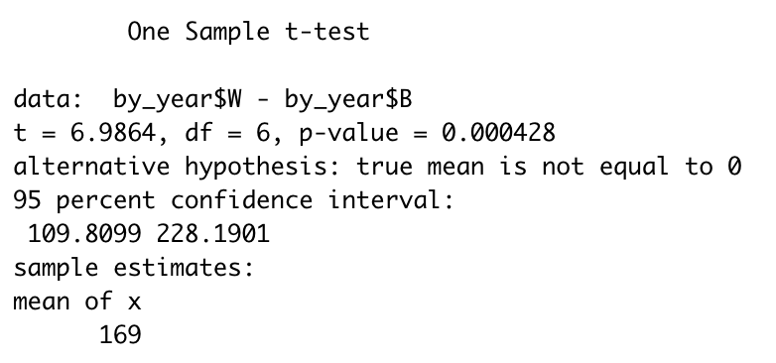
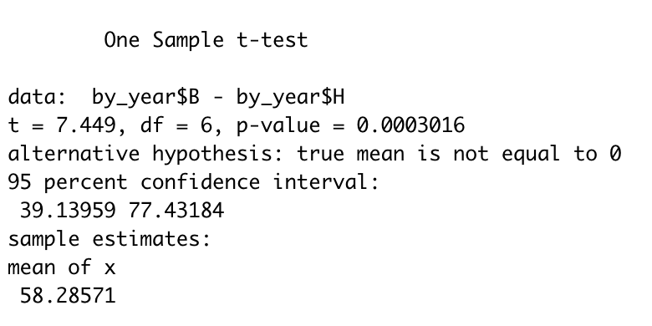
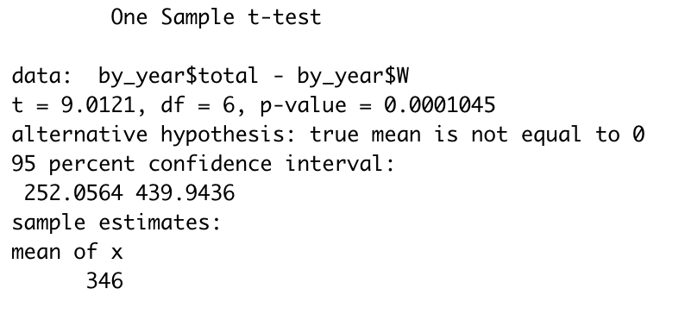

Slide 15
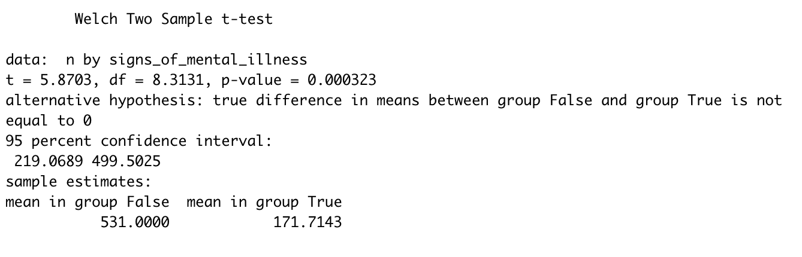

Slide 16
Conclusion

