Slide 1
Fatal police shootings
Abigail Ward, Simran Kota

Slide 2
Goal:
Assess the significance various factors such as age, race, mental illness and gender have on the population of civilians in the United States who have been fatally shot by the police.

Slide 3
The Data
Every fatal police shootings in the US from 2015-2021
Definition of fatal shooting: A police officer in the line of duty who shoots and kills a civilian
Not included:
deaths of people in police custody
fatal shootings by off-duty officers
non-shooting deaths
Collected by the Washington Post via:
local news reports
law enforcement websites
social media
independent databases such as Killed by Police and Fatal Encounters
Details about each individual: race, gender, age, location, signs of mental illness, etc

Slide 4
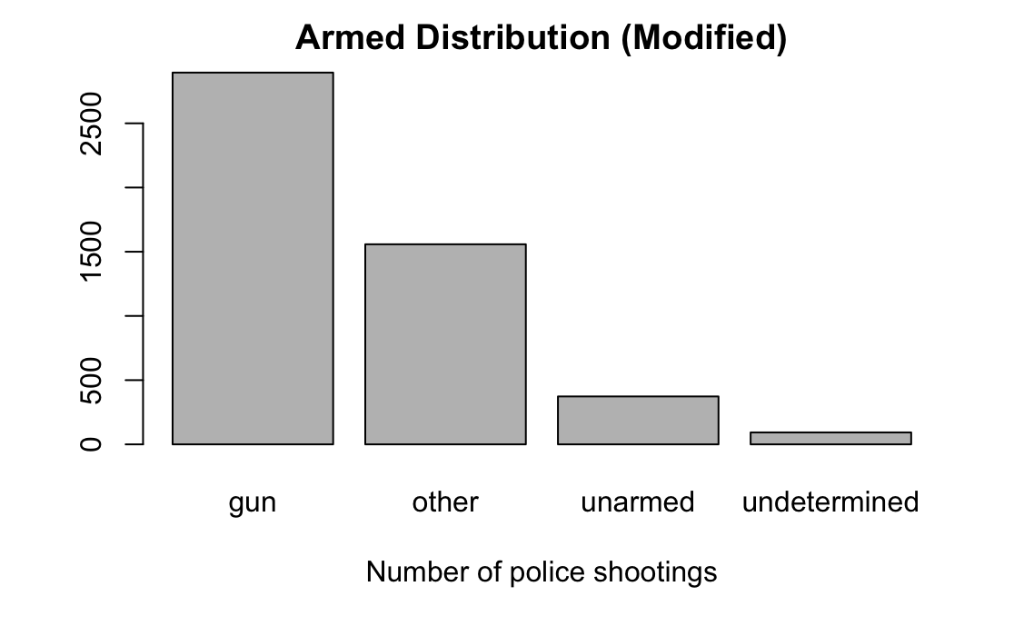
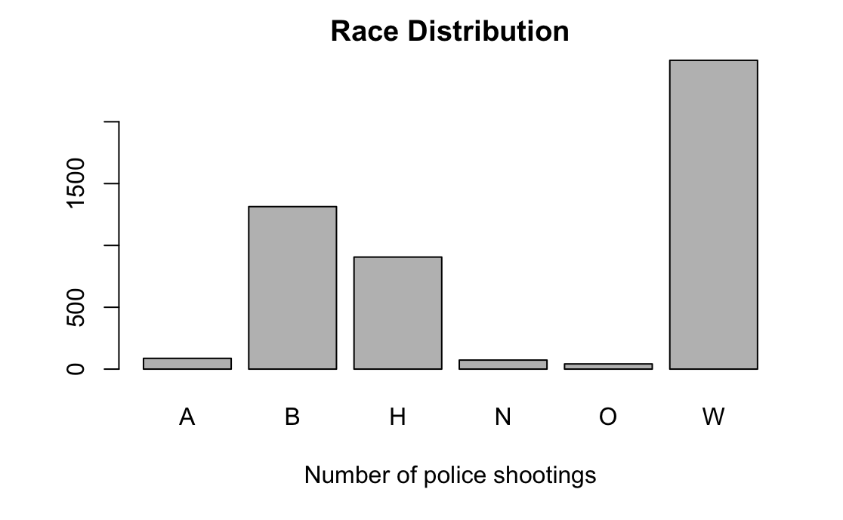
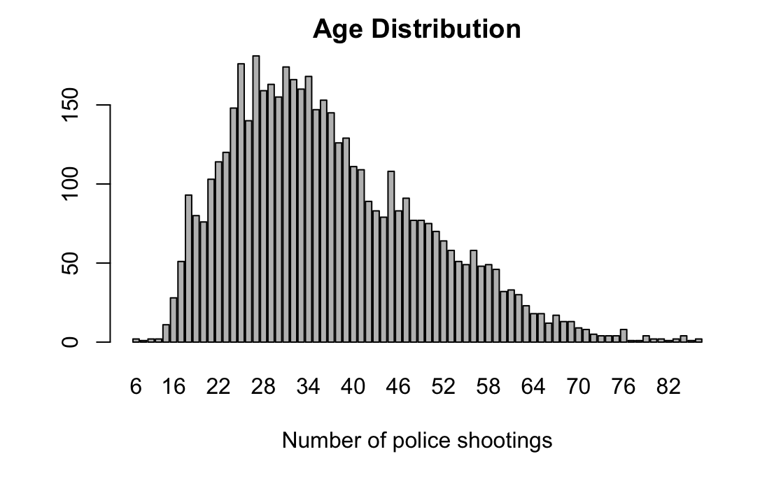
Initial exploration of the data

Slide 5
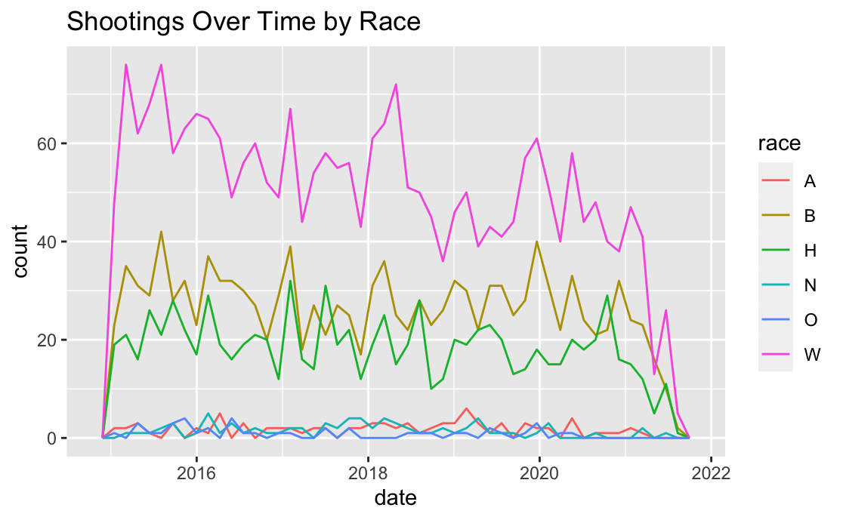
Shootings Over Time by Race A Asian B Black or African American H Hispanic N American Native or Alaskan Native O Unknown/Other/Two or More W White

Slide 6
Statistical Model

Slide 7
Chi-squared and fisher tests for independence

Slide 8
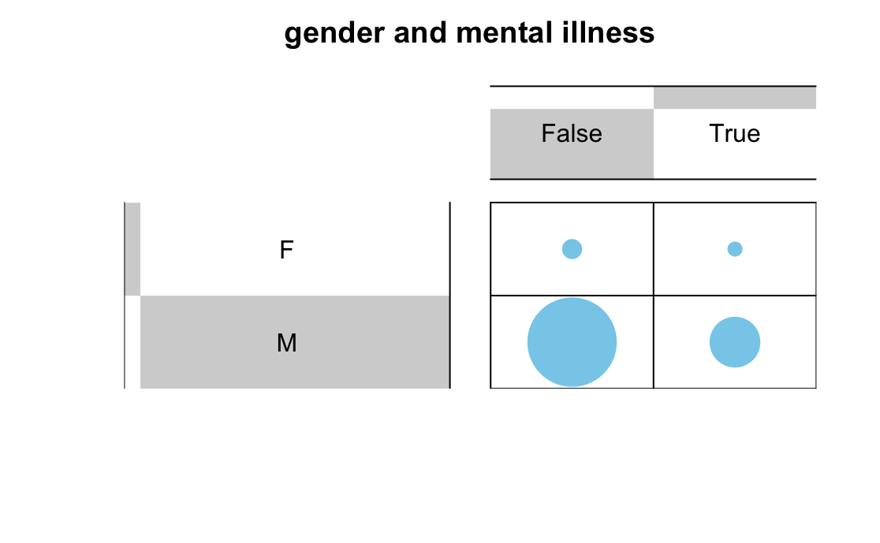
p-value = 0.0002213

Slide 9
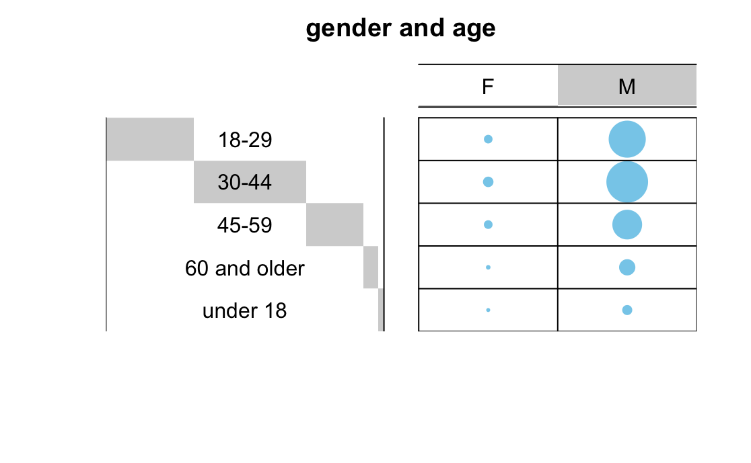
p-value = 0.05697

Slide 10
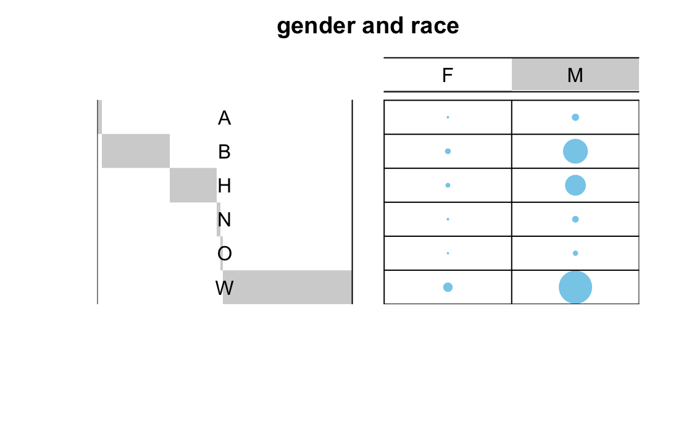
p-value = 0.0009995

Slide 11
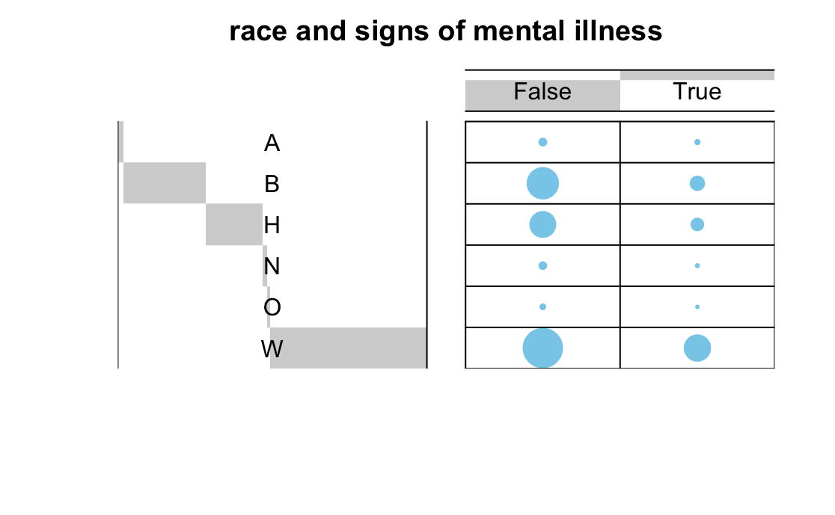
p-value = 0.0004998

Slide 12
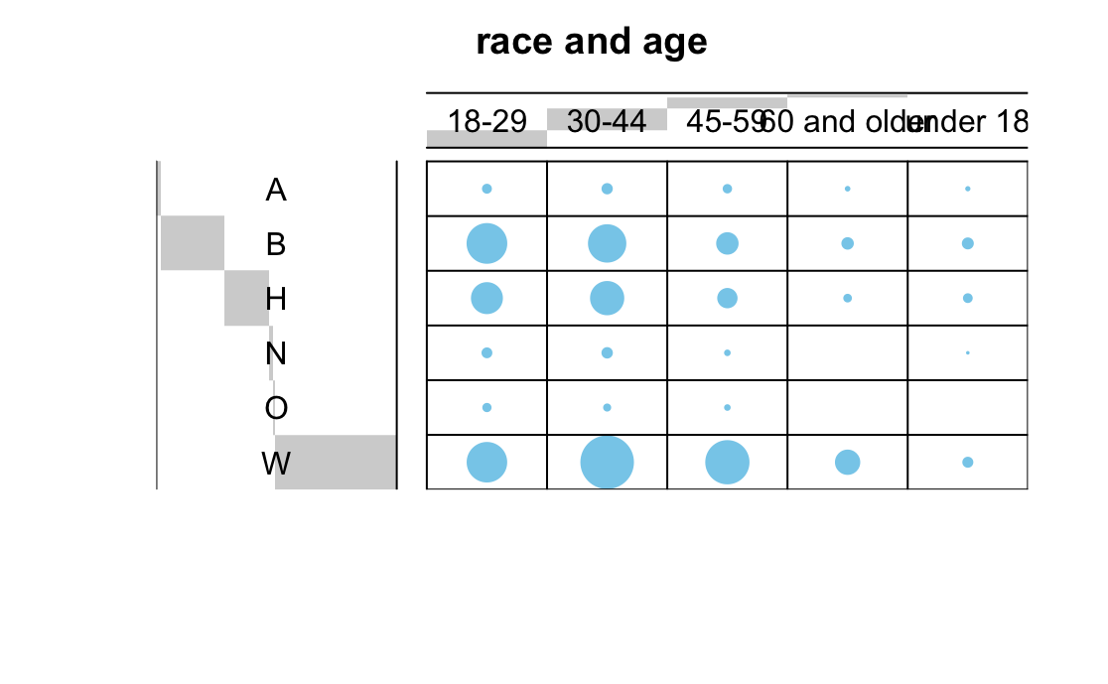
p-value = 0.0004998

Slide 13
Two sample tests

Slide 14
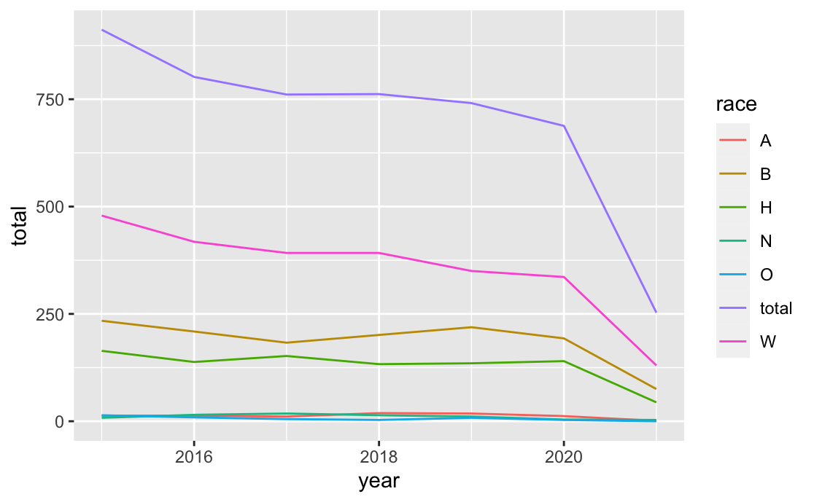

Slide 15
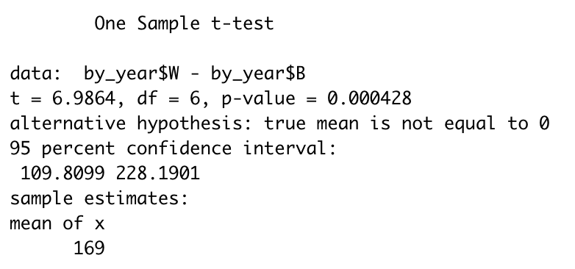
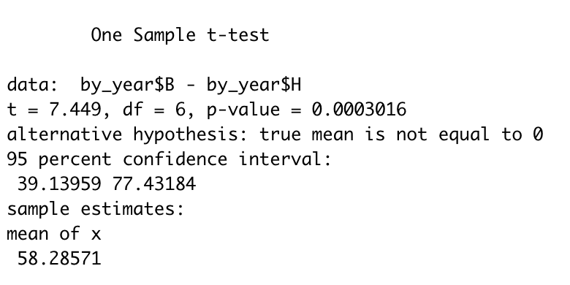
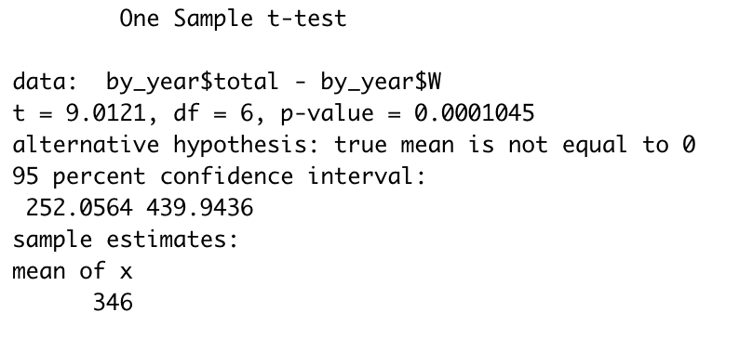

Slide 16
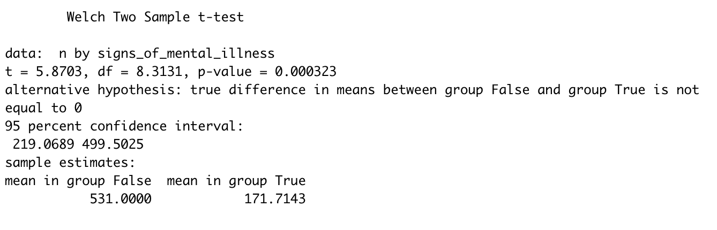

Slide 17
Conclusion

