Slide 1
Fatal Police Shootings in the US
Abigail Ward, Simran Kota

Slide 2
Goal
Assess the significance various factors such as age, race, mental illness and gender have on the population of civilians in the United States who have been fatally shot by the police.

Slide 3
The Data
Every fatal police shooting in the US from 2015-2021
Fatal Shooting: A police officer in the line of duty shoots and kills a civilian
Not included:
Deaths of people in police custody
Fatal shootings by off-duty officers
Non-shooting deaths
Collected by the Washington Post via:
local news reports
law enforcement websites
social media
independent databases such as Killed by Police and Fatal Encounters
Details about each individual such as race, gender, age, location, signs of mental illness, etc

Slide 4
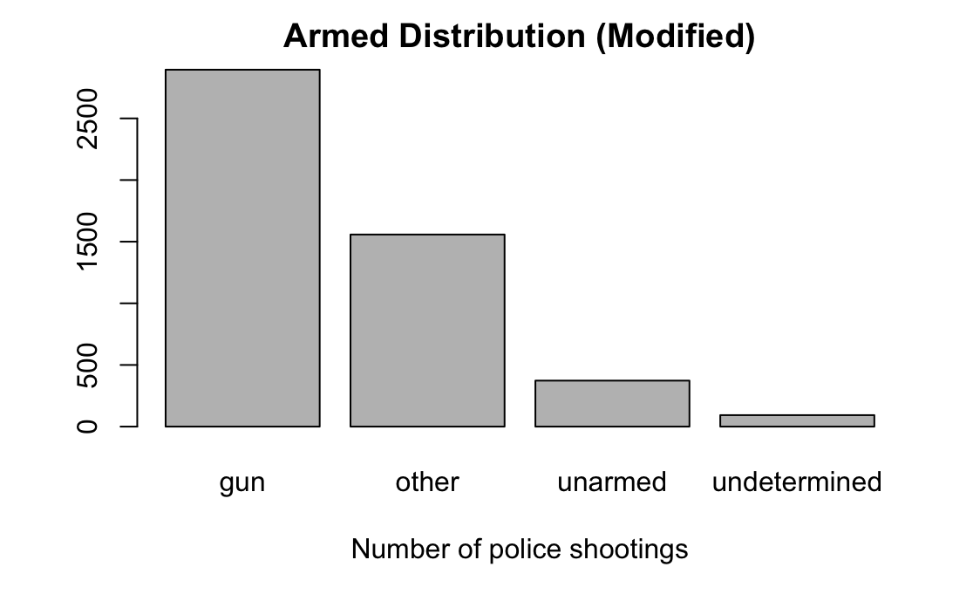
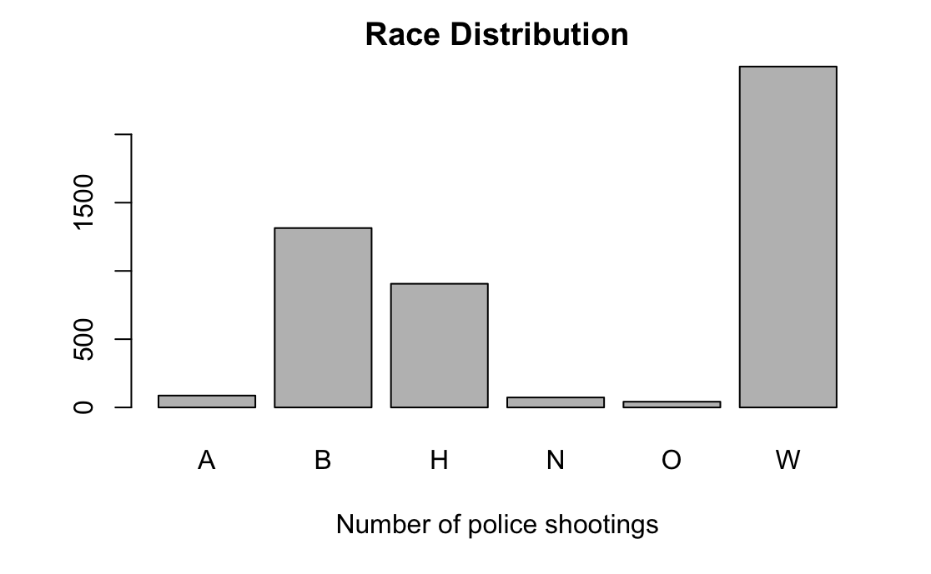
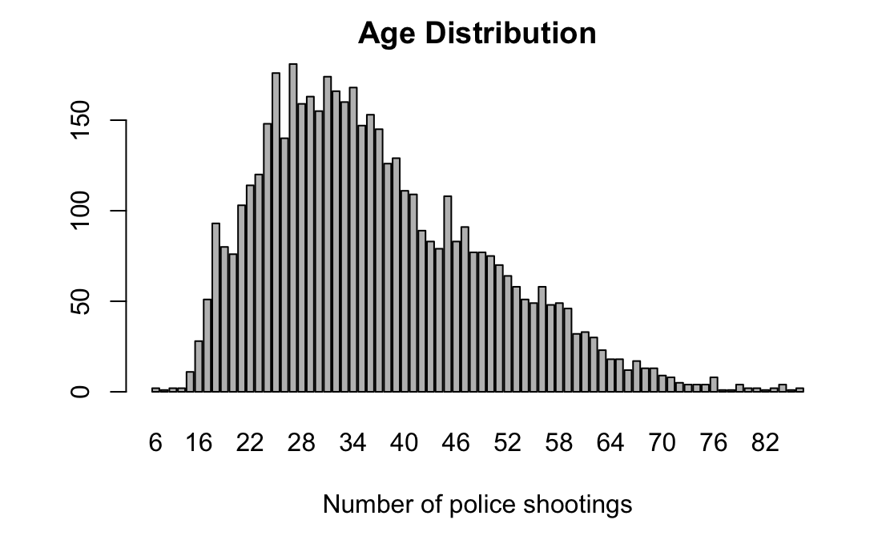
Exploratory Data Analysis

Slide 5
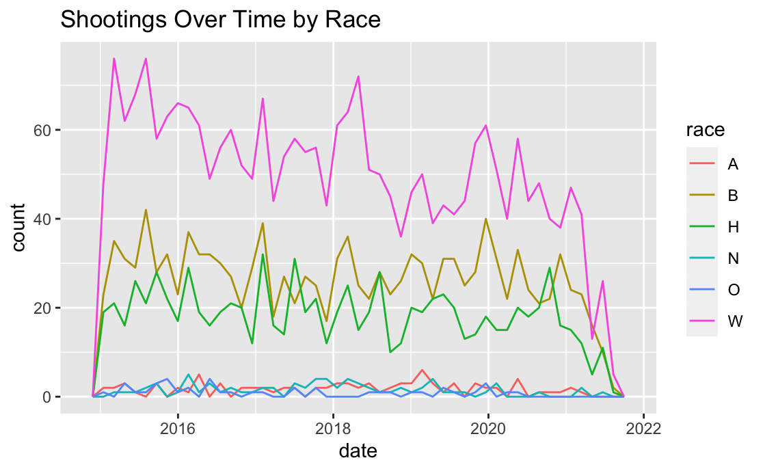
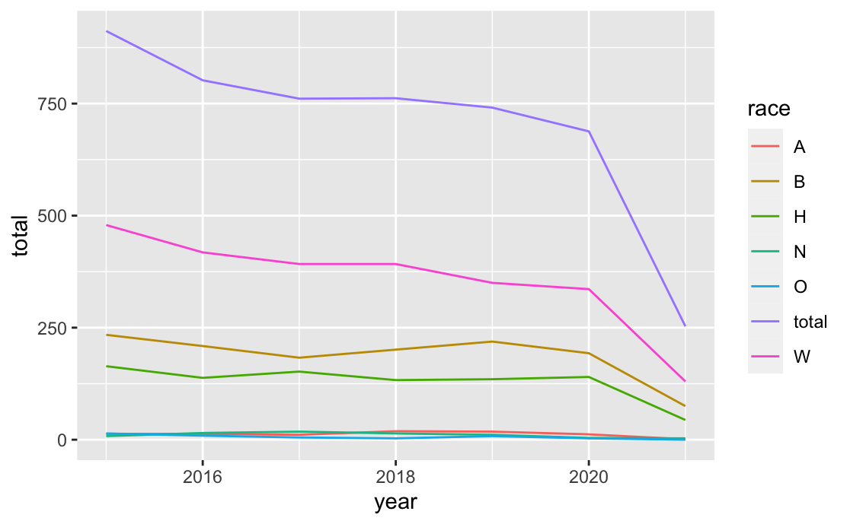
Shootings Over Time by Race
A Asian
B Black or African American
H Hispanic
N American Native or Alaskan Native
O Unknown/Other/Two or More
W White

Slide 6
1. Two Sample Tests

Slide 7
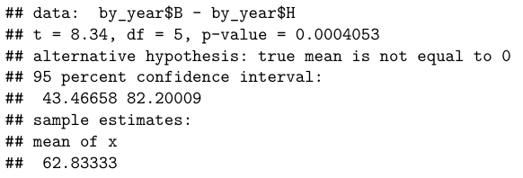
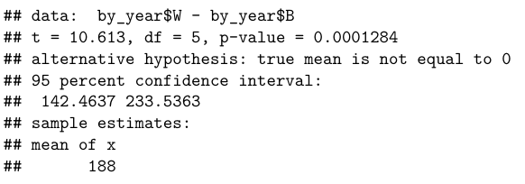
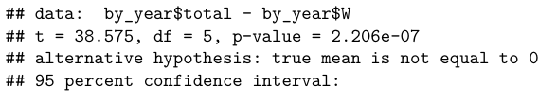
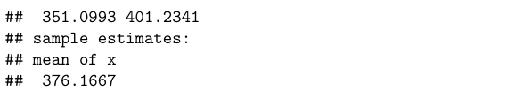
Difference Between Races
There is a significant difference between the distributions of each race

Slide 8
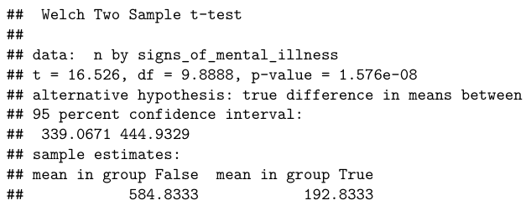

Effect of Signs of Mental Illness
In the differences between the group with Mental Illness and the group without, we also see a statistically significant difference. However, 24.8% of the data population had signs of mental illness, while only ~20.6% of adults in the US experienced mental illness. Is this difference statistically significant?

Slide 9
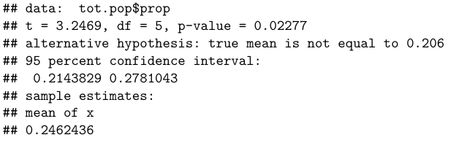
Effect of Signs of Mental Illness (cont.)
The difference is statistically significant. Although there are more people who are fatally shot that don’t have signs of mental illness, there is a higher chance of someone being fatally shot if they do show signs of mental illness.

Slide 10
2. Statistical Model

Slide 11
Lets take a deeper look at the differences by race
We will create 1000 samples of a population of 500000 people in the US based on 2019 Census data regarding racial proportions

Slide 12
Assaults by firearm kill about 13,000 people in the US each year, and this translates to a roughly 1-in-315 lifetime chance of death from gun violence.
- Business Insider

Slide 13
Results of Student’s t-Test
Race | Observed Proportion | Sample Mean Proportion | P-Value
B | 26.5 | 13.1 | 2.2e-16
W | 50.7 | 58.9 | 2.2e-16
A | 1.8 | 5.8 | 2.2e-16
H | 18.5 | 18.1 | 2.2e-16
N | 1.5 | 1.3 | 2.2e-16
The only race with a significantly higher rate of shootings than the simulated case is African Americans.

Slide 14
3. Tests of Independence

Slide 15
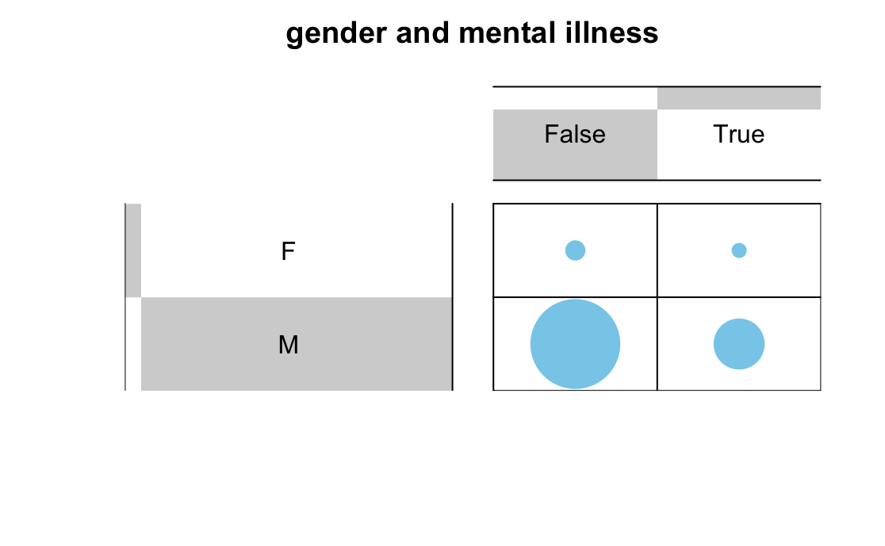
Gender vs Mental Illness
p-value = 0.0004998

Slide 16
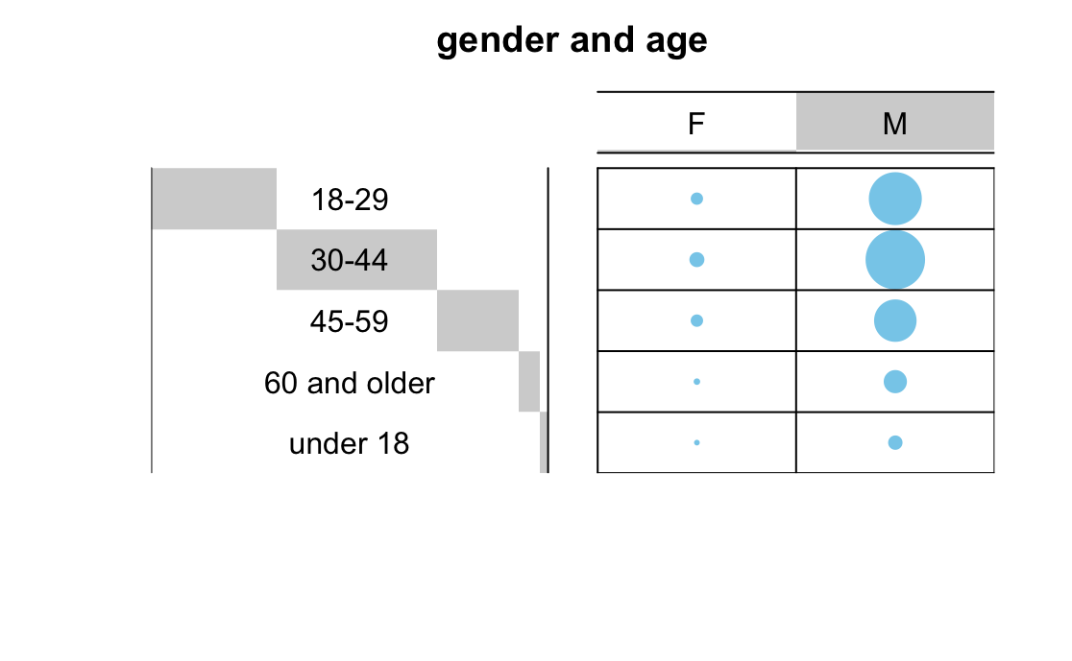
Gender vs Age
p-value = 0.1784

Slide 17
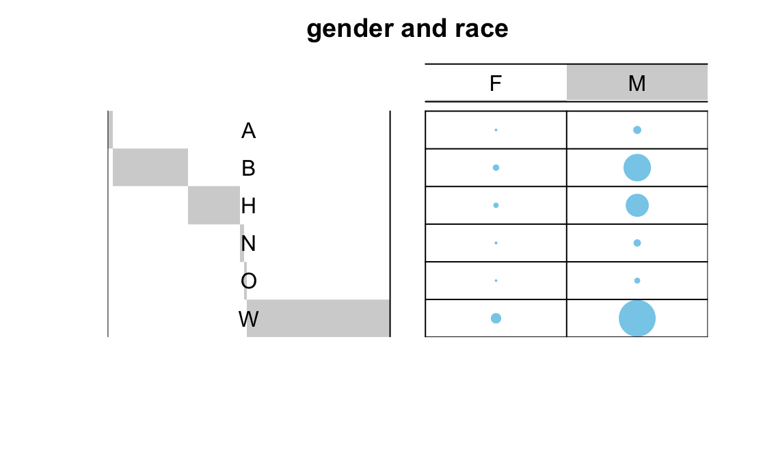
Gender vs Race
p-value = 0.002499

Slide 18
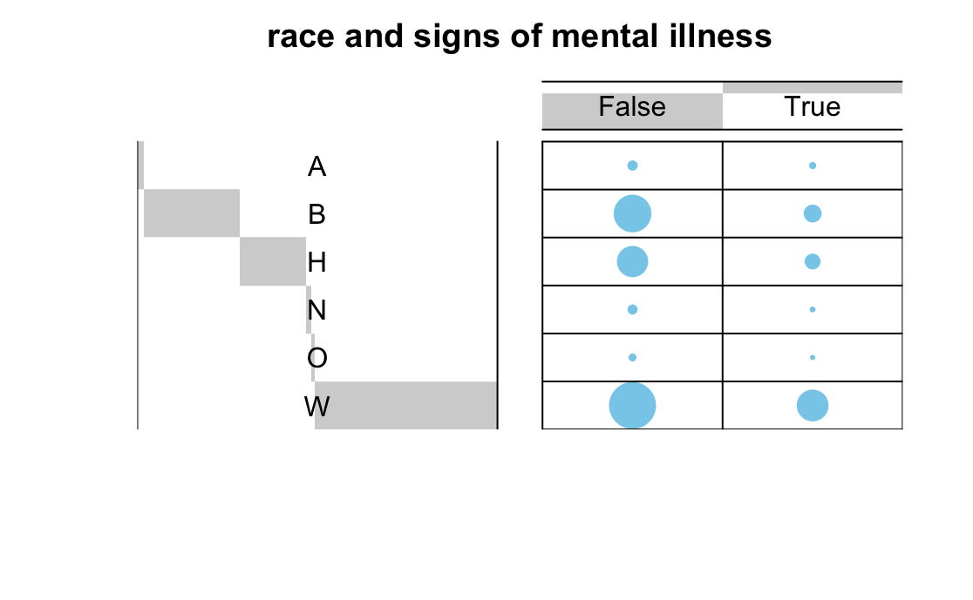
Race vs Mental Illness
p-value = 0.0004998

Slide 19
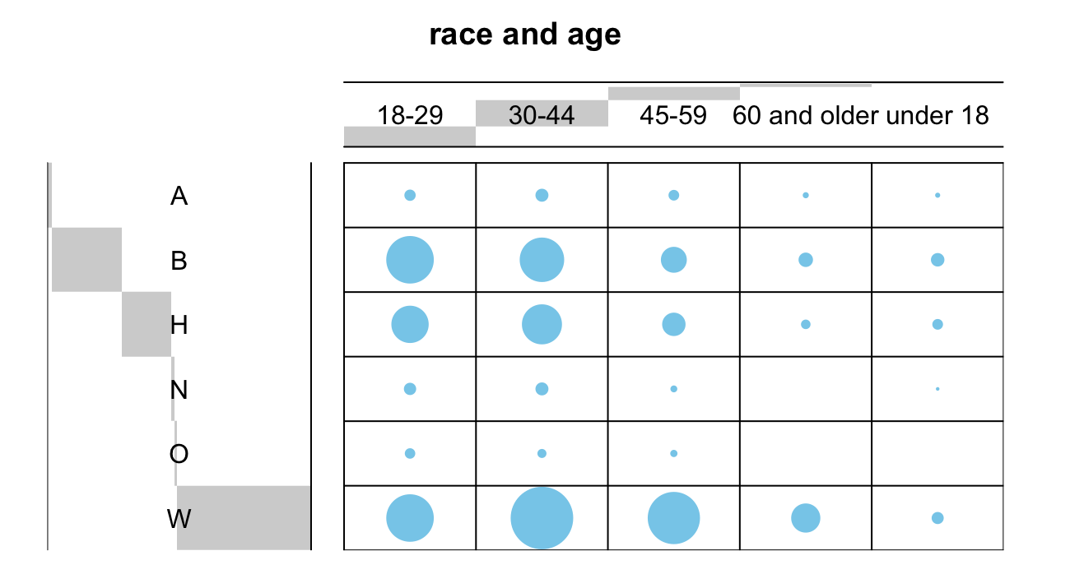
Race vs Age
p-value = 0.0004998

Slide 20
4. Logistic Regression

Slide 21
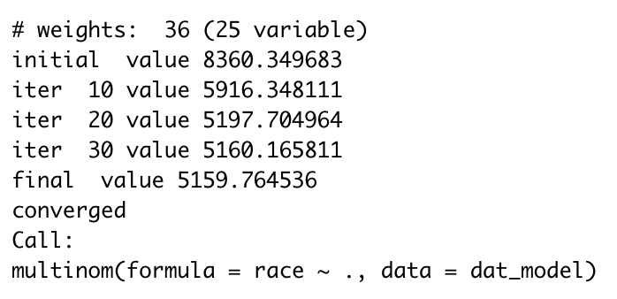
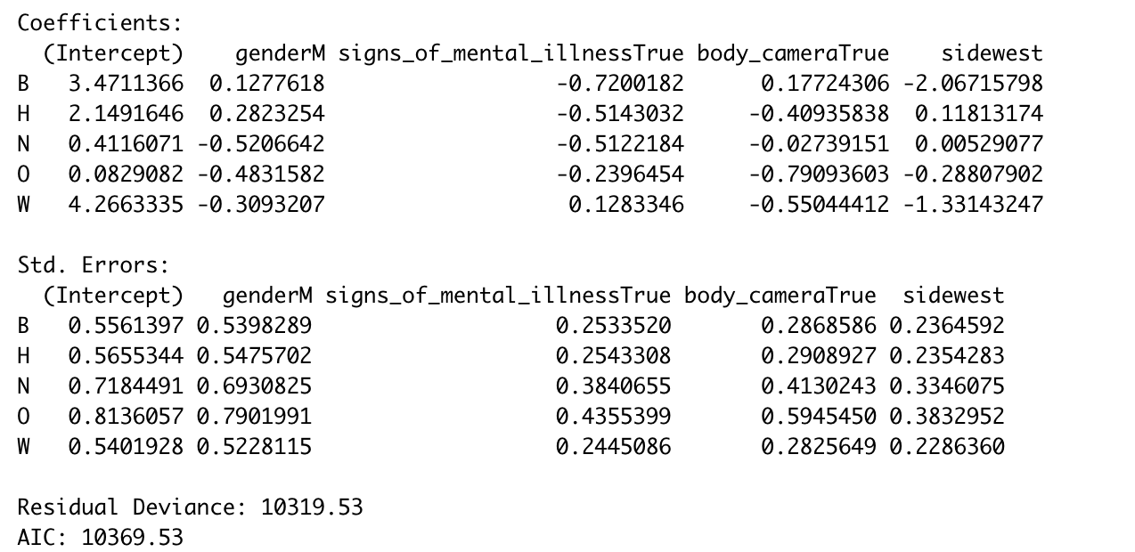
Training the model

Slide 22
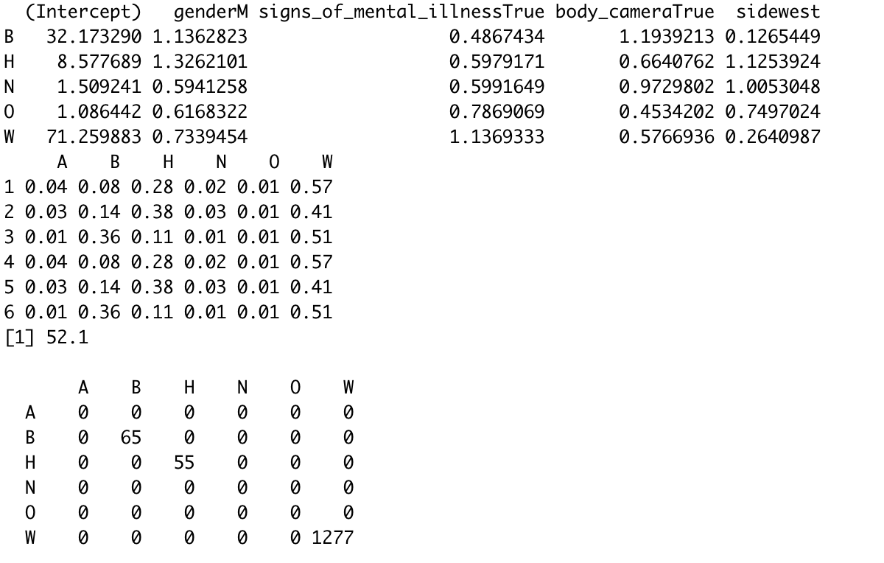
Understanding the model

Slide 23
Questions?

