Slide 1

Using Random Forest to Predict Housing Prices
Which variables are most important to predicting the price of housing?
An analysis by Simran Kota and Yusef Haswarey

Slide 2
DATA SOURCE
Dataset
Attributes
Data Reduction
Features
USA Housing Dataset from Kaggle
81 features, 1460 records
Reduced to 69 features
Mostly categorical
Continuous response variable (sale price)
Notes:
USA Housing Dataset from Kaggle
81 features, 1460 records
Related to house attributes: lot area, neighborhood, overall quality, year built, year remodeled, square footage, rooms, bathrooms, etc.
Narrowed down to 69 features to use in model
Mostly categorical variables, some continuous
Continuous response variable (sale price of house)

Slide 3
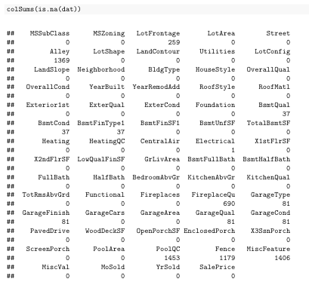
EXPLORATORY DATA ANALYSIS (PT 1)
Not all houses have yards, garages, basements, etc.
Replace with a “None” or “Unknown” category for factors, 0 for numeric
Predictors where neither option would work well were excluded

Slide 4
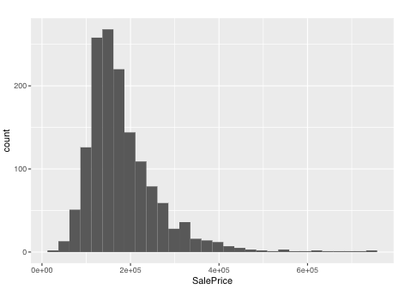
EXPLORATORY DATA ANALYSIS (PT 2)
Outcome variable is somewhat normally distributed with outliers – right skewed

Slide 5
INTRO TO RANDOM FOREST
Large collection of uncorrelated decision trees using random subsets of predictor variables and observations
No preprocessing or specific data requirements – can be used for classification or regression, but is slow when used on large datasets
Is a predictive modeling method, not a descriptive modeling method
Basic implementation using randomForest package – we used this package for our analysis
Package features built-in cross-validation – keeps some observations out-of-bag (OOB) for validation purposes

Slide 6

Strength in numbers
A forest of decision trees
Average of tree predictions
HOW IT WORKS
Basic concept: wisdom of crowds
Prediction from a large group of models is likely more accurate than a single model
Perform classification or regression by recursively asking simple true or false question that splits the data into subgroups
Highly sensitive to training data – doesn’t generalize well
Each tree spits out a prediction, and an average of all trees produces the output (for regression)
Classification: uses majority prediction

Slide 7

BUT HOW DOES HAVING A BUNCH OF IDENTICAL TREES HELP US?
Spoiler Alert: It doesn’t.

Slide 8

CREATING UNCORRELATEDNESS
Bootstrapping
Feature Randomness
Each tree randomly samples a subset of data with replacement, resulting in different trees
Some observations might be repeated
Limit the number of features the tree can consider, resulting in diverse trees

Slide 9

DATA REQUIREMENTS
Dataset
Applications
Performance
Any dataset appropriate for use with a classification or regression method can be used with Random Forest
Random Forest may not be the best method for a given application
Excessively large datasets or time-sensitive applications may require the use of other methods for generating predictions

Slide 10
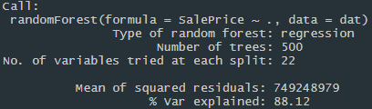
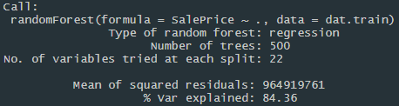
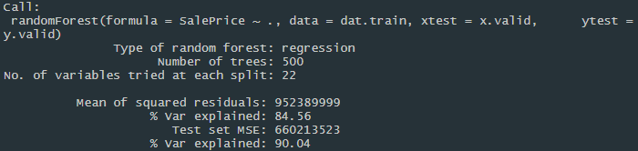
IMPLEMENTATION
Due to its good performance without any tuning, our first function call had only the formula (SalePrice ~ .) and the full dataset
We also manually split the dataset into a training and validation set to perform a manual validation of the forest predictions
The randomForest function also allows specification of a test dataset – used to perform additional validation alongside OOB set
Randomness in selection of training set and building of decision trees leads to variance in predictions between forests

Slide 11
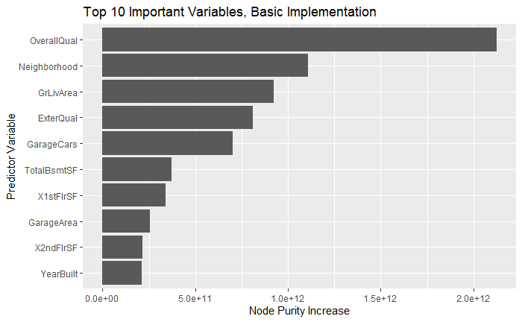
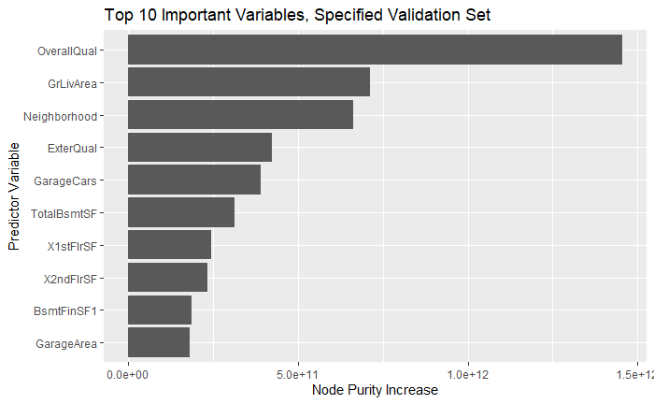
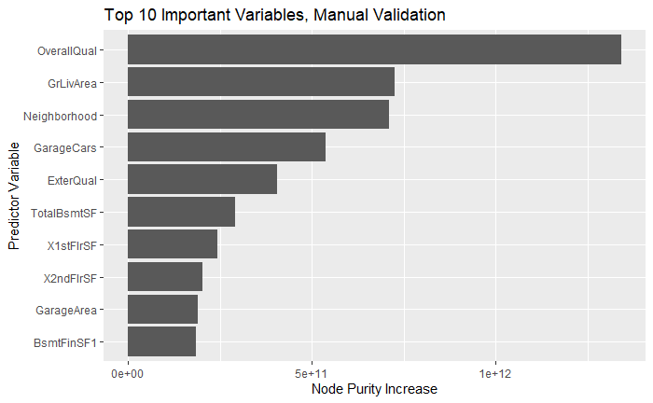
RESULTS
In each forest, overall quality was most important predictor variable
Remaining 9 of top 10 predictors saw few changes between forests

Slide 12
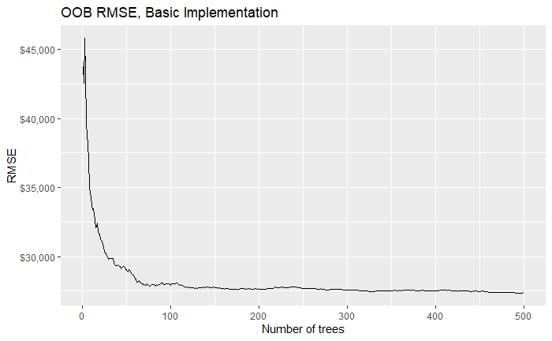
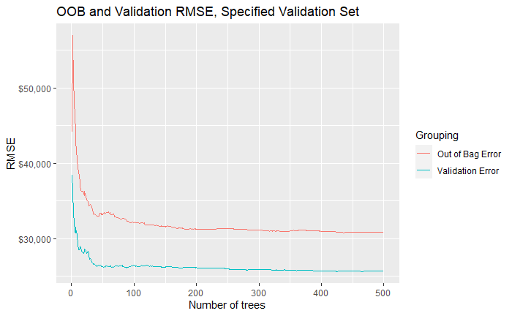
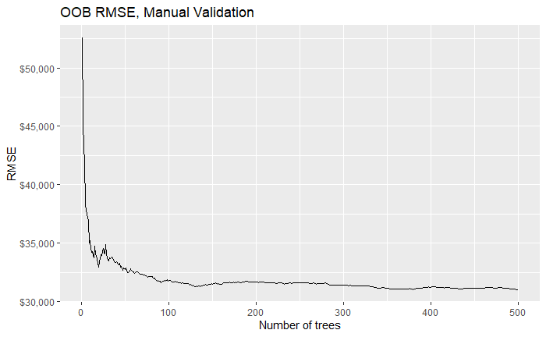
RESULTS
Root mean square prediction error was around $25k – 31k range for each forest. This includes the error for the manual validation and the OOB sets.

Slide 13
THANKS
Any questions?
Please keep this slide for attribution

