Slide 1

Housing Price Prediction
Submitted by:
Simran Kumari

Slide 2
Problem
Problem Statement:
Customer satisfaction has emerged as one of the most important factors that guarantee the success of online store; it has been posited as a key stimulant of purchase, repurchase intentions and customer loyalty. A comprehensive review of the literature, theories and models have been carried out to propose the models for customer activation and customer retention. Five major factors that contributed to the success of an e-commerce store have been identified as: service quality, system quality, information quality, trust and net benefit. The research furthermore investigated the factors that influence the online customers repeat purchase intention. The combination of both utilitarian value and hedonistic values are needed to affect the repeat purchase intention (loyalty) positively. The data is collected from the Indian online shoppers. Results indicate the e-retail success factors, which are very much critical for customer satisfaction.
Be careful: There are two sheets (one is detailed) and second is encoded in the excel file. You may use any of them by extracting in separate excel sheet. The number of column(s) is more than 47. Read the column header carefully.
Note : Data Scientists have to apply their analytical skills to give findings and conclusions in detailed data analysis written in jupyter notebook . Only data analysis is required.

Slide 3
Data Anaylsis
The data has column names with digits in it which should be removed for better data representation.
There are 269 rows and 71 columns in the data.
All the columns are of object datatype except for pincode column which is of int type.
There are no null values is the dataset.
All the columns are of categorical types. There are no identifier or constant columns

Slide 4
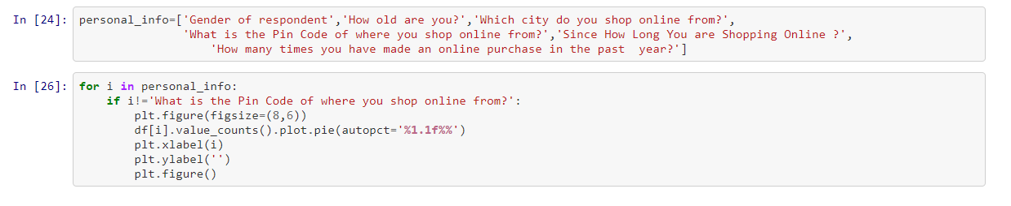
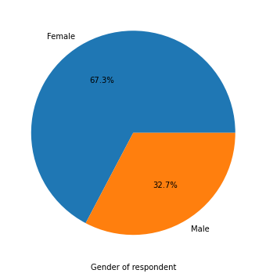
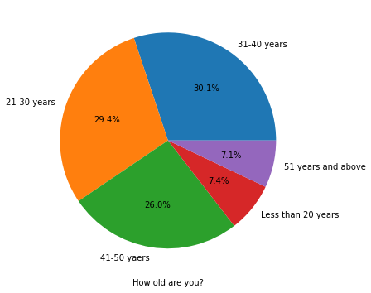
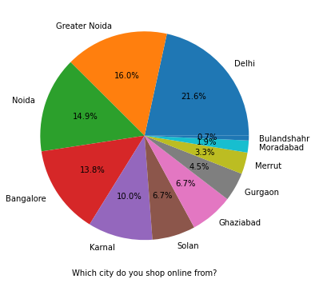
EDA Process and Virtualization

Slide 5
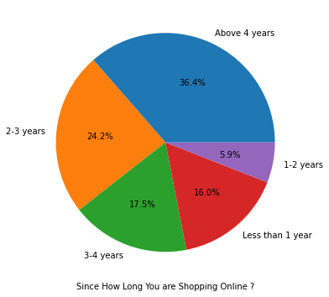
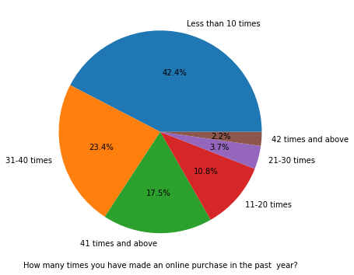
EDA and Visualization
There is double the number of women than men who have taken this survey.
Most of the people are in their 30's followed by 20's, teenagers and senior citizen are the least in number.
Most of the people belong from delhi, noida and banglore, ambiguity can also be seen as noida has two categories (noida and grater noida) which need to be handled.
Most of the people shopping online have been shopping from a long time.
Majority of people shop online 10 times a year, ambiguity can also be seen for range 42 times and above which needs to be handled

Slide 6
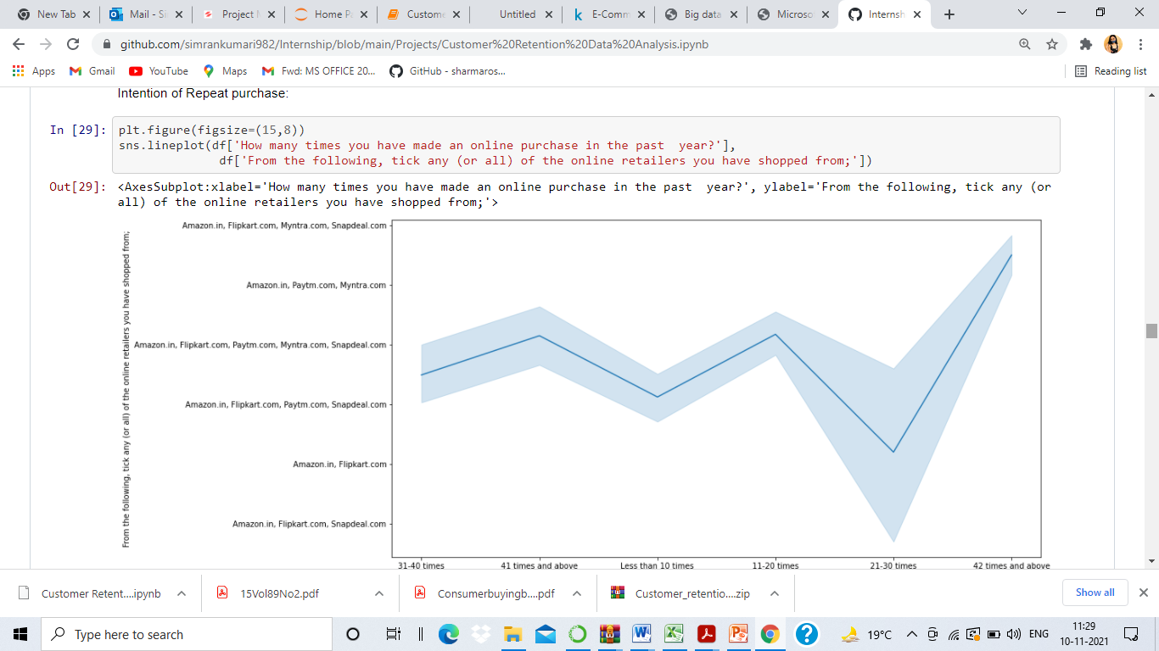
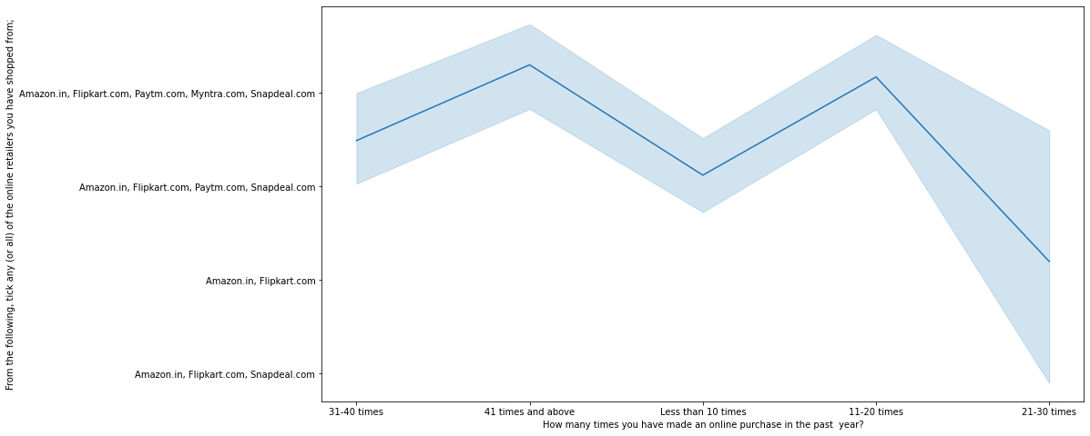
Heavy shoppers who shop more than 41 times a year shop from all the online brands, some of the people who shop for 32-40 and less than 10 times a year seem to exclude Myntra. People shop from Amazon and Flipkart whatever be the case.

Slide 7
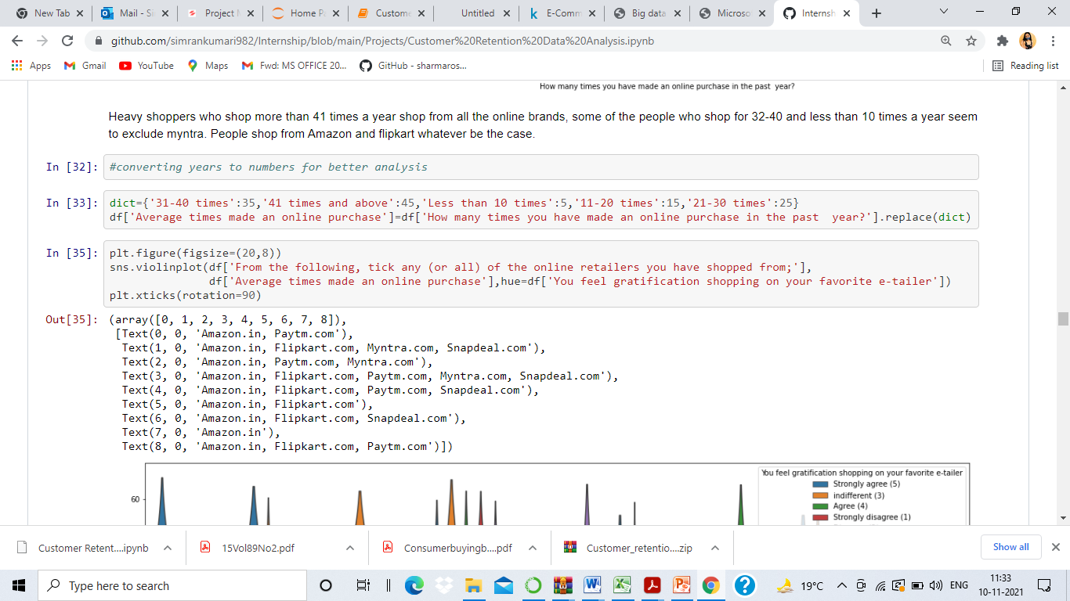
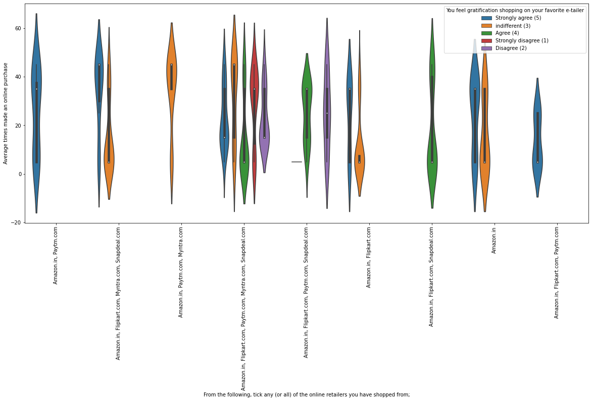

Slide 8
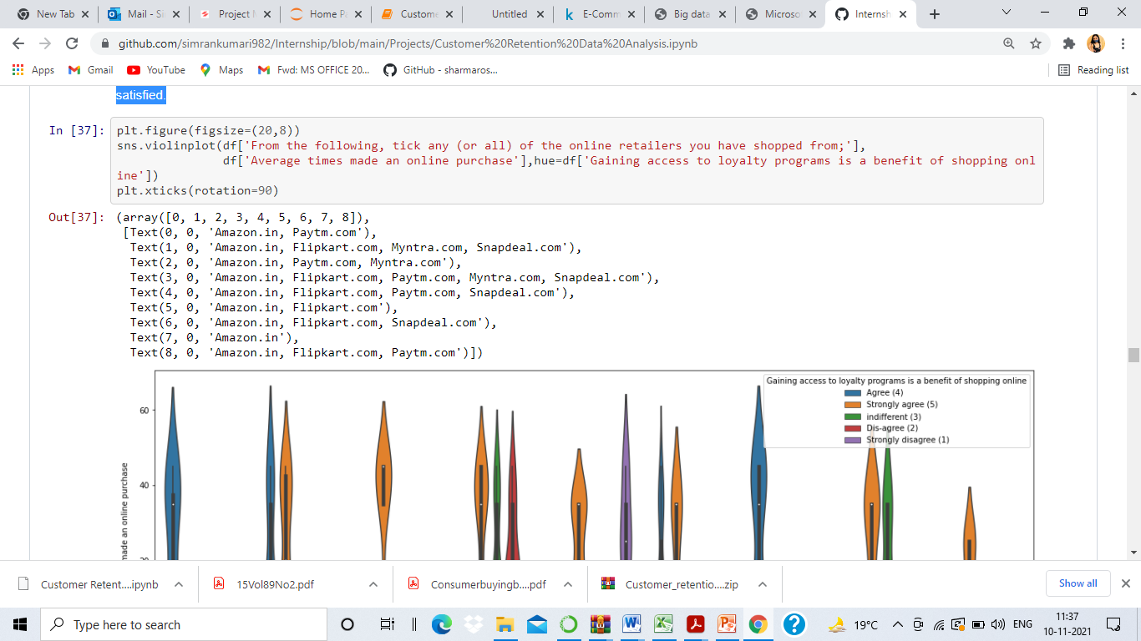
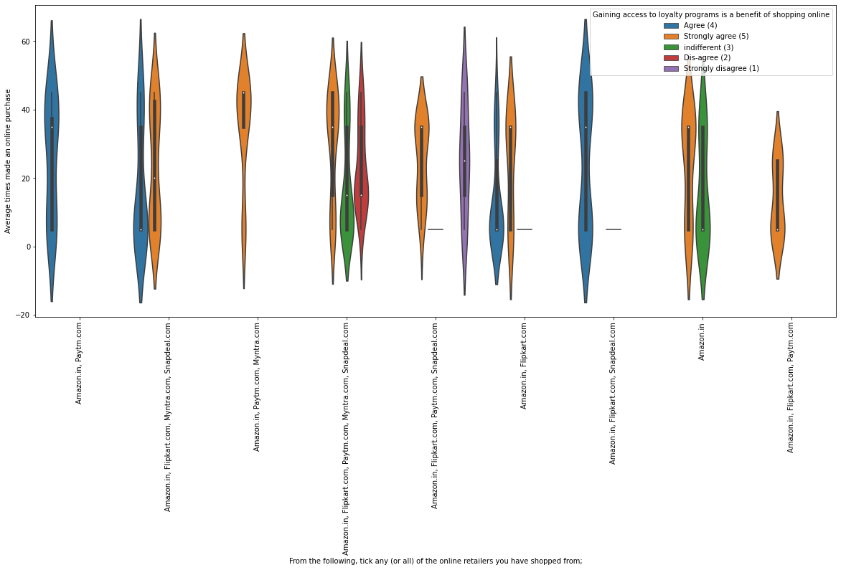
Almost all the people who have shopped from amazon, flipkart and paytm are satisfied. People who shop from a more number of online brands dosen’t seem to be satisfied.

Slide 9
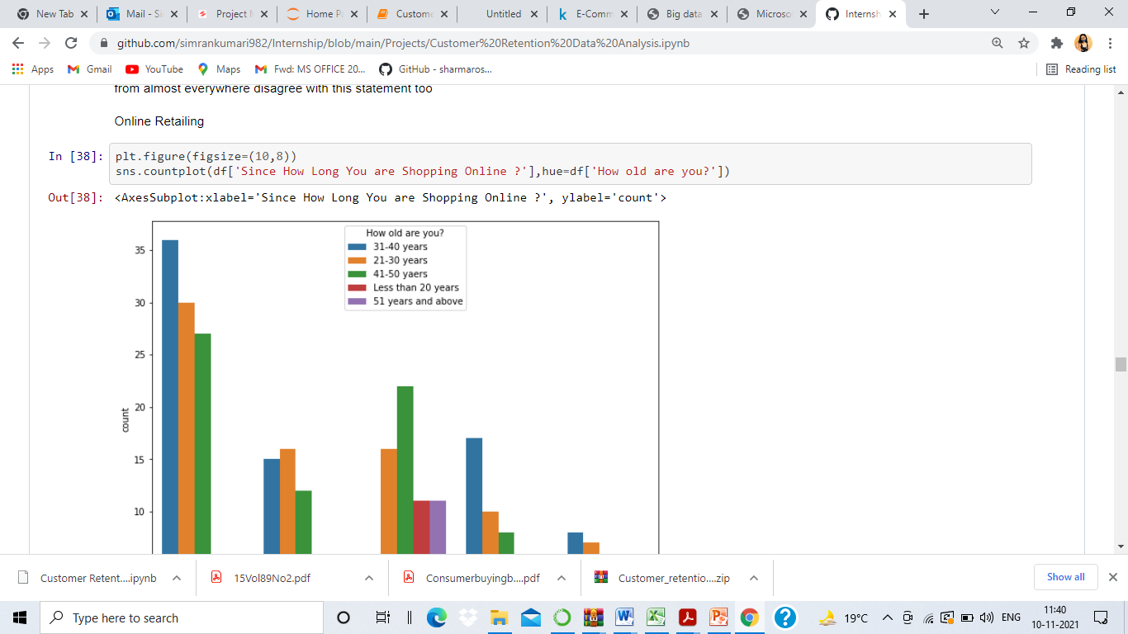
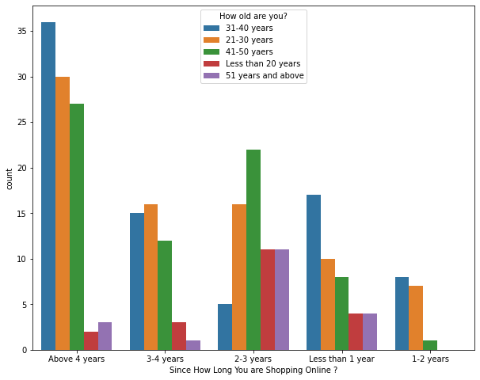
People shopping from amazon and paytm are getting benefits from the loyalty points, flipkart and sanpdeal also seem to give such benefits but people who shop from almost everywhere disagree with this statement too
Highest number of people have been shopping online for above 4 years except for the age group below 20 years and above 50 years. People who are shopping online for 1-2 years does not include teenagers and elder people

Slide 10
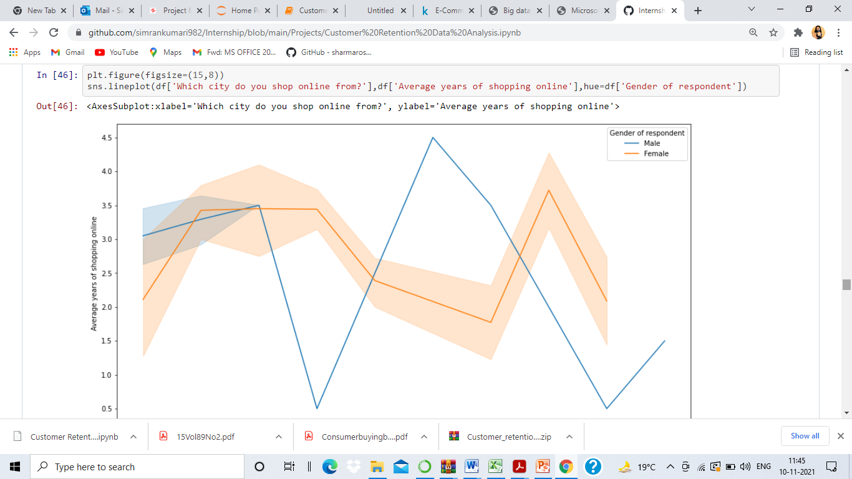
In lines, we can see that density of female customers is more than male. Men living in banglore and ghaziabad shop have shopped online for less than 1 year. Highest number of men shopping online belong from delhi and noida, while men from moradabad have been shopping online for the longest. Women from meerut and noida have shopped the longest

Slide 11
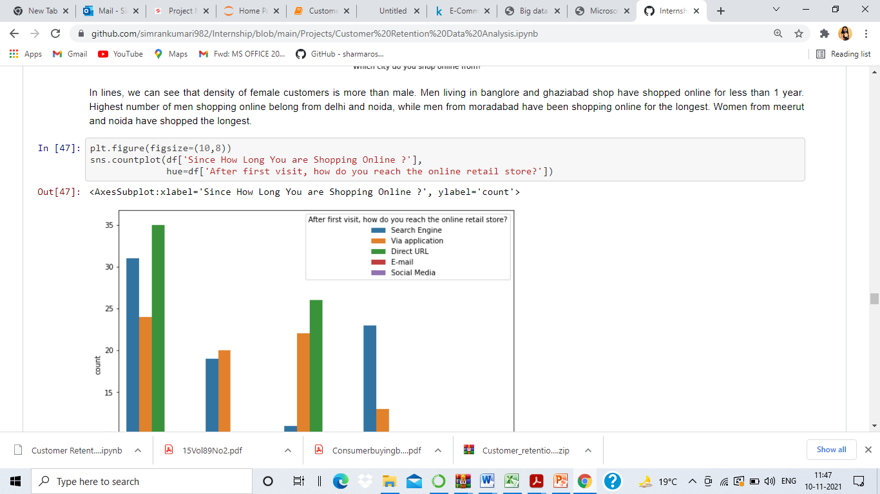
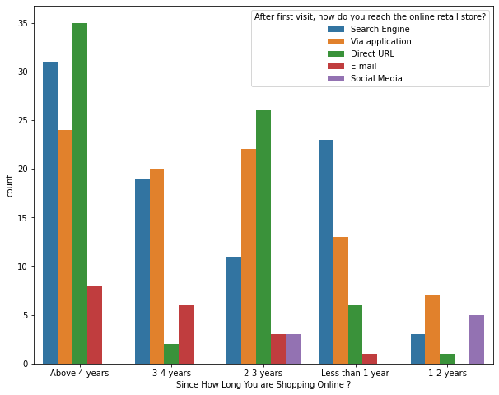
Even though people who are shopping online for more than 3 years do not use the application rather use search engine and direct url's in large number which indicates that online brands should update all their platforms rather than just application.

Slide 12
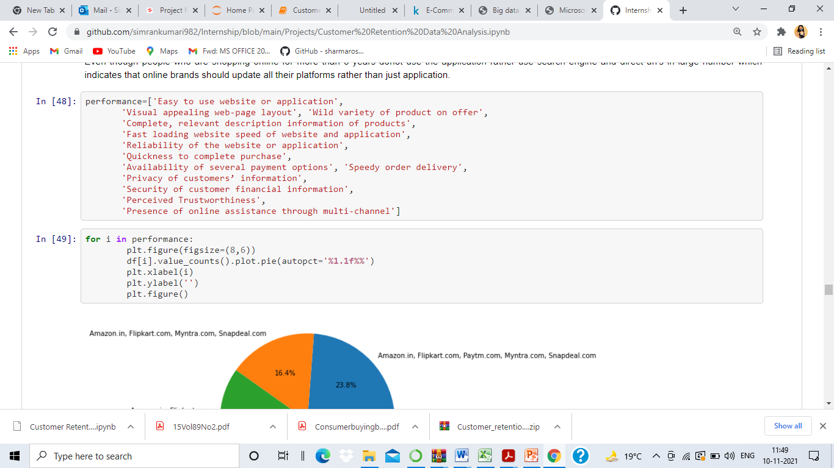
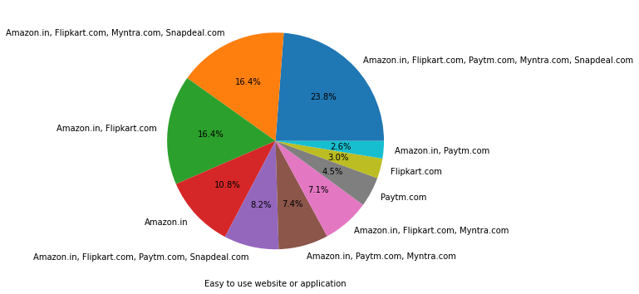

Slide 13
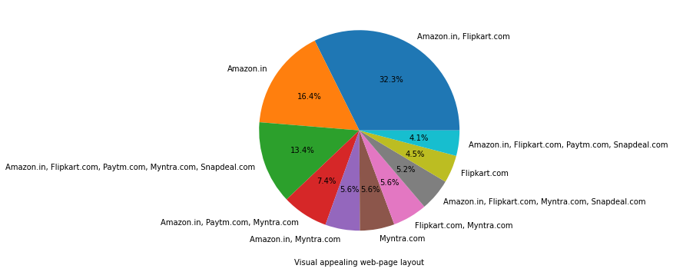
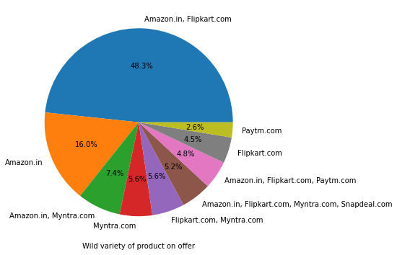

Slide 14
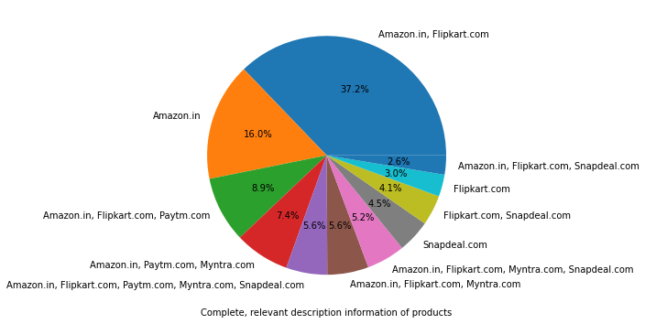
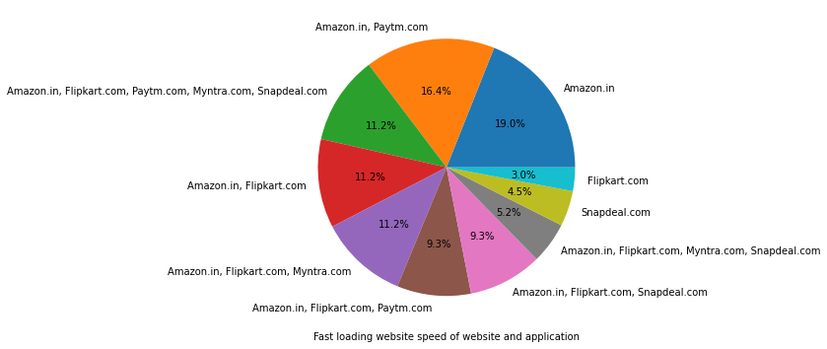

Slide 15
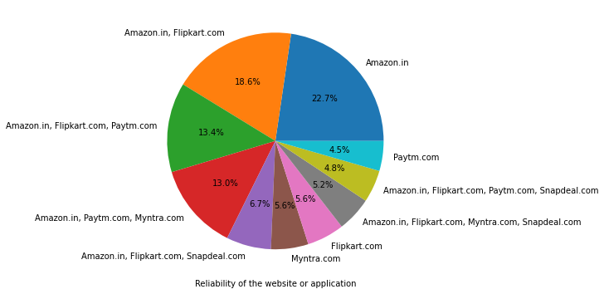
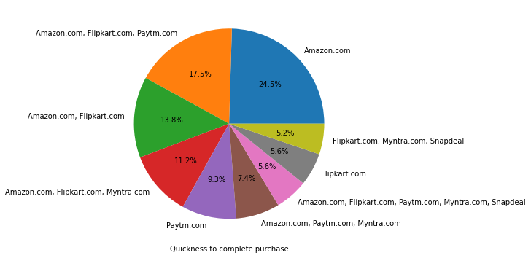

Slide 16
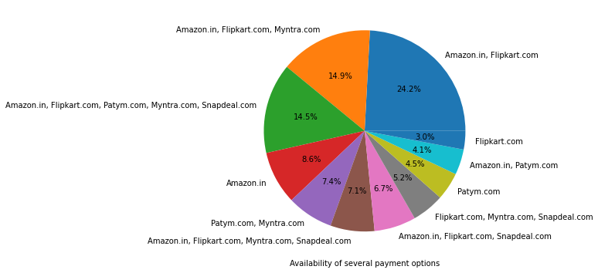
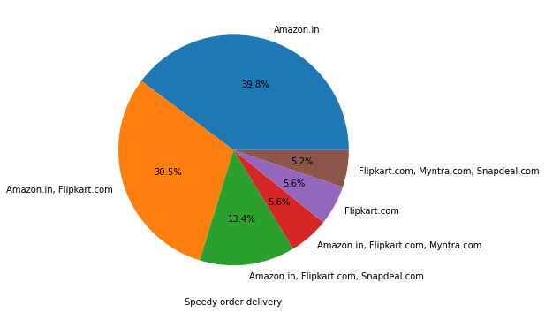

Slide 17
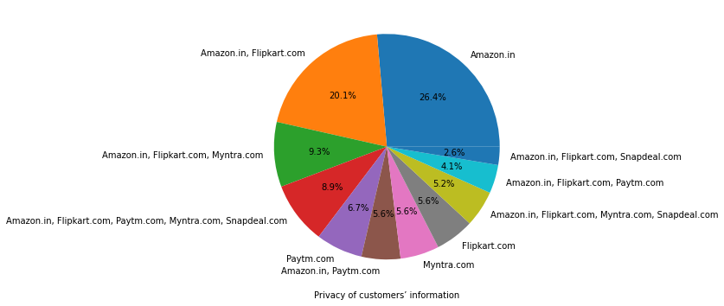
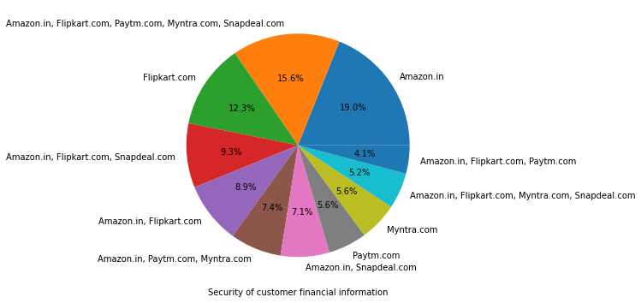

Slide 18
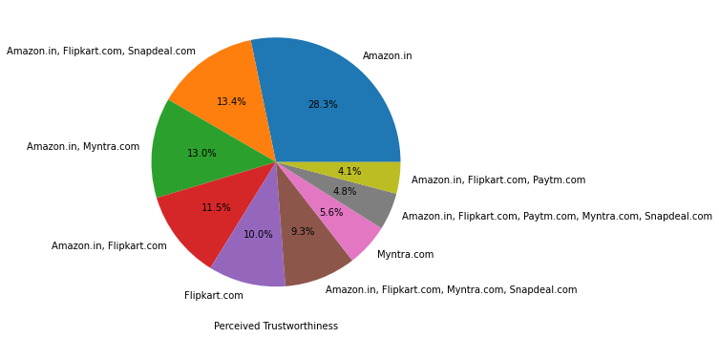
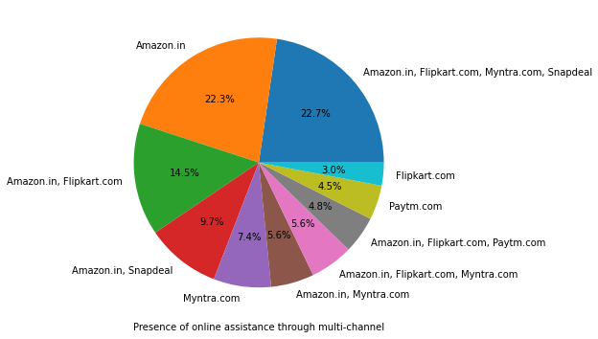
Amazon, Flipkart have been had the highest votes for having all the positive points and have maintained a very good brand image followed by paytm and the myntra

Slide 19
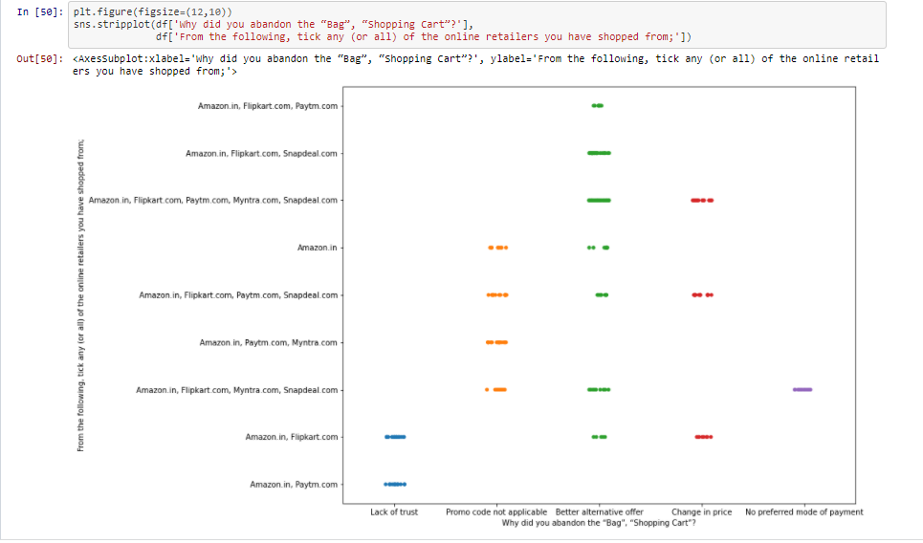
We can clearly see that most of the time people abandon the bag is beacuse they get a better alternative offer or promo code not applicable. There is also lack of trust seen in amazon, flipkart and paytm by some people.

Slide 20
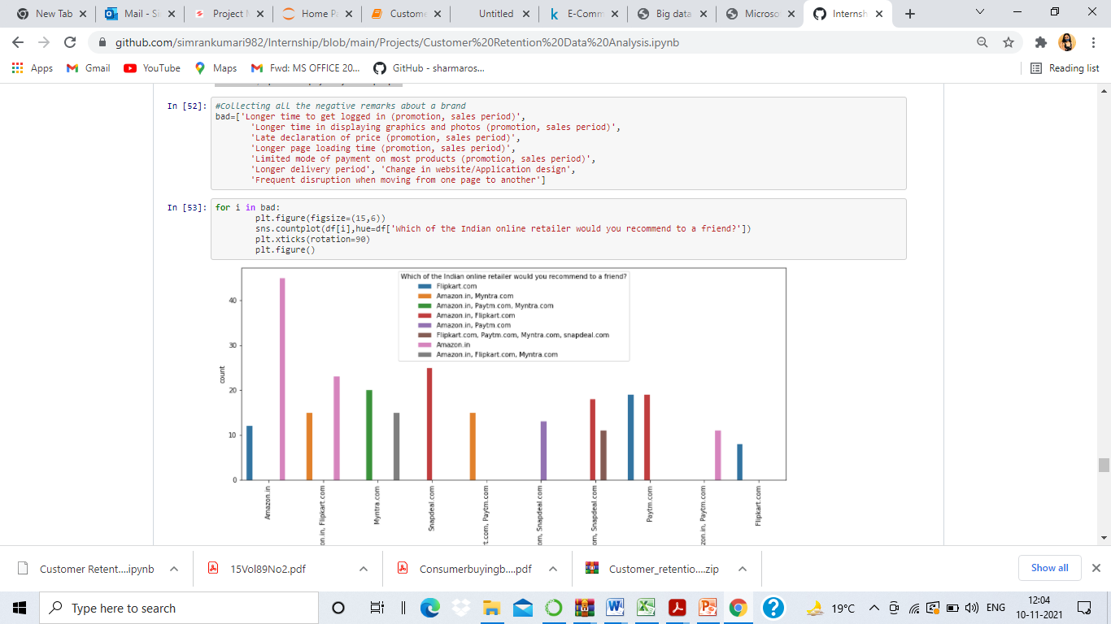

Slide 21
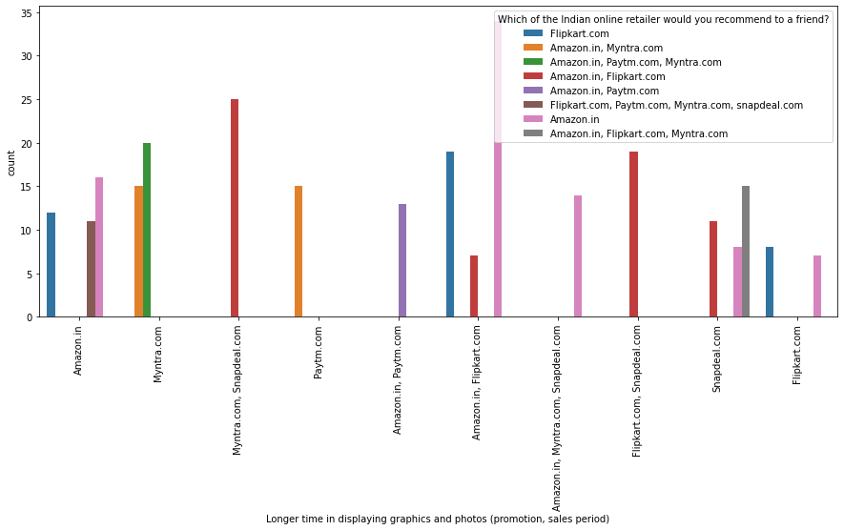

Slide 22
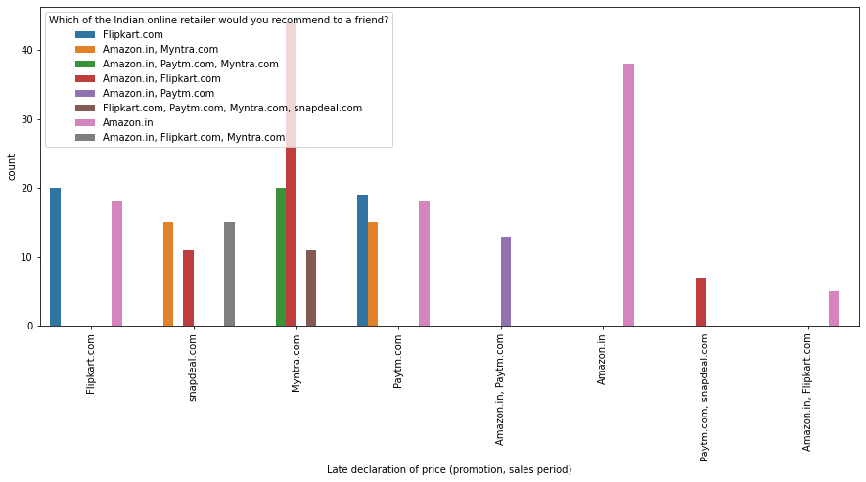

Slide 23
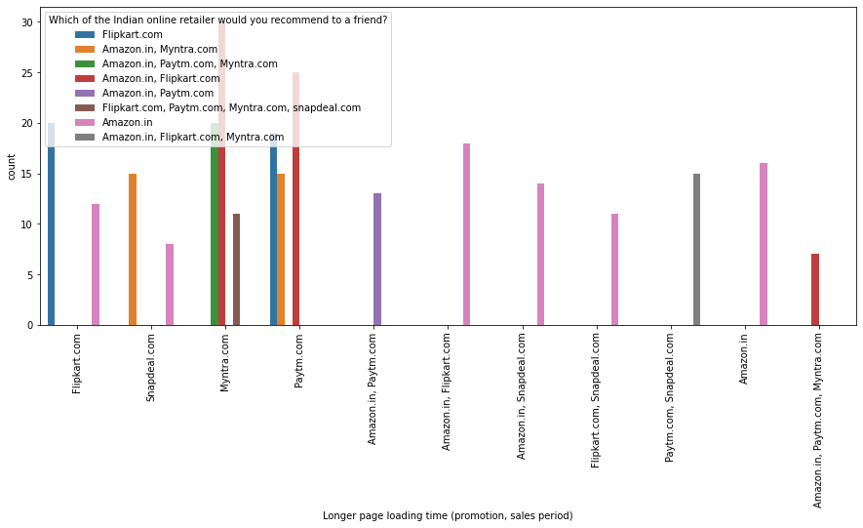

Slide 24
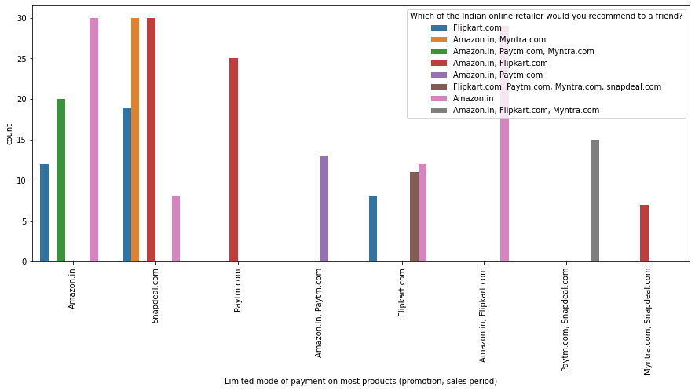

Slide 25
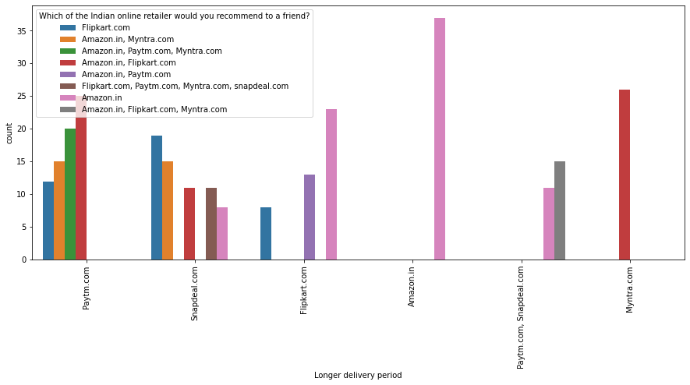

Slide 26
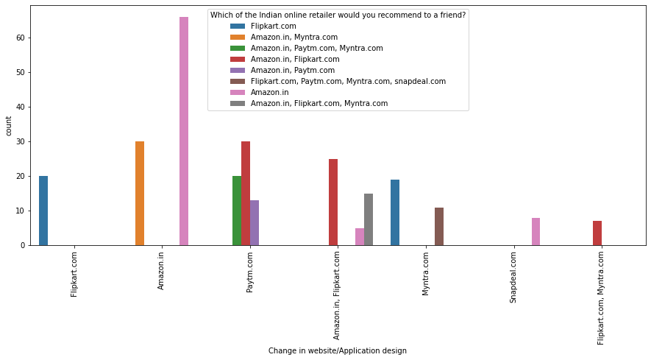

Slide 27
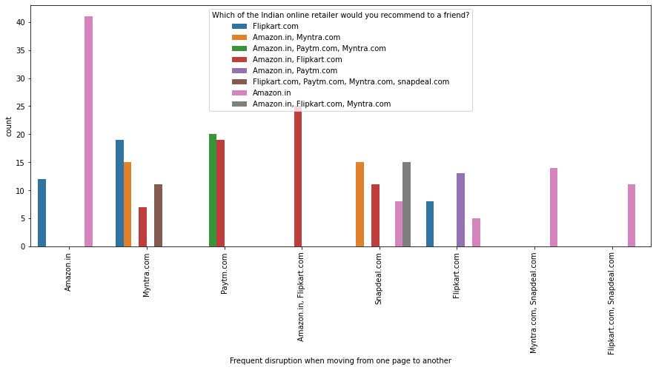
Customers seem to be more loyal to amazon, flipkart and paytm as even though many of them have given negative remarks about them still they would recommend these platforms to their friend

Slide 28
Conclusion
The results of this study suggest following outputs which might be useful for E-commerce websites to extend their business
The cost of the product, the reliability of the E-commerce company and the return policies all play an equally important role in deciding the buying behavior of online customers. The cost is an important factor as it was the basic criteria used by online retailers to attract customers. The reliability of the E-commerce company is also important, as it is even required in offline retail. It is important because customers are paying online, so they need to be sure of security of the online transaction. The return policies are important because in online retail customer does not get to feel the product. Thus, he wants to be sure that it will be possible to return the product if he does not like it in real. Whereas, the logistics factor, which included Cash on delivery option, One day delivery and the quality of packaging plays a secondary role in this process though these are Must-be-quality. This is so because these all does not interfere with the real product and people believe that this is the basic value that E-commerce websites provide.
All the websites were not equally preferred by online customers. Amazon was the most preferred followed by Flip kart. This can be explained easily by previous result that we got. These two companies are most trusted in the industry and hence, have a huge reliability. Also, the sellers listed on these websites are generally from Tier 1 cities as compared to Snapdeal and PayTM which have more sellers from tier 2 and 3 cities. Also, these websites have the most lenient return policies as compared to others and also the time required to process a return is low for these.

