Slide 1




Introduction to UiPath Automations
UiPath is a leading Robotic Process Automation (RPA) platform that allows businesses to automate repetitive, rules-based tasks. This presentation will explore the step-by-step process of creating effective UiPath automations, from designing a sequence-based workflow to implementing control flow logic.
by Simran Paliwal

Slide 2

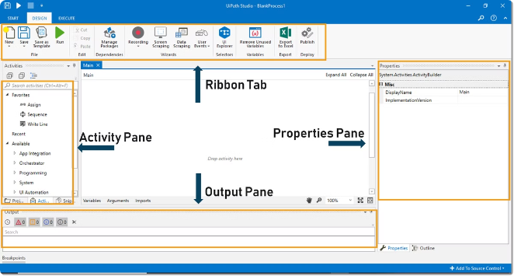
Step-by-Step Example Using Sequence and Flowchart
1
Design Workflow
Start by mapping out the steps of your automation process using a flowchart or sequence diagram.
2
Implement Sequence
Construct the workflow in UiPath using the Sequence activity, which executes each step in a linear, top-to-bottom order.
3
Test and Refine
Run the automation and make any necessary adjustments to ensure it functions correctly.

Slide 3
Breakdown of the Sequence and Flowchart Approach
Advantages
Limitations
Intuitive, easy-to-understand workflow design.
Limited flexibility for complex or branching processes.
Suitable for automations with a clear, linear process.
Difficulty in representing parallel or conditional logic.
Straightforward debugging and error handling.
Potential for long, unwieldy sequences as complexity increases.

Slide 4

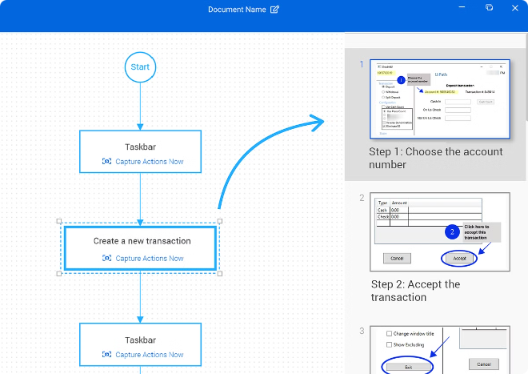
Step-by-Step Example Using Sequence and Control Flow
1
Design Workflow
Identify the key decision points and branching logic in your automation process.
2
Implement Sequence
Use the Sequence activity as the foundation, then incorporate Control Flow activities (e.g., If/Else, Switch, While) to handle conditional logic.
3
Test and Refine
Thoroughly test the automation to ensure it handles all possible scenarios and edge cases.

Slide 5
Breakdown of the Sequence and Control Flow Approach
Advantages
Limitations
Increased flexibility for handling complex, branching processes.
May require more upfront planning and design effort.
Ability to represent parallel and conditional logic effectively.
Increased complexity can make the workflow less intuitive.
Improved maintainability and scalability as complexity grows.
Debugging and error handling can be more challenging.

Slide 6
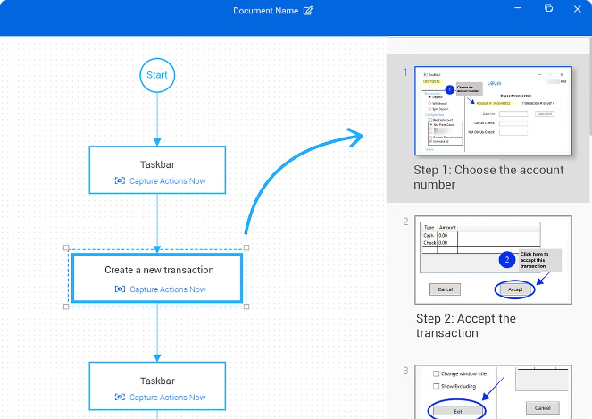
Comparison of Sequence and Flowchart vs. Sequence and Control Flow
1
Simplicity vs. Flexibility
Sequence and Flowchart are simpler to understand and implement, while Sequence and Control Flow offer more flexibility for complex processes.
2
Debugging and Error Handling
Sequence and Flowchart workflows are generally easier to debug and handle errors, while Sequence and Control Flow can be more challenging.
3
Scalability and Maintainability
Sequence and Control Flow workflows are better equipped to scale and remain maintainable as complexity increases.

Slide 7

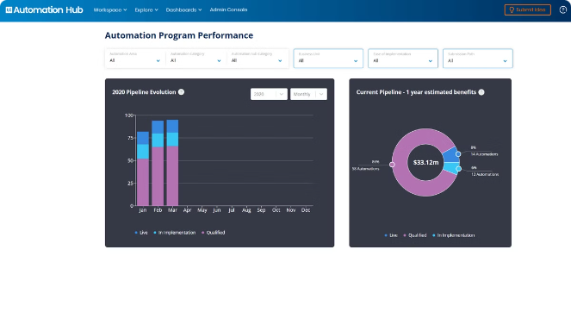
Best Practices for Effective UiPath Automation
Identify Suitable Processes
Carefully evaluate which tasks and workflows are best suited for automation, considering factors like repeatability, rules-based nature, and time-saving potential.
Design for Scalability
Build your automations with future growth and expansion in mind, using modularity, reusable components, and robust exception handling.
Implement Effective Monitoring
Incorporate logging, error reporting, and performance tracking to ensure your automations are running smoothly and provide valuable insights for optimization.
Foster Continuous Improvement
Regularly review and refine your automations, incorporating user feedback and leveraging new UiPath features to enhance efficiency and effectiveness.

Slide 8


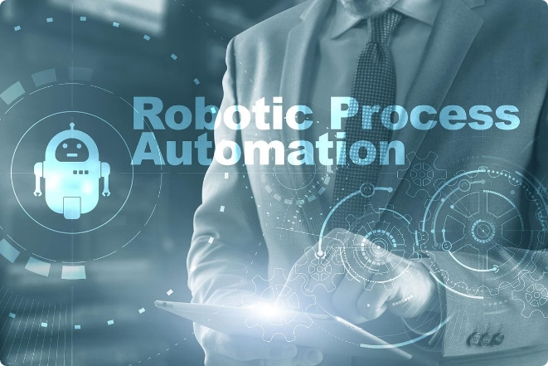


Conclusion and Key Takeaways
Flexibility
UiPath offers multiple approaches to automation, each with its own strengths and trade-offs.
Best Practices
Adopting effective design, implementation, and maintenance strategies is crucial for successful UiPath automations.
Continuous Improvement
Regularly reviewing and refining your automations will help you maximize their efficiency and impact.

