Slide 1
Sprite (computer graphics)

Slide 2
  In computer graphics, a sprite is a two-dimensional image or animation that is integrated into a larger scene. Initially including just graphical objects handled separately from the memory bitmap of a video display, this now includes various manners of graphical overlays.

Slide 3
Types Of Sprites:
Hardware sprites
Sprites by software
Sprites by CSS

Slide 4
Hardware sprites
In early video gaming, hardware sprites were a method of compositing separate bitmaps so that they appear to be part of a single image on a screen.
These contrasted with software and blitter methods of 2D animation which modify a framebuffer held in RAM, which required more memory cycles to load and store the pixels, sometimes with an additional mask, and refresh backgrounds behind moving objects.

Slide 5
Sprites by software
Many popular home computers of the 1980s lack any support for sprites by hardware. The animated characters, bullets, pointing cursors, etc. for videogames (mainly) were rendered exclusively with the CPU by software, as part of the screen video memory in itself. Hence the term software sprites.

Slide 6
  Mainly, two distinct techniques were used to render the sprites by software, depending on the display hardware characteristics:
Transparent color
Binary image masks

Slide 7
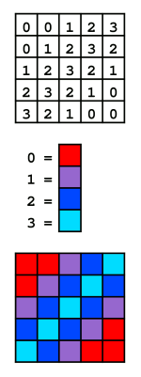
Transparent color, mainly for systems with indexed color displays
A 2-bit indexed color image. The color of each pixel is represented by a number; each number (the index) corresponds to a color in the color table (the palette).

Slide 8
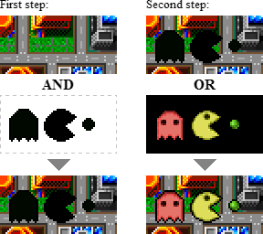
Binary image masks, mainly for systems with bitmapped video frame buffers.

Slide 9
Sprites by CSS
To reduce the number of requests the browser makes to the server, some web designers combine numerous small images or icons into a larger image called a sprite sheet or tile set
CSS is used to select the parts of the composite image to display at different points in the page.
If a page has ten 1 kB images, they can be combined into one 10 kB image, downloaded with a single HTTP request, and then positioned with CSS.
Reducing the number of HTTP requests can make a Web page load much faster.
In this usage, the sprite sheet format that had been developed for use in game and animation engines is being applied to static images

Slide 10
  Advantages of using CSS sprites
Performance - Fewer HTTP requests means less overhead.
Automatic preloading - In situations where you have an image which isn't displayed until some user interaction happens (e.g. a hover state), you will often see a flicker as the browser loads the new image. It is possible to preload such images, but using CSS sprites ensures that this happens automatically.

Slide 11
  Disadvantages
Perceived load speed - Even though CSS sprites can often be used to increase a page's overall load speed, this can come at the cost of perceived speed. The browser needs to load the entire sprite sheet before it can display any of the images within that sheet. For large pages, it may be preferable to load the images individually so that the top of the page can finish rendering before the entire page has loaded.
Development workflow - It can be inconvenient for a development workflow to be required to regenerate a sprite sheet whenever you add an image to your project. Depending on the method used to generate and manage the sprite sheet, this can range from a minor annoyance to a significant waste of productivity

Slide 12
Application:
For characters and other moving objects in video games.
For mouse pointers
For writing letters to the screen.
For on-screen moving objects larger than one sprite's extent, sprites may sometimes be scaled and/or combined.

Slide 13
S imple and
    Fast Multimedia Library

Slide 14
SFML is multi-media
SFML provides a simple interface to the various components of your PC, to ease the development of games and multimedia applications. It is composed of five modules: system, window, graphics, audio and network.

Slide 15
SFML is multi-platform
With SFML, your application can compile and run out of the box on the most common operating systems: Windows, Linux, Mac OS X and soon Android & iOS.

Slide 16
SFML is multi-language
SFML has official bindings for the C and .Net languages. And thanks to its active community, it is also available in many other languages such as Java, Ruby, Python, Go, and more.

Slide 17
OpenGl or SDL or SFML?
OpenGL is just an API to talk to your graphics hardware - for rendering.
SDL and SFML are libraries which act as an abstraction layer between your program and the operating system.
While OpenGL is an API for 2D and 3D rendering, SDL and SFML are libaries that offer you (easy) access to audio, input, graphics, the windows system (not exclusive).
SDL or SFML, Both have an accelerated 2D rendering API that uses OpenGL under the hood , even though it might have been quite nice to create a window in less than 100 lines.

Slide 18
Thank You!!!
Made By:
Jasmine Kaur (1258)
Simranpreet Kaur (1203)
(B.Tech Comp. Sc.)

