Slide 1
Job Salary Prediction
By,
Simranjit Singh Sachar
Gaurav Wadhwani
& Shreya Dubey

Slide 2
Problem Statement
Predict the salary of job advertisement based on its description and other structured data fields
This would improve the user experience for jobseekers and employers alike & also bring more transparency to the overall process
Only about half of the job ads listed on the website have a salary publicly displayed
Problem was hosted by Adzuna, a UK based classified ads website
Problem and the dataset were hosted on kaggle.com

Slide 3
Data Source
The dataset was mostly unstructured text, with a few structured data fields.
It mainly consisted of a large number of rows representing individual job ads, and a series of fields about each job ad.
Because almost all of the data was in word form we had to find and learn a program that would allow us to break down these words and match certain job descriptions with job titles in order to predict that salary

Slide 4
Variables
Id - A unique identifier for each job ad
Title - A freetext field supplied to us by the job advertiser as the Title of the job ad. Normally this is a summary of the job title or role.
FullDescription - The full text of the job ad as provided by the job advertiser.
LocationRaw – The location as provided by the job advertiser.
LocationNormalized - Adzuna's normalised location from within our own location tree, interpreted by us based on the raw location. Our normaliser is not perfect!
ContractType - full_time or part_time, interpreted by Adzuna from description or a specific additional field received from the advertiser.
ContractTime - permanent or contract, interpreted by Adzuna from description or a specific additional field received from the advertiser.
Company - the name of the employer as supplied by the job advertiser.
Category - which of 30 standard job categories this ad fits into
SalaryRaw – the salary field received in the job advert from the advertiser.
SalaryNormalised - the annualised salary interpreted by Adzuna from the raw salary. This is always a single value based on the midpoint of any range found in the raw salary. This is the value we are trying to predict.
SourceName - the name of the website or advertiser of the job advert.

Slide 5
Natural Language Processing
Unstructured data anlaysis on Job Description and Job Titles.
Data cleaning -> Tokenization, stemming, exclude stopwords, filter junk values.
Text Parsing: Used Python-NLTK to determine Tf-idf (Term frequency inverse document frequency) for feature analysis of job Title.
Bag of Words: Used High Frequency counts for determining bag of words for Job description and used that as a feature in our models.

Slide 6
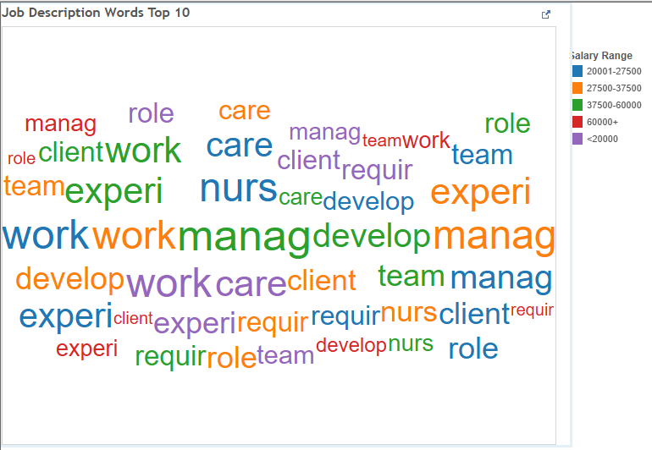
Word Frequency – Job Description

Slide 7
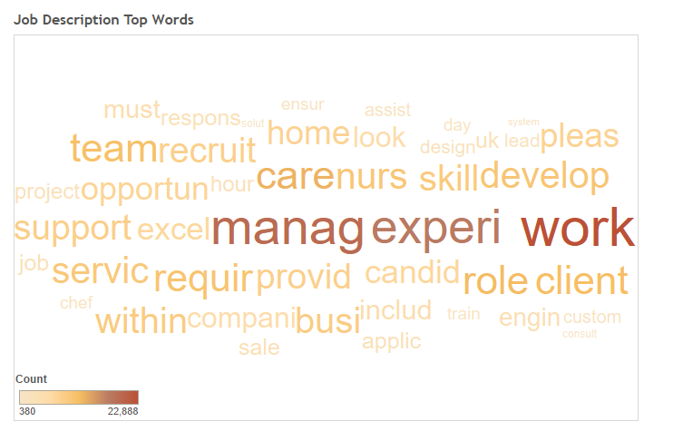
Word Frequency – Job Description

Slide 8
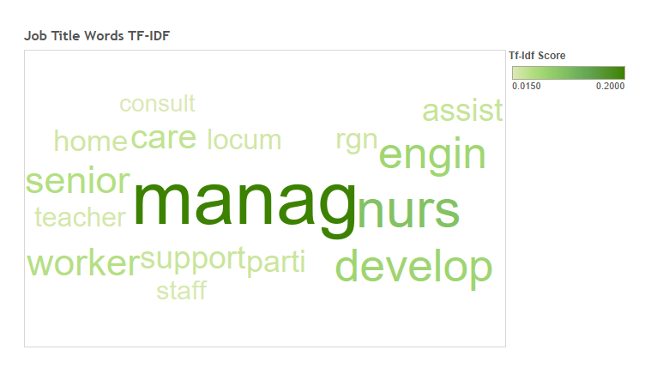
TF-IDF - Job Title

Slide 9
Exploratory Data Analysis
Analyzed different parameters before feature generation
Example: Number of jobs for different categories and their average salaries
Analysis on job title and description based on seniority. Example: Inter, Senior Analyst, Junior Analyst etc.
Distribution over contract parameters

Slide 10
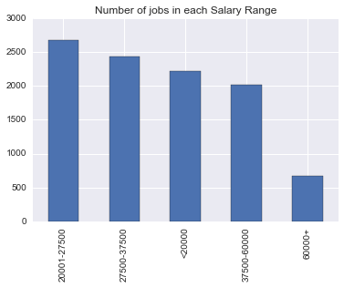

Slide 11
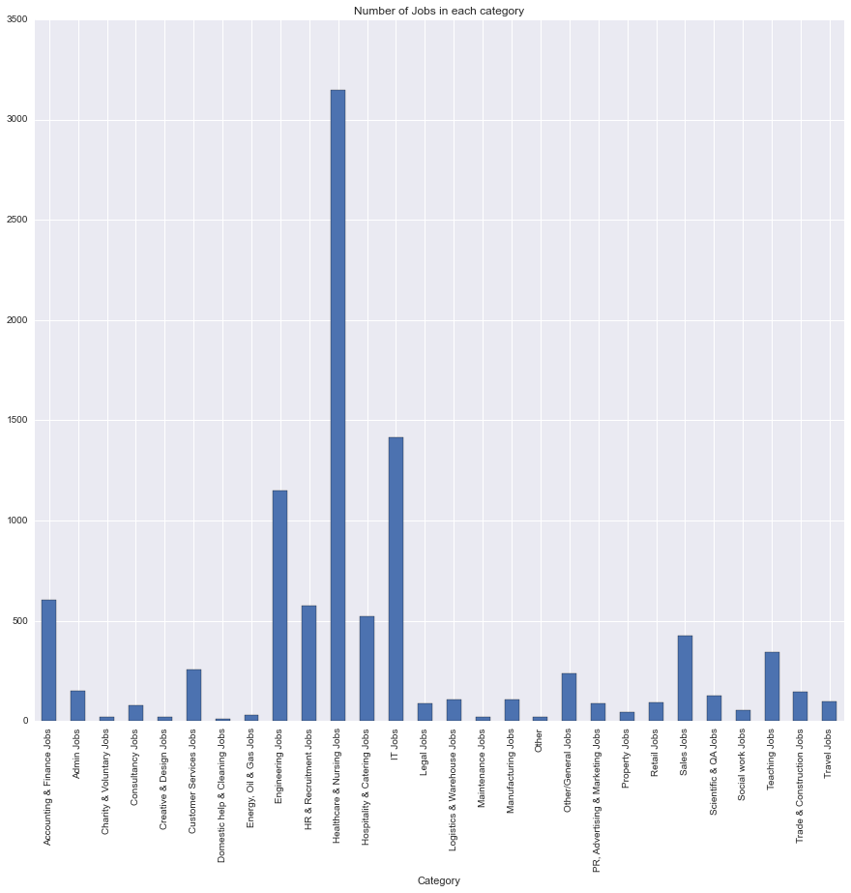

Slide 12
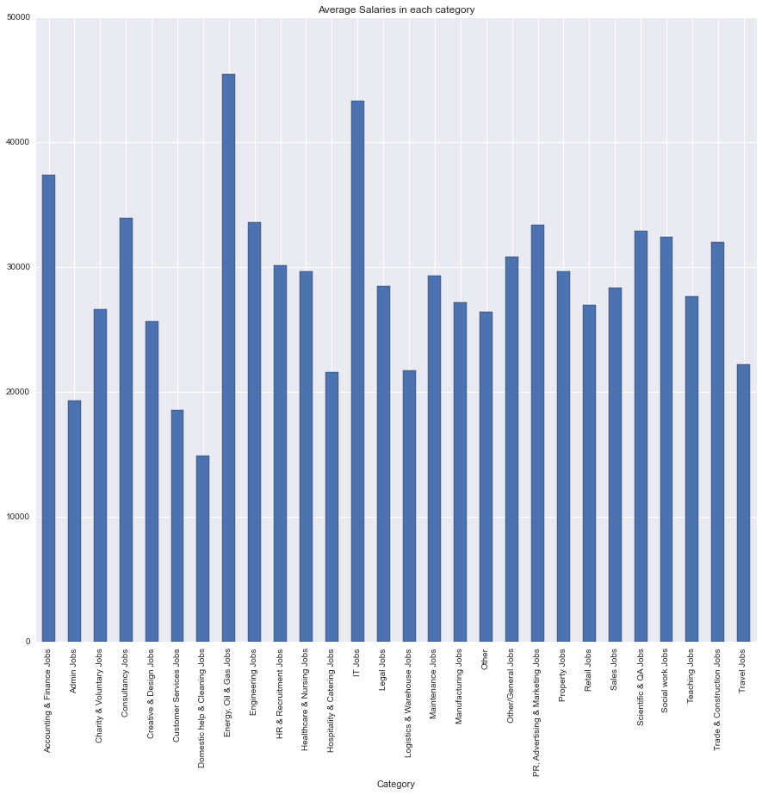

Slide 13
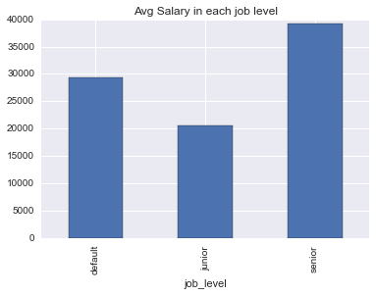

Slide 14
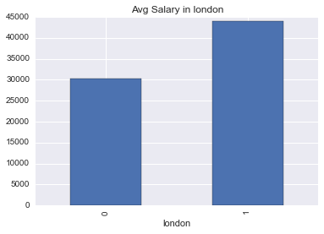

Slide 15
Regression or Classification?
This competition on Kaggle expected MAE as the evaluating criteria, hence it was a regression problem
We worked on this problem using both approaches
Divided the normalized salary into bins for classification problem
Used 80-20(train-validation) split for both the approaches

Slide 16
Feature Engineering
Feature -1 : Bag of Words
Job Title
Description
Location Raw
Location Normalized
Feature – 2 :
Feature 1 + Category
Feature -3 :
Feature 2+ Contract Type + Contract Time

Slide 17
Regression
Used the following models for Regression:
Random Forest Regressor
Decision Tree
Extra Trees Regressor
To evaluate a regressor model we used MAE and MSE as the evaluating criteria
MAE – Mean Absolute Error
MSE – Mean Squared Error

Slide 18
Regression Results
MODEL | FEATURE | MAE
Random Forest Regressor | F-1 | 7676.68
Random Forest Regressor | F-2 | 7217.21
Random Forest Regressor | F-3 | 7012.14
Decision Tree | F-3 | 9258.98
Extra Trees Regressor | F-3 | 6839.547

Slide 19
Classification
Used the following models for Classification:
Random Forest Classifier
Naïve Bayes
Support Vector Machine(SVC)
Extra Trees Classifier
To evaluate a classifier model we used Accuracy as the evaluating criteria and also used Confusion Matrix & Classification Report for further analysis

Slide 20
Classification Results
MODEL | FEATURE | ACCURACY
Random Forest Classifier | F-1 | .5709
Random Forest Classifier | F-3 | .5820
Random Forest Classifier | F-4 | .5910
Support Vector Machine | F-4 | .5333
Naïve Bayes | F-4 | .4581
Extra Trees Classifier | F-4 / F-3 | .6126

Slide 21
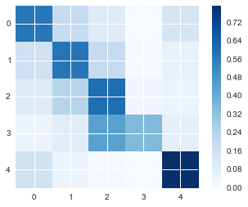
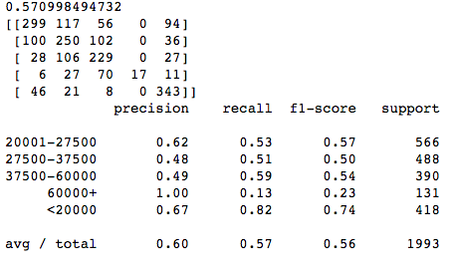
Confusion Matrix

Slide 22

Any Question?

