Slide 1
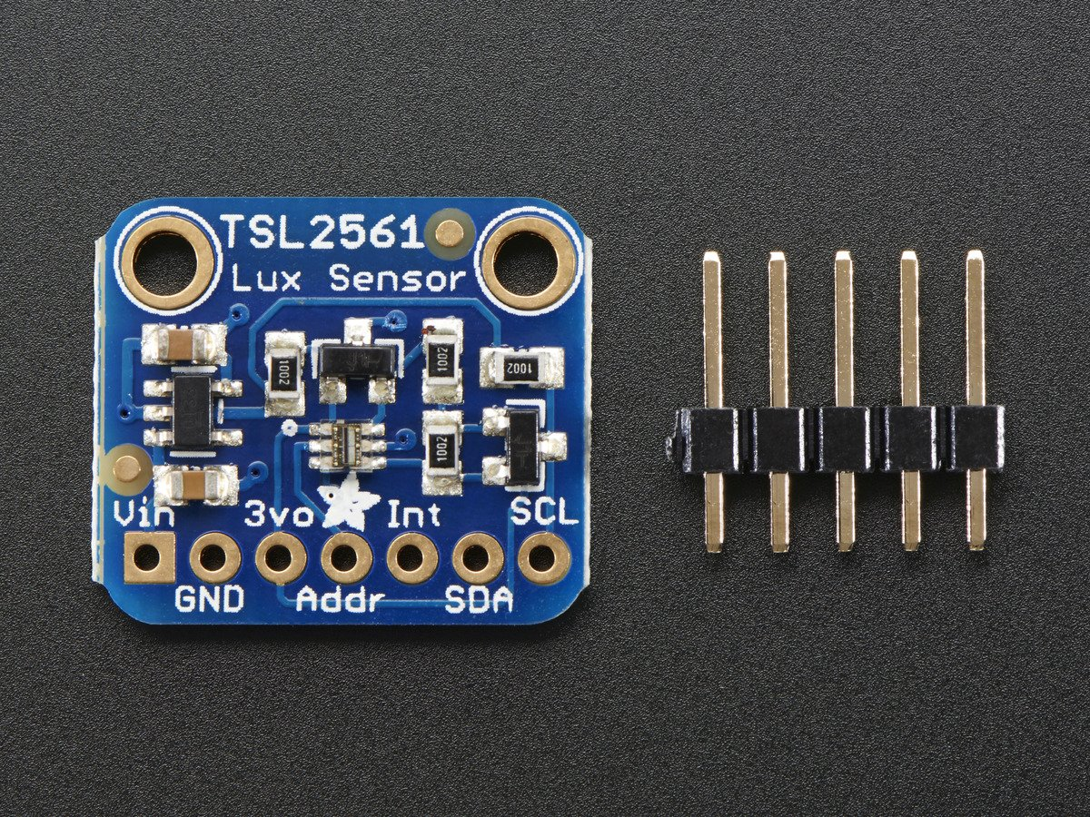
TSL2561
Lumi-Monitor
By:Harsimran Saini

Slide 2
Introduction
TSL2561 – Luminosity Sensor
The luminosity sensor is going to dim and brighten the light of the lumi-monitor according to the light level in the room

Slide 3
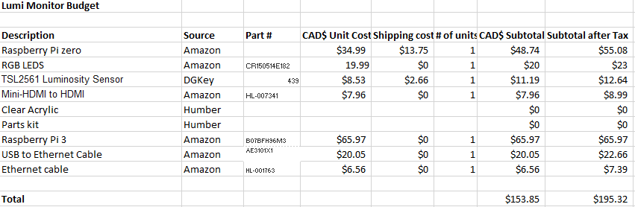
Budget

Slide 4
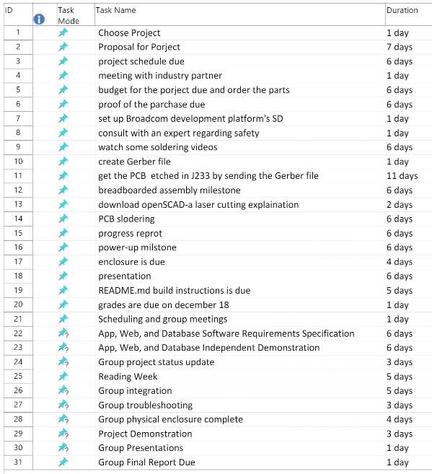
Schedule

Slide 5
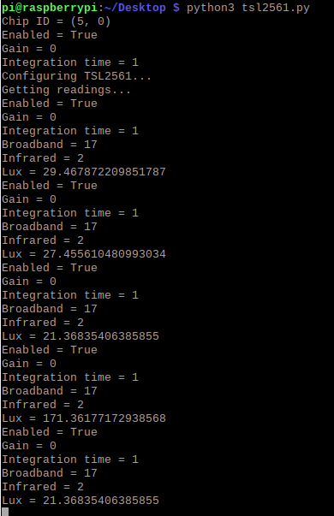
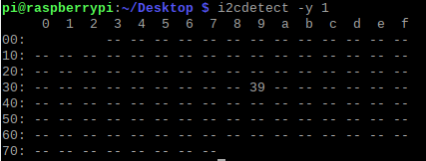
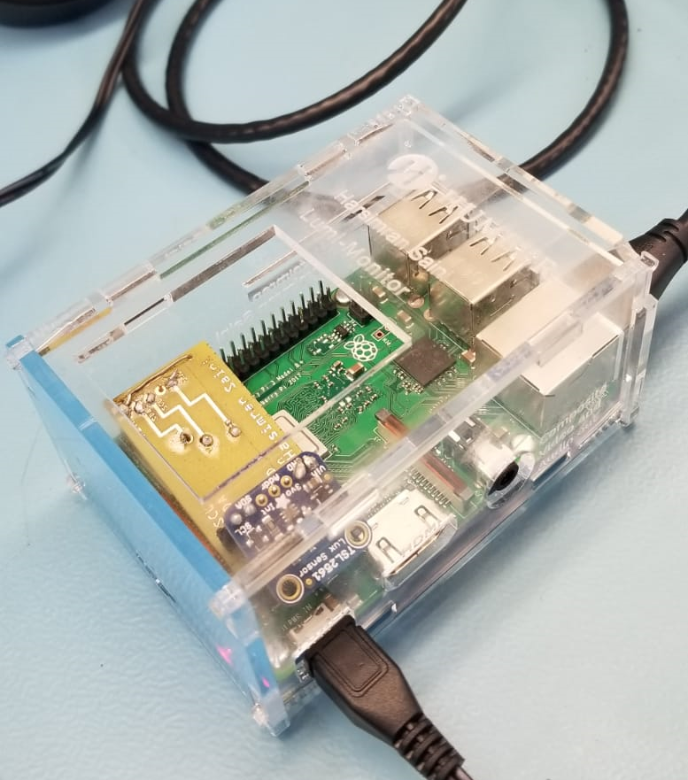
Images
Address

Slide 6
Course knowledge utilized from previous courses
TECH 101 – ELECTRIC CIRCUITS
CENG 216 – INTRO TO SOFTWARE ENGINEERING
CENG 252 – EMBEDDED SYSTEMS
CENG 200 – UNIX SCRIPTING

