Slide 1


CONCRETE ARCHITECTURE
BY: ANALYSIS PARALYSIS
Presented by:
Harsimran Saini - 215604960
Aisha Mahmood - 217714189
Siddhanth Bakshi - 218305144
Esha Vij - 218123307
Harrish Elango - 218187781
Adewusi Fashokun - 218329540

Slide 2
TABLE OF CONTENTS
01
Cluster Manager
09
NoteWorthy Aspects
02
Efficiency
10
Component Sequence Diagram
03
Architectural Diagram
11
Reflexion Model
04
12
Demo
Use Cases
05
Derivation Process
13
Lessons Learned + Limitations
06
14
References
Architectural Styles
07
Design Patterns
08
Master-Slave Sequence Diagram

Slide 3
Cluster Manager
The main purpose of this assignment is to cover the Cluster Manager and its underlying architecture and significance within the Flink.
The Cluster Manager comprises the following components within the system:
Job Manager
Job Master
Task Manager
Resource Manager
The cluster manager leverages these components and other sub-components within the system to manage the deployment and execution of the Flink Jobs.

Slide 4
Unlocking Efficiency: The Crucial Role of Cluster Manager
The cluster manager uses the mentioned components to ensure the following processes within the pipeline:
Resource Management: The cluster manager is responsible for managing the resources for the Flink jobs.
Job Submission: The cluster manager offers a “Dispatcher” which allows a REST API to submit a Flink Job and attach a Job Master with every new submitted job.
Fault Tolerance: It can automatically recover failed tasks and ensure proper functioning of Flink in case of software or hardware failure.
Scalability: It can increase or decrease the parallelism of Flink tasks based on workload and resource availability

Slide 5
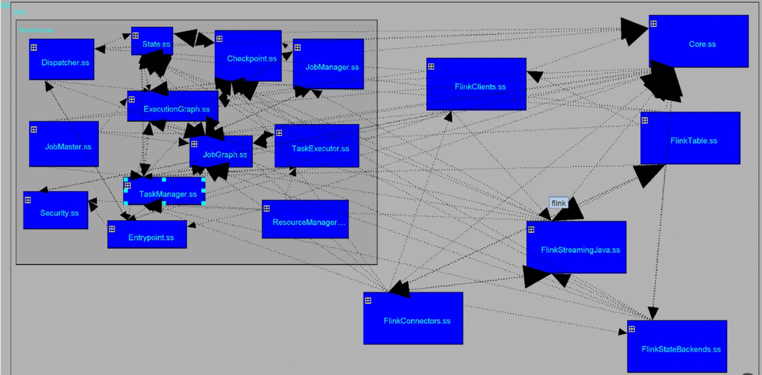
Architectural Diagram

Slide 6


Slide 7
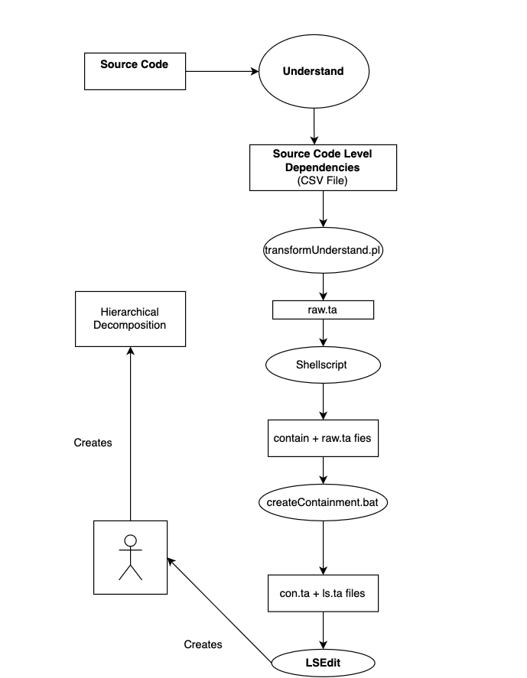
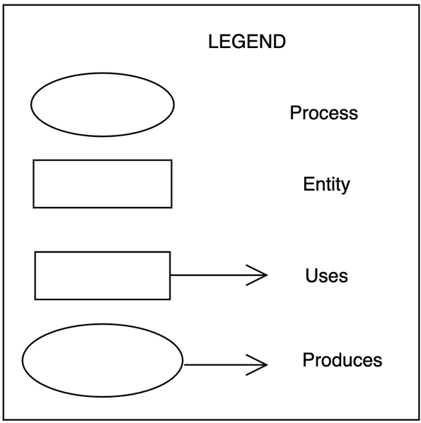
DERIVATION
PROCESS

Slide 8
ARCHITECTURAL STYLES
Client-Server: Systems/applications submit jobs to the Flink cluster via a REST API exposed by the Dispatcher for processing, using one of Flink’s APIs. This also enables the monitoring the status of the cluster and its jobs (both running and recently executed).
Master-Slave: A single JobManager node serves as the master, assigning work to the TaskManagers. The JobManager keeps track of distributed tasks and decides when to schedule them, as well as what TaskManager the task(s) is passed to.
Pipe-and-filter: Flink makes use of this architectural style to batch and process realtime data. It is also used in stream processing, where Flink events are passed to message queues who in turn pass them over to the Window Operator, to process the events.

Slide 9
Design Patterns
Singleton Pattern
Resource Management
Observer Pattern
Master/Slave Pattern
Builder Pattern
ensures the Flink cluster session is managed with only a single instance of the cluster manager
adopts a centralized approach to allocate and release resources for Flink jobs in Apache Flink.
define mechanisms like JobManager, TaskManagers, and Flink Sessions.
the JobManager serves as the master node, while the TaskManager acts as the slave node. This design allows for concurrent processing within Cluster Management.
is utilized in cluster management to create different representations of objects or job configurations using a set of function arguments.

Slide 10
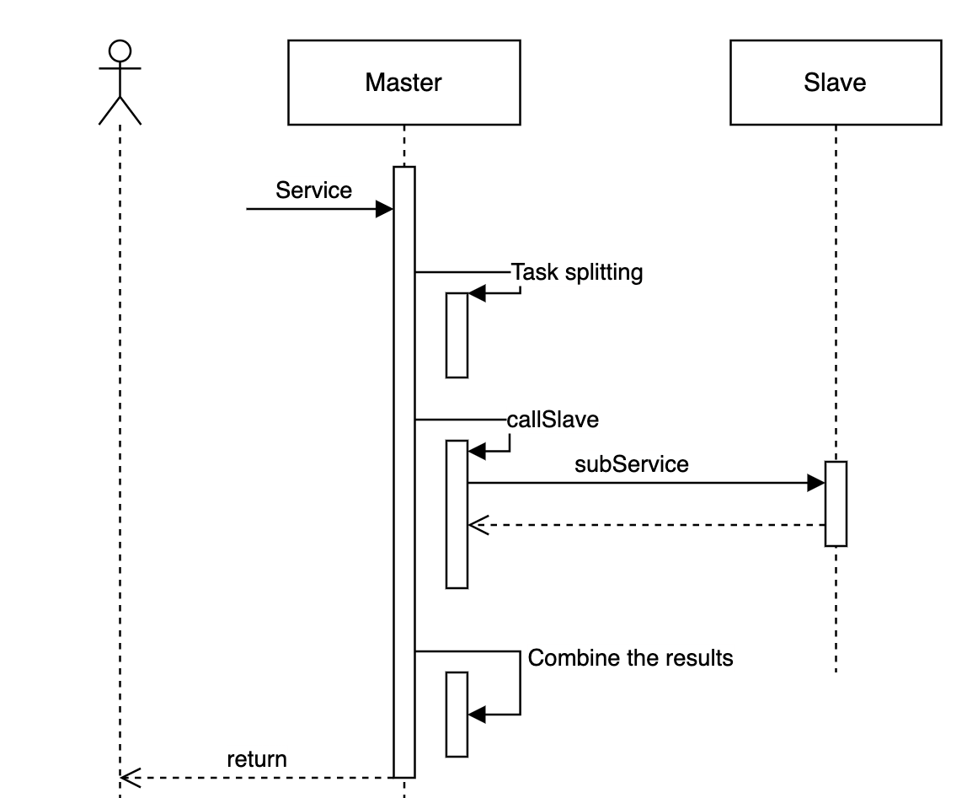
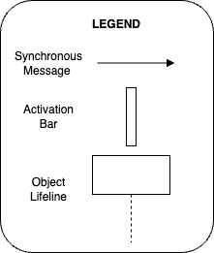
MASTER-SLAVE SEQUENCE DIAGRAM

Slide 11
NOTEWORTHY ASPECTS
The Cluster Manager coordinates: resource allocation, task scheduling, resource cleanup, health monitoring, and failure recovery within the system.
The Cluster Manager communicates with Flink’s underlying components. Some of these include: ResourceManager, Scheduler, Health Monitoring and Reporting components and Resource Cleanup components.
The ResourceManager is responsible for resource distribution and management.
The Scheduler, determines when and where Flink jobs execute.
The Health Monitoring and Reporting components actively evaluate the cluster and its components.
The Resource Cleanup components release unused resources.

Slide 12
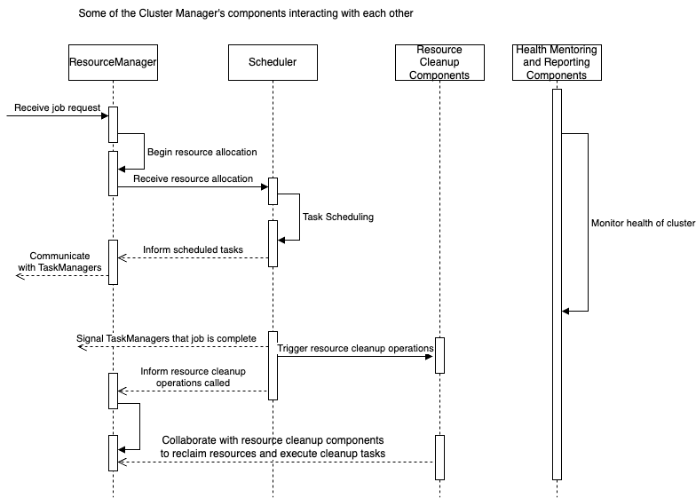
COMPONENT SEQUENCE DIAGRAM

Slide 13
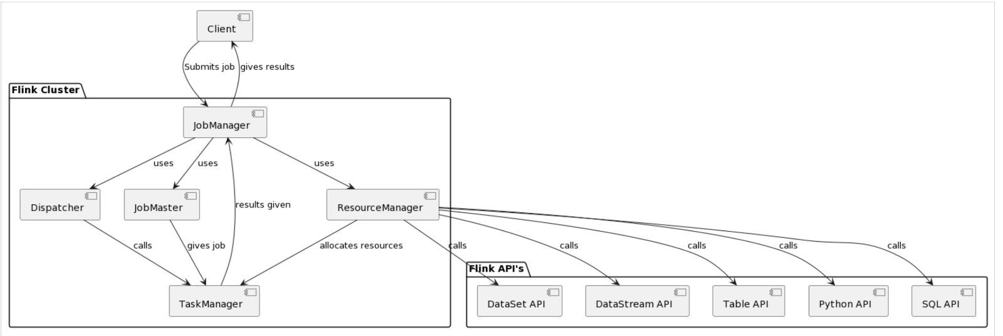
Reflexion Model
Figure 1: Conceptual Architecture of Apache Flink from Assignment 1
Concrete Architecture has many more dependencies than the conceptual architecture so its hard to pinpoint the most important ones .

Slide 14



USE CASES
Resource Management
Job Coordination
Scalability
E-Commerce Website
Used in many Financial institutions as fraud detection
Used to process real-time location data to match users to the nearest riders

Slide 15
LESSONS LEARNED LIMITATIONS
Prior knowledge of analytic tools for expedited architectural insights.
Improved proficiency in tools like Understand for faster mapping procedures.
Cooperative strategy for Cluster Manager's design examination.
Benefits of diverse ideas, varied viewpoints, and cross-verification for comprehensive insights.
Avoiding sole reliance on one tool, exploring multiple analytic tools for a holistic understanding of subsystem architecture

Slide 16
REFERENCES
https://flink.apache.org/2020/12/02/improvements-in-task-scheduling-for-batch-workloads-in-apache-flink-1.12/
https://nightlies.apache.org/flink/flink-docs-release-1.11/concepts/flink-architecture.html
https://refactoring.guru/design-patterns/creational-patterns
https://www.eventhelix.com/design-patterns/resource-manager/#:~:text=The%20resource%20manager%20design%20pattern,resource%20usage%20in%20the%20system.
https://docs.gigaspaces.com/solution-hub/master-worker-pattern.html#:~:text=The%20Master%2DWorker%20Pattern%20(sometimes,a%20Master%20and%20multiple%20Workers%20.
https://flink.apache.org/how-to-contribute/code-style-and-quality-java/

