Slide 1
Query Processing in a Multidatabase System

Slide 2
Introduction
Multiple autonomous databases
Relational model
Standard SQL at each participating node
How can we issue a global query and get answers back from the participating databases?
Some of the problems to consider:
Schema mismatches
Semantic incompatibilities
Gathering local results

Slide 3


Setting
Multi DB
Metadata Manager
Local DB
Local DB
Subquery Results
Local DB

Slide 4
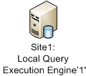
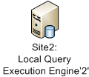
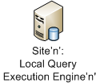
Architecture of a MDBS
Canonical Global Query
Metadata Manager
Global Query Modifier/Decomposer
Post-Processing Engine
Local Query Wrapper
Subquery Results

Slide 5
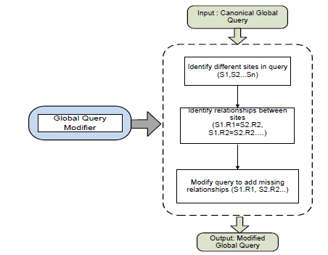
Global Query Modifier

Slide 6
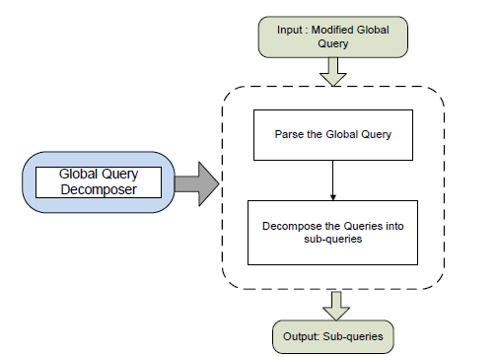
Global Query Decomposer

Slide 7
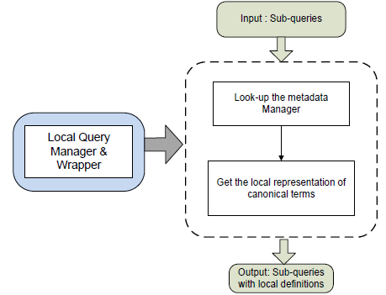
Local Query Wrapper

Slide 8
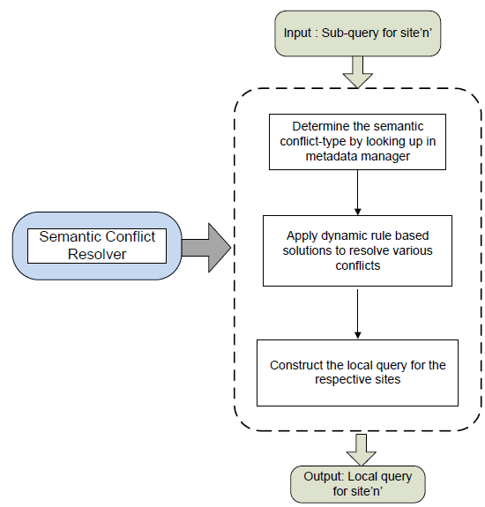
Semantic Conflict Resolver

Slide 9
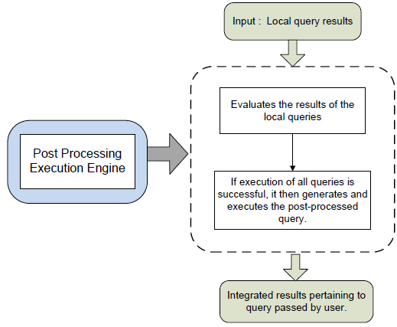
Post-processing

Slide 10
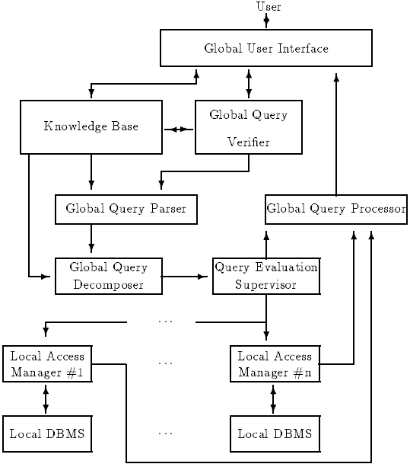
Omnibase Architecture

Slide 11
Example Query Flow
DB1
EMP (SSN, Name, Salary, Sex, Depno, Address)
DEPT (Deptno, Dname, MgrSSN, Budget)
DB2
EMPLOYEE (SSN, Name)
PROJECT (Projno, Projname, Leader_SSN)
WORKS_ON (SSN, Projno, Hrsperweek)
List name, project name, hrsperweek for employees in the “Research” dept who work more than 10 hours per week

Slide 12
Global Query
What is the Global Query?

Slide 13
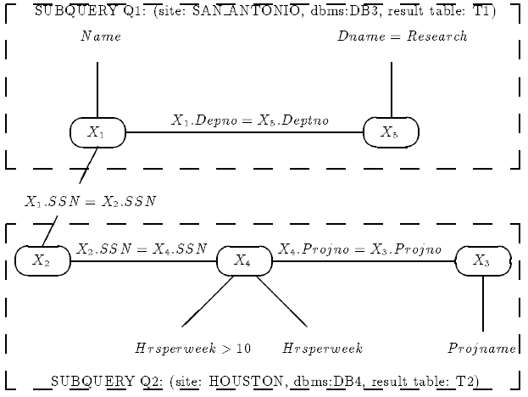
Global Query Decomposition

Slide 14
Subquery 1
SELECT Name, SSN
FROM EMP, DEPT
WHERE Dname = ‘Research’
AND EMP.Depno = DEPT.Deptno

Slide 15
Subquery 2
SELECT SSN, Projname, Hrsperweek
FROM EMPLOYEE, WORKS_ON, PROJECT
WHERE
WORKS_ON.hoursperweek > 10 AND
EMPLOYEE.ssn=WORKS_ON.ssn AND
WORKS_ON.projno = EMPLOYEE.projno

Slide 16
Post-processing
Subquery 1 generated a table TEMP1(Name, SSN)
Subquery 2 generated a table TEMP2(Hrsperweek, Projname, SSN)

Slide 17
Post-processing query
What is the final post-processing query?
Post-processing on the Temp tables:
SELECT Name, Projname, Hrsperweek
FROM Temp1, Temp2
WHERE Temp1.SSN = Temp2.SSN

Slide 18
Questions?

Slide 19
Questions?

