Slide 1

From Cat Stabilization to Quantum Readout
ALICE & BOB CHALLENGE · DUQUANTUM 2026
Introductory Track complete, extended into the Standard Track
Simran Malik
Background: Wigner function of our simulated cat, full memory + buffer model, t = 1 μs
Notes:
~15 s. We entered the Introductory Track, finished every task, then pushed into the Standard Track readout problem. The image behind us is our own simulation: the cat state, two blobs with interference fringes between them.

Slide 2
Why cat qubits?
THE PHYSICS
Memory a
stores the cat
Buffer b
leaks fast
g₂ (a²b† + h.c.)
photons swap in pairs
κb loss
to the readout line
κa loss the unwanted part
εd drive sets α² = εd / g₂
|+α⟩ and |−α⟩
Two stable wells are the logical 0 and 1
Bit flips ∝ e^(−γα²)
Shrink exponentially as the cat grows
Phase flips ∝ 2κa α²
Grow only linearly: the price of a bigger cat
Notes:
~30 s. The memory holds the cat. The buffer exchanges photons with it two at a time and leaks quickly, so the memory only loses photons in pairs. That pins it to two coherent states, plus and minus alpha, our logical 0 and 1. Bigger cats make bit flips exponentially rarer, but phase flips only grow linearly. That bias is the whole point of cat qubits.

Slide 3
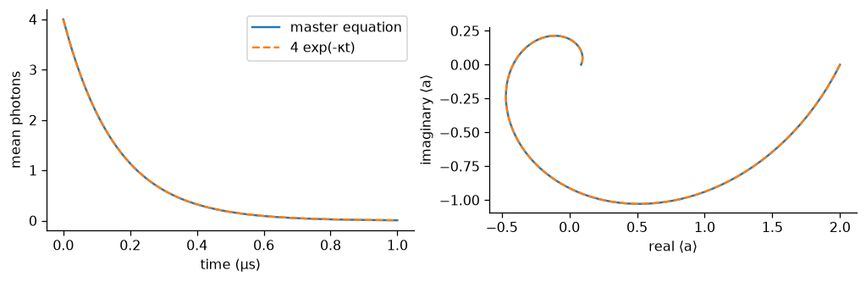
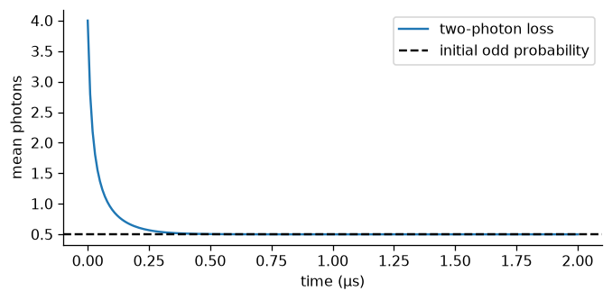
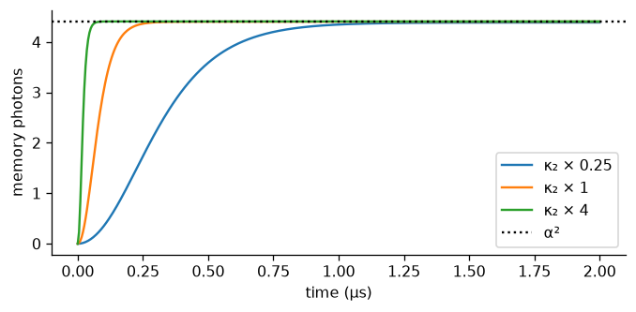
Engineering dissipation, one ingredient at a time
INTRODUCTORY · TASK 1.0
(a) One-photon loss: matches the analytic decay to 2×10⁻¹¹ photons
(b) Pair loss: stalls at 0.4998 photons, exactly the initial odd-parity probability
(c) Drive + pair loss: every κ₂ settles at α² = 4.41, a stable cat manifold
Notes:
~30 s. Three steps. One-photon loss just shrinks a coherent state, and we match the analytic curve. Pair loss alone gets stuck, because a-squared can never remove the last odd photon, so it stops at the odd-parity probability. Add the two-photon drive and it becomes a stabilizer: every kappa-2 lands on alpha squared = 4.41, it only changes how fast.

Slide 4
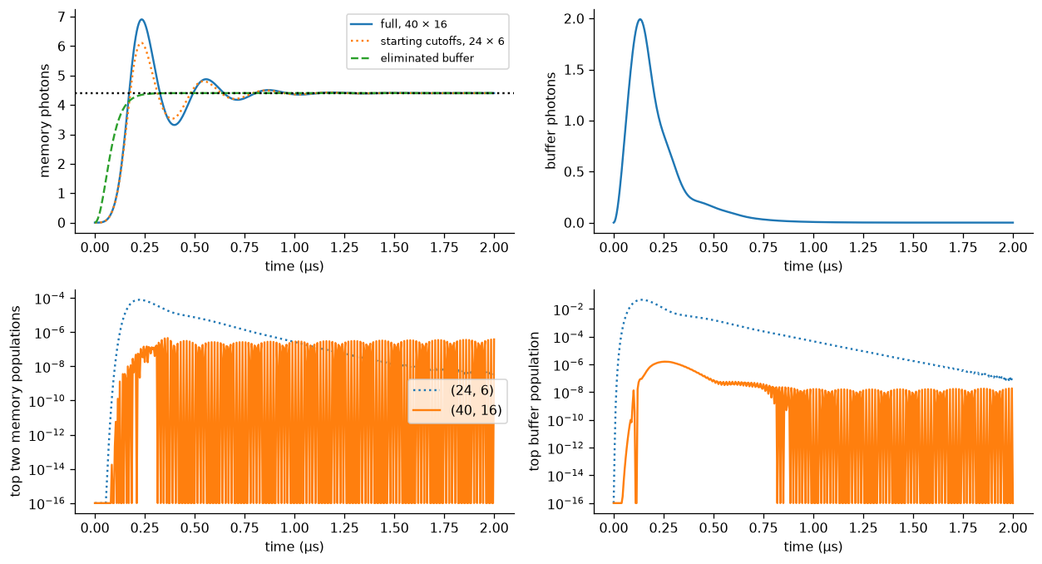
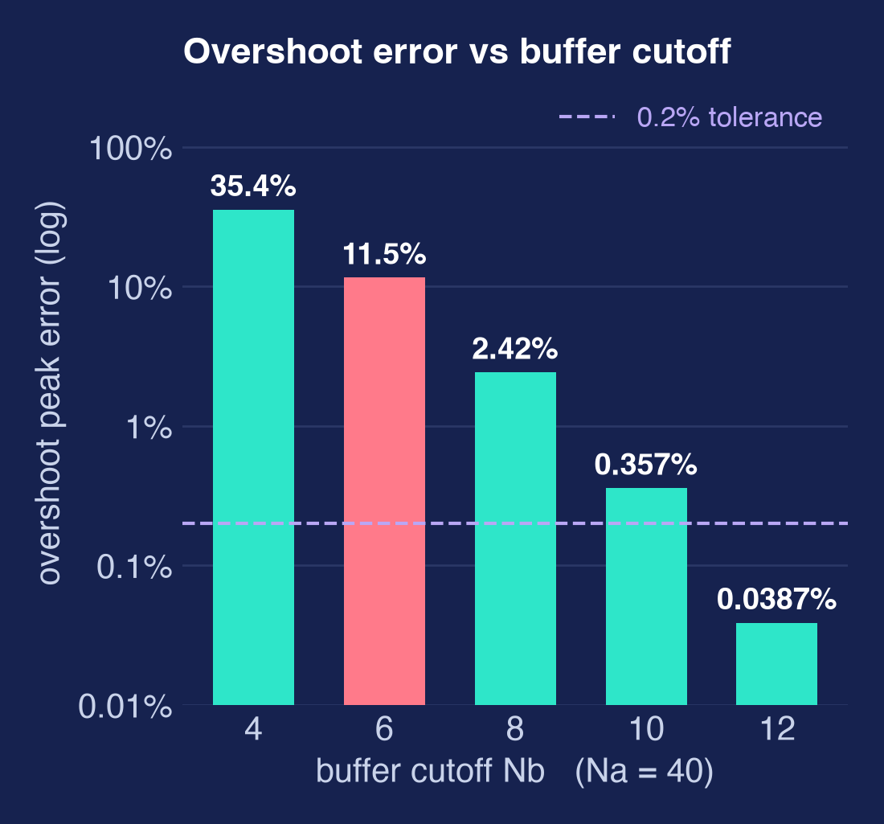
Beyond the ideal model: the buffer is real
INTRODUCTORY · TASKS 1.1–1.2
6.91
peak photons vs 4.41 target
4.402
final photons, converged
11.5%
peak error at suggested Nb = 6
Converged within 0.2%: peak needs Na ≥ 32 and Nb ≥ 12. The steady state passes at every cutoff we tried.
Notes:
~40 s. With a real buffer the memory overshoots to almost 7 photons before ringing down to 4.40. The effective model can't show this: g2/kappa_b is 0.29 and eps_d/kappa_b is 1.29, so the buffer isn't fast. The buffer briefly holds about 2 photons, so the suggested Nb = 6 misses the overshoot peak by 11.5%. We swept each cutoff separately: the steady state converges right away, the transient needs Na >= 32 and Nb >= 12.

Slide 5
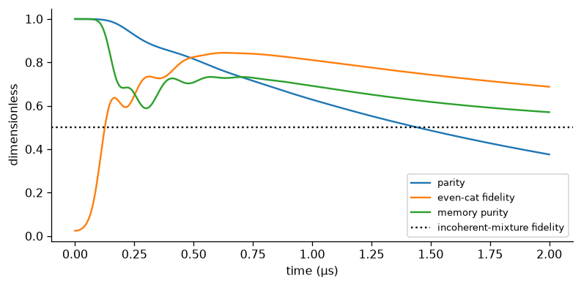
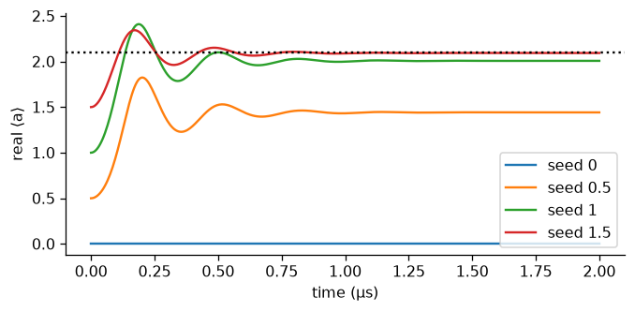
Preparing logical states
INTRODUCTORY · TASK 1.3
Vacuum makes a superposition
Why: pairs can't change parity, and vacuum has parity +1
Not a mixture: fidelity 0.844 vs 0.5 for a classical mixture, plus negative Wigner fringes
How long: parity 1/e time 1.96 μs (predicted 1.94 μs)
A definite bit: seed before inflating
Method: a small displacement breaks the ±α symmetry, then the stabilizer grows it
Result: seed 1.5 → fidelity 0.9988 with |+α⟩
Cost: a calibrated, phase-locked memory drive port
Notes:
~35 s. From vacuum we get the even cat, not one codeword: the stabilizer only moves photons in pairs, so parity stays +1 except for slow kappa_a loss. Fidelity hits 0.844, far above the 0.5 a classical mixture could reach, and the Wigner fringes go negative. It stays a cat for about 2 μs. For a definite bit, we seed a small displacement before inflating: seed 1.5 gives 99.9% fidelity. The cost is a phase-calibrated memory drive.

Slide 6
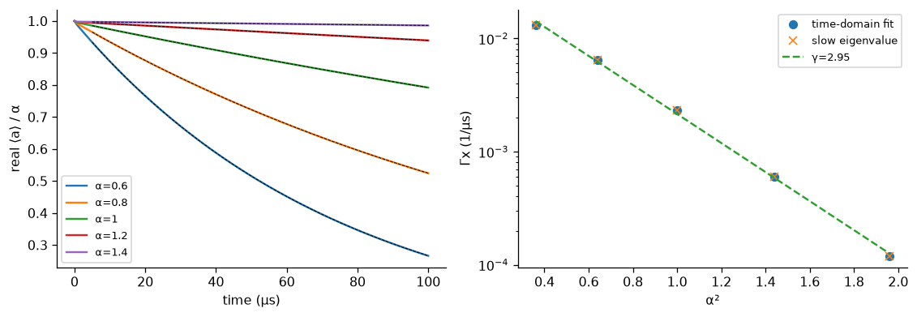
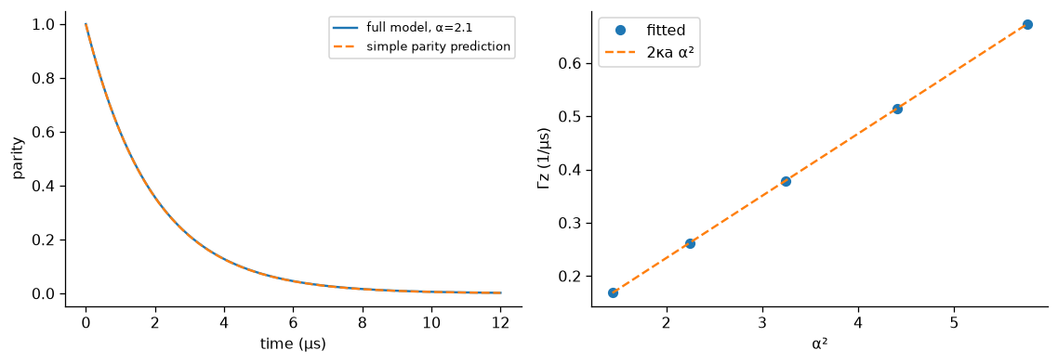
Characterizing logical errors
STANDARD · TASKS 2.1–2.2
γ = 2.95
bit flips ∝ e^(−γα²), α = 0.6–1.4; fit, eigenvalue and qutip all agree
0.1167
fitted Γz slope vs 2κa = 0.1169 (0.2% off)
Why γ > 2? There's no thermal noise in this model. A second-order loss process and finite cat size set the slope, not the naive e^(−4α²) overlap.
Notes:
~35 s. Bit flips: Re<a> decays slowly, and we fit it, then confirm with the slowest eigenvalue of the full two-mode generator and a qutip solve. The log-slope is gamma = 2.95: exponential suppression. Phase flips: parity decays at 2 kappa_a alpha squared, our slope matches to 0.2%. So bigger cats trade an exponential win on bit flips for a linear loss on phase flips.

Slide 7
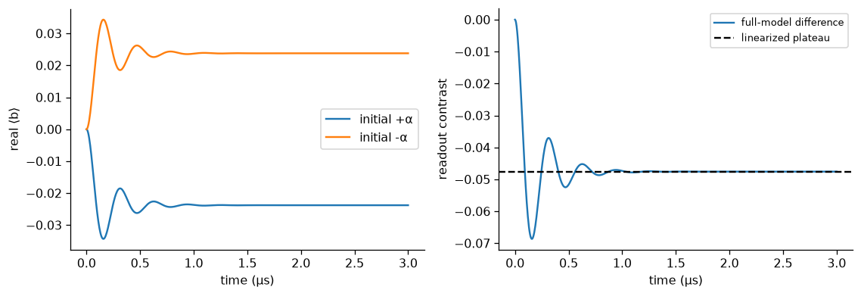
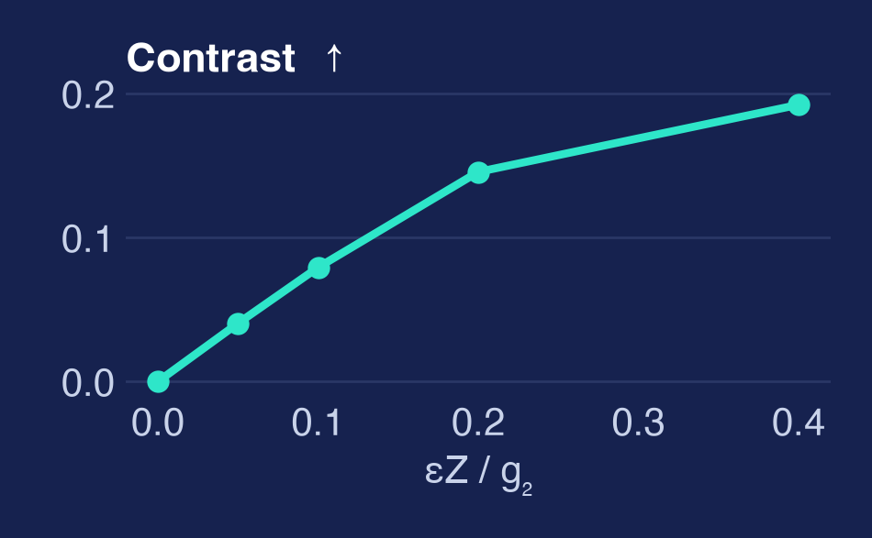
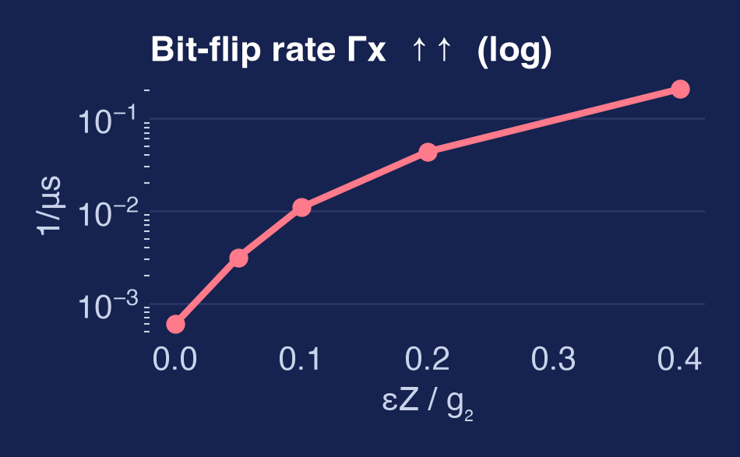
Reading the cat through the buffer
STANDARD · TASK 2.3
−0.048
contrast, matches linear estimate
0.82 μs
to settle within 2%, with ringing
The trade-off
Pushing harder makes the signal louder, but bit flips speed up ~350× by εZ = 0.4 g₂ (α = 1.2, where Γx is resolvable).
Notes:
~30 s. A weak memory drive pushes each well sideways, and the buffer answers with opposite signs for +alpha and -alpha. That difference is the readout. It matches the linear estimate and settles in about 0.8 μs, with ringing because the buffer isn't fast. The catch: driving harder gives more contrast but bit flips speed up roughly 350 times. The measurement disturbs what it measures. That's what Task 2.4 attacks.

Slide 8
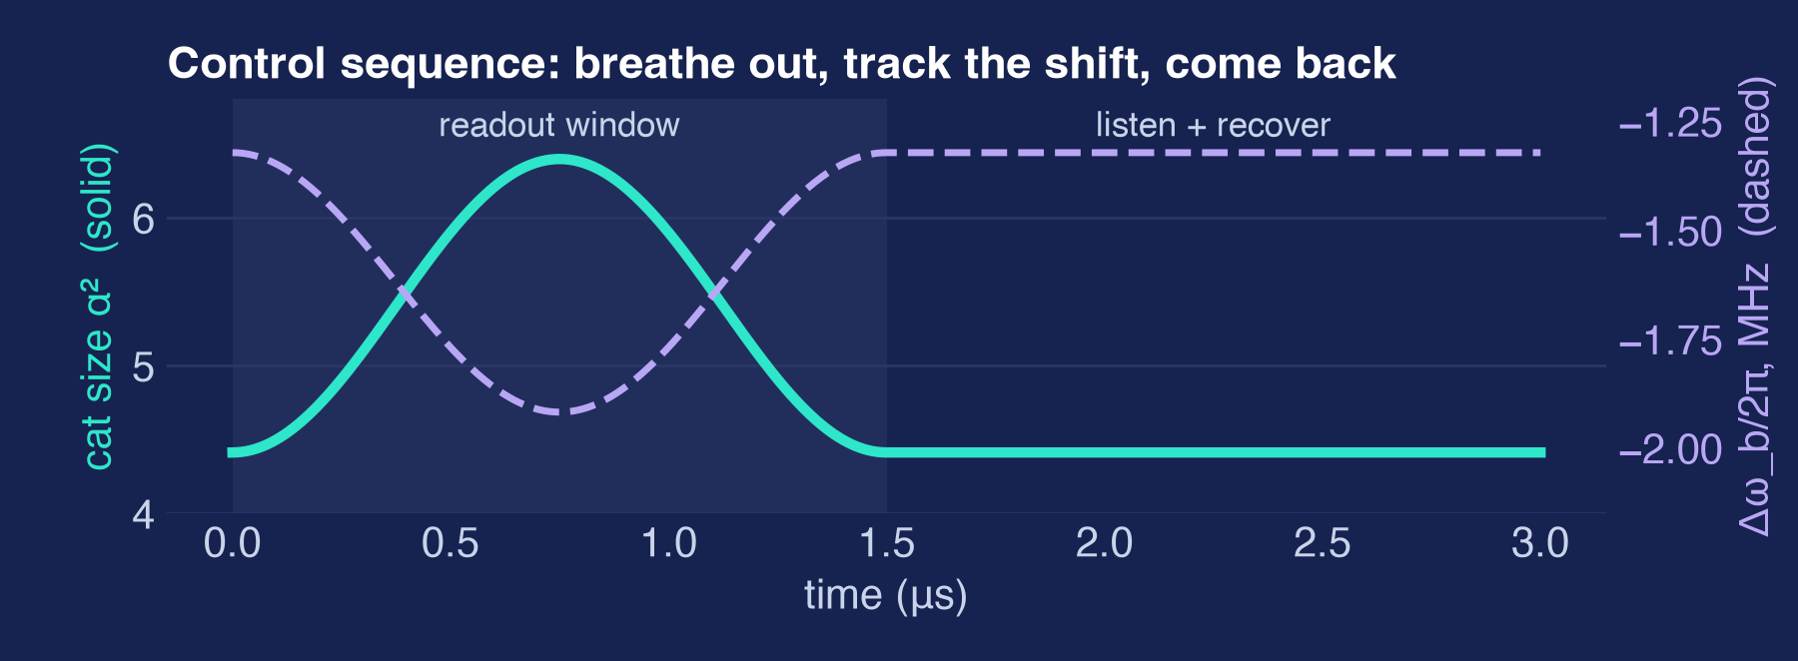
Cross-Kerr-aware readout
STANDARD · TASK 2.4 · OUR CAPSTONE
20%
less endpoint damage than a matched flat pulse, at equal information (χ/2π = 0.30 MHz)
89%
less extra decay per readout cycle (χ/2π = 0.15 MHz test)
1 Breathe
Buffer drive rises 45% on a smooth sin² ramp. The cat swells, the wells separate, and the buffer hears more.
2 Track
A bigger cat shifts the buffer frequency by −χ⟨n⟩ (cross-Kerr). Pump, drive and homodyne phase chirp together to follow it.
3 Listen
Drive returns. A matched filter reads the buffer's ringdown while stabilization pulls the cat back.
1.67×
active vs idle decay — still above our 1.10 limit
Notes:
~45 s. This is our own idea. Stage 1: temporarily raise the buffer drive by 45%, so the cat breathes outward and the two wells are further apart, which makes the buffer signal louder. Stage 2: a bigger cat means more photons, and through cross-Kerr that shifts the buffer frequency. If you ignore it, the readout phase drifts. So the pump, the buffer drive and the homodyne reference all chirp together to track the estimated shift. Stage 3: we listen to the ringdown with a matched filter. Result: 20% less damage than a matched flat pulse, and it beats either knob alone. But active decay is still 1.67 times idle.

Slide 9
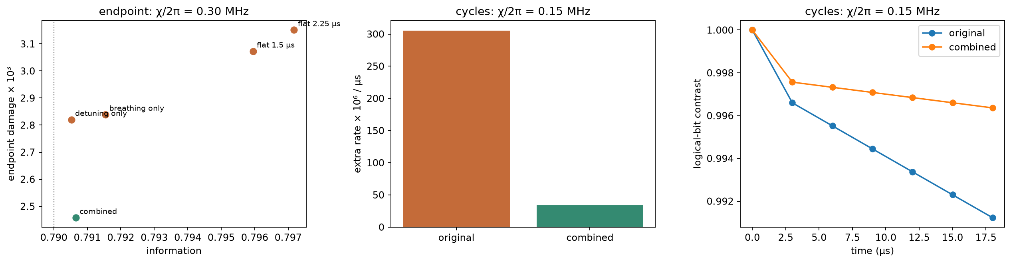
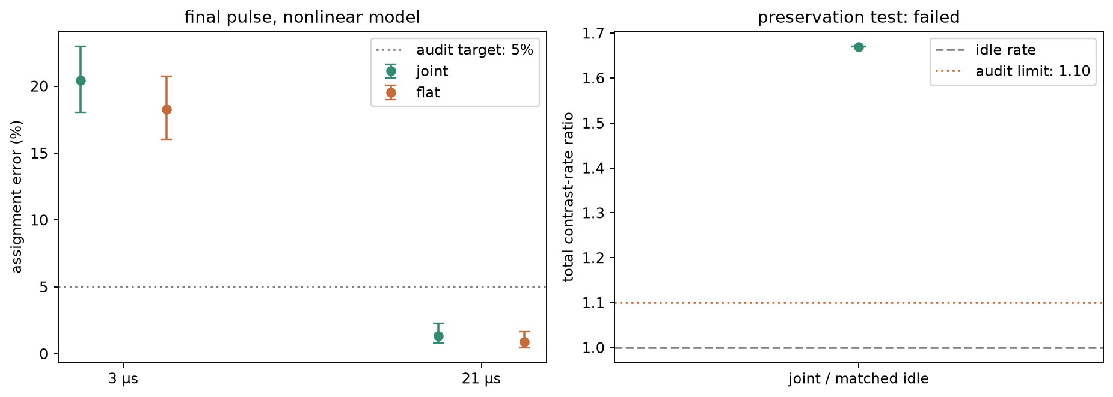
What worked, and what didn't
RESULTS
Worked
20% less damage; beats both single-knob versions
1.37% error (14/1024) after 21 μs
Didn't (yet)
Not more accurate: flat gets 0.88% (9/1024)
Idle protection fails: 1.67× vs 1.10 limit
Notes:
~45 s. Top left: at equal information, the combined pulse (green) has the lowest damage, below breathing-only, detuning-only and flat. Top middle and right: across repeated cycles, extra decay drops 89%. Bottom: the honest audit with full noisy trajectories. After 21 μs we read with 1.37% error, but the matched flat pulse gets 0.88%, so we haven't shown better accuracy. And active decay is 1.67 times idle, above our 1.10 limit, so it doesn't yet preserve protection. Lower damage is real; a readout that fully preserves the cat is the open problem.

Slide 10

Meet Watchcat
BONUS · RESEARCH TOOL
Checks the numerics
Fock-edge population, trace drift, observable convergence and the α² target, across the whole trace.
1
Worries when it should
On our run it flags the reference as not yet safely truncated and refuses a cheaper cutoff.
2
Lives in VS Code
A status-bar cat and popup; Run sweep calls the real Dynamiqs pipeline, not a mock.
Inspired by Task 1.2, not the main submission
3
Notes:
60–90 s including the live demo. Watchcat came out of Task 1.2: we kept asking whether a result was physics or truncation. It checks edge populations, trace, convergence across the full time trace, and the alpha-squared target. Demo: click the cat, show final population ~4.402 vs 4.41, transient peak ~6.85, edge population 0.00267. It's worried, because the reference isn't safely truncated, so it won't recommend a cheaper run. Open Wigner, then Run sweep to show the real pipeline. Don't claim compute savings.

