Slide 1
LEAD SCORE CASE STUDY LOGISTIC REGRESSION
Simran
Vaibhav
Kiran

Slide 2
PROBLEM STATEMENT
X Education is an organization which provides online courses for industry professional. The company marks its courses on several popular websites like google.
X Education wants to select most promising leads that can be converted to paying customers.
Although the company generates a lot of leads only a few are converted into paying customers, wherein the company wants a higher lead conversion. Leads come through numerous modes like email, advertisements on websites, google searches etc.
The company has had 30% conversion rate through the whole process of turning leads into customers by approaching those leads which are to be found having interest in taking the course. The implementation process of lead generating attributes are not efficient in helping conversions.

Slide 3
BUSINESS GOAL
The company requires a model to be built for selecting most promising leads.
Lead score to be given to each leads such that it indicates how promising the lead could be. The higher the lead score the more promising the lead to get converted, the lower it is the lesser the chances of conversion
The model to be built in lead conversion rate around 80% or more.

Slide 4
STRATEGY
Import data
Clean and prepare the acquired data for further analysis
Exploratory data analysis for figuring out most helpful attributes for conversion
Scaling features
Prepare the data for model building
Build a logistic regression model
Assign a lead score for each leads
Test the model on train set
Evaluate model by different measures and metrics
Test the model on test set
Measure the accuracy of the model and other metrics for evaluation

Slide 5
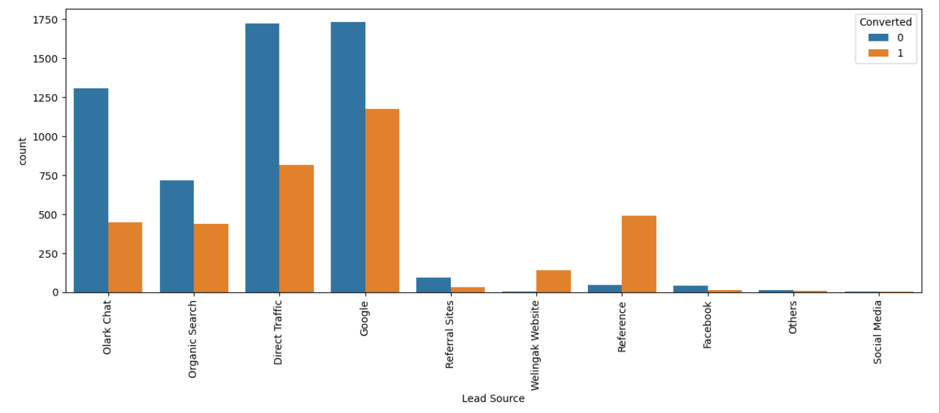
EXPLORATORY DATA ANALYSIS
LEAD SOURCE VS CONVERTED
Google searches has had high conversions compared to other modes, whilst references has had high conversion rate.

Slide 6
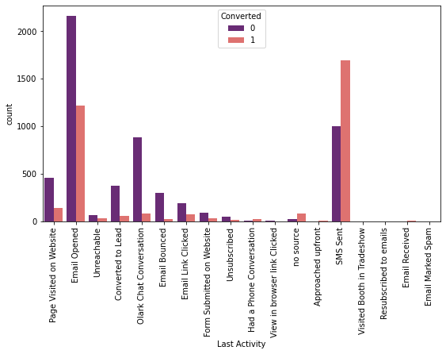
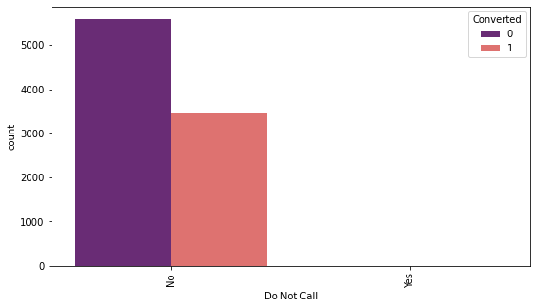
LAST ACTIVITY VS CONVERTED
SMS has shown to be a promising method for getting higher confirmed leads, emails also has high conversions.
DO NOT CALL VS CONVERTED
Most leads prefer not to informed through phone

Slide 7
LAST ACTIVITY VS CONVERTED
SMS has shown to be a promising method for getting higher confirmed leads, emails also has high conversions.
DO NOT CALL VS CONVERTED
Most leads prefer not to informed through phone

Slide 8
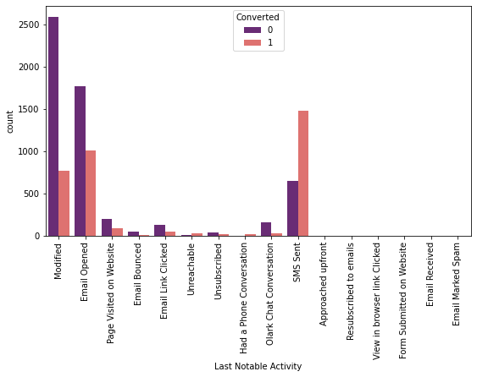
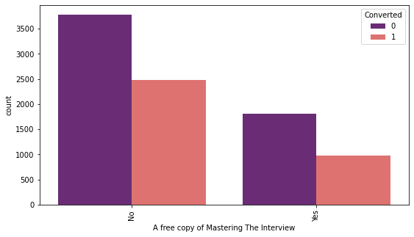
LAST NOTABLE ACTIVITY VS CONVERTED
Most leads are converted with messages. Emails also induce leads.
A FREE COPY OF MASTERING THE INTERVEIW
VS CONVERTED
Leads prefer less copies of interviews.

Slide 9
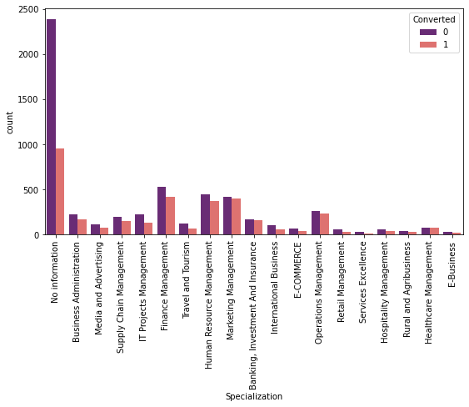
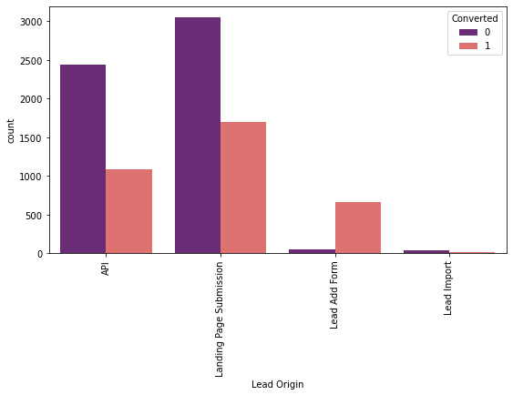
SPECIALIZATION VS CONVERTED
Most of the leads have no information about specialization.
On the other hand,
marketing management, human resources management has high conversion rates. people from these specializations can be promising leads
LEAD ORIGIN VS CONVERTED
Landing page submissions has had high lead conversions

Slide 10
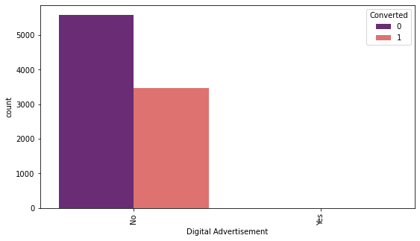

DIGITAL ADVERTISEMENTS VS CONVERTED
Based on the above graph digital advertisements do not have promising leads
THROUGH RECOMMENDATIONS VS CONVERTED
From the above graph, recommendations are not a good source for promising leads

Slide 11
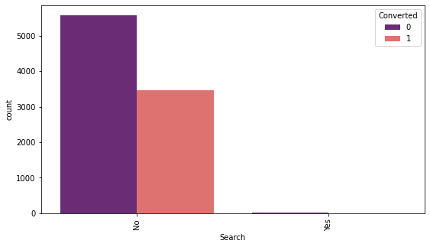
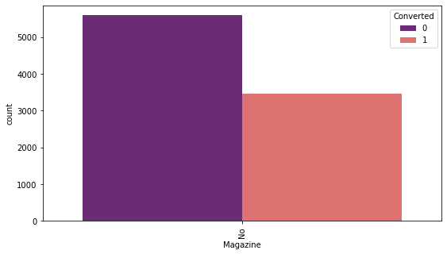
SEARCH VS CONVERTED
The above graph shows searches are not good source of leads
MAGAZINE VS CONVERTED
Magazines do not have higher conversion rate

Slide 12
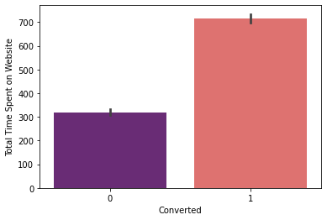
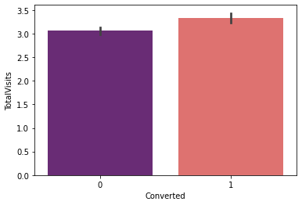
TOTAL TIME SPENT ON WEBSITES VS CONVERTED
People spending higher than average time are promising leads
TOTAL VISITS VS CONVERTED
Higher total visits have a slight higher chances of being a promising lead

Slide 13
MODEL BUILDING
Splitting into train and test set
Scale variables in train set
Build the first model
Use RFE to eliminate less relevant variables
Build the next model
Eliminate variables based on high p-values
Check VIF value for all the existing columns
Predict using train set
Evaluate accuracy and other metric
Predict using test set
Precision and recall analysis on test predictions

Slide 14
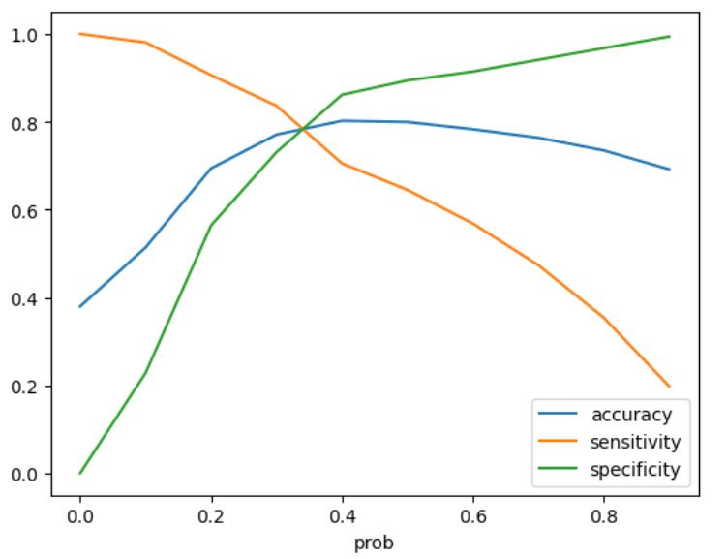
MODEL EVALUATION (TRAIN)
ACCURACY SENSITIVITY AND SPECIFICITY
77% Accuracy
2889 1064
83.2%Sensitivity
396 2023
73% Specificity
PRECISION AND RECALL
65% Precision
84% Recall

Slide 15
MODEL EVALUATION (TEST)
PRECSION AND RECALL
Hence we can see that the final prediction of conversions have a target rate of 83% (similar to predictions made on training data set)
66% Precision
83% Recall
ACCURACY SENSITIVITY AND SPECIFICITY
78% Accuracy
1251 438
83.2% Sensitivity
175 867
74% Specificity

Slide 16
Conclusion
While we examined both Sensitivity-Specificity and Precision and Recall Metrics, we chose the optimal cut off based on Sensitivity and Specificity to calculate the final prediction.
The test set's accuracy, sensitivity, and specificity values are around 78%, 83.2%, and 74%, respectively, which are roughly close to the respective values calculated using the trained set.
In addition, the lead score calculated in the trained set of data indicates that the final predicted model's conversion rate is around 80%.
----- As a result, this model appears to be good overall.
Important features responsible for a high conversion rate or those that contribute more to the likelihood of a lead being converted are:
Lead Origin_Lead Add Form
What is your current occupation_Working Professional
Total Time Spent on Website

