Slide 1
Ethics of Artificial Intelligence

Slide 2

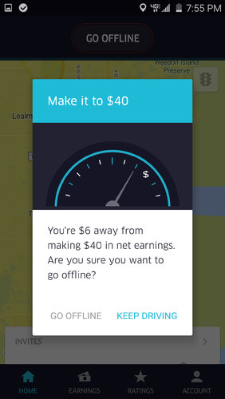
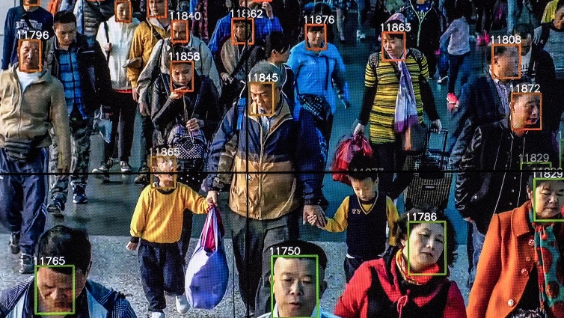
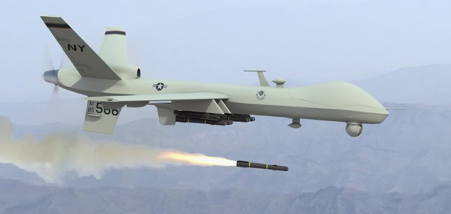
Ethics of AI
Will a new technology:
disempower individuals vs corporations?
user modeling; data mining; fostering addictive behaviors; developmental effects on children
disempower individuals vs governments?
facilitate disinformation (deep fakes; bots masquerading as people; filter bubbles); enable qualitatively new military or security tactics
take autonomous actions in a way that obscures responsibility
autonomous weapons; self-driving cars; loan approval systems
disproportionately affect vulnerable/marginalized groups
automated decision making tools trained in ways that may encode existing biases

Slide 3
Bias and fairness

Slide 4
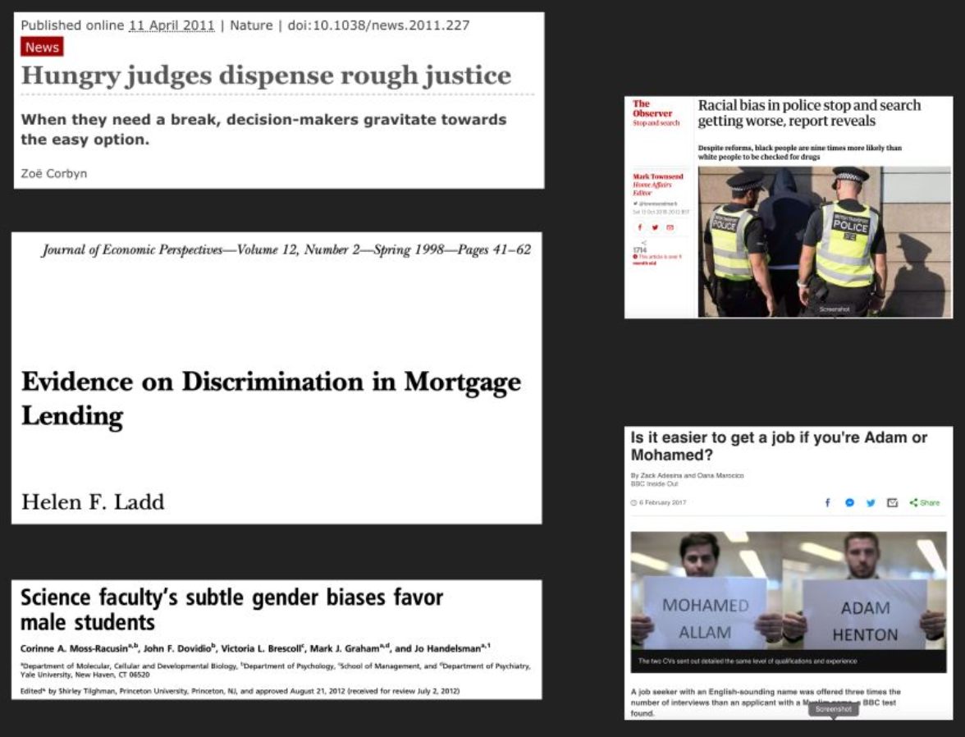
Human bias
Bias in people refers to our tendency to take quick decisions based on little information

Slide 5



Can technology have bias?

Slide 6
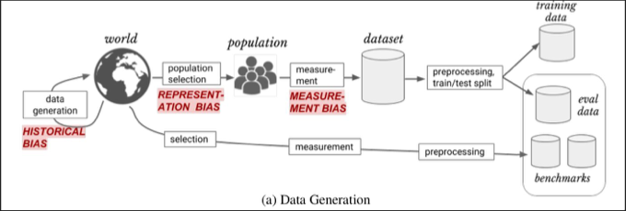
Sources of bias in ML algorithms

Slide 7

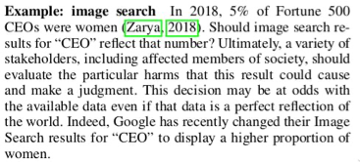
Historical bias

Slide 8

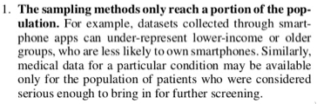
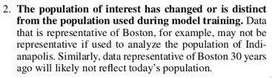
Representation bias

Slide 9
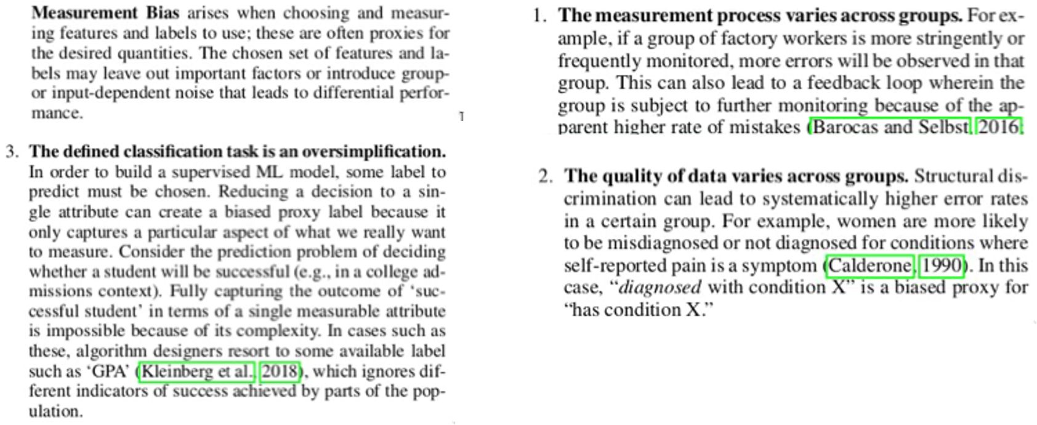
Measurement bias

Slide 10
Why worrying about bias in algorithms
Decisions made by a ML algorithm are:
Cheap
Scalable
Automated
Self-reinforcing
Seemingly objective
Often lacking appeals processes
Not just predicting but also causing the future

Slide 11
Fairness in algorithms
Nowadays, more attention is placed on algorithms being fair, and not just accurate.
Fairness can be measured as:
demographic (or statistical) parity: population percentage should be reflected in the output classes
Equality of false negatives or equalized odds: constant false-negative (or both false-negative and true-negative) rates across groups.
Equal opportunity: equal True Positive Rate for all groups
Other metrics...
Accuracy and fairness tend to be at odds with each other.
Algorithms can be audited to test their fairness.
Are we ethically required to sacrifice accuracy for fairness?

Slide 12
When the metric becomes the target (Goodhart’s Law)
"When a measure becomes a target it ceases to be a good measure"
Metrics introduced in the British public healthcare system (e.g. waiting time in ER) caused people to game it:
Cancelled scheduled operations to draft extra staff to ER
Required patients to wait outside the ER, e.g. in ambulances
Put stretchers in hallways and classified them as "beds"
Hospital and patients reported different wait times
Big Data is significantly changing college applications (not in a good way)
Universities are given higher ranking for things such as receiving more applications, being more selective, and having more students accept their offers (while tuition is not considered)
This even pushed some mid-tier universities to reduce the number of offer letter sent out, especially to good students who they think would not accept. Students are losing their safety options
Is this always undesirable? Can you think of ways to avoid this trap?
Notes:
Use multiple metrics instead of a single score
Listening to qualitative first-person experiences
Involve domain experts
Consider biases and what can go wrong beforehand
Transparent algorithms
Assess and review your metrics regularly
Legislative incentives for companies to adhere

Slide 13
Algorithms to promote engagement
Large, popular social media platforms use algorithms to increase user engagement
Proposed content is designed to keep the user on the website longer
It also often becomes more extreme as the user follows the suggestions
Sometimes with very disturbing results: https://www.npr.org/sections/thetwo-way/2017/11/27/566769570/youtube-faces-increased-criticism-that-its-unsafe-for-kids
They also tend to promote content that the user will agree/engage with, creating echo-chambers
Some theorize that echo-chambers can push people towards more extreme opinions
Do you agree? Should social media be required to change their recommendation algorithms to avoid these issues?
https://www.pnas.org/doi/10.1073/pnas.2023301118

Slide 14
Ethics of algorithmic pricing
Algorithms are currently used to adjust prices based on:
Willingness of buyer
Availability
You are probably familiar with car-sharing apps, like Uber.
Unlike cabs, which work with fixed rates, the cost of a Uber ride is determined by an algorithm, based on supply and demand.
This can introduce unfairness in several ways:
Underserved (poorer) neighbors get higher fares than more served ones
Surges in time of crisis (hostage siege in Sidney in 2014)
Algorithmic wage discrimination
https://papers.ssrn.com/sol3/papers.cfm?abstract_id=4331080
https://www.latimes.com/business/technology/story/2023-04-11/algorithmic-wage-discrimination
Notes:
Question: do you think algorithmic pricing is fair?

Slide 15
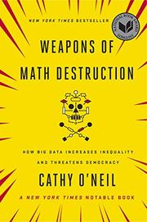
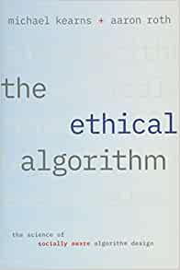
Interesting reads

Slide 16
DSCI 430 - Fairness, Accountability, Transparency and Ethics (FATE) in Data Science
If you’d like to know more

