Slide 1



SilkSphere
MINOR PROJECT
B.Tech CSE 7th Sem
(2023-2027)
DEPARTMENT OF COMPUTER SCIENCE AND ENGINEERING
Submitted By: Simriti Pandita (2023A1R006), Ujval Singh (2023A1R028), Himanshu Chib (2023A1R046)
Title: Digitizing the Silk Value Chain with AI Disease Detection, IoT Environmental Control & a Transparent E-Marketplace
Model Institute of
Engineering & Technology
Notes:
SilkSphere

Slide 2
Problem Statement & Background
#2 silk producer worldwide
Silkworm rearing and silk marketing involve several connected decisions, but health, environment, batch history and buyer access are often handled separately.
Disease detection
Environment
Batch & market access
Grasserie can weaken silkworms and affect cocoon yield and quality. Checks may rely on visual inspection.
Temperature, humidity, air/gas conditions and light require attention during rearing.
Disconnected records make it harder to share a batch’s history with quality-focused buyers.
CORE PROBLEM
How can one digital platform connect silkworm health, rearing conditions, cocoon quality and batch-to-buyer traceability?
Project motivation: provide a connected workflow for monitoring, recording and communicating batch information—not just a standalone disease detector.

Slide 3
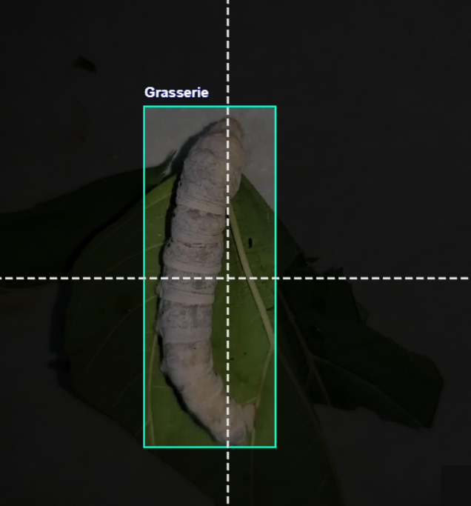
Understanding Grasserie Disease
What Is Grasserie?
A viral disease caused by Nuclear Polyhedrosis Virus (NPV). It weakens silkworms and reduces cocoon production and quality.
Common Symptoms
Swelling of the body
Shiny appearance
Weakness, reduced movement
Abnormal behaviour
Fragile body
Eventually, death
Healthy vs Grasserie-infected
Healthy
Grasserie-infected
Actual YOLOv8 model output on an infected larva
Key Idea: early identification = timely action = less spread across the batch.

Slide 4
Existing Approaches & Their Limitations
AREA
COMMON APPROACH
LIMITATION / OPPORTUNITY
Disease checks
Visual inspection of larvae
May be subjective; batch-level counts can be difficult.
Environment
Periodic/manual checking
Conditions may change between checks; alerts may be absent.
Batch records
Paper notes or separate records
Health and environment history may not stay linked to each lot.
Market access
Intermediary-led selling
Buyers may not receive a consistent digital batch history.
SilkSphere proposes to bring these functions into one traceable workflow; effectiveness must be evaluated through prototype testing.

Slide 5
Objectives & Proposed Solution
01
Detect & count
02
Monitor conditions
Use YOLOv8 to identify healthy and Grasserie-infected silkworms.
Read temperature, humidity, air/gas and light using Arduino-based sensors.
03
Track each batch
04
Assess quality
Maintain lifecycle records from rearing stages through cocoon formation.
Explore health and environmental indicators for cocoon quality assessment.
05
Grade consistently
06
Connect buyers
Organize quality output into proposed Grade A–D categories.
Provide a digital marketplace concept with batch-level information.
PROPOSED SOLUTION
Detect → Monitor → Track → Assess → Grade → Connect
Scope note: grading logic and marketplace functionality should be presented as implemented only after they are verified in the prototype.

Slide 6
System Architecture & Technology Stack
USER LAYER
Farmer • Buyer • Admin
APPLICATION LAYER
Dashboard • Diagnostics • Batches • Lifecycle • Marketplace
INTELLIGENCE LAYER
INTELLIGENCE LAYER
YOLOv8 detection • Health/environment indicators • Quality assessment
IoT LAYER
Arduino Uno • DHT11 • MQ-135 • LDR • Buzzer
DATA LAYER
Farmer records • Batch history • Environment • Disease observations • Quality
TECHNOLOGY STACK
Frontend
React.js • Vite • JavaScript
Backend / DB
Firebase
AI / Vision
YOLOv8 • Roboflow dataset
IoT
Arduino Uno and selected sensors
Visualization
Recharts

Slide 7




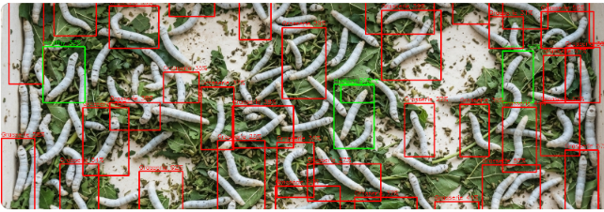
AI Module: Grasserie Detection with YOLOv8
Image Input
YOLOv8 Model
Object Detection
Classify & Count
Example Output
Real Detection Example
50
42
8
16%
Total
Healthy
Grasserie
Disease rate
Healthy
42
Grasserie
8
YOLOv8 on a live silkworm batch: green = healthy, red = Grasserie-infected
Healthy vs infected
Key Idea: not just “disease detected” — a quantitative view of batch health.

Slide 8
Cocoon Quality & Digital Marketplace
Quality is judged from the complete batch history — not the final cocoon in isolation.
Silkworm health history
Grade
A
Grade
B
Environmental history
Cocoon Quality
Assessment
AI health score
AI environmental score
Grade
C
Grade
D
Rearing / batch history
Digital Marketplace: Farmers Meet Quality-Focused Buyers
Traditional
Farmer
Middleman
Market
Buyer
SilkSphere
Farmer
SilkSphere
Buyer
Buyer View: origin, farmer, batch / lot, environment, health and AI scores stay tied to every lot — a documented batch, not an unknown one. Premium silk markets, including Japan’s, value this consistency.

Slide 9
IoT Monitoring, Batch Quality & Marketplace
IoT monitoring components
Data flow
Arduino Uno coordinates sensor readings:
• DHT11 — temperature and humidity
• MQ-135 — air/gas-related readings
• LDR — light intensity
• Buzzer — threshold alert
Sensors → Arduino Uno → readings / threshold check → dashboard or alert. Verify live readings, calibration and alert behavior in testing.
BATCH LIFECYCLE & QUALITY
Farmer / lot
→
Rearing stage
→
Health + environment
→
Cocoon assessment
→
Buyer view
Quality grades A–D
Marketplace contribution
The deck proposes using batch history and health/environment indicators. Define and validate the actual grading rules before treating grades as reliable output.
The concept links farmers and buyers with lot origin and batch history. State clearly whether listing, buyer views and database integration are functional or still planned.

Slide 10
Methodology: Batch-to-Buyer Workflow
1
Create batch
2
Monitor
3
Detect
Record farmer, source and lot ID.
Capture environmental readings.
Run YOLOv8 on silkworm images.
↓
↓
4
Assess
5
Record & grade
6
Share
4
Combine available batch indicators.
Store lifecycle history; apply defined grading rules.
Present verified batch information to buyers.
REAR → MONITOR → DETECT → RECORD → ASSESS → SHARE
The diagram describes the intended workflow; the presentation should distinguish completed modules from planned integration.

Slide 11
Implementation Progress & Milestone Tracking
MODULE / TASK
STATUS IN CURRENT DECK
EVIDENCE / NEXT ACTION
YOLOv8 detection
Example output included
Verify dataset, inference setup and evaluation results.
IoT monitoring
Design/components described
Add circuit photo, sensor readings and alert test.
Batch lifecycle
Workflow designed
Show a real batch record and confirm database persistence.
Quality grading
Proposed A–D logic
Document grading rules and validate with domain guidance.
Marketplace
Workflow described
Demonstrate listing/buyer view and end-to-end integration.

Slide 12
Challenges, Risks & Corrective Actions
Dataset quality & variation
Sensor calibration
Check labels, class balance, lighting and image diversity; evaluate on images not used for training.
Compare sensor readings with a reference where possible; record thresholds and repeat tests.
Module integration
Quality grading validity
Test AI, IoT, database and UI separately, then connect one interface at a time.
Define transparent A–D criteria and validate them before claiming reliable cocoon grading.
Traceability & data consistency
Use a unique batch/lot ID and check that records remain linked across stages.
Corrective approach: test each module, record evidence, fix issues incrementally, and re-test the integrated workflow.

Slide 13
References
[1]
J. Redmon, S. Divvala, R. Girshick, and A. Farhadi, “You only look once: Unified, real-time object detection,” in Proc. IEEE Conf. Comput. Vis. Pattern Recognit. (CVPR), Las Vegas, NV, USA, Jun. 2016, pp. 779–788, doi: 10.1109/CVPR.2016.91.
[2]
G. Jocher, A. Chaurasia, and J. Qiu, “Ultralytics YOLOv8,” version 8.0.0, 2023. [Online]. Available: https://github.com/ultralytics/ultralytics
[3]
H. Shi, W. Xiao, S. Zhu, L. Li, and J. Zhang, “CA-YOLOv5: Detection model for healthy and diseased silkworms in mixed conditions based on improved YOLOv5,” Int. J. Agric. Biol. Eng., vol. 16, no. 6, pp. 236–245, 2023, doi: 10.25165/j.ijabe.20231606.7854.
[4]
V. A. Binson and G. Manju, “Automated disease detection in silkworms using machine learning techniques,” Adv. Sustain. Sci. Eng. Technol. (ASSET), vol. 6, no. 4, Sep. 2024, doi: 10.26877/asset.v6i4.965.
[5]
Central Silk Board, Ministry of Textiles, Government of India. [Online]. Available: https://csb.gov.in (accessed Oct. 13, 2026).
[6]
Arduino, “Arduino Uno Rev3,” Arduino Documentation. [Online]. Available: https://docs.arduino.cc/hardware/uno-rev3/ (accessed Oct. 13, 2026).
[7]
Google, “Firebase documentation.” [Online]. Available: https://firebase.google.com/docs (accessed Oct. 13, 2026).
[8]
Meta Platforms, Inc., “React documentation.” [Online]. Available: https://react.dev (accessed Oct. 13, 2026).

Slide 14

Thank You

