Slide 1
Conservatoire Virtuel
Music school management system – project defense
Group 2 · I2new · November 2026
Notes:
Opening (about 10 s). Introduce the team and the project in one sentence, then move straight to the plan.

Slide 2
Four parts in twelve minutes, the demo at the centre
DEFENSE PLAN
1 min
3 min
7 min
1 min
1
Introduction, overview & architecture
2
UML & OOP design requirements
3
Live demonstration
4
Management, testing, challenges & conclusion
The demo follows the five functional areas of the application, then the business rules and the OOP mechanisms. Each step shows one concrete requirement, on prepared data, with direct navigation.
Notes:
About 10 s. The bar is drawn to scale: the demo takes more than half of the time.

Slide 3
One information system for the whole music school
1 · INTRODUCTION, OVERVIEW & ARCHITECTURE
Objective
Replace scattered tools with one Java 25 application on MySQL that registers candidates, schedules lessons, runs exams and bills every service – and enforces the school's rules.
ui
Swing desktop app and console menus
model
domain classes and business rules, used by every layer
service
6 services: the use cases and transactions
Main entities
Student
Teacher
Instrument
dao
9 DAOs: all the SQL in one place
Room
Course package
Rental
Enrollment
Lesson
Room booking
MySQL
23 tables, keys and constraints
Exam
Invoice
Payment
Notes:
1 minute for the whole part. Context in one sentence: a private music school needs one system for candidates, teachers, instruments, lessons, exams and payments. Name the entities quickly. Architecture: two interfaces on the same services, services call the DAOs, DAOs talk to MySQL; the model package holds the domain classes and their rules, so the rules are tested without a database. A Hibernate/JPA version of the persistence layer also exists on a separate branch.

Slide 4
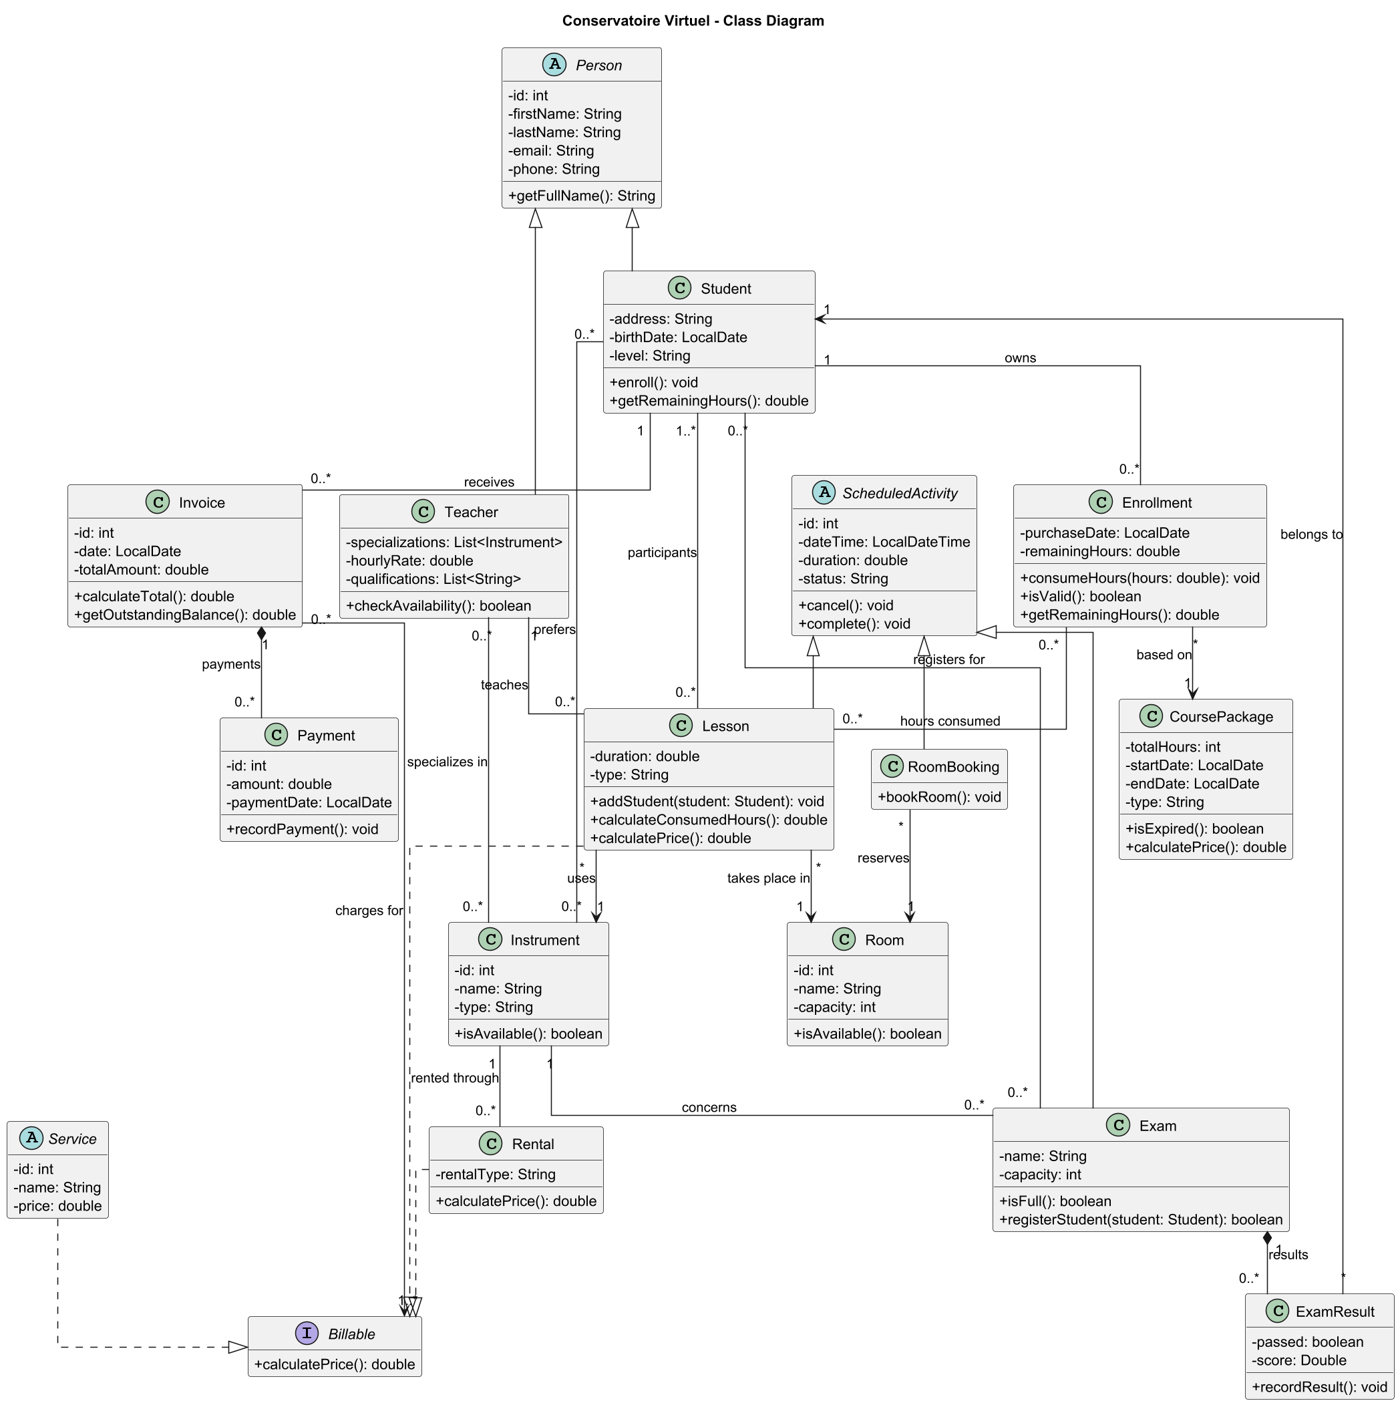
Class diagram: inheritance, composition and associations
2 · UML & OOP DESIGN REQUIREMENTS
Inheritance
Person → Student, Teacher
Service → CoursePackage, Rental
ScheduledActivity → Lesson, RoomBooking, Exam
Composition
Invoice owns its Payments
Exam owns its ExamResults
Student owns its Enrollments
Associations
Lesson → Teacher, Room, Instrument
Lesson ↔ Students (many-to-many)
Teacher ↔ Instruments (specializations)
Notes:
About 45 s. The class diagram is mapped one to one to Java classes and to tables. Point at the three hierarchies, then the three compositions (the black diamonds), then the main associations: a lesson links a teacher, a room, an instrument and one or more students.

Slide 5
Abstract classes and interfaces
2 · UML & OOP DESIGN REQUIREMENTS
Abstract classes – never instantiated
Interfaces – capabilities across hierarchies
Person
▸ Student, Teacher
I
Billable
getRole(), describe()
double calculatePrice()
Service
▸ CoursePackage, Rental
Implemented by Service (CoursePackage, Rental) and Lesson
Anything the school charges for – a lesson is billable without being a service
describe() + Billable
ScheduledActivity
▸ Lesson, RoomBooking, Exam
I
Schedulable
getActivityType(), describe()
boolean isAvailable(start, duration)
Menu
▸ 5 console sub-menus
Implemented by Teacher and Room
Anything that can be booked for a time slot
getTitle(), getOptions(), handle()
Notes:
About 45 s. Four abstract classes, each a real generalization with abstract methods the subclasses must implement. Two interfaces model capabilities that cut across the hierarchies: Billable (Lesson is billable but is not a Service) and Schedulable (teachers and rooms both have availability).

Slide 6
Polymorphism and dynamic dispatch
2 · UML & OOP DESIGN REQUIREMENTS
Polymorphic collection – Invoice
Overriding – Lesson
private List<Billable> items;
public double calculateTotal() {
return items.stream()
.mapToDouble(Billable::calculatePrice)
.sum();
}
@Override
public void cancel(LocalDateTime when) {
boolean late = isLateCancellation(when);
super.cancel(when);
this.lateCancellation = late;
}
One invoice holds a package, a rental and a lesson. Each item computes its own price at run time – the invoice never tests the type.
Only lessons add the 24 h rule; they reuse the common status change through super. Bookings and exams keep the base version.
Same idea for the schedule: List<ScheduledActivity> mixes lessons, room bookings and exams; getActivityType() and describe() dispatch to each subclass.
Notes:
About 45 s. Left: dynamic dispatch through an interface over a mixed collection. Right: an override that refines the inherited behaviour instead of replacing it. Both will be visible in the demo (invoice totals and the mixed planning list).

Slide 7
Encapsulation and copy constructors
2 · UML & OOP DESIGN REQUIREMENTS
✓
Private, validated fields
Deep copy – Student(Student other)
setters reject invalid values: negative prices, a score outside 0–100, an empty name
public Student(Student other) {
super(other); // Person fields
this.level = other.level;
for (Instrument i : other.preferredInstruments)
preferredInstruments.add(new Instrument(i));
for (Enrollment e : other.enrollments)
enrollments.add(new Enrollment(e));
}
✓
Read-only views
getters return unmodifiable lists; changes go through methods like enroll() or registerStudent()
✓
Invariants in the owner
A copied student cannot spend the original's hours: every mutable part is copied, not shared. 16 classes have a copy constructor.
Invoice.addPayment() refuses an overpayment; Enrollment.consumeHours() refuses an expired package
Notes:
About 30 s. Copy constructors chain to the parent (super(other)) and deep-copy mutable parts. Encapsulation keeps every invariant inside the class that owns the data, so no caller can break it. The unit test copyConstructorsAreIndependent proves the copies are independent – it is shown in demo step 7.

Slide 8
How the design meets the technical requirements
2 · UML & OOP DESIGN REQUIREMENTS
Requirement | Where in the code | Why it fits the domain
Inheritance & composition | Person, Service, ScheduledActivity trees; Invoice ◆ Payment | Shared fields once; parts owned by their whole
Abstract classes | Person, Service, ScheduledActivity, Menu | Real generalizations: nobody is just a "person"
Interfaces | Billable, Schedulable | Capabilities shared by unrelated classes
Polymorphism | List<Billable>, List<ScheduledActivity>, List<Menu> | Bill and schedule mixed objects with one loop
Encapsulation | Private validated fields, unmodifiable lists | Rules such as "no overpayment" always hold
Copy constructors | 16 classes, deep copies of mutable parts | Copies never share state with the original
Notes:
About 15 s – a summary to leave on screen while moving to the demo. Each requirement is used where it fits the domain, not just to tick a box.

Slide 9
Seven steps in seven minutes
3 · LIVE DEMONSTRATION
1
2
3
4
5
6
7
Registration & subscriptions
Candidate payments
Learning hours & scheduling
Trainers & instruments
Exams & results
Business rules & conflicts
OOP implementation
1 min
45 s
1 min 30
1 min
1 min
1 min
45 s
Steps 1–5 follow the five functional areas. Steps 6–7 prove the business rules and the OOP design.
Start: desktop app, demo data freshly reset · console open in a second window
Notes:
7 minutes in total. Before the defense: click "Réinitialiser les données de démo" so the dates are relative to today, and open the console (java -jar ... --console) in a second window for the exam result. Keep this slide on screen, then switch to the application.

Slide 10
Demo steps 1–4: the core functional areas
3 · LIVE DEMONSTRATION
1
Registration & subscriptions
1 min
2
Candidate payments
45 s
Go to Élèves → Ajouter un élève; Facturation → Acheter une offre
Show new candidate with level and instruments, then buy "Pack Decouverte 10h": 10 h appear
OOP CoursePackage extends Service; Student ◆ Enrollment
Go to Facturation → Enregistrer un paiement
Show pay part of Emma's invoice: the balance drops; an overpayment is refused
OOP encapsulation – Invoice ◆ Payment guards its total
3
Learning hours & scheduling
1 min 30
4
Trainers & instruments
1 min
Go to Planning → Planifier un cours
Show piano lesson for Lucas: 7 h → 6 h; the same lesson at 21:00 is refused – outside the teacher's hours
OOP Schedulable.isAvailable() on Teacher and Room
Go to Professeurs; Offres & instruments → Changer la disponibilité
Show specializations and rates; drums out of service; wrong teacher for the instrument is refused
OOP InvalidSpecializationException from teacher.teaches()
Notes:
Steps 1 to 4, 4 minutes 15 in total.
1 (1 min): Élèves tab, add a candidate (level BEGINNER, preferred instrument Piano). Facturation tab, "Acheter une offre": choose the new student and Pack Decouverte 10h; the Élèves tab now shows 10 h remaining.
2 (45 s): Facturation, "Enregistrer un paiement" on Emma's invoice (650 €, 300 paid): pay 100 €, the remaining balance becomes 250 €. Then try 1000 €: refused.
3 (1 min 30): Planning, "Planifier un cours": Lucas, Claire, Piano, Studio A, tomorrow 10:00, 1 h. Lucas goes from 7 h to 6 h. Then try the same lesson at 21:00: outside Claire's availability (9–20), refused.
4 (1 min): Professeurs tab: specializations, rates, qualifications. Offres & instruments → Instruments: drums are unavailable; toggle with "Changer la disponibilité". Back in Planning: a violin lesson with Claire is refused – she does not teach violin.

Slide 11
Demo steps 5–7: exams, rules and OOP
3 · LIVE DEMONSTRATION
5
Exams & results
1 min
6
Rules & conflicts
1 min
7
OOP in action
45 s
Go to Examens → Inscrire un élève; console e → Record a result
Show take the last seat of the piano exam (3/3); the next one is refused: "registration is closed". Record a result on the past guitar exam.
OOP Exam ◆ ExamResult; Exam.registerStudent()
Go to Planning → Planifier un cours, then Annuler
Show an overlapping lesson is refused (double booking). Cancel the lesson starting in 3 h: < 24 h, its hour is consumed. Cancel the group lesson in 3 days: refunded.
OOP ScheduleConflictException; Lesson.cancel() override
Go to Planning list and Hugo's invoice; IntelliJ test run
Show one list mixes lessons, room bookings and exams; one invoice mixes a package and a rental. Run copyConstructorsAreIndependent: green.
OOP List<ScheduledActivity>, List<Billable>; Student(Student) deep copy
Notes:
Steps 5 to 7, 2 minutes 45 in total.
5 (1 min): Examens tab, "Inscrire un élève" on Piano Exam – Level 1 (2/3): register a piano student, it becomes 3/3. Try again: "Exam registration is closed". Console: e → 5 Record a result, exam 7 (guitar, already taken), student Hugo #3, passed, 65; then e → 2 shows the results.
6 (1 min): Planning: schedule Claire again on the slot of step 3: refused as a conflict. Select the lesson starting in about 3 hours and click "Annuler": late cancellation, the hour is consumed. Cancel the group guitar lesson in 3 days: hours refunded.
7 (45 s): show the Planning list – one List<ScheduledActivity> with three subclasses, each describing itself. Facturation: Hugo's invoice holds a package and a rental, total 930 € computed by calculatePrice() on each item. IntelliJ: run BusinessRulesTest.copyConstructorsAreIndependent – the copy spends 3 h, the original keeps 10 h.

Slide 12
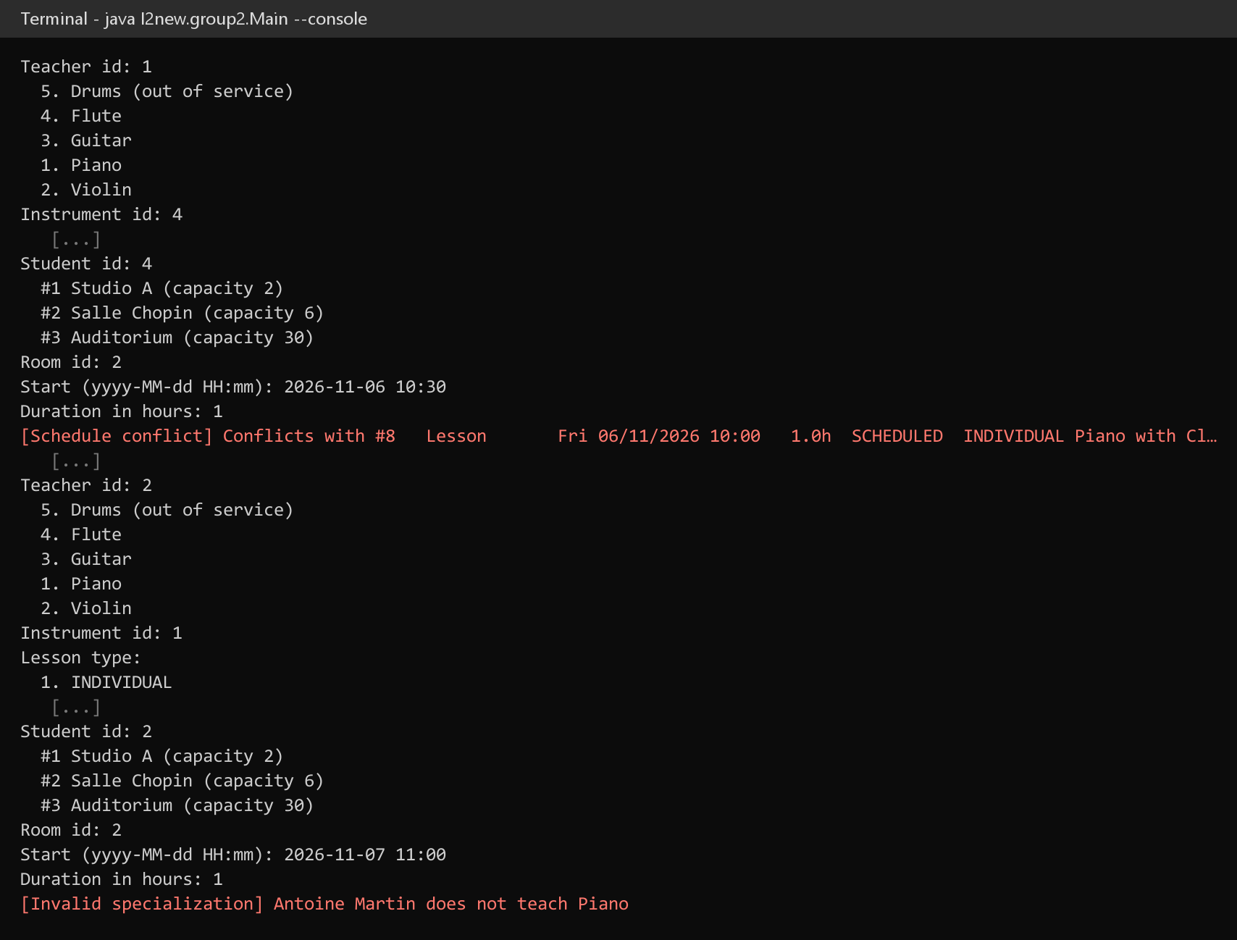
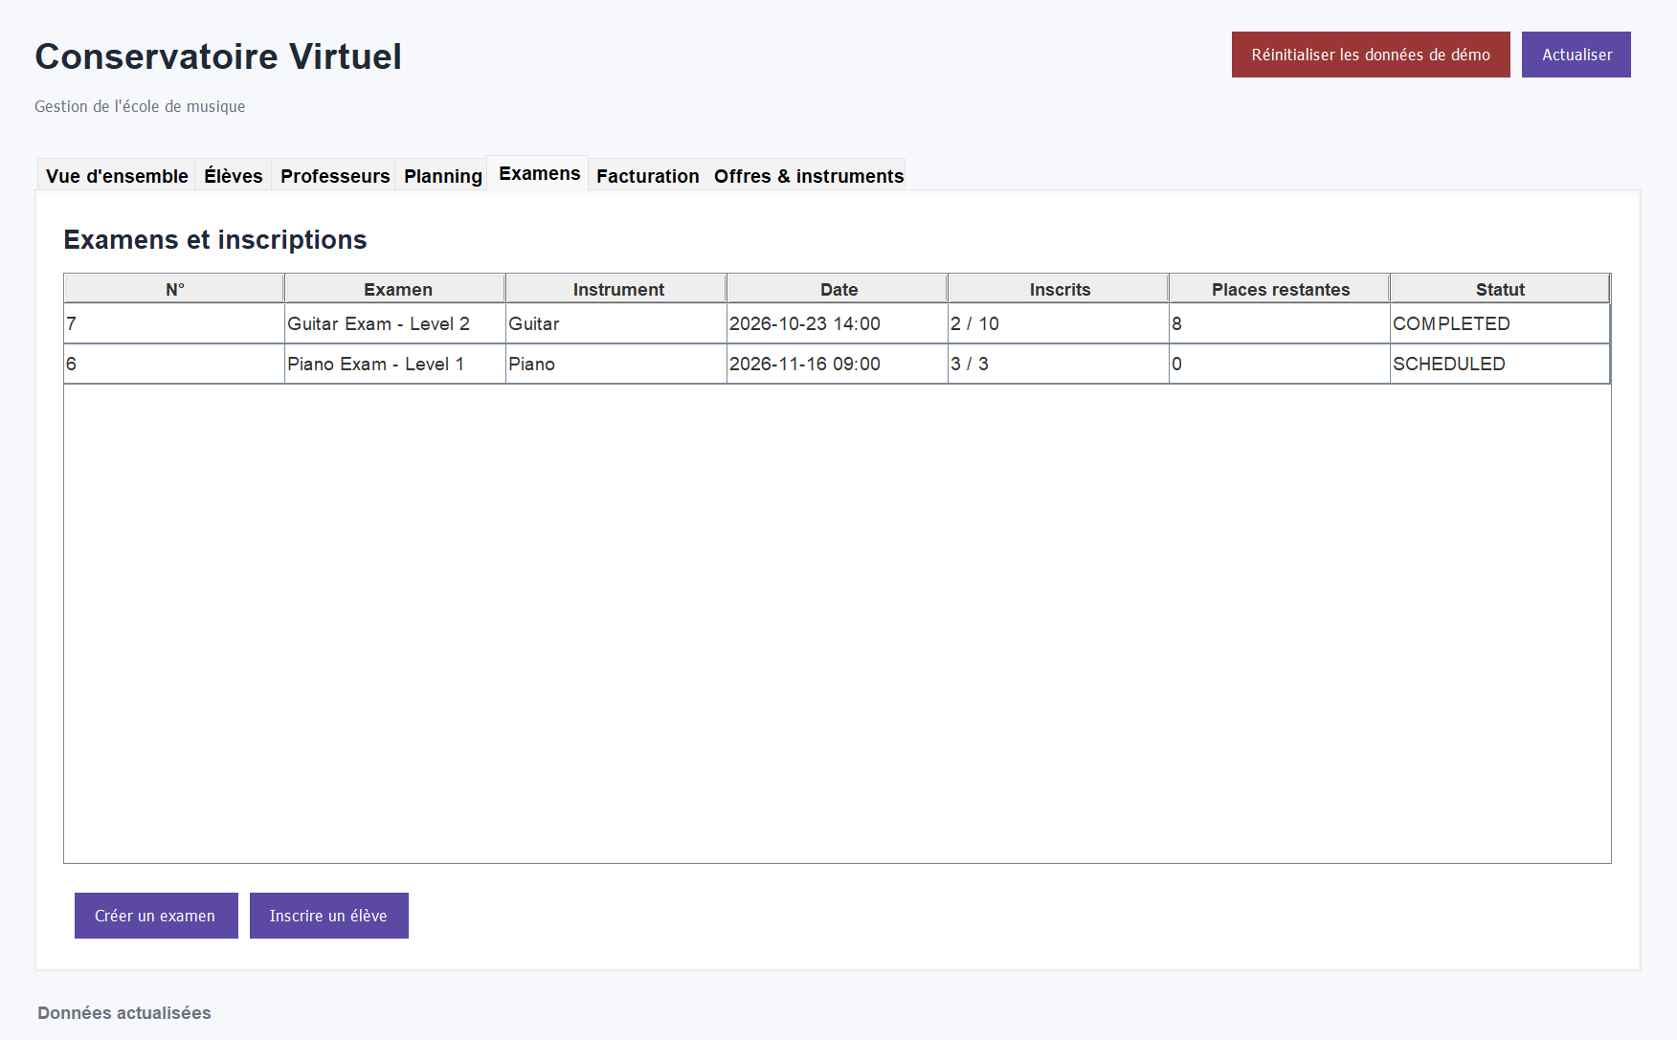
Recorded evidence, in case the live demo fails
3 · LIVE DEMONSTRATION
Desktop: the piano exam is full (3/3)
Console: conflict and wrong specialization refused
Notes:
Backup only – skip it if the live demo works. Every demo step has a matching screenshot in section 5 of the report.

Slide 13
What we did, how we checked it, what comes next
4 · PROJECT MANAGEMENT, TESTING, CHALLENGES & CONCLUSION
Development approach
Testing strategy
UML first, then database, business layer, console, and finally the Swing GUI
Git with feature branches – a Hibernate/JPA version of the persistence layer lives on its own branch
13/13 JUnit tests on the model, without a database
16/16 end-to-end scenarios on MySQL, refusals tested as much as successes
Challenges → solutions
Achievements & next steps
UML and code drifting apart → one-to-one mapping, every deviation agreed
Rules spanning objects (refund + remove charge) → one service method, one transaction
All functional areas and OOP requirements delivered, on two interfaces
Next: catalogue editing in the GUI, user accounts, a connection pool
Notes:
1 minute. One sentence per box. Approach: UML first, then layers bottom-up, Git for versioning. Testing: unit tests on the business rules and scenario tests on the real database. Challenges and their solutions. Close on what was achieved and the realistic next steps.

Slide 14
Thank you
Questions?
Conservatoire Virtuel · Group 2
Notes:
Questions. Keep the application open on the Planning tab and the report on the OOP section.

