Slide 1
FPROG – Project Presentation
Rutschka Simon, Wunsch Lukas

Slide 2
Programming Language F# - F Sharp

Slide 3
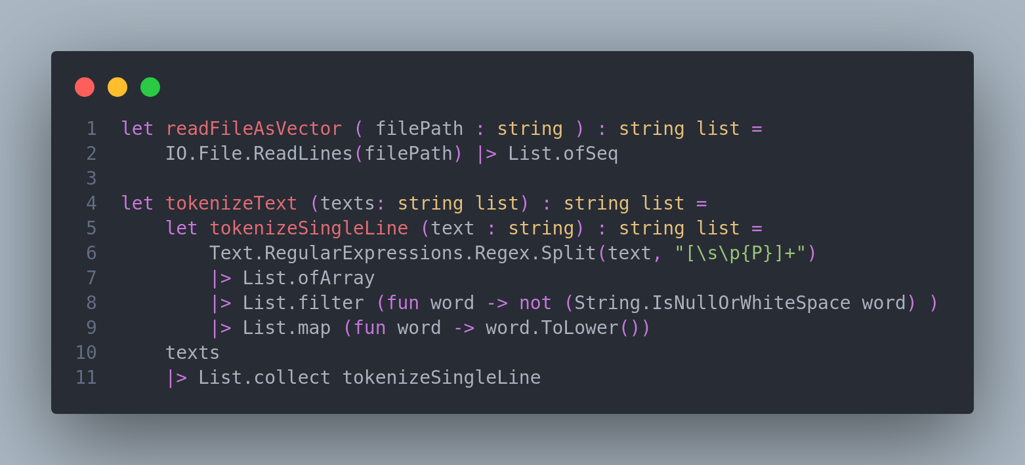
Read Files and Tokenize

Slide 4
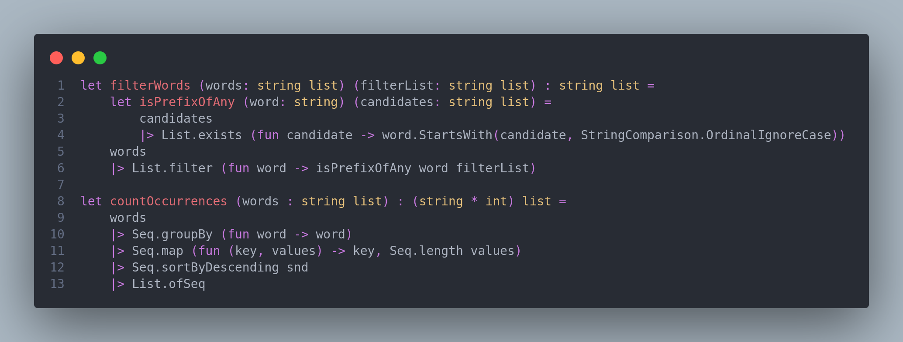
Filter words and Count occurrences

Slide 5
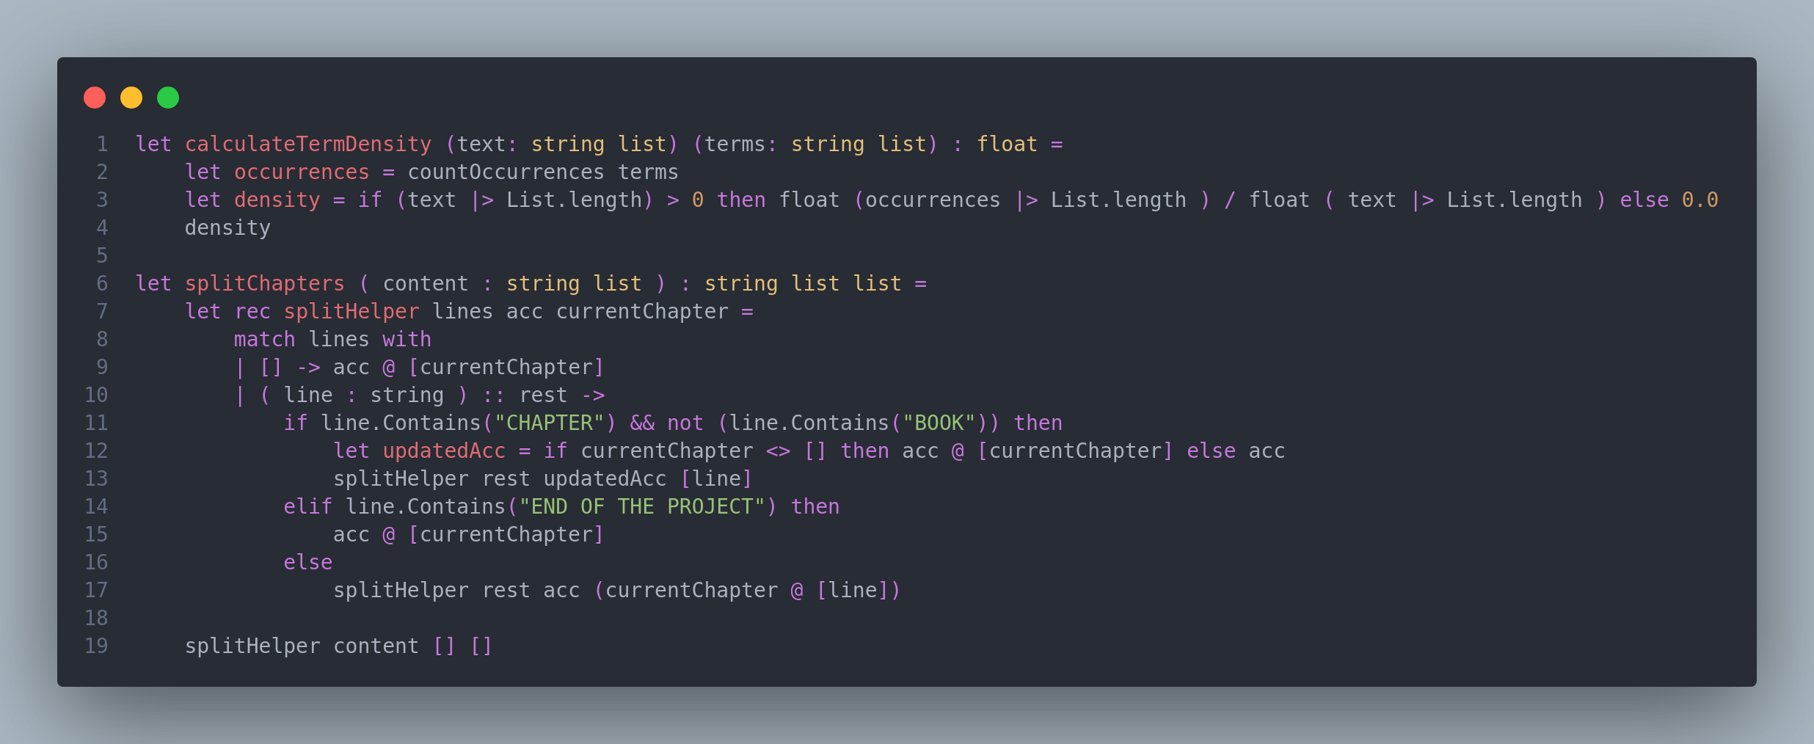
Term density and Chapter splitting

Slide 6
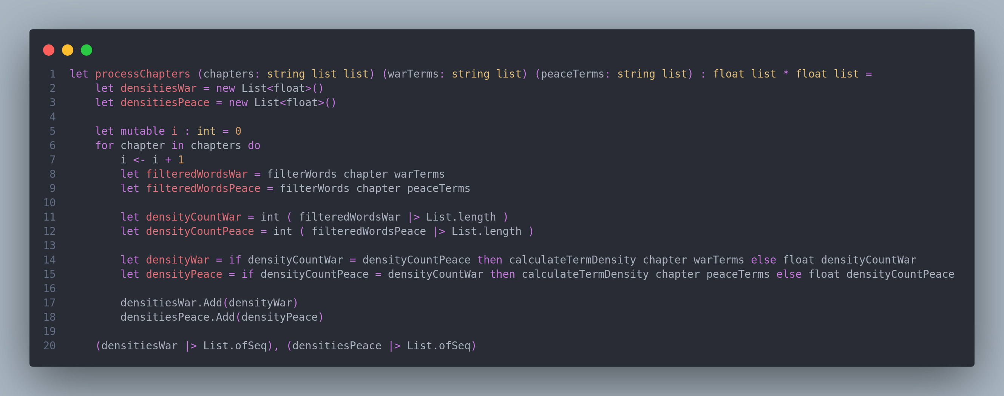
Chapter processing

Slide 7
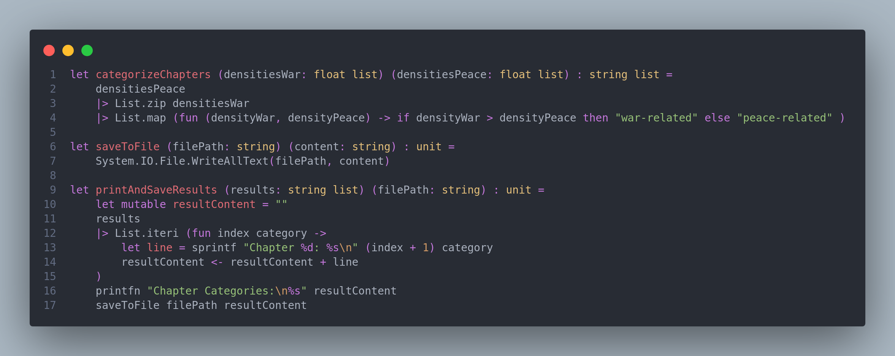
Chapter Categorization and Output

