Slide 1
CMSC 411 – Section 03 Computer Architecture
Dr. Ergün Simsek
Assistant Professor of CSEE
Director of Graduate Data Science Programs
Fall 22 - Lecture 1
.
.

Slide 2
Credits
Some of these slides were developed by Profs. Mohamed Younis, Jeannette Kartchner, David Black-Schaffer, Onur Mutlu, Don Porter, Leonard McMillan, Gary Bishop, Alok Choudhary, and Montek Singh.
Some slides and other materials are from the book publisher.

Slide 3
People
Instructor: Dr. Ergun Simsek
E-mail: simsek@umbc.edu
Office: https://umbc.webex.com/meet/simsek
Office hours: Wednesdays 10:00 - 12:00 noon
Research: Photonics, scientific computing, and machine learning.
TA: Saquib Ahmed
Office: TBA
E-mail: NQ41459@umbc.edu
Office hours: Monday – Wednesday 10:30 am – 12:30 noon
Grader: Shalini Nomula
E-mail: OM77059@umbc.edu

Slide 4
Textbook
Computer Organization and Design:
The Hardware/Software Interface
by Patterson and Hennessy
DO NOT PURCHASE A HARDCOPY
We’ll use ZYBOOKS
$72
1. Sign in or create an account at https://learn.zybooks.com/signup
Important Note: For signing up, you need to use your UMBC email account in the following format: CampusID@umbc.edu
2. Enter zyBook code: UMBCCMSC411SimsekFall2022
3. Subscribe

Slide 5
Tentative Syllabus
1. Performance Evaluation
Measures of performance
Benchmarks and metrics
2. Instruction Set Architecture
Instruction formats & semantics
Addressing modes
Procedures and Stacks
3. Machine Arithmetic
ALU design
Integer multiplication & division
Floating-point arithmetic
4. Processor Design
Datapath design
Instruction exec. & sequencing
Hardwired & microcode control
5. Performance boosting features
Pipelining
Instruction level parallelism
6. Memory Hierarchy
Cache design & evaluation
Virtual addressing
Performance evaluation
7. Input/Output
Types of I/O devices
Device access and interface
Device control
I/O performance
8. Multiprocessor (time permitting)
Interconnection networks
Programming issues
(3)
(3)

Slide 6
Tentative Course Load
Homework Assignments
6-7 assignments will be given and normalized to %20 of the final grade
An average assignments requires about 2-3 hours to perform
Assignments are due in class on the due date (not later)
Exams
A midterm exam is scheduled on October 24 during scheduled class time (30%)
The final exam is scheduled on December 16, 1 – 3 pm (40 %)
Final Exam is comprehensive, but the focus will be on subjects covered after the midterm
Quizzes
We will have 4 quizzes (10% of your final grade)

Slide 7
Grade Structure and Policy
You must do your own work and not copy from anyone else
Copying/cheating will result in a minimum punishment of a zero grade for the assignment or quiz or the exam

Slide 8
Course Mechanics
Policies:
Problem Sets:
You will typically have 1 week to do them.
Honor Code:
The honor code is in effect for all homework, quizzes, exams etc. Please review the policy on the university website.
Lecture Notes:
I will attempt to make Lecture Slides, Problem Sets, and other course materials available on Blackboard either before class, or soon after, on the day they are given.

Slide 9
Teaching Style and Philosophy
Instructor’s role
Facilitate and guide the students to the fundamental concepts
Make it simple and elaborate with examples
Relate as much as possible to available products
Prepare class notes to be as rich and comprehensive as possible
Student’s role
Focus on understanding and digesting the concept
Do not worry about the grade more than concepts, soon will be a professional
Slow down the instructor if you do not understand and raise questions
Participate
TA’s role
Help students with questions related to their assignments
Resolve computer and tool issues related to the project
Grader’s role
Grade assignments and projects
Exams will question the level of understanding of fundamental concepts

Slide 10
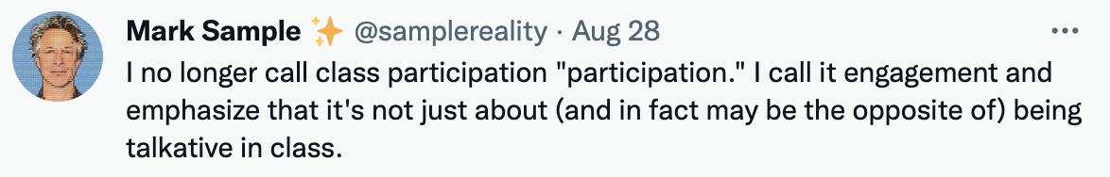
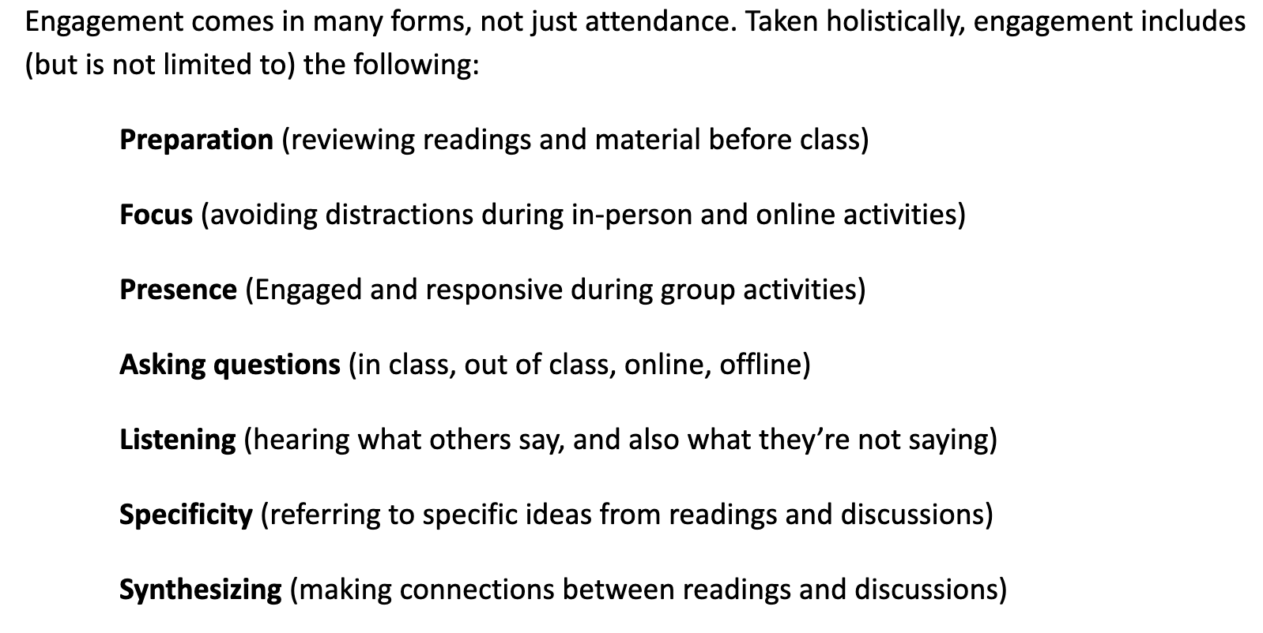
Engagement!

Slide 11
Prerequisites
You must have completed CMSC 313 or CMPE 212 and CMPE 310 with a grade of C or better
You need to know at least the following concepts:
basic data types: integers, characters, Boolean, etc.
basic arithmetic operators and expressions
“if-then-else” constructs, and “while”/“for” loops
function and procedure calls
basic Boolean operators (AND, OR, XOR, etc.)
If you don’t know many of the above concepts, you might be in the wrong class(room)

Slide 12
How NOT to do well in this course
BIG mistakes
Skipping lectures
Not reading the book (only reviewing lecture slides)
Not spending enough time to do homework
Start early. Many problem sets are too hard to attempt the night before.
Not asking questions in class
Not discussing concepts with other students
But all work handed in must be your own (see Honor Code)
Looking up solutions from earlier semesters = cheating. Not worth it.

Slide 13
Helpful Links
MIPS Simulators:
Download SPIM: http://spimsimulator.sourceforge.net/
Download MARS: http://courses.missouristate.edu/kenvollmar/mars/download.htm
Online manual for MIPS using QtSpim: http://www.egr.unlv.edu/~ed/MIPStextSMv11.pdf
MIPS Reference:
Quick Reference
MIPS Opcode LookUp
"Cheat Sheet"MIPS Reference (Green Card from the text for use on exams)
Calculators:
Decimal-Binary-Hex Converter
IEEE754 Floating Point Calculator
Desmos Graphing Calculator
Logic Circuit Simulator
Warning: 32-bit
https://circuitverse.org

