Slide 1
CMSC 411
Computer Architecture
Lecture 10
Arithmetic Logic Unit
Ergun Simsek
How can we design/build an adder?
How can we determine whether a<b?

Slide 2
Overview
  Logic gates and operations
  Constructing an Arithmetic Logic Unit
  Scaling bit operations to word sizes
  Optimization for carry generation

Slide 3
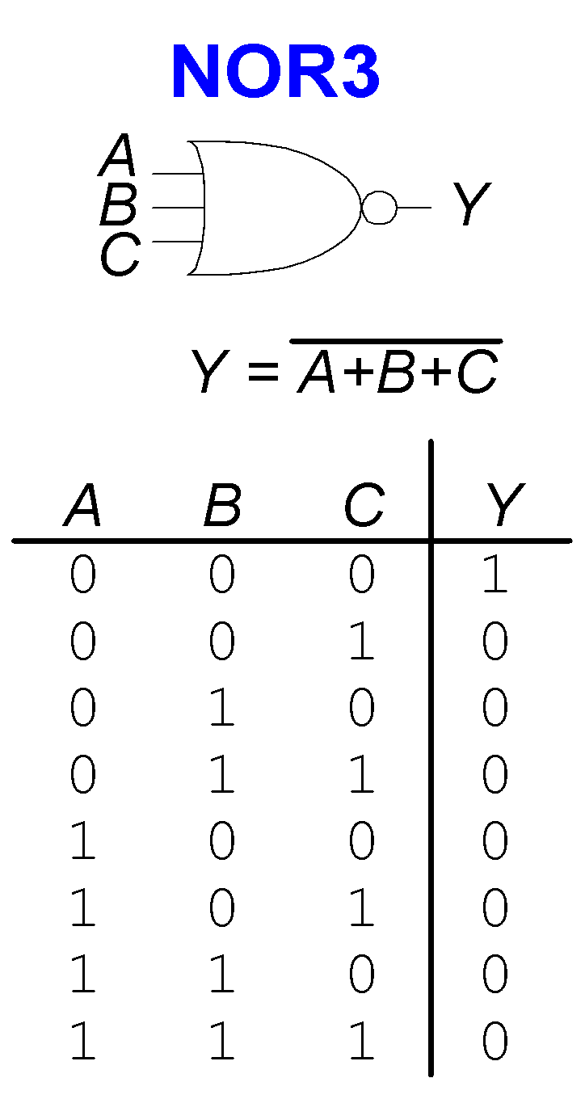
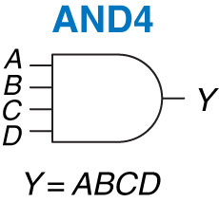
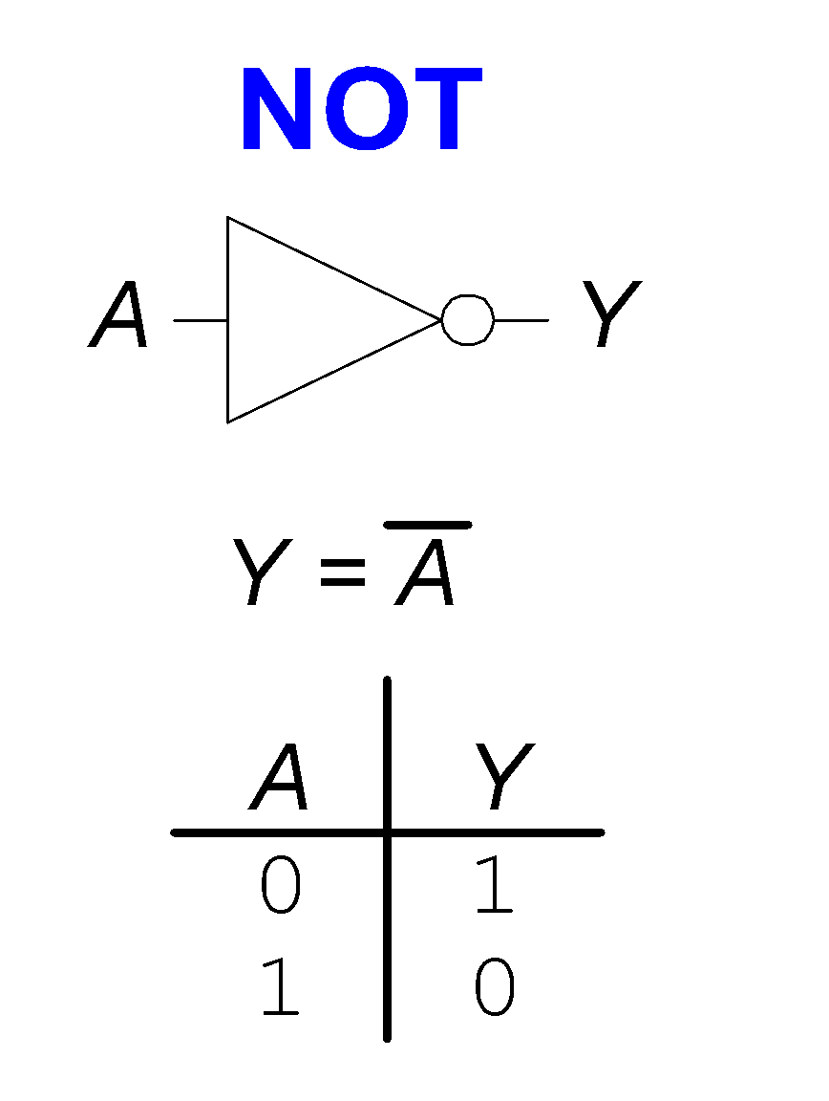
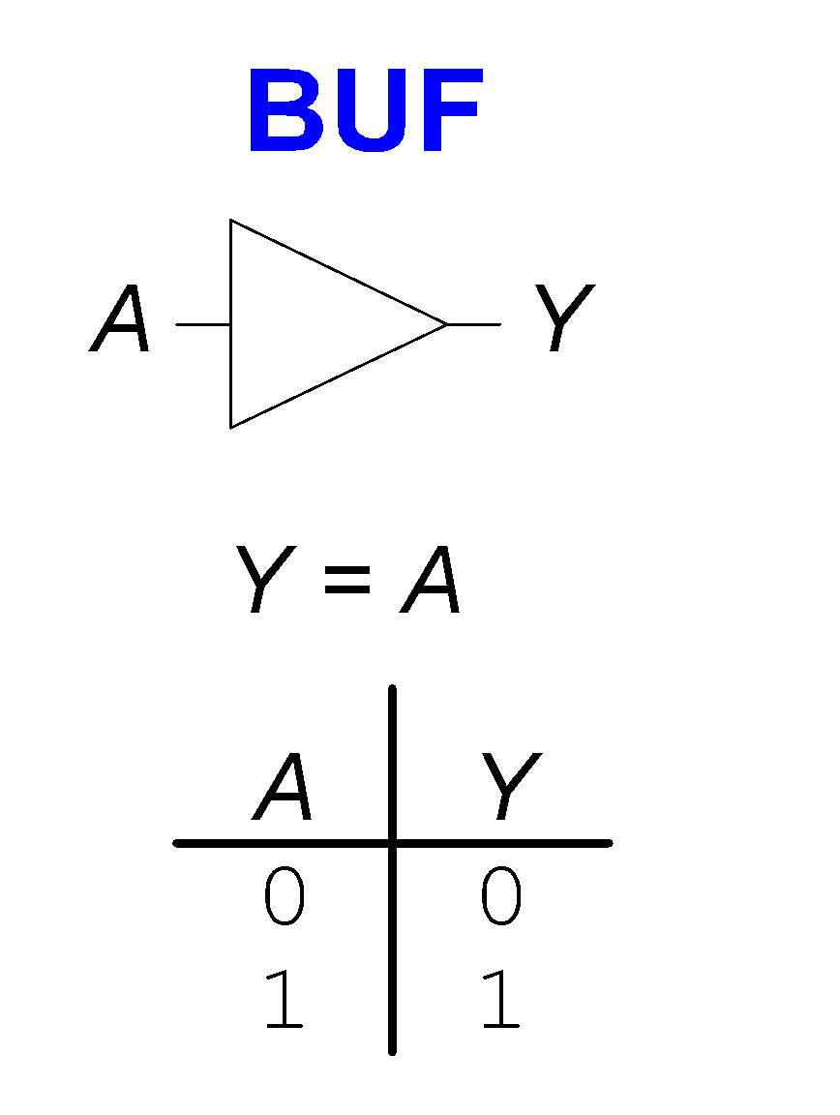
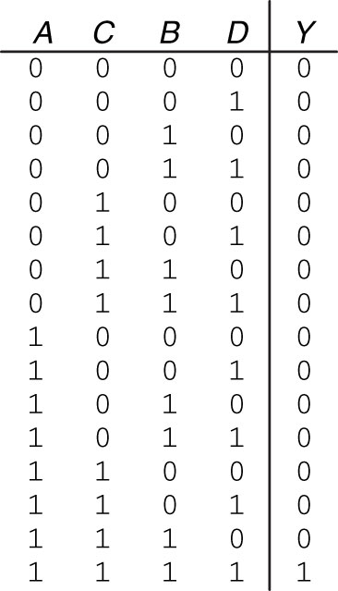
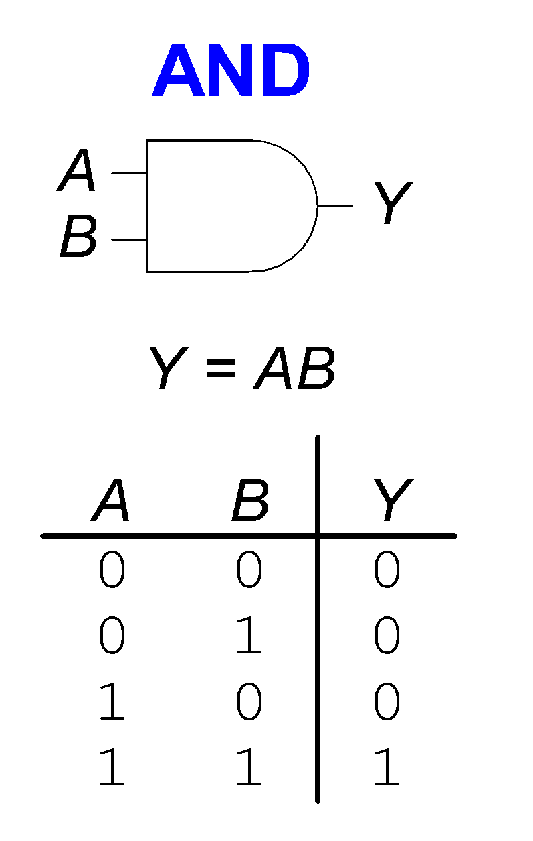
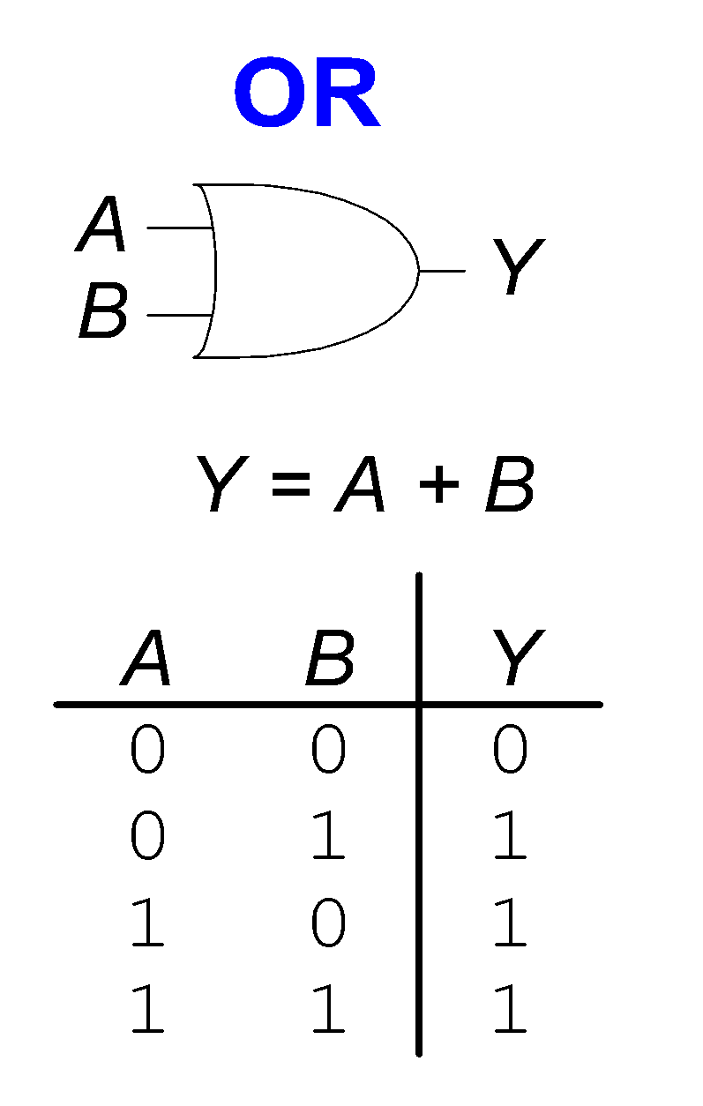
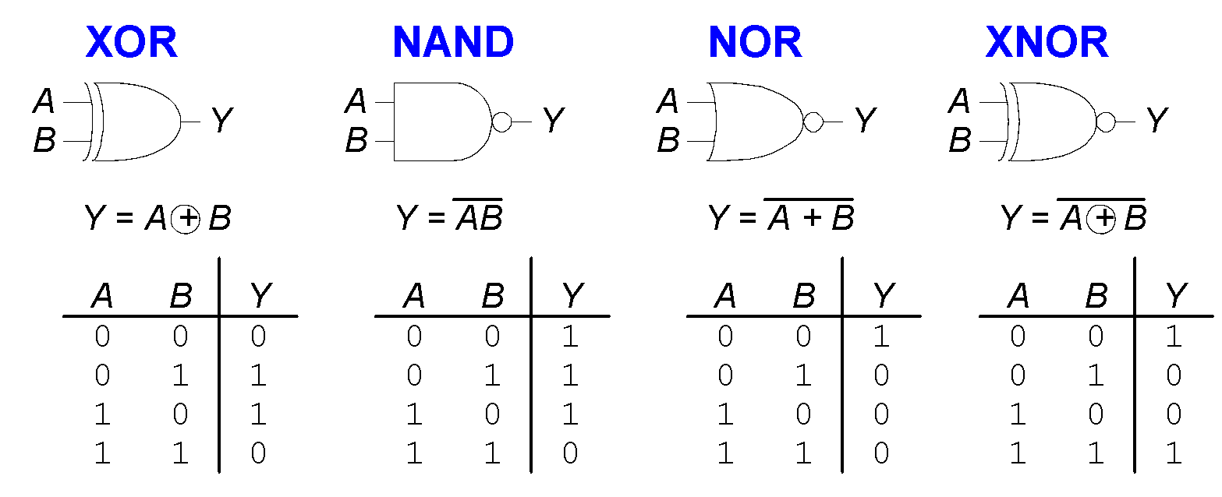
Single-Input Logic Gates
Multiple-Input Logic Gates
Two-Input Logic Gates

Slide 4
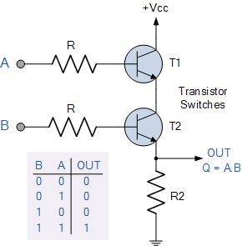
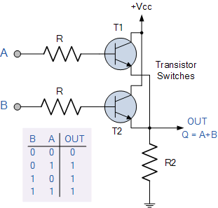
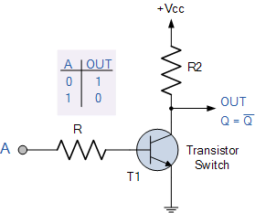
Building Gates with Transistors
AND
OR
NOT
If you put two NOTs back to back, what do you get?

Slide 5
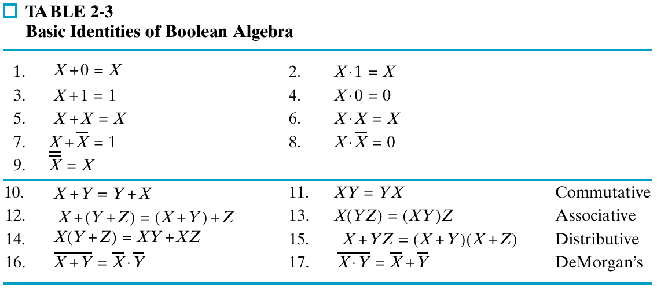
Boolean Algebra
NOR = invert, then AND
NAND = invert, then OR
Left and right columns are duals
Replace ANDs and ORs, 0s and 1s

Slide 6
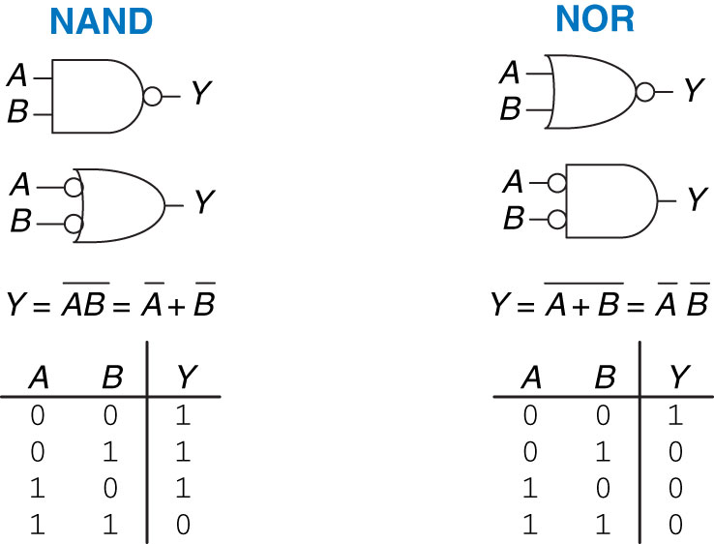
DeMorgan’s Theorem: Bubble Pushing
Bubble pushing: imagine the bubble at the output is being pushed towards the inputs
    it becomes a bubble at every input, and
    the shape of the gate changes from AND to OR, and vice versa

Slide 7
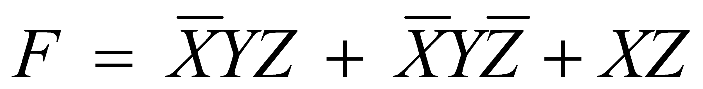
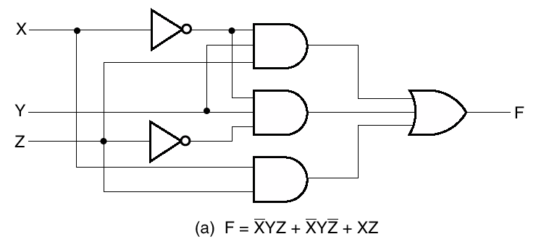
Algebraic/Boolean Manipulation
Apply algebraic and Boolean identities to simplify expression
  Example:

Slide 8
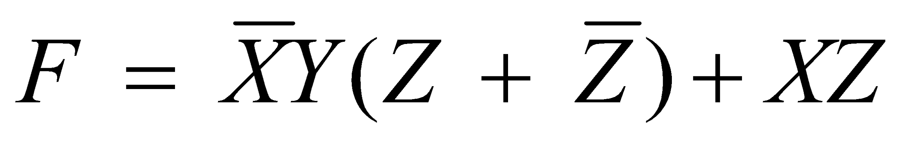

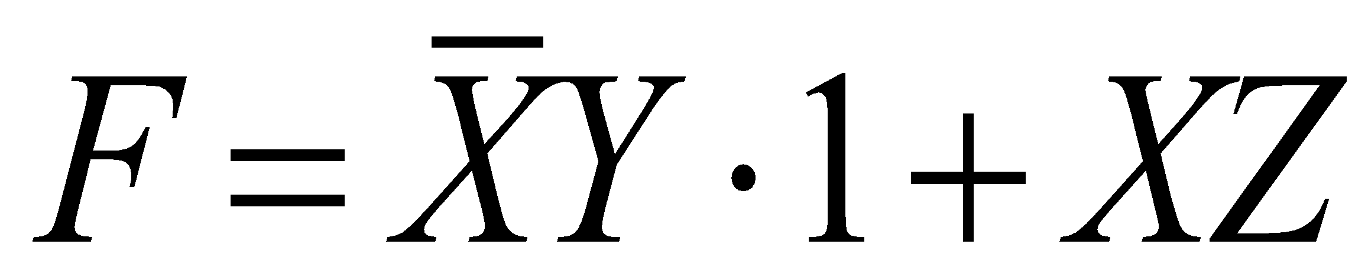

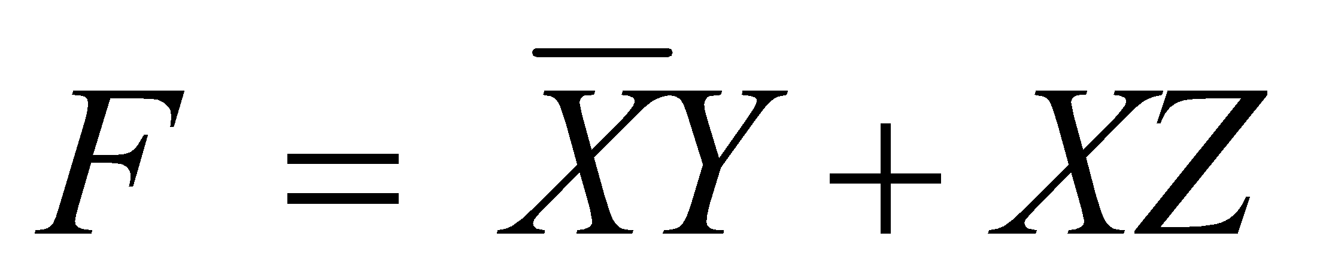
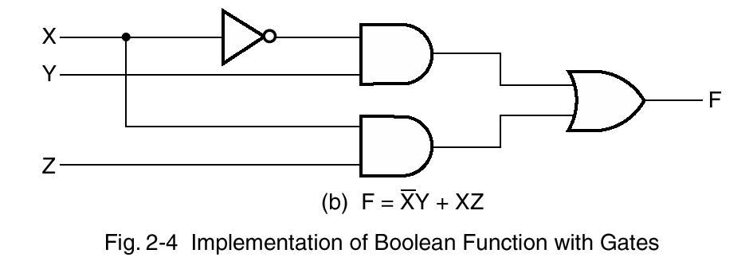
Simplification Example
Apply
Fewer Gates

Slide 9
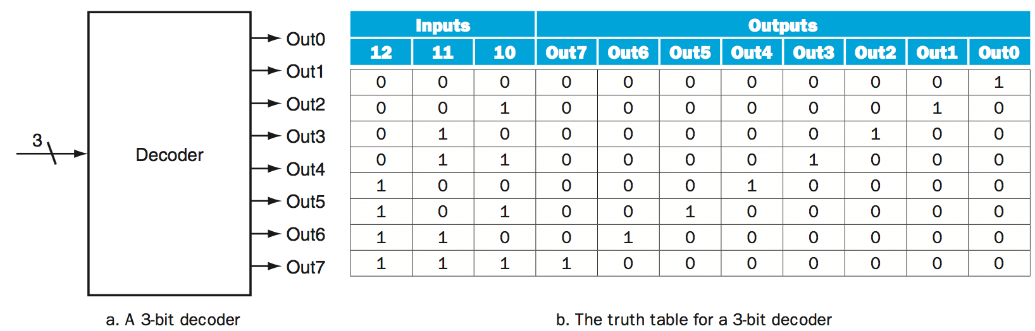
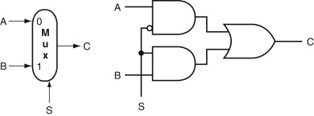
Combinational logic
A logic system whose blocks do not contain memory and hence compute the same output given the same input.
Example: Decoders
Example: Multiplexor

Slide 10
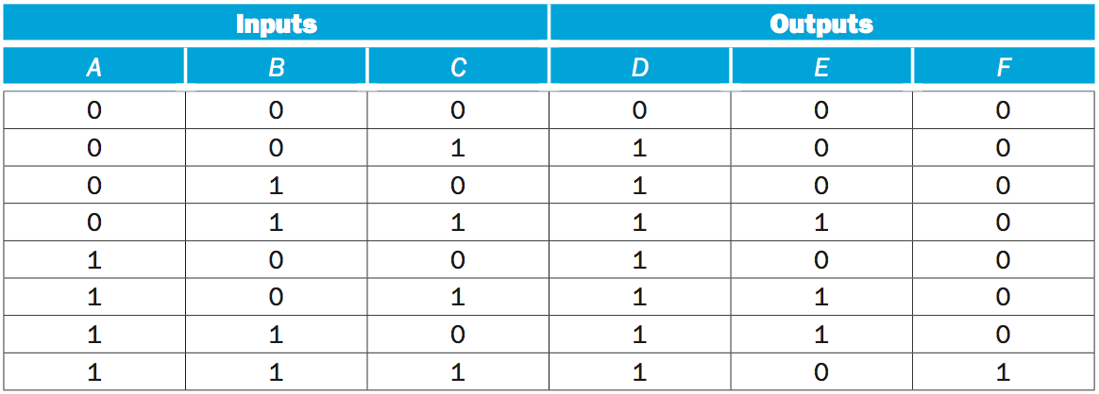
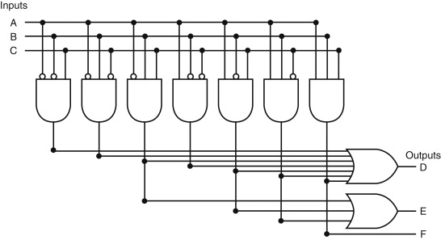
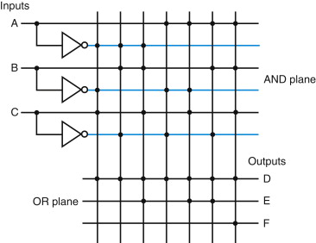
Combinational logic
Example: Programmable logic array (PLA)
Two stage logic elements functioning as a sum of products
e.g.,
D = “A not” and “B not” and “C” or
“A not” and “B” and “C not” or
….
Products
=
Sums

Slide 11
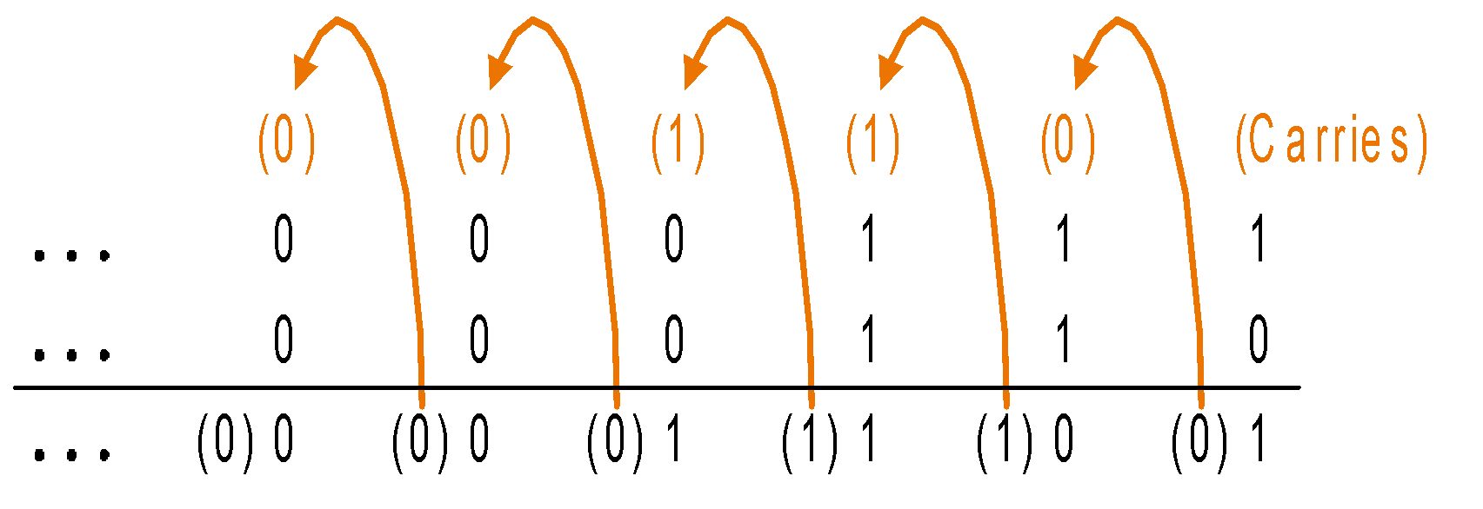
Addition and Subtraction
Digits are added bit by bit from right to left, with carries passed to the next digit to the left
Example:
0000 0000 0000 0000 0000 0111 = 7
+ 0000 0000 0000 0000 0000 0110 = 6
-----------------------------------------------
0000 0000 0000 0000 0000 1101 = 13
Subtraction uses addition: the appropriate operand is simply negated
Example:
  0000 0000 0000 0000 0000 0000 0000 0111 = 7
  - 0000 0000 0000 0000 0000 0000 0000 0110 = 6
  ------------------------------------------------------------------
  0000 0000 0000 0000 0000 0000 0000 0001 = 1
  Or using two’s complement arithmetic
  0000 0000 0000 0000 0000 0000 0000 0111 = 7
  + 1111 1111 1111 1111 1111 1111 1111 1010 = - 6
  -----------------------------------------------------------------
  0000 0000 0000 0000 0000 0000 0000 0001 = 1

Slide 12
Arithmetic Overflow
Overflow occurs when the result of an operation cannot be represented with the available hardware
Most hardware detects and signals overflow via an exception
Some high level languages ignore overflow (e.g. C and Java) and some check for and handle it (e.g. Ada and Fortran)
addu/addiu doesn’t check for overflow
Try this in MARS or in SPIM (then replace addi with addiu!)
.text
li $t0, 0x7fffffff
addi $t0, $t0, 1
Runtime exception at 0x00400008: arithmetic overflow

Slide 13
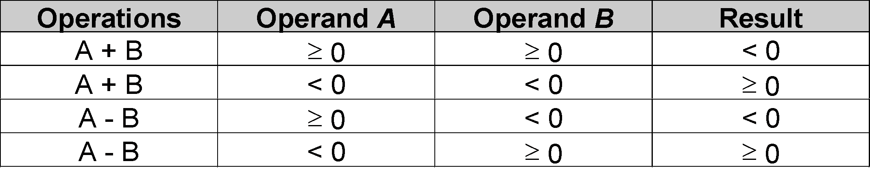
Arithmetic Overflow
How can MIPS detect an overflow?
Look at these examples (using two’s complement)
  0110 + 0101 = 1 011, 1010 + 1001 = 10011
pos. no + pos no = neg. no! 4 bit + 4 bit = 5 bit!
This is exactly how MIPS detect overflows
carry-out of the last full adder is equal to 1!
or
sign(a) = sign(b) ≠ sign(sum)

Slide 14
Overflow or No Overflow?
0 1 1 0
+ 0 1 1 1
---------
1 1 0 1
1 1 0 0
+ 1 1 0 1
---------
1 0 0 1
OVERFLOW
NO OVERFLOW
0 0 0 1
+ 1 0 0 1
---------
1 0 1 0
NO OVERFLOW
If an overflow is detected,
PC will be changed to a predefined address in memory for exception
Interrupted address is saved for resumption

Slide 15
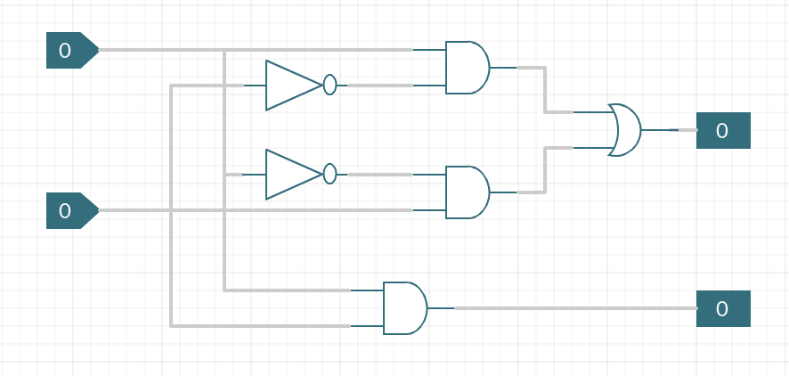
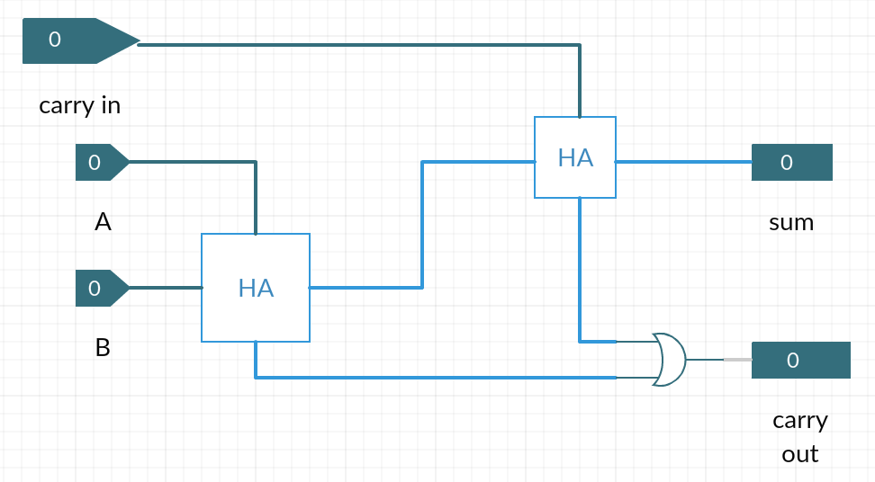
One-Bit Addition (a.k.a Half Adder)
One-Bit Addition with Carry-in (a.k.a Full Adder)
sum = A XOR B
carry = A AND B
sumfull = carryin XOR sumh1
carryout = carryh1 OR carryh2

Slide 16
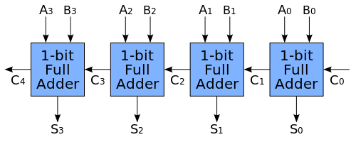
4-Bit Adder
Full Adder has 3 inputs (two operands and a carry-in) and it generates a sum bit and a carry-out to be passed to the next 1-bit adder.
By using N-full adders in series, we can obtain N-bit adders.

Slide 17
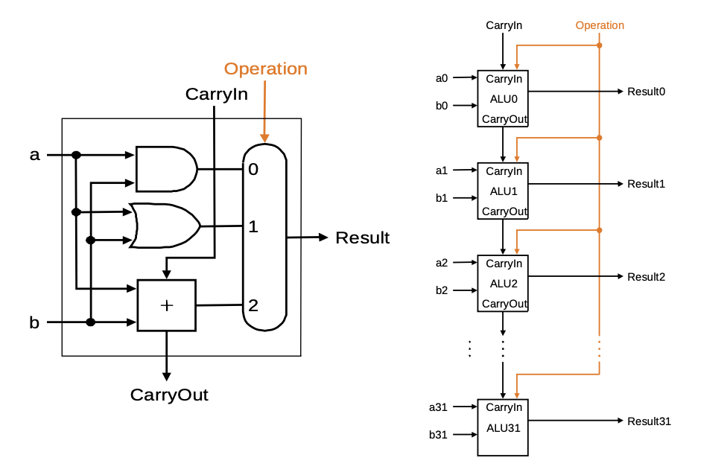
Simple Arithmetic Logic Unit: One-Bit ALU
Handles AND, OR, and binary addition. The two Operation control bits determine which result is passed through the MUX (AND, OR, or sum).
Full Adder

Slide 18
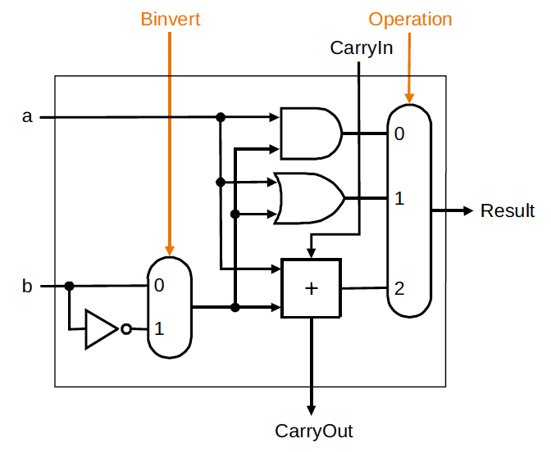
What about subtraction?
Subtraction can be performed by inverting the operand and setting the “CarryIn” input for the adder to 1 (i.e. using two’s complement)
By adding a multiplexor to the second operand, we can select either b or b
The Binvert line indicates a subtraction operation and causes the two’s complement of b to be used as an input
Notes:
The simplicity of the hardware design of a two’s complement adder explains why it is a universal standard for computer arithmetic

Slide 19
A 32-Bit ALU
A full 32-bit ALU can be created by connecting adjacent 1-bit ALU’s using the Carry-in and carry-out lines
The carry out of the least significant bit can ripple all the way through the adder (ripple carry adder)
Ripple carry adders are slow since the carry propagates from a unit to the next sequentially
Subtraction can be performed by inverting the operand and setting the “CarryIn” input for the whole adder to 1 (i.e. using two’s complement)

Slide 20
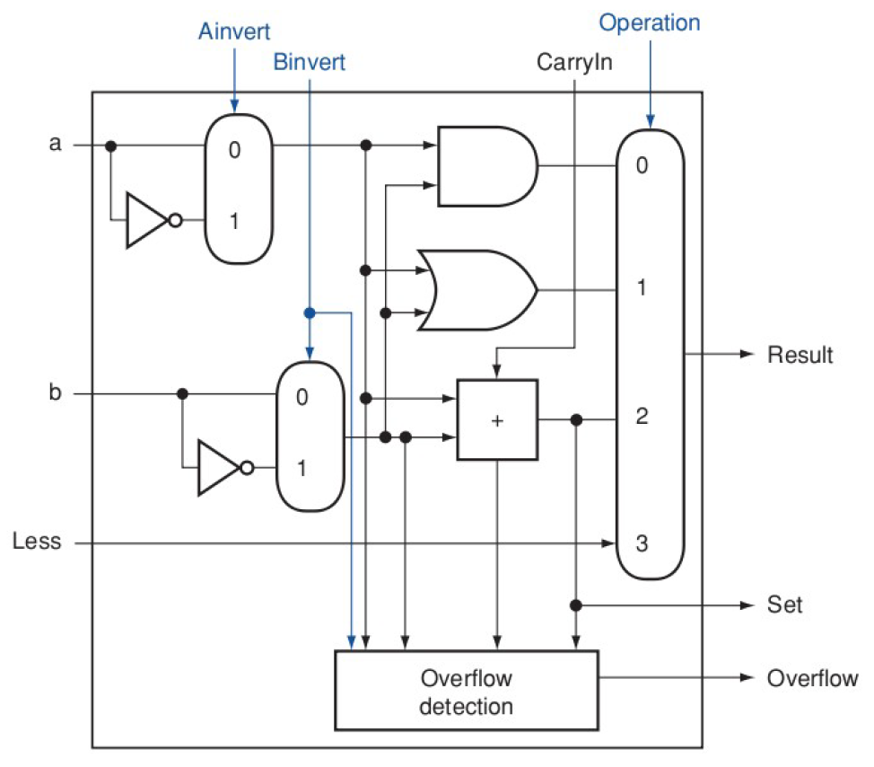
MIPS “slt” instruction
Each 1-bit ALU has an additional input called “Less”, which provides results for slt function. This input has value 0 for all but 1-bit ALU for the least significant bit.
Note that a < b if and only if (a-b) < 0, which requires “bit 31” to be 1.
Sets the least significant bit to the value of sign bit
So, it returns
1 when a<b, because bit-31 is 1
0 otherwise, because bit-31 is 0
Pay attention to the inputs to the overflow detection unit

Slide 21
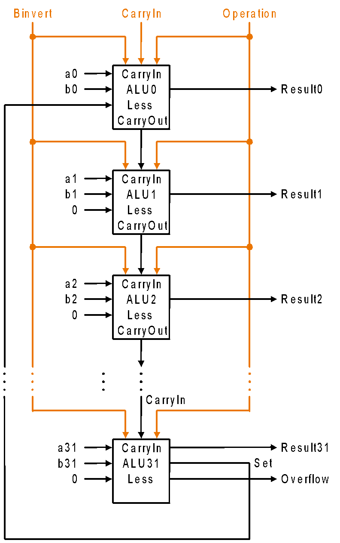
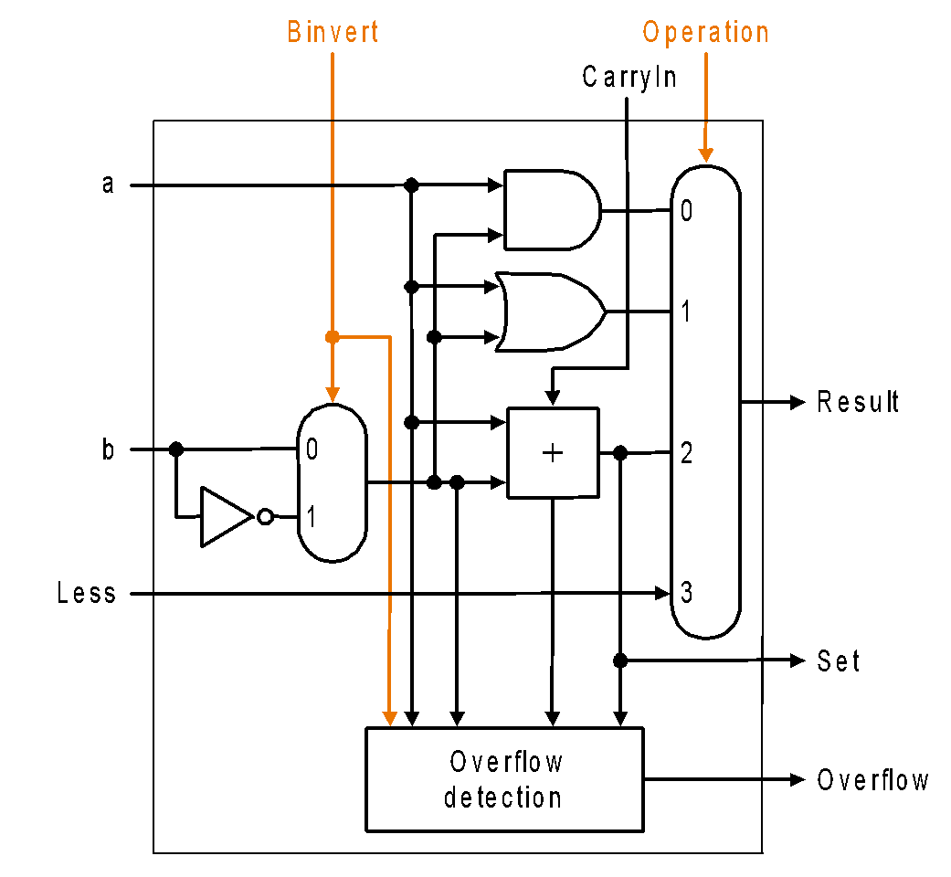
32-Bit ALU
Most Significant Bit
32-Bit Basic MIPS ALU

Slide 22
How can we do conditional branching?
Conditional Branching
“bne” and “beq” instruction compares two operands for equality
a = b if and only if (a-b) = 0
Then why don’t we
subtract b from a for all the bits
“or” all of them
if they are all 0, then the output will be 0 (iow, a=b)
otherwise, output will be 1
This is exact opposite of what we want!

Slide 23
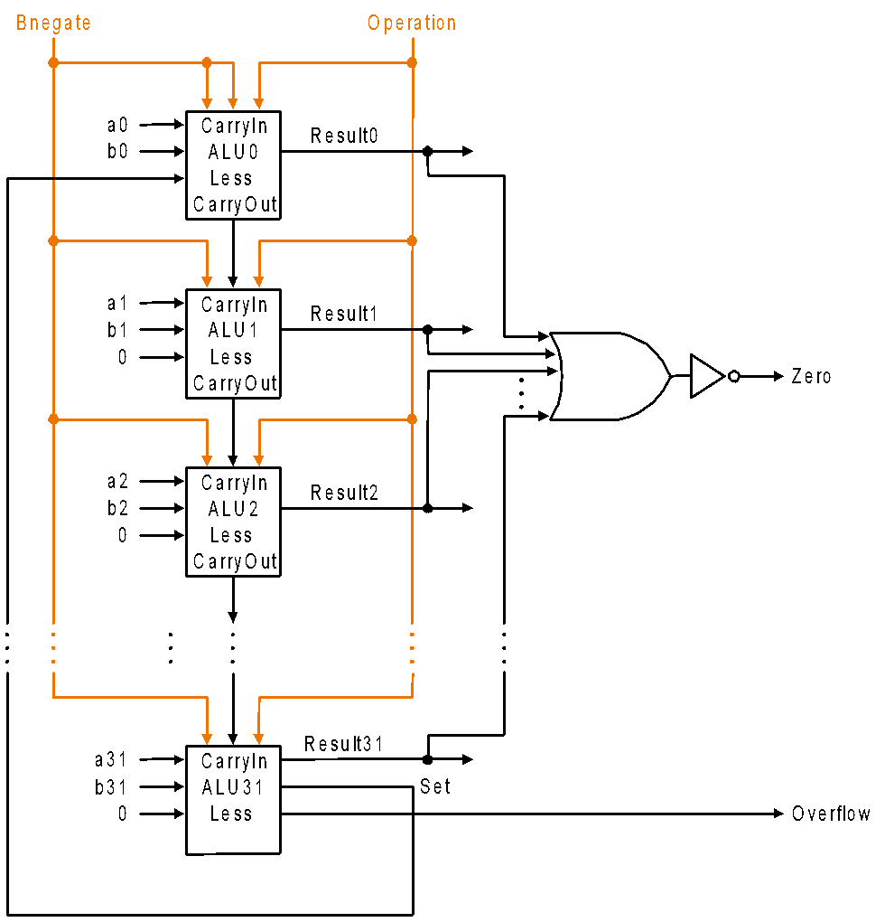
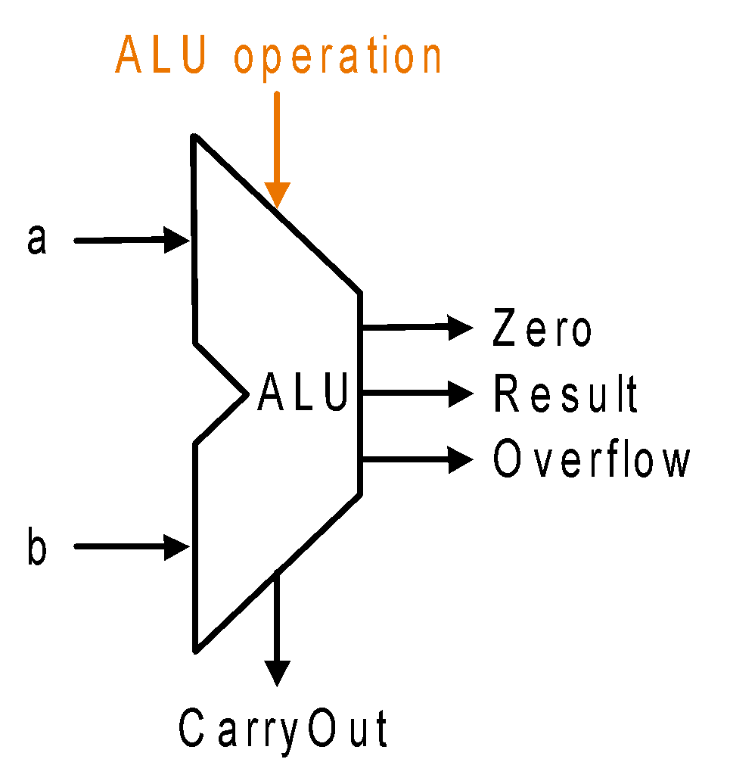
How can we do conditional branching?
ALU Symbol
MIPS’ ALU Circuits

Slide 24
Optimizing Adder’s Design
Problem with Ripple Carry Adders
The CarryIn input depends on the operation in the adjacent 1-bit adder
The result of adding most significant bits is only available after all other bits, i.e. after n-1 single-bit additions
The sequential chain reaction is too slow to be used in time-critical hardware
Approach-1: Assume we have infinite hardware!
We know that c1 = (b0 . c0) + (a0 . c0) + (a0 . b0)
Similarly, c2 = (b1 . c1) + (a1 . c1) + (a1 . b1)
Then c2 = (a1 . a0 . b0) + (a1 . a0 . c0) + (a1 . b0 . c0)
+ (b1 . a0 . b0) + (b1 . a0 . c0) + (b1 . b0 . c0) + (a1. b1)
We can build a fast adder in the expense of exponentially growing gate number

Slide 25
Optimizing Adder’s Design
Approach-2: Divide N-bits into M groups (e.g. 1011 1001 0110 1001), work on these small groups, propagate group’s “CarryOut”s
We know that
if a = 0, b = 0, we won’t have a CarryOut
if a = 1, b = 1, we will always have a CarryOut
Otherwise, CarryOut = CarryIn
p = a or b
g = a and b
c_{i+1} = (b_{i} . c_{i}) + (a_{i} . c_{i}) + (a_{i} . b_{i})
= (a_{i} . b_{i}) + c_{i} . (a_{i} + b_{i})
= g_{i} + c_{i} . p_{i}
a b c-out
0 0 0 “kill”
0 1 c-in “propagate”
1 0 c-in “propagate”
1 1 1 “generate”

Slide 26
Carry Lookahead (propagate & generate)
c-in
a0
S
g
b0
p
c1 =g0 + c0 ∙ p0
a1
S
g
b1
p
c2 = g1 + g0 ∙ p1 + c0 ∙ p0 ∙ p1
a2
S
g
b2
p
c3 = g2 + g1 ∙ p2 + g0 ∙ p1 ∙ p2 + c0 ∙ p0 ∙ p1 ∙ p2
a3
S
g
g
b3
p
p

Slide 27
An Example
Determine g_{i}, p_{i}, P_{i}, G_{i} and carry out (C₄) values for these two 16-bit numbers:
    a: 0001 1010 0011 0011
    b: 1110 0101 1110 1011
Answer: Using the formula g_{i} = (a_{i} . b_{i}) and p_{i} = (a_{i} + b_{i})
  g_{i} : 0000 0000 0010 0011
  p_{i} : 1111 1111 1111 1011
  The “super” propagates (P₀ , P₁ , P₂ , P₃) are calculated as follows:
  P₀ = p₃. p₂. p₁. p₀ = 0 P₁ = p₇. p₆. p₅. p₄ = 1
  P₂ = p₁₁. p₁₀. p₉. p₈ = 1 P₃ = p₁₅. p₁₄. p₁₃. p₁₂ = 1
  The “super” generates (G₀ , G₁ , G₂ , G₃) are calculated as follows:
  G₀ = g₃ + (p₃.g₂) + (p₃.p₂.g₁) + (p₃.p₂.p₁.g₀) = 0
  G₁ = g₇ + (p₇.g₆) + (p₇.p₆.g₅) + (p₇.p₆.p₅.g₄) = 1
  G₂ = g₁₁ + (p₁₁.g₁₀) + (p₁₁.p₁₀.g₉) + (p₁₁.p₁₀.p₉.g₈) = 0
  G₃ = g₁₅ + (p₁₅.g₁₄) + (p₁₅.p₁₄.g₁₃) + (p₁₅.p₁₄.g₁₃.g₁₂) = 0
  Finally carry-out (C₄) is:
  C₄ = G₃ + (P₃.G₂) + (P₃.P₂.G₁) + (P₃.P₂.P₁.G₀) + (P₃.P₂.P₁.P₀.C₀) = 1

