Slide 1
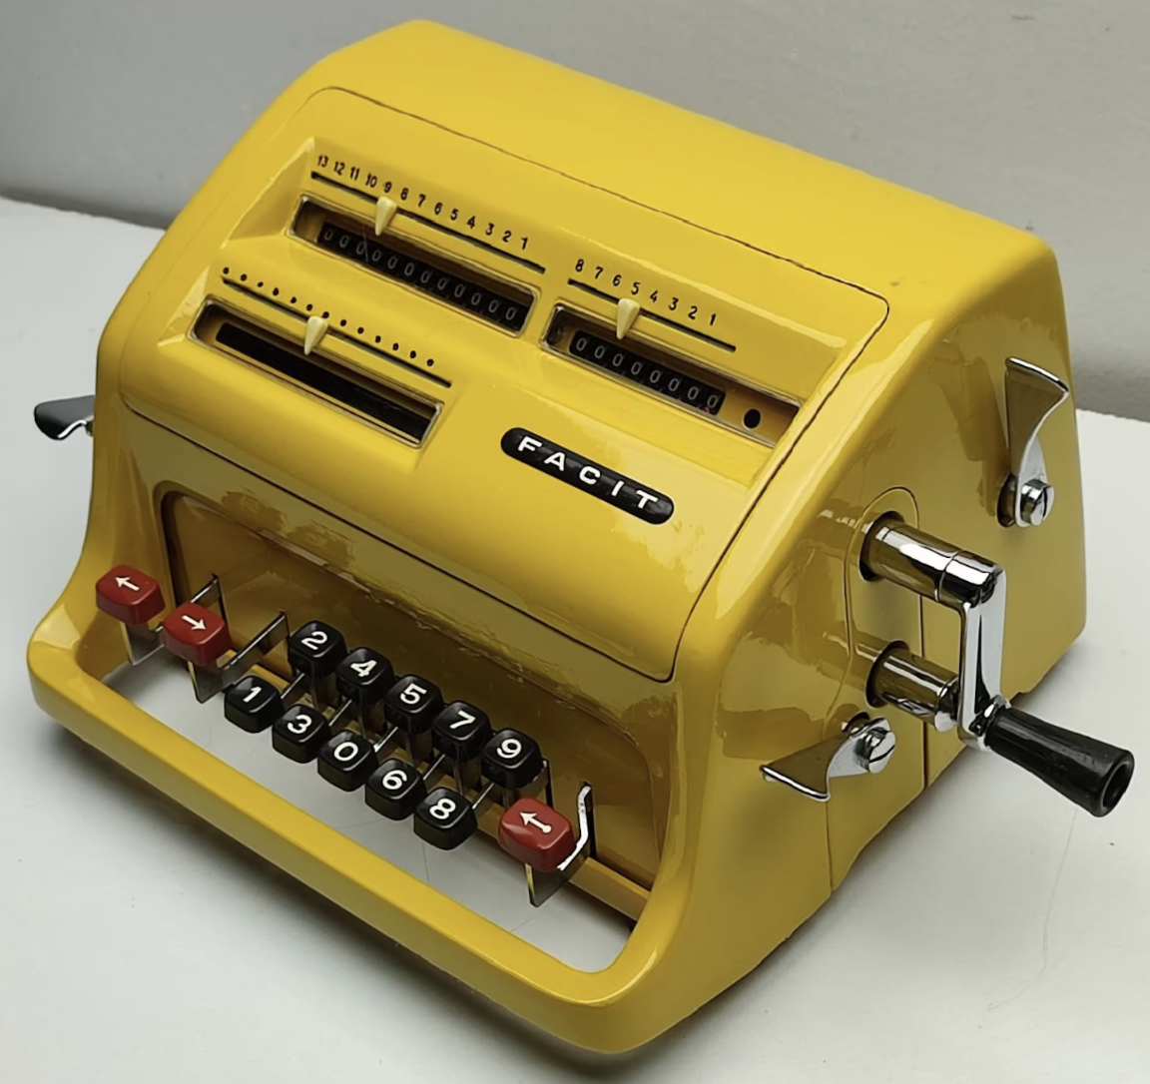
CMSC 411 | Computer Architecture Lecture 11: Multiplier Design
Dr. Ergun Simsek
Facit C1-13
https://www.youtube.com/watch?v=zJ3q4zjCKnM

Slide 2
Overview
Previous Lecture
Constructing an Arithmetic Logic Unit
Addition, subtraction, slt, and branching
This Lecture
Algorithms for multiplying unsigned numbers
Booth’s algorithm for signed number multiplication
Multiple hardware design for integer multiplier

Slide 3
How Humans Multiply
Multiplicand 1000 Multiplier x1001 + Product
m bits
n bits
1000
0000
0000
1000
0
1001000
m+n bits
Computer does the almost same thing
Unsigned mult has no overflow risk, so let’s forget about the sign problem and focus on some mult designs
How would you design it?
Binary makes things easy
0 => place 0 ( 0 x multiplicand )
1 => place a copy ( 1 x multiplicand )

Slide 4
Unsigned Combinational Multiplier
0
0
0
0
0
0
0
A₃
A₂
A₁
A₀
B₀
A₃
A₂
A₁
A₀
B₁
A₃
A₂
A₁
A₀
B₂
A₃
A₂
A₁
A₀
B₃
P₇
P₆
P₅
P₄
P₃
P₂
P₁
P₀
Stage i accumulates A * 2^{i} if B_{i} == 1
At each stage shift A left ( x 2)
Use next bit of B to determine whether to add in shifted multiplicand
Accumulate 2n bit partial product at each stage

Slide 5
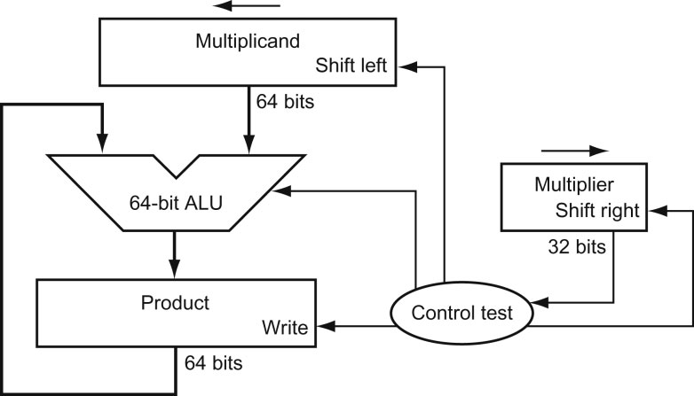
Unsigned shift-add multiplier (version 1)
Assume we have a
64-bit multiplicand register,
64-bit ALU,
64-bit product register, and
32-bit multiplier register
The 32-bit value of the multiplicand starts in the right half of the 64-bit register
The multiplier is shifted in the opposite direction of the multiplicand shift
The product register starts with an initial value of zero
Control decides when to shift the multiplicand and the multiplier registers and when to write new value into the product register

Slide 6
Unsigned shift-add multiplier (version 1)
Multiplicand
Shift Left
64 bits
Multiplier
Shift Right
Add
64-bit ALU
32 bits
Product
Write
Control
64 bits
Multiplier = Datapath + Control

Slide 7
Unsigned shift-add multiplier (version 1)
1000 x1001
????
Multiplicand
Shift Left
0000…………………1000
64 bits
Multiplier
0………1001
Shift Right
Add
64-bit ALU
32 bits
Product
0000…………………0000
Write
Control
64 bits
Multiplicand 1000 Multiplier x1001
Product 00000000
Multiplier = Datapath + Control

Slide 8
Unsigned shift-add multiplier (version 1)
1000 x1001
????
Multiplicand
Shift Left
0000…………………1000
64 bits
Multiplier
0………1001
Shift Right
Add
64-bit ALU
32 bits
Product
0000…………………0000
Write
Control
64 bits
Multiplier = Datapath + Control

Slide 9
Unsigned shift-add multiplier (version 1)
1000 x1001
????
Multiplicand
Shift Left
0000…………………1000
64 bits
0000…………………0000
0000…………………1000
Multiplier
0………1001
Shift Right
Add
64-bit ALU
32 bits
Product
0000…………………0000
Write
Control
64 bits
Multiplier = Datapath + Control

Slide 10
Unsigned shift-add multiplier (version 1)
1000 x1001
????
Multiplicand
Shift Left
0000…………………1000
64 bits
0000…………………0000
0000…………………1000
Multiplier
0………1001
Shift Right
Add
64-bit ALU
32 bits
Product
0000…………………1000
Write
Control
64 bits
Multiplier = Datapath + Control

Slide 11
Unsigned shift-add multiplier (version 1)
1000 x1001
????
Multiplicand
Shift Left
0000…………………1000
64 bits
0000…………………0000
0000…………………1000
Multiplier
0………1001
Shift Right
Add
64-bit ALU
32 bits
Product
0000…………………1000
Write
Control
64 bits
Multiplier = Datapath + Control

Slide 12
Unsigned shift-add multiplier (version 1)
Multiplicand
Shift Left
000…………………10000
64 bits
Multiplier
00………100
Shift Right
Add
64-bit ALU
32 bits
Product
0000…………………1000
Write
Control
64 bits
Multiplier = Datapath + Control

Slide 13
Unsigned shift-add multiplier (version 1)
Multiplicand
Shift Left
000…………………10000
64 bits
Multiplier
00………100
Shift Right
Add
64-bit ALU
32 bits
Product
0000…………………1000
Write
Control
64 bits
Multiplier = Datapath + Control

Slide 14
Unsigned shift-add multiplier (version 1)
Multiplicand
Shift Left
00…………………100000
64 bits
Multiplier
000………10
Shift Right
Add
64-bit ALU
32 bits
Product
0000…………………1000
Write
Control
64 bits
Multiplier = Datapath + Control

Slide 15
Unsigned shift-add multiplier (version 1)
Multiplicand
Shift Left
00…………………100000
64 bits
Multiplier
000………10
Shift Right
Add
64-bit ALU
32 bits
Product
0000…………………1000
Write
Control
64 bits
Multiplier = Datapath + Control

Slide 16
Unsigned shift-add multiplier (version 1)
Multiplicand
Shift Left
0…………………1000000
64 bits
Multiplier
0000………1
Shift Right
Add
64-bit ALU
32 bits
Product
0000…………………1000
Write
Control
64 bits
Multiplier = Datapath + Control

Slide 17
Unsigned shift-add multiplier (version 1)
Multiplicand
Shift Left
0…………………1000000
64 bits
Multiplier
0000………1
Shift Right
Add
64-bit ALU
32 bits
Product
0000…………………1000
Write
Control
64 bits
Multiplier = Datapath + Control

Slide 18
Unsigned shift-add multiplier (version 1)
Multiplicand
Shift Left
0…………………1000000
64 bits
0000…………………1000
0…………………1000000
Multiplier
0000………1
Shift Right
Add
64-bit ALU
32 bits
Product
0000…………………1000
Write
Control
64 bits
Multiplier = Datapath + Control

Slide 19
Unsigned shift-add multiplier (version 1)
Multiplicand
Shift Left
0…………………1000000
64 bits
0000…………………1000
0…………………1000000
Multiplier
0000………1
Shift Right
Add
64-bit ALU
32 bits
Product
0000……………1001000
Write
Control
64 bits
Multiplier = Datapath + Control

Slide 20
Unsigned shift-add multiplier (version 1)
Multiplicand
Shift Left
0…………………1000000
64 bits
0000…………………1000
0…………………1000000
Multiplier
0000………1
Shift Right
Add
64-bit ALU
32 bits
Product
0000……………1001000
Write
Control
64 bits
Multiplier = Datapath + Control

Slide 21
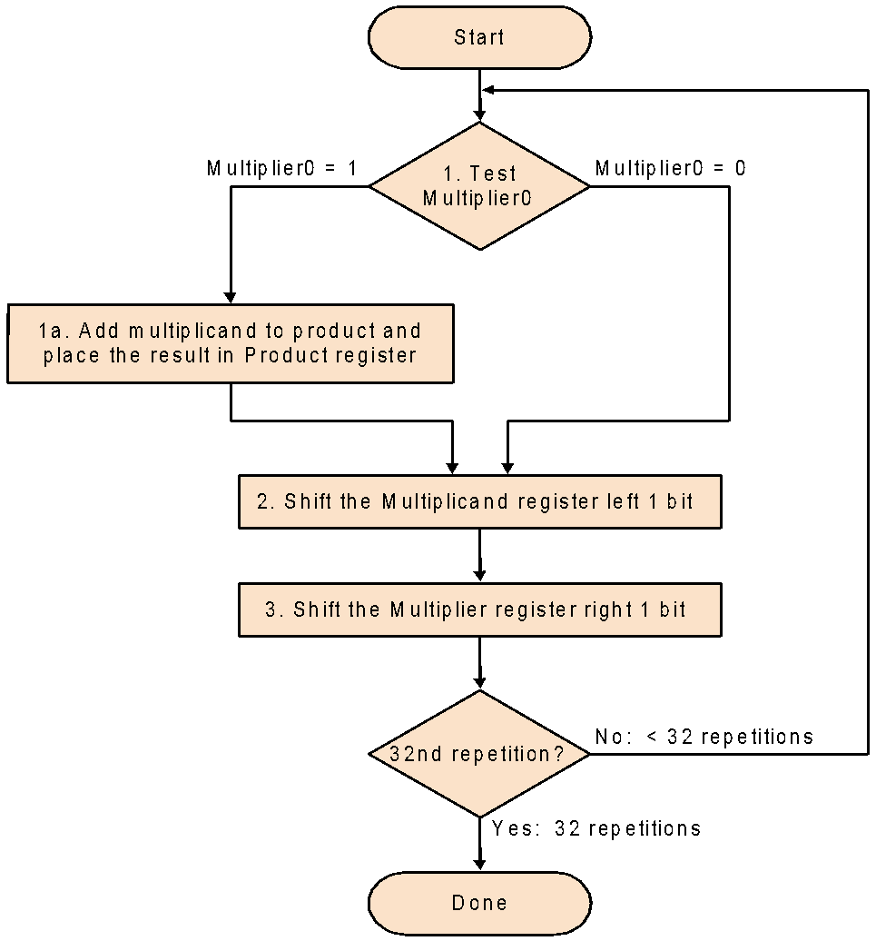
Multiply Algorithm Version 1
Multiplying two n-bit numbers needs a maximum of 2n² addition operations mostly for adding zeros
If the least significant bit of the multiplier is
1, then add the multiplicand to the product
0, then go to the next bit
Shift the multiplicand left and the multiplier right
Repeat for 32 times

Slide 22
Multiply Hardware Version 2
Since half of the 64-bit Multiplicand are zeros, a 64-bit ALU looks wasteful in the first version of multiplier
This version uses only 32-bit Multiplicand register, 32-bit ALU, 64-bit Product register, and 32-bit Multiplier register
Since the least significant bits of the product would not change, the product could be shifted to the right instead of shifting the multiplicand
The most significant 32-bits would be used by the ALU as a result register
Multiplicand
32 bits
Multiplier
Shift Right
32-bit ALU
32 bits
Shift Right
Product
Control
64 bits
Write

Slide 23
Multiply Algorithm Version 2
0
0
0
0
A₃
A₂
A₁
A₀
B₀
A₃
A₂
A₁
A₀
Multiplicand stays still
Product shifts right
Multiplier shifts right!
B₁
A₃
A₂
A₁
A₀
B₂
A₃
A₂
A₁
A₀
B₃
P₇
P₆
P₅
P₄
P₃
P₂
P₁
P₀

Slide 24
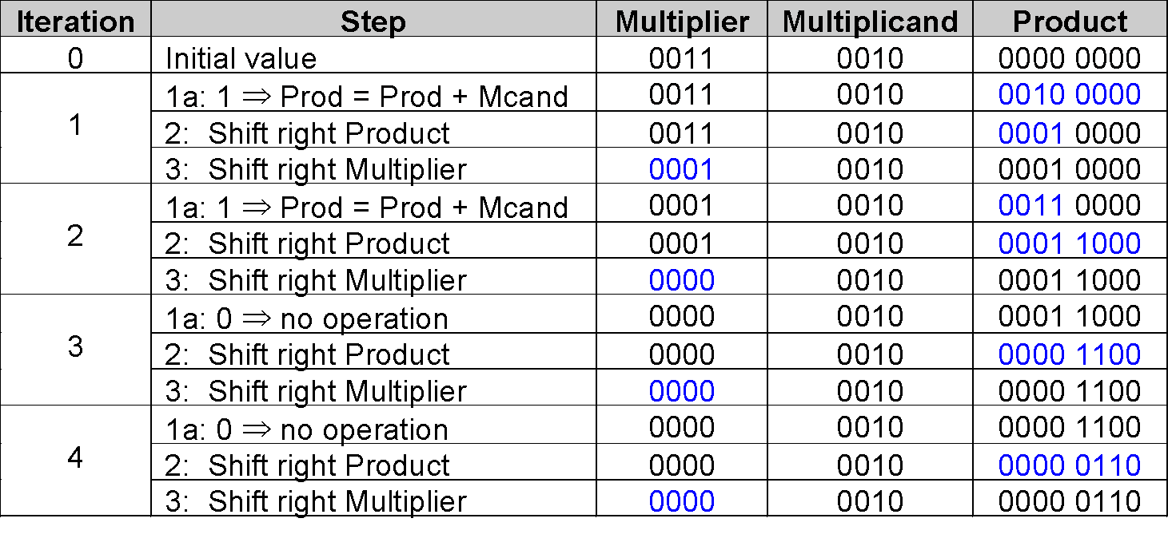
An Example
Follow the multiplication algorithm (version 2) to get the product of 2 × 3 using only 4-bit binary representation
Doesn’t
Change
Can we do something better?

Slide 25
Multiply Hardware Version 3
Product register wastes space that exactly matches size of multiplier ⇒ combine Multiplier register and Product register
Uses only 32-bit Multiplicand register, 32-bit ALU, 64-bit Product register, and 0-bit Multiplier register
Shifting the product register would remove the least significant bit which is already used in the multiplication
The most significant 32-bits are still being used by ALU as a result register
Multiplicand
32 bits
32-bit ALU
Shift Right
Product
(Multiplier)
Control
64 bits
Write

Slide 26
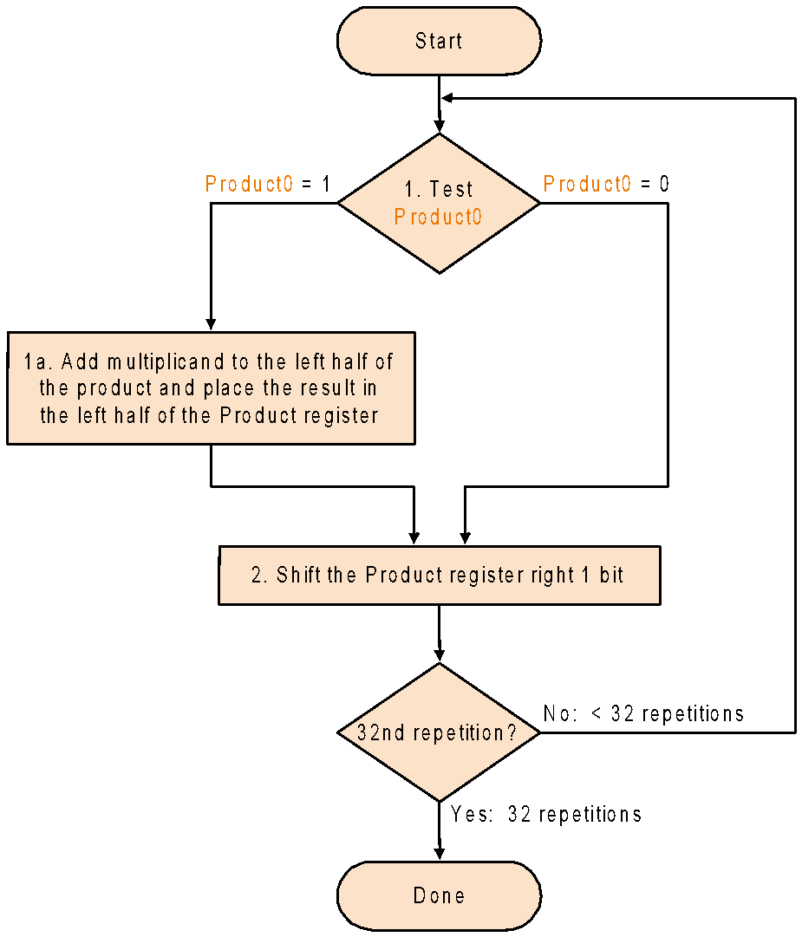
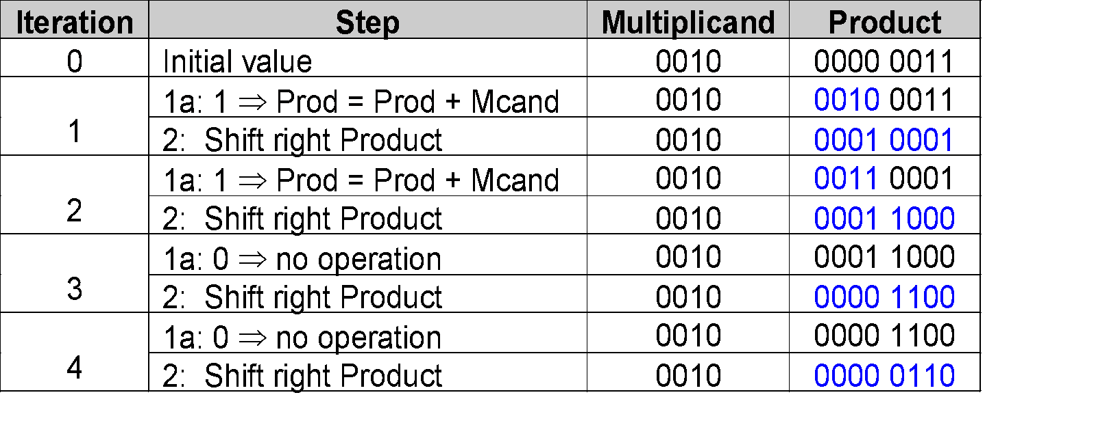
Multiply Algorithm Version 3
2 steps per bit because Multiplier & Product combined
The product of 2 × 3
MIPS registers Hi & Lo

Slide 27
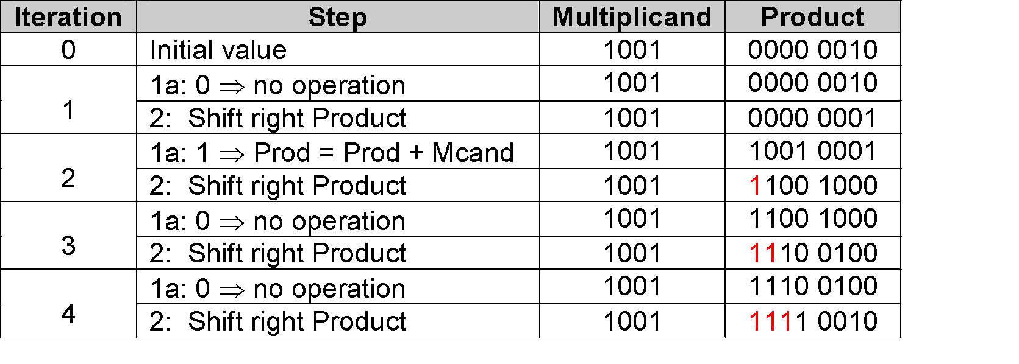
Multiplying Signed Number
Easiest solution is to make both positive and remember whether to complement product when done (leave out the sign bit, run for 31 steps)
Alternative idea: Apply definition of 2’s complement ⇒ need to sign-extend partial products
Example: multiply 1001 (-7) by 0010 (+2)
-128+(64+32+16+2) = -14
Does it work for all cases?

Slide 28
Multiply 0111 (+7) by 1110 (-2)
Iteration | Step | Multiplicand | Product
0 | Initial value | 0111 | 0000 1110
1 | 1a: 0 ⇒ no operation | 0111 | 0000 1110
 | 2: Shift right Product | 0111 | 0000 0111
2 | 1a: 1 ⇒ Prod = Prod + Mcand | 0111 | 0111 0111
 | 2: Shift right Product | 0111 | 0011 1011
3 | 1a: 0 ⇒ Prod = Prod + Mcand | 0111 | 1010 1011
 | 2: Shift right Product | 0111 | 1101 0101
4 | 1a: 0 ⇒ Prod = Prod + Mcand | 0111 | 0100 0101
 | 2: Shift right Product | 0111 | 0010 0010
×
Solution: Booth’s Algorithm
An elegant way to multiply signed numbers using same hardware as before and save cycles

Slide 29
The Idea Behind Booth’s Algorithm
Let’s say we want to compute the following multiplication
1101 × 0111
Since there are three 1’s in 0111, normally this would require
3 “8-bit numbers addition” = 24 “1-bit addition”
How about writing the same multiplication in the following format?
1101 × (1000-0001)
There are two 1’s here, this would require
1 “8-bit numbers addition” and 1 “8-bit numbers subtraction”
Booth observed and proved that this can be partially applied to multiplication of long binary numbers

Slide 30
Booth’s Algorithm
Let’s say we want to multiply M by n = 6
n = 6 = (0110)₂
Product = M * (8 – 2)
= (M * 8) - (M * 2)
= (M * 2³) - (M * 2¹)
= shifting M left by 3 - shifting M left by 1
How can this be implemented on ALU? Booth came up with the following algo
Scan left from the LSB, compare current “bit i” with the previous “bit i-1” to take the arithmetic action
00 ⇒ no arithmetic operation
01 ⇒ add multiplicand to left half of product
10 ⇒ subtract multiplicand from left half of product
11 ⇒ no arithmetic operation
Important: If it is the FIRST pass, use 0 as the previous LSB.

Slide 31
Binary Arithmetic
2⁵ 2⁴ 2³ 2² 2¹ 2⁰
0 1 1 0 0 0 ⇒ 24 = 2⁵ – 2³ = 32 – 8
Starting from LSB, scan left 0 0 ⇒ no arithmetic operation
0 1 ⇒ add 2^{i} to the sum
1 0 ⇒ subtract 2^{i} from the sum
1 1 ⇒ no arithmetic operation
0010 2
x 0110 x 6
Product = 2 * (8 – 2)
= (2 * 8) - (2 * 2)
= (0010 * 2³) - (0010 * 2¹)
= (shift 0010 left by 3) – (shifting 0010 left by 1)
= 0001 0000 – 0000 0100
= 0001 0000 + 1111 1100 (2’s complement of 4)

Slide 32
Booth’s Algorithm
Why should we use Booth’s Algorithm?
Provides fast multiplication for consecutive 0's or 1's in the multiplier
Handles signed multiplication
Extend the sign when shifting to preserve the sign (arithmetic right shift)

Slide 33
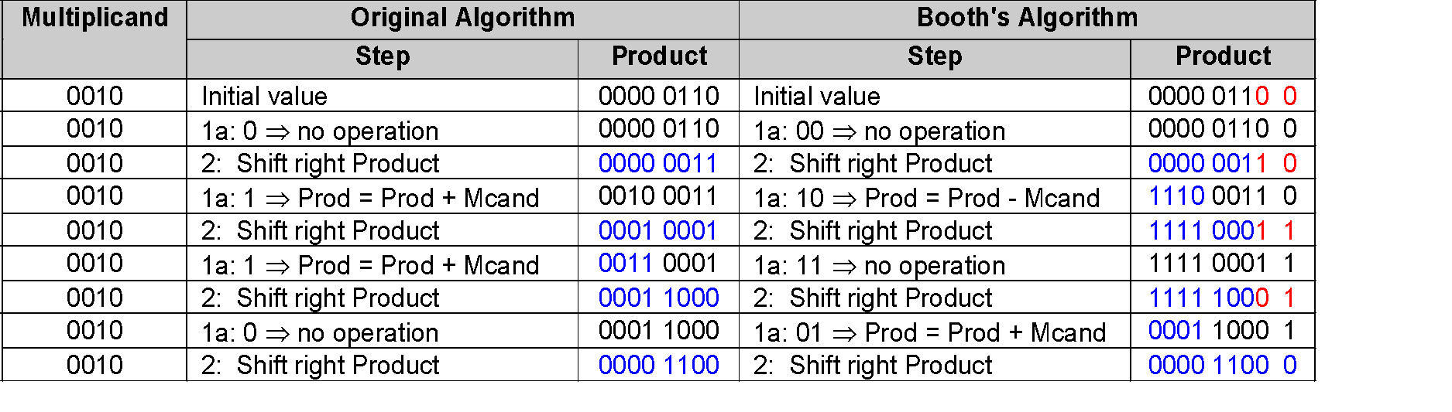
Example (unsigned numbers)
Compare the multiplication algorithm (version 3) and Booth’s algorithm applied to getting the product of 2 × 6 using only 4-bit binary representation
Booth’s algorithm uses both the current bit and the previous bit to determine its course of action
Extend the sign when shifting to preserve the sign (arithmetic right shift)

Slide 34
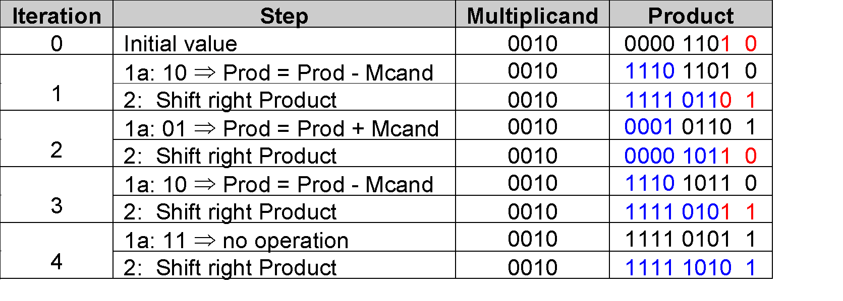
Example (signed numbers)
Follow Booth’s algorithm to get the product of 2 × -3 using only 4-bit binary representation

Slide 35
Faster Multiplication-1
We know whether the multiplicand is to be added or not at the beginning of the multiplication by looking at each of the 32 multiplier bits
Faster multiplications are possible by essentially providing one 32-bit adder for each bit of the multiplier
Input-1: the multiplicand ANDed with a multiplier bit
Input-2: the output of a prior adder

Slide 36
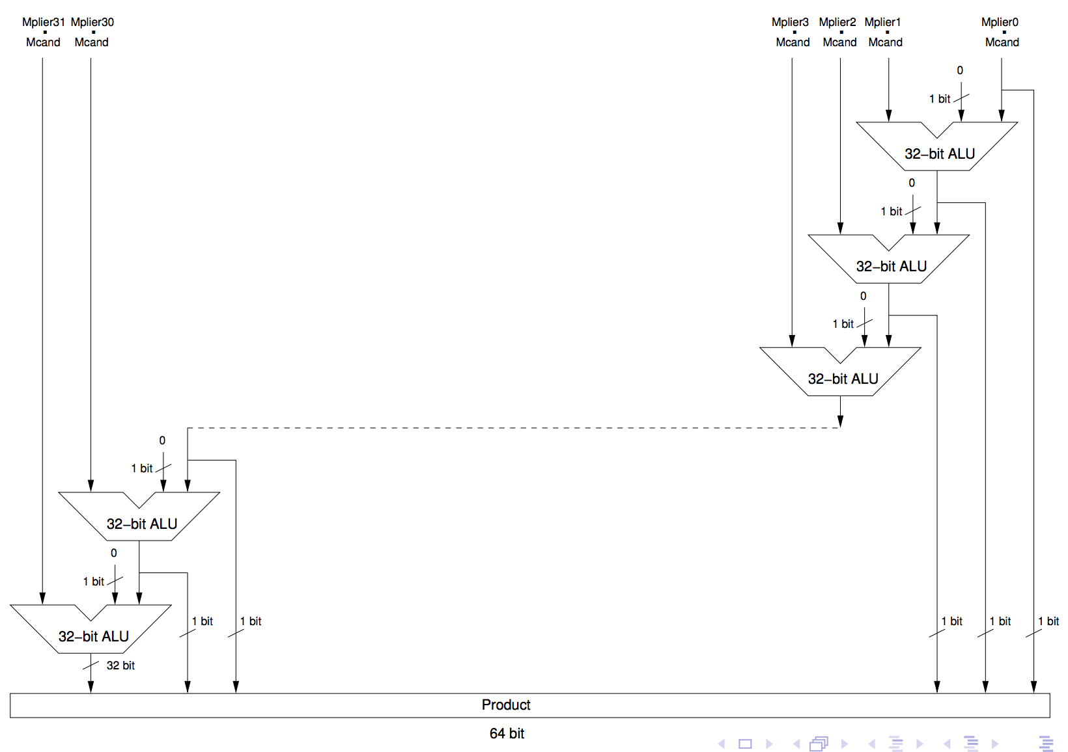
Faster Multiplication-1
Since we deal with bit-wise ANDs, no data storage is required

Slide 37
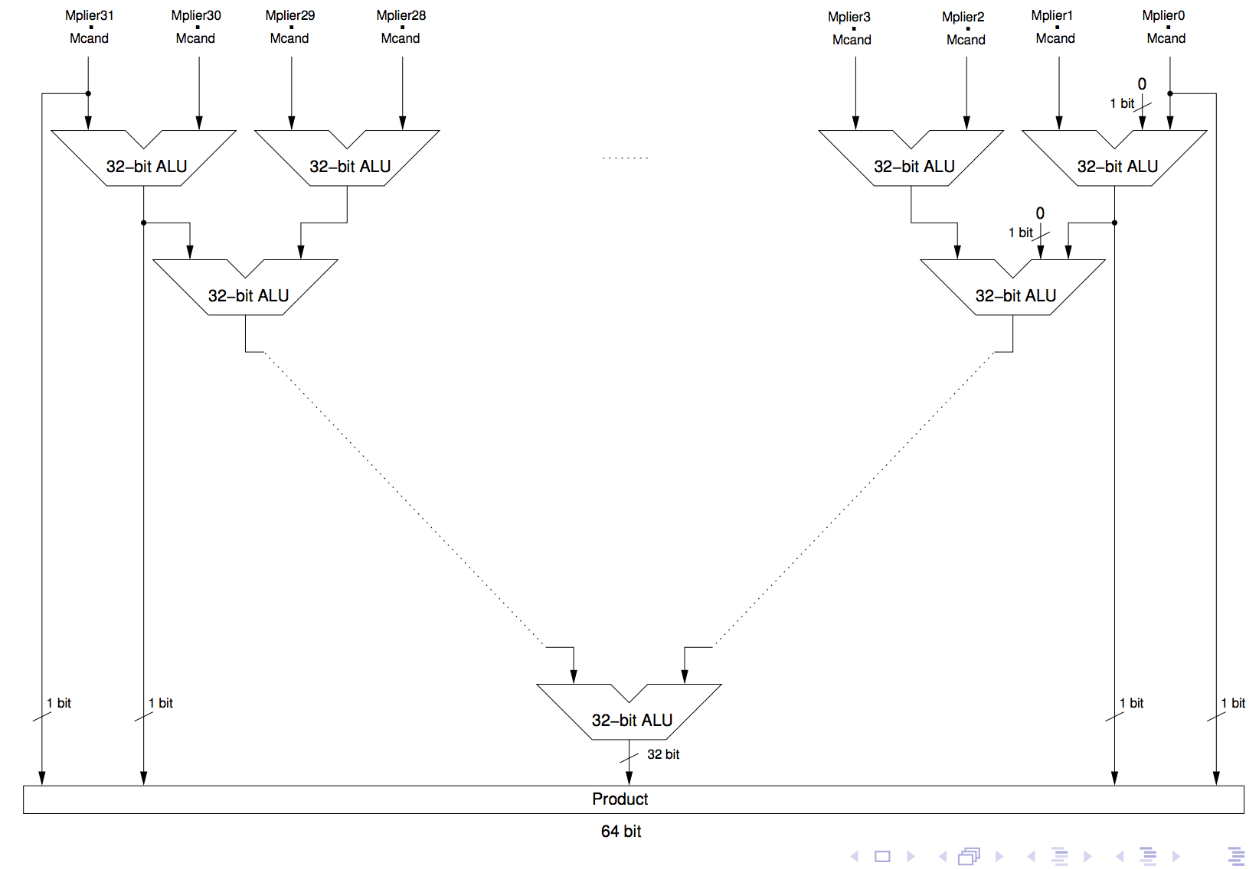
Faster Multiplication-2

