Slide 1
REST APIs and Android
Presented by:
James Simshaw

Slide 2
What is REST?
REpresentational
State
Transfer

Slide 3
Why Use REST APIs?
Communicate with a web application
Simple interface for sending and retrieving data
No need to directly touch a database

Slide 4
NEVER Run a Call to a REST API on the Main Thread

Slide 5
Libraries
Volley
  Created by Google
Retrofit
  Created by Square
  compile 'com.squareup.retrofit2:retrofit:2.0.0-beta3'

Slide 6
Retrofit's REST API Interface
public interface InternalAPI {
@GET("items.json")
Call<List<Item>> getItems();
@POST("items.json")
Call<Item> createItem(@Body Item item);
@PATCH("item/{id}.json")
Call<Item> updateItem(@Path("id") long id, @Body Item item);
}

Slide 7
Preparing to Call
Retrofit retrofit = new Retrofit.Builder()
.baseUrl(getString(R.string.internalAPIBase))
.addConverterFactory(GsonConverterFactory.create())
.build();
InternalAPI internalAPI = retrofit.create(InternalAPI.class);

Slide 8
Asynchronous Request
internalAPI.getItems().enqueue(new Callback<List<Items>>() {
@Override
public void onResponse(Response<List<Items>> response, Retrofit retrofit) {
//Do Stuff Here for Success
}
@Override
public void onFailure(Throwable t) {
// Do Stuff here for Failures
}
});

Slide 9
Synchronous Request
Call<Item> call = internalAPI.getItems();
call.execute();

Slide 10
What's Next?
Caching

Slide 11
Why Use Caching?
62% of mobile phone users globally are still on 2G data speeds*
500MB data plan in India requires 17 hours of min. wage work*
Reduced data usage in our app means all users can use the saved data elsewhere and less likely to uninstall our app
*https://youtu.be/9jmqsq2OQjc

Slide 12
Caching
HTTP Caching
  REST APIs allow for the use of HTTP caching
Persistent Storage Caching
  Text file
  SharedPreferences
  SQLite database

Slide 13
Server Side Requirements
API needs to support getting items after a certain criteria
  Twitter uses the since_id parameter
    https://api.twitter.com/1.1/search/tweets.json?since_id=1234

Slide 14

We're Done!

Slide 15
Putting the Pieces Together
Tutorial sites include calls in the Activity
Google IO 2010
  3 different examples

Slide 16
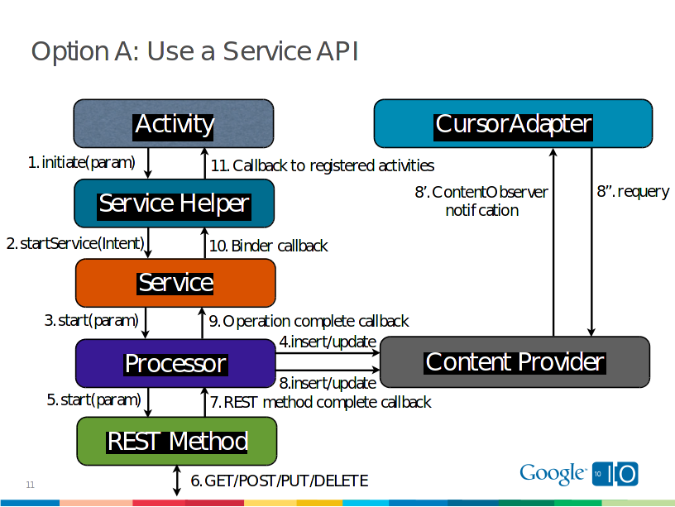
https://dl.google.com/googleio/2010/android-developing-RESTful-android-apps.pdf

Slide 17
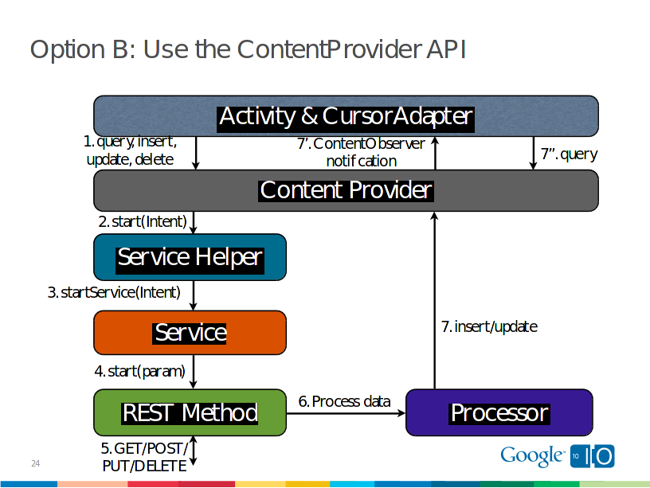
https://dl.google.com/googleio/2010/android-developing-RESTful-android-apps.pdf

Slide 18
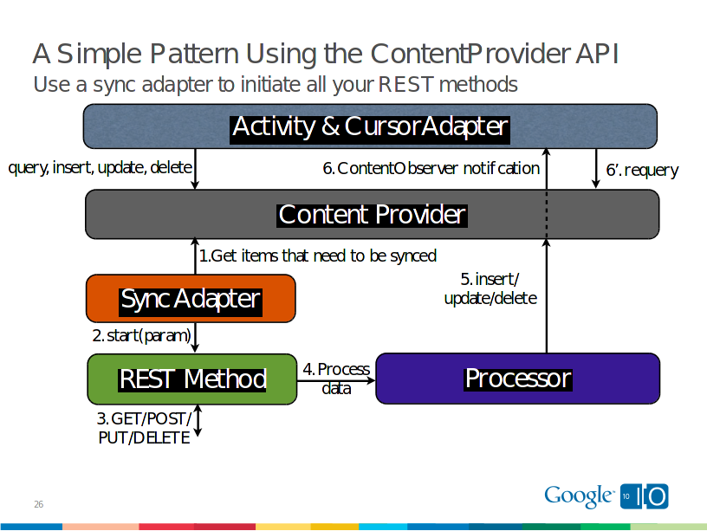
https://dl.google.com/googleio/2010/android-developing-RESTful-android-apps.pdf

Slide 19
Can We Do Better?
Activity
Content
Providing
Service
Activity
REST API
Cache

Slide 20
Follow me on Twitter @JamesSimshaw
I'm currently looking for work, if you have any openings, I'd love to get in touch

Slide 21
Questions?

