Slide 1
Bootstrap
- A front-end framework

Slide 2
Bootstrap Responsive Utilities Classes
There are few helper classes available in Bootstrap for showing and hiding content by device
If you want to enable the visibility of elements based on the devices when
screen size is within a specific range, then you can use the below classes:
.visible-xs-* .visible-sm-* .visible-md-* .visible-lg-*
Makes the element visible only on devices having screen width less than the limit for that particular device.(<768px,<992px,<1200, >=1200)
Similarly you have hidden utility classes to hide the elements on certain devices.
.hidden-xs .hidden-sm .hidden-md .hidden-lg
Makes the element hidden only on the appr. devices having the screen width appr. for that device.

Slide 3


Visibility Demo
<!DOCTYPE html>
<html>
<head>
<title>Example of Bootstrap 3 Visible Responsive Classes</title>
<link rel="stylesheet" href="css/bootstrap.min.css">
<link rel="stylesheet" href="css/bootstrap-theme.min.css">
<script src="js/jquery-2.1.4.min.js"></script>
<script src="js/bootstrap.min.js"></script>
</head>
Copy the necessary files from the Bootstrap downloaded folder to your project folder
**Note: All javascript plugins require jQuery to be included
Download the jquery jar file and copy it to the js folder

Slide 4
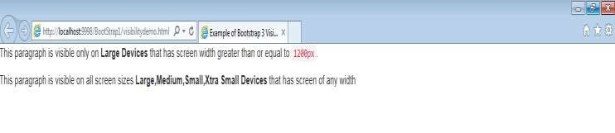

Visibility Demo
<div class="bs-example">
<p class="visible-xs">This paragraph is visible only on <strong>Extra Small Devices</strong> that has screen width less than <code>768px</code></p>
<p class="visible-lg">This paragraph is visible only on <strong>Large Devices</strong> that has screen width greater than or equal to
<code>1200px</code>.</p>
<p class="visible-lg visible-md visible-sm visible-xs">This paragraph is visible on all screen sizes <strong>Large,Medium,Small,Xtra Small Devices</strong> that has screen of any width </p>
</div>
</body>
</html>
Note the first paragraph is not visible Reduce the browser and check the output

Slide 5
Bootstrap Typography
➢Bootstrap Typography provides styling and formatting of text contents like headings, paragraphs etc.
➢ Classes for headings: Similar to <h1> to <h6> tags, we have classes
like .h1 to .h6
➢ Classes for secondary text of any heading: Similar to <small> , we have class called .small
➢ Classes for text alignment: text-left, text-center, text-right,text-justify, text-nowrap
➢ Classes for text transformation: text-lowercase, text-uppercase, text- capitalize.

Slide 6
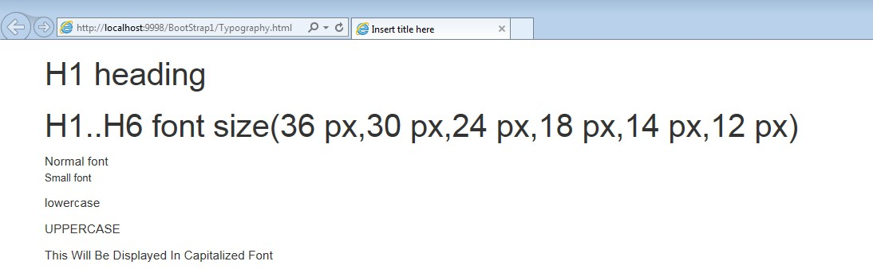
Bootstrap Typography -Demo
<body>
<h1>H1 heading</h1>
<p class="h1">H1..H6 font size(36 px,30 px,24 px,18 px,14 px,12 px)</p>
Normal font<br>
<p class="small">Small font</p>
<p class="text-lowercase">LOWERCASE</p>
<p class="text-uppercase">uppercase</p>
<p class="text-capitalize">this will be displayed in capitalized font</p>
</body>

Slide 7
Bootstrap Tables
➢Bootstrap provides you several classes using which you can create stylish tables.
➢ Classes:
.table : for basic table with horizontal dividers
.table-bordered (used with .table class) : for a table border
.table-striped (used with .table class) : for a zebra striped table
.active, .info , .success, .warning, .danger etc : for emphasizing the row/cell through appropriate colouring.

Slide 8


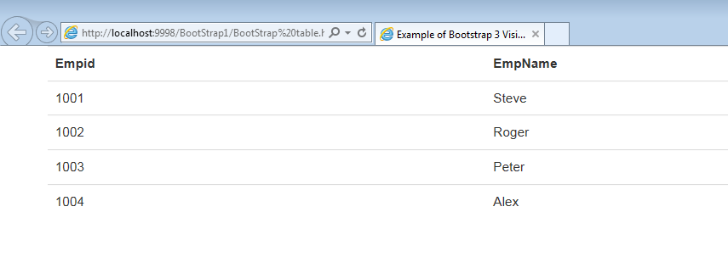
Bootstrap Tables - Demo
<div class="container">
<table class="table">
<tr><th>Empid</th><th>EmpName</th></tr>
<tr><td>1001</td><td>Steve</td></tr>
<tr><td>1002</td><td>Roger</td></tr>
<tr><td>1003</td><td>Peter</td></tr>
<tr><td>1004</td><td>Alex</td></tr>
</table>
</div>

Slide 9

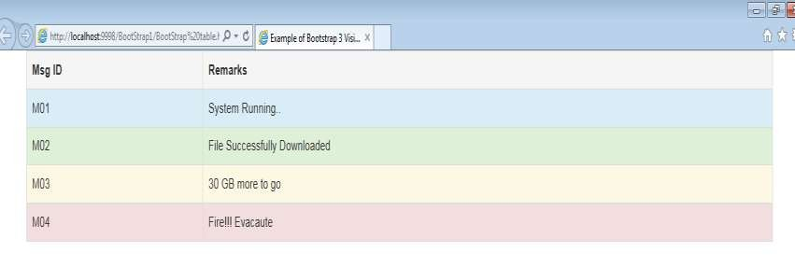
Bootstrap Tables - Demo
<div class="container">
<table class="table table-striped table-bordered">
<tr class="active"><th>Msg ID</th><th>Remarks</th></tr>
<tr class="info"><td>M01</td><td>System Running..</td></tr>
<tr class="success"><td>M02</td><td>File Successfully Downloaded</td></tr>
<tr class="warning"><td>M03</td><td>30 GB more to go</td></tr>
<tr class="danger"><td>M04</td><td>Fire!!! Evacaute</td></tr>
</table>
</div>

Slide 10
Bootstrap Images
➢ Images play a very important role in web design.
➢ Styling images and placing them properly on the pages enhances the
look and feel of the web pages
➢ Bootstrap classes for image related styling:
img-rounded, img-circle, img-thumbnail

Slide 11
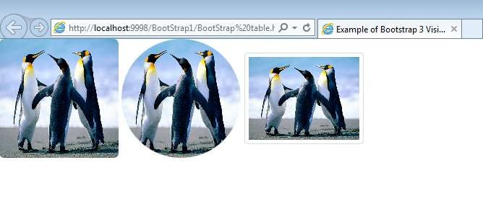
Bootstrap Images - Demo
<img src="images/Penguins.jpg" class="img-rounded" height="150" width="150">
<img src="images/Penguins.jpg" class="img-circle" height="150" width="150">
<img src="images/Penguins.jpg" class="img-thumbnail" height="150" width="150">

Slide 12
Bootstrap Glyphicons
➢ Bootstrap 3.3.2 allows around 259 glyphicons.
➢ Few icon classes
glyphicon
glyphicon-heart
glyphicon-asterisk
glyphicon-search
glyphicon-home
glyphicon-envelope
You can use the bootstrap icons along with the <span> tag with the base class “glyphicon” and individual icon class glyphicon-*

Slide 13
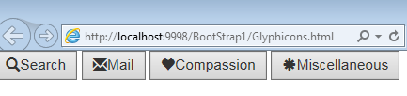
Bootstrap Icons - Demo
<!DOCTYPE html>
<html lang="en">
<head>
<title>Example of Bootstrap 3 Visible Responsive Classes</title>
<link rel="stylesheet" href="http://maxcdn.bootstrapcdn.com/bootstrap/3.3.4/css/bootstrap.min.css">
<script src="https://ajax.googleapis.com/ajax/libs/jquery/1.11.1/jquery.min.js"></script>
<script src="http://maxcdn.bootstrapcdn.com/bootstrap/3.3.4/js/bootstrap.min.js"></script>
</head>
<body>
<button><span class="glyphicon glyphicon-search"></span>Search</button>
<button><span class="glyphicon glyphicon-envelope"></span>Mail</button>
<button><span class="glyphicon glyphicon-heart"></span>Compassion</button>
<button><span class="glyphicon glyphicon-asterisk"></span>Miscellaneous</button>
</body>
</html>

Slide 14
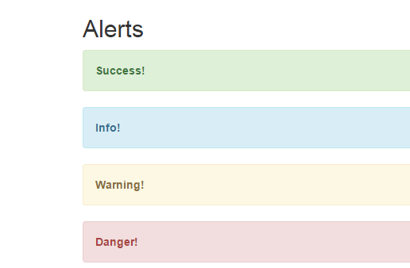

Bootstrap Alert
➢ Bootstrap provides 4 different types of alerts
➢ Alert related bootstrap classes:
alert-success
alert-warning
alert-info
alert-danger
Example :
<div class="alert alert-success">
<strong>Success!</strong>
</div>

Slide 15
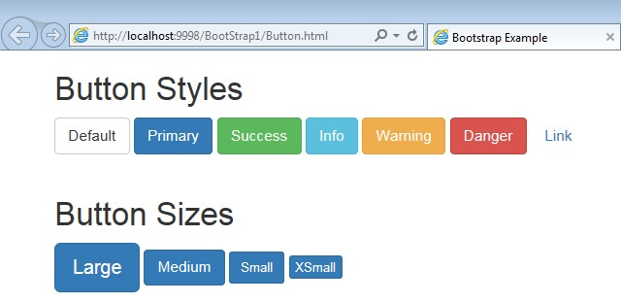
Bootstrap Buttons
Using Bootstrap we can enhance the views of normal HTML Butttons
The following are some of the button styles available
Button Styles
.btn-default
.btn-primary
.btn-success
.btn-info
.btn-warning
.btn-danger
.btn-link
Button Sizes
.btn-lg
.btn-md
.btn-sm
.btn-xs
Example :
<button type="button" class="btn btn-default">Default</button>

Slide 16
Quiz
Which of the following is used to add images to text,buttons etc?
icons
glyphicons
emoticons
None of the above
Which of the following bootstrap class should we use to display an
image in a circular format?
img-rounded
img-circle
img-thumbnail
None of the above

Slide 17
Thank You

