Slide 1
Bootstrap Grid
System

Slide 2

Agenda
BootStrap Grid System

Slide 3
Objective
At the end of this module, you will be able to learn
What is a Bootstrap Grid System
How to work with a Bootstrap Grid System

Slide 4


BootStrap Grid System

Slide 5
Bootstrap Grid System
Bootstrap grid system provides an easy way to create layouts of web pages
Bootstrap grid system allows up to 12 columns across the page
If you don’t want to use all 12 columns, you can group the columns together to create wider columns
Bootstrap grid system is responsive and the columns will re-arrange according to the screen size of the device
In a big screen, the contents will be organized in the respective columns, in smaller screen, the content items will be stacked on top of each other

Slide 6
Grid system rules
Some Bootstrap grid system rules:
Rows must be placed within a .container (fixed-width) or .container-fluid (full-
width) for proper alignment and padding
Use rows to create horizontal groups of columns
Content should be placed within columns, and only columns may be immediate children of rows
Predefined classes like .row and .col-sm-4 are available for quickly making grid layouts
Columns create gutters (gaps between column content) via padding. That padding is offset in rows for the first and last column via negative margin on
.rows
Grid columns are created by specifying the number of 12 available columns you wish to span. For example, three equal columns would use three .col-sm-4

Slide 7
Grid classes
➢ The Bootstrap grid system has four classes:
xs (for phones)
sm (for tablets)
md (for desktops)
lg (for larger desktops)
➢ The classes above can be combined to create more dynamic and flexible layouts.

Slide 8
Bootstrap 3 grid system features
Features Bootstrap 3 Grid System | Extra small devices Phones (<768px) | Small devices Tablets (≥768px) | Medium devices Desktops (≥992px) | Large devices Desktops (≥1200px)
Max container width | None (auto) | 750px | 970px | 1170px
Class prefix | .col-xs- | .col-sm- | .col-md- | .col-lg-
Max column width | Auto | ~62px | ~81px | ~97px
Gutter width | 15px on each side of a column (i.e. 30px)

Slide 9

Creating layouts with Bootstrap 3 Grid System
➢ Bootstrap 3 mobile first grid system can easily help you to control how your website layout will render on different types of devices with different screen sized like cell phone, tablet, desktops etc.
3R – 4C
4R – 3C
6R – 2C
12R –1C
➢ 12 content boxes in total but placement will vary depending on the
device.

Slide 10
Basic structure of Bootstrap Grid
<div class="container">
<div class="row">
<div class="col-*-*"></div>
</div>
<div class="row">
<div class="col-*-*"></div>
<div class="col-*-*"></div>
<div class="col-*-*"></div>
</div>
<div class="row">
...
</div>
</div>

Slide 11





Example: grid system
<!DOCTYPE html>
<html>
<head>
Bootstrap uses HTML5 doctype
<title>Grid System program for medium desktop</title>
<link rel="stylesheet" type="text/css" href="css/bootstrap.min.css" />
<script src="js/bootstrap.min.js" type="text/javascript"></script>
<style type="text/css"> p {
padding: 10px; font-size: 20px; font-weight: bold; text-align: center; color: #000099;
background: #FF0000;
}
Include above files in the respective folder
Style for paragraph

Slide 12

Example: grid system
h1 {
padding: 50 px; text-align: center; padding: 10px; color: red;
background: yellow;
}
</style>
</head>
Style for h1 tag

Slide 13




Example: grid system
<body>
<div class="container">
<div class="row">
<div class="col-lg-12">
Bootstrap requires a containing element to wrap site contents
First row, the container occupies 12 columns
<h1>Demo for Bootstrap Grid System</h1>
</div>
</div>
<div class="row">
<br>
<div class="col-lg-2">
<p>2 columns</p>
</div>
<div class="col-lg-8">
<p>8 columns</p>
</div>
contd..

Slide 14


Example: grid system (Contd.).
<div class="col-lg-2">
<p>2 columns</p>
</div>
</div>
<div class="row"><br>
<div class="col-lg-4">
<p>4 columns</p>
</div>
<div class="col-lg-4">
<p>4 columns</p>
</div>
<div class="col-lg-4">
<p>4 columns</p>
</div>
</div><body></html>
Second row
Third row

Slide 15
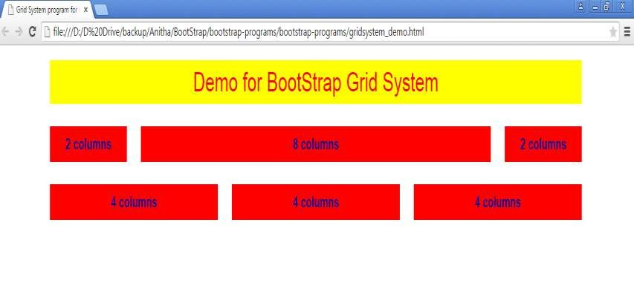
Output

Slide 16
Quiz
Bootstrap's grid system allows up to ------ columns across the page
8 columns
10 columns
12 columns
6 columns
Which of the following is a Bootstrap grid system class?
xs
sm
md
lg

Slide 17
Summary
In this module, you have learnt
What is a Bootstrap Grid System
How to work with a Bootstrap Grid System

Slide 18

Thank You

