Slide 1

Formatting with CSS
CSS

Slide 2

Agеnda
1
Formatting with CSS

Slide 3

Formatting with CSS Properties

Slide 4
Objеctivеs
In this module, you will
Define Background effect
Apply Text Formatting
Learn how to apply font properties

Slide 5
CSS Background
We can use CSS Background properties to define
the background effects of an element.
The following properties can be used for background effects :
background-color
background-image
background-repeat
background-position

Slide 6
Background Color
The background-
color property is used to specify the background
color of an element.
The background color of a page can be specified by
in the selector body.
body {background-color:cyan;}
Similarly, we can specify the background for any element(wherever applicable).
p {background-color:yellow;}

Slide 7

Demo : Background Color
<html>
<head>
<style>
h1{background-color:black;color:cyan;text-align:center;}
p{background-color:yellow; color:red;text-align:center;}
</style>
</head>
<body>
<h1>Wipro Technologies </h1>
<p>Talent Transformation</p>
</body>
</html>
Wipro Technologies
Talent Transformation

Slide 8
Background Image
You can use an image as the background for an
element using background-image property.
You can set an image as the background in the following manner :
body{background-image:url(‘java.bmp’);}
By default, the image is repeated, both horizontally and vertically, so as to cover the entire body(or the element on which it is applied).

Slide 9

Demo : Background Image
<html>
<head>
<style>
body {background-image:url("force1.jpg");} h1 {color:yellow;}
p {color:yellow;}
</style>
</head>
<body>
<h1>Wipro Technologies </h1>
<p>Talent Transformation</p>
</body>
</html>

Slide 10

Demo : Background Image Repeat Horizontally
<html>
<head>
<style> body {
background-image:url("force1.jpg");
background-repeat:repeat-x;
}
h1 {color:yellow;}
p {color:yellow;}
</style>
</head>
<body>
<h1>Wipro Technologies </h1>
<p>Talent Transformation</p>
</body>
10
</html>
© 2013 WIPRO LTD | WWW.WIPRO.COM | CONFIDENTIAL

Slide 11

Demo : Background Image Repeat Vertically
<html>
<head>
<style> body {
background-image:url("force1.jpg");
background-repeat:repeat-y;
}
</style>
</head>
<body>
<h1>Wipro Technologies </h1>
<p>Talent Transformation</p>
</body>
</html>

Slide 12

Demo : Background Image No Repeat
<html>
<head>
<style> body {
background-image:url(“kitten.jpg");
background-repeat:no-repeat;
}
</style>
</head>
<body>
<h1>Wipro Technologies </h1>
<p>Talent Transformation</p>
</body>
</html>

Slide 13
Background Position
If the background image disturbs the text, i.e. if the text cannot be read clearly due to the image in the background, we can set the position of the background image.
We need to add the property background-position in the selector.
Example :
body {
background-image:url(“kitten.jpg");
background-repeat:no-repeat;
background-position:right top;
}

Slide 14

Demo : Background Position
<html>
<head>
<style> body {
background-image:url(“kitten.jpg"); background-repeat:no-repeat;
background-position:right top;
}
</style>
</head>
<body>
<h1>Wipro Technologies </h1>
<p>Talent Transformation</p>
</body>
</html>

Slide 15
Background Shorthand
You can also specify all the properties in a single property. This property is known as shorthand property.
For specifying shorthand property, you just need to use background.
Example :
body {
background:cyan url(‘kitten.jpg') no-
repeat right top;
}

Slide 16

Background Shorthand
<html>
<head> <style>
body {
background:yellow url("kitten.jpg") no-repeat right top;
}
</style></head>
<body>
<h1>Wipro Technologies </h1>
<p>Talent Transformation</p>
</body>
</html>

Slide 17
Quiz
To set a Background Image using a file,
depp1.jpg, you have to use the following syntax :
background-image:(“depp1.jpg”);
bg-image:(“depp1.jpg”);
bg-image:url(“depp1.jpg”);
background-image:url(“depp1.jpg”);
If you do not want the background image to be
repeated, you will have to use the syntax :
background-repeat:zero-repeat;
background-repeat:no-repeat;
background-repeat:single;
background-repeat:once;

Slide 18
Text Formatting
Now let us have a look at some of the Text Formatting
properties.
The following properties can be used for formatting text :
Text Color
Text Alignment
Text Decoration
Text Transformation
Text Indentation

Slide 19
Text Color
The color property is used to set the color of text.
Example :
body { color:blue;}
p1 {color:magenta;}

Slide 20
Text Alignment
You have already observed in many of our previous examples that the text-align property is used for setting the horizontal alignment of text.
We can either align the text to the left, right, center or we can make it justified.
Example :
p { text-align:left;}
h1{text-align:center;}

Slide 21
Text Decoration
You can use text-decoration property to set or
remove decorations from text.
This property can be used to remove underlines from hyperlinks.
Example :
To remove decorations : p {text-decoration:none;}

Slide 22
Text Decoration (Contd.).
You can set decorations in the following manner:
p {text-decoration:overline;}
p {text-decoration:line-through;}
p {text-decoration:underline;}

Slide 23
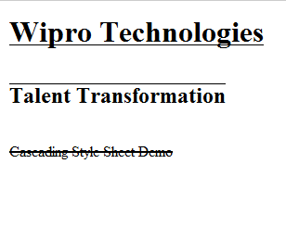
Demo : Text Decoration
<html>
<head>
<style>
p {text-decoration:line-through;} h1 {text-decoration:underline;} h2 {text-decoration:overline;}
</style>
</head>
<body>
<h1>Wipro Technologies </h1>
<br>
<h2>Talent Transformation</h2>
<br>
<p>Cascading Style Sheet Demo</p>
</body>
Output :
</html>
23
© 2013 WIPRO LTD | WWW.WIPRO.COM | CONFIDENTIAL

Slide 24
Text Transformation
You can use text-transform property to specify
uppercase and lowercase letters of any text.
Use this property to turn everything into uppercase or lowercase letters or capitalize the first letter of each word.
h1 {text-transform:uppercase;} h2 {text-transform:lowercase;} p {text-transform:capitalize;}

Slide 25


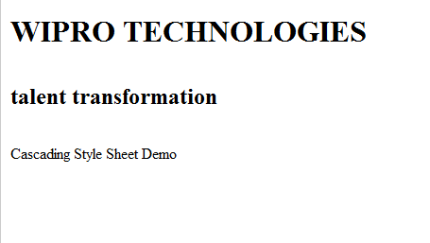
Demo : Text Transformation
<html>
<head>
<style>
h1 {text-transform:uppercase;} h2 {text-transform:lowercase;} p {text-transform:capitalize;}
</style>
</head>
<body>
<h1>Wipro Technologies</h1>
<br>
<h2>Talent Transformation</h2>
<br>
Output :
<p>cascading style sheet demo</p>
</body></html>

Slide 26
Text Indentation
You can use the text-indent property is used to
specify the indentation of the first line of a text.

Slide 27


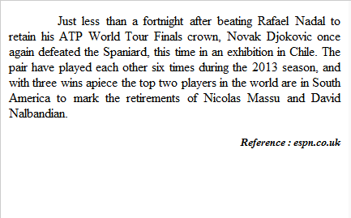
Text Indentation
Output :
<html>
<head><style>
Rafael Nadal to retain his ATP World
p {text-align:justify; text-indent:60px;} h5{text-align:right;font-style:italic;}
</style></head>
<body>
<p>
Just less than a fortnight after beating
Tour Finals crown, Novak Djokovic once again defeated the Spaniard, this time in an exhibition in Chile. The pair have played each other six times during the 2013 season, and with three wins apiece the top two players in the world are in South America to mark the retirements of Nicolas Massu and David Nalbandian.
</p>
<h5>Reference : espn.co.uk</h5>
</body>
</html>

Slide 28
Quiz
To underline the text of a paragraph, you will
have to style the paragraph as follows :
p1 {text-transformation:underline;}
p1 {text-transform:underline;}
p1{text-decoration:uline;}
p1{text-decoration:underline;}
To make the first character of every word
uppercase, you will have use the style :
h2{text-transformation:capitalize;}
h2{text-transform:capitalize;}
h2{text-transformation:uppercase;}
h2{text-transform:uppercase;}

Slide 29
CSS Font
CSS font properties are used to define the font
family, size, style and boldness of the text.

Slide 30
CSS Font Family
We can set the font family of text using the font-family
property.
It is possible to set more than one value for the font- family property. This is useful in case where the browser may not support the font-family we have specified. If the browser does not support the first font, it tries to set the next font.
Example :
p { font-family:”Arial”, Times, “Sans-serif”;}

Slide 31
Font Style
You can use the property font-style to specify italic
text.
Example :
If you want text as italic, you can use p { font-style:italic; }
You can also specify normal text :
p { font-style:normal; }

Slide 32
Font Size
You can use the font-size property to set the size of
text.
The font-size value can be absolute or it can be relative.
Absolute size allows you to set the text to a
specified size.
On the other hand, relative size sets the size relative to the surrounding elements.

Slide 33
Demo : Setting Font Size with pixels (Absolute size)
<html><head><style>
#p1 {
text-align:center; color:red;
font-family:arial; font-weight:bold; font-size:25px;
}
#p2{
text-align:center; color:blue;
font-family:Serif; font-style:italic; font-size:25px;
}

Slide 34

Demo : Font Size with pixels (Contd.).
#p3{
text-align:center;
font-family:Times; font-style:normal; font-size:18px;
}
</style>
</head>
<body>
Output :
<p id="p1">Wipro Technologies</p>
<p id="p2"> Bangalore </p>
<p id="p3"> India </p>
</body>
</html>

Slide 35
Font Size with em (Relative size)
You may face resizing problems, when you use older
versions of browsers.
To avoid such problems, you can use set font size using em, instead of pixels.
The em size unit is a W3C recommendation.
1 em is equal to the current font size. The default text size is 16 px. So, the default size of 1 em is 16 px.

Slide 36
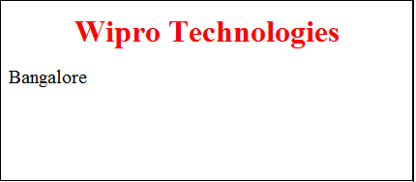
Demo : Font Size with Em
<html><head><style>
h1 {
text-align:center; color:red;
font-weight:bold; font-size:2em;
}
p{
font-size:1.25em;
}
</style></head>
<body>
<h1>Wipro Technologies</h1>
<p> Bangalore </p>
</body></html>
Output :

Slide 37
Quiz
To set the color of text as red for a paragraph,
you will have to use the style :
p{font-color:#ff0000;}
p{text-color:#ff0000;}
p{paragraph-color:#ff0000;}
p{color:#ff0000;}
For specifying the font for the text of a paragraph
as arial, you will have to use the style :
p{text-font:arial;}
p{font:arial;}
p{font-family:arial;}
p{text-family;arial;}

Slide 38
Summary
In this module, you were able to :
Define Background effect
Apply Text Formatting
Learn how to apply font properties

Slide 39
Thank You

