Slide 1

This Photo by Unknown Author is licensed under CC BY-ND
VBA OF WALL STREET
SMU Data Science Bootcamp
Rebekah Vinson
September 1, 2019

Slide 2
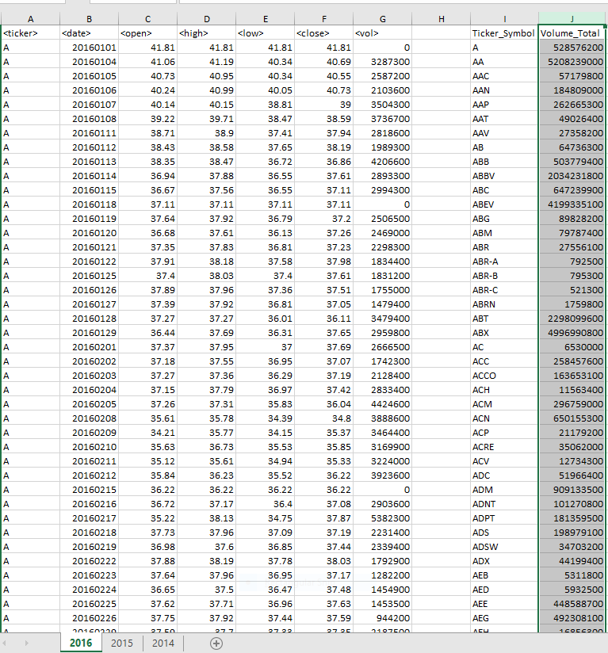
EASY SCRIPT – JUST THE FACTS
Loop through the data for the entire year
Add Ticker Symbol
Add Volume Total
The Ticker Symbol coincides with the Total Stock Volume
Adjustments to the script allowed all worksheets to run 2014, 2015 and 2016

Slide 3
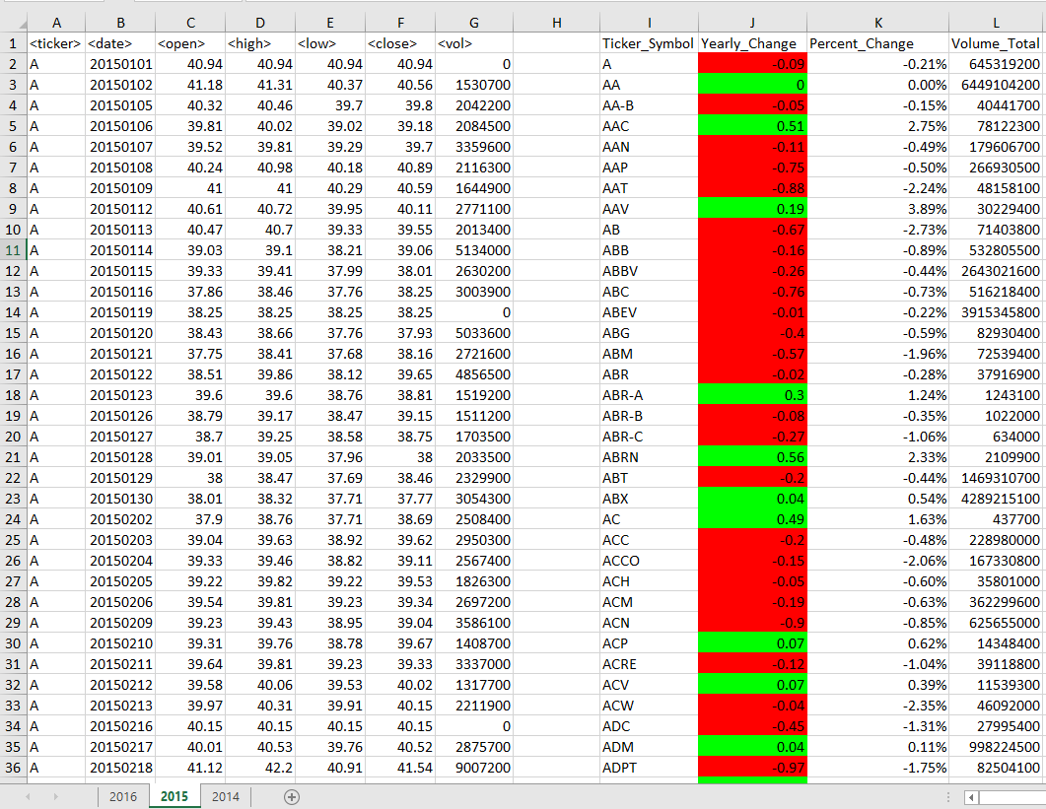
MODERATE - VISUALIZATION
Moderate script added Yearly Change of stock price and the Percent change
The yearly change was the difference of opening stock price and the close price
Fun fact: The percent change is (close date – open date)/open date formatted to percent
The most important component of the moderate scripting is the visualization added.
visualization is key to the user experience as it allows the user to see the positive % change in bright green vs negative change in red

Slide 4
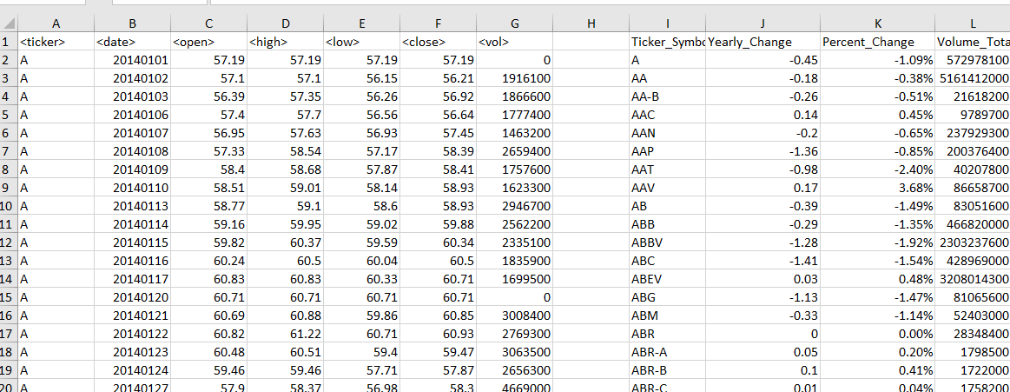

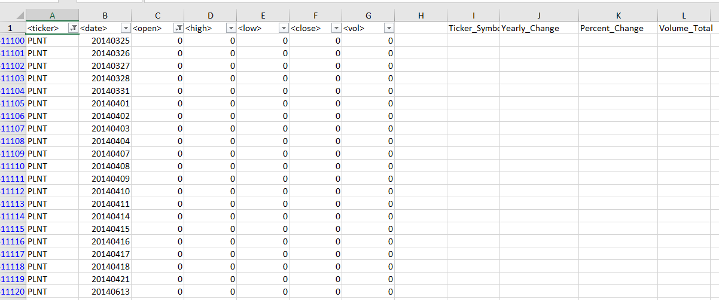
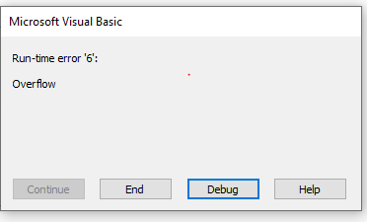
DEBUG!
INITIAL LOOP – NO ERRORS
ADDING MORE COMPLEXITY CREATED PROBLEM FOR 2014 work sheet – it is due to ticker symbol plnt.
PLNT Header: open, high, low, close and volume cells contain ‘0’
My script is unable to account for this
MUST DEBUG CODE TO FIND FIX

Slide 5
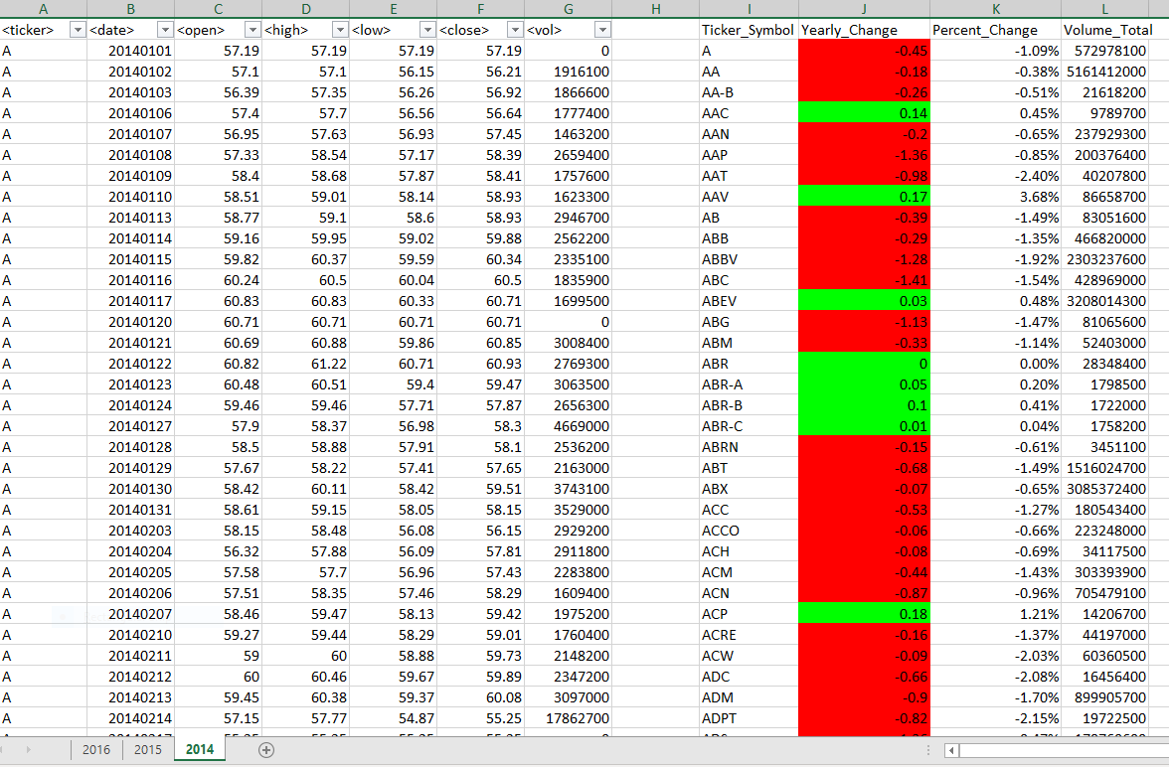
Data Cleansing
Confirmed the cause of the error: Ticker symbol PLNT ‘first day open’ = 0.
The formula for ‘percent change’ is yearly change/first day open (not divisible by 0)
To fix the problem, I removed all data: ticker symbol = plnt and first date open = 0, in worksheet (2016,2015,2014) and saved the data set.
I received no error after I ran the script on the new data set.
Visualization for yearly change is available for all three years.

