Slide 1
Smallest Enclosing Circle
Subgradient Method

Slide 2
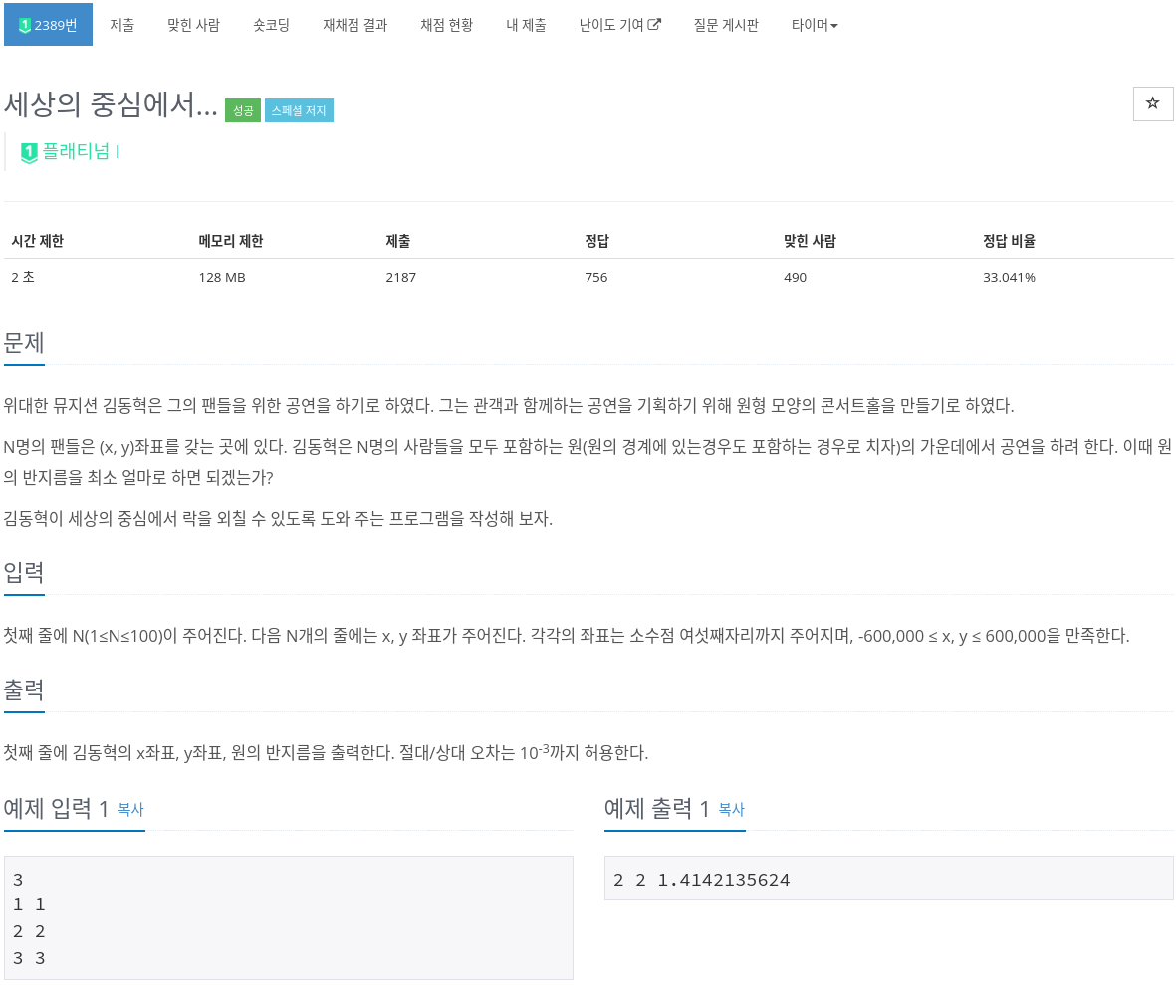

Slide 9
How to solve?

Slide 10
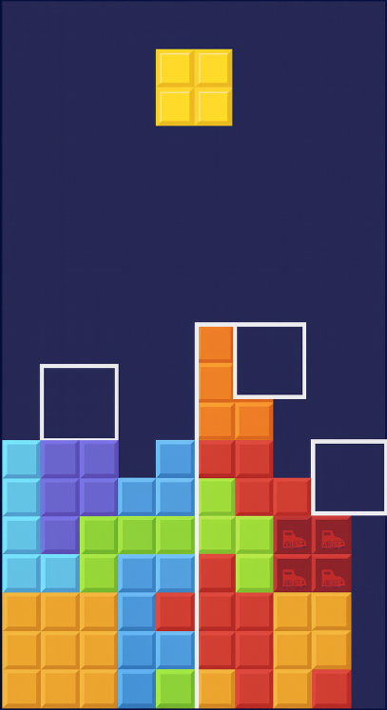
How to solve?
Heuristic....

Slide 11
How to solve?
https://simta1.github.io/Smallest-Enclosing-Circle/
8
197.9 -94.1
-16.9 17.7
197.0 -152.2
-90.3 22.1
12.8 -85.3
-184.3 -175.2
-41.4 -132.9
-107.7 182.8

Slide 12
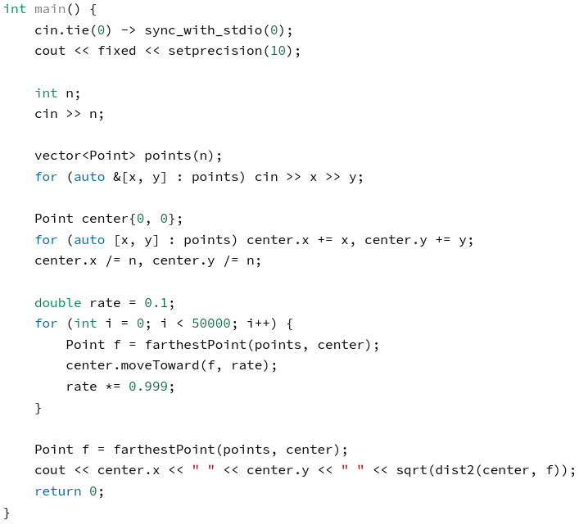
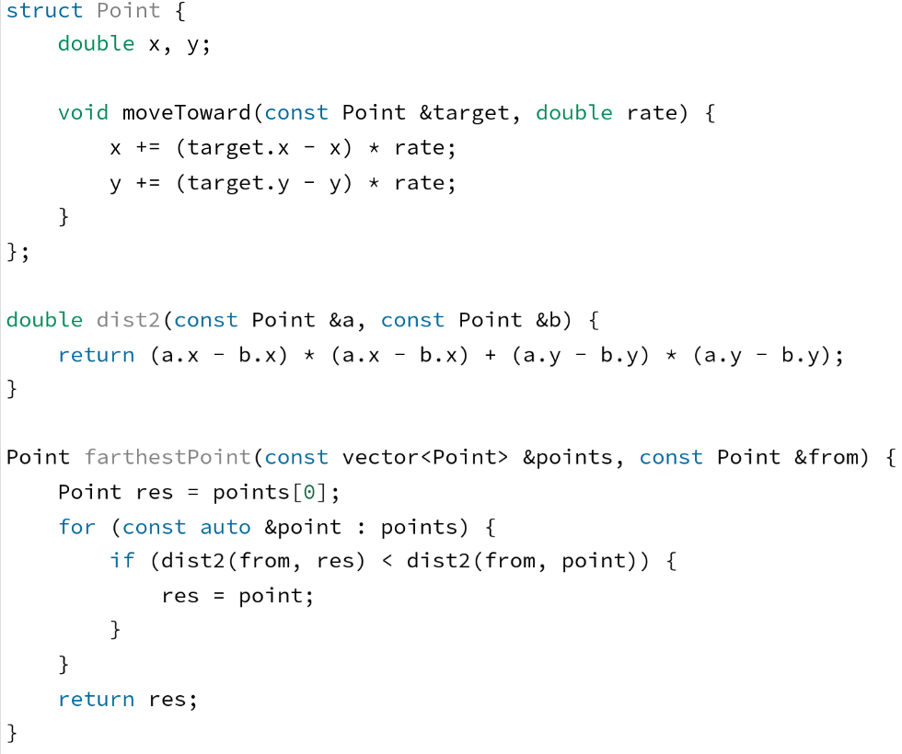
How to solve?
http://boj.kr/e9171f71b0db43e3bdb48d7e0a74d69d
https://www.acmicpc.net/problem/2389

Slide 13
Why it works

Slide 14
Why it works
subgradient method
S. Xu, Solution Methodologies for the Smallest Enclosing Circle Problem, Tech. Rep. HPCES 024, Massachusetts Institute of Technology, 2002. [Online]. Available: https://dspace.mit.edu/bitstream/handle/1721.1/4015/HPCES024.pdf?sequence=2

Slide 15
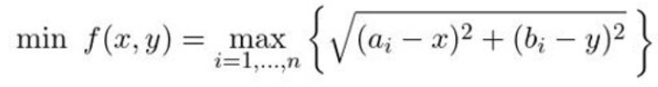
Subgradient method

Slide 16

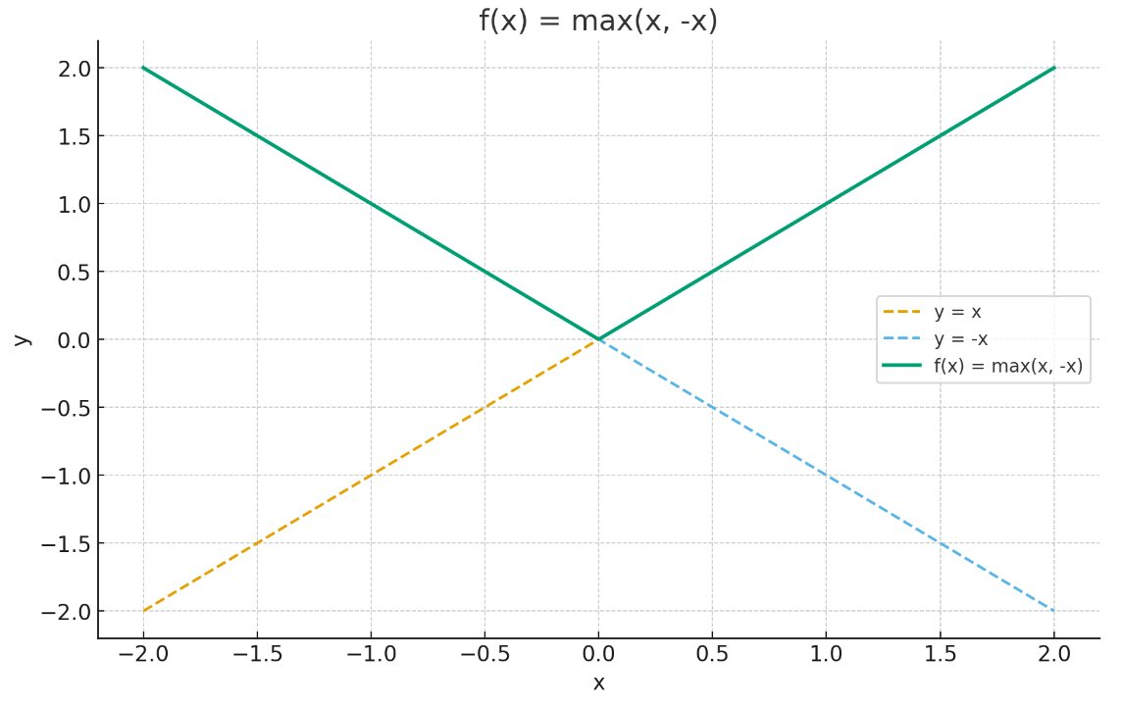
Gradient descent

Slide 17


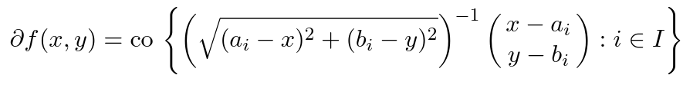
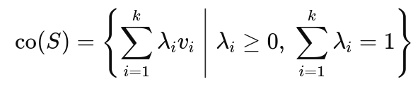

Subgradient method

Slide 18
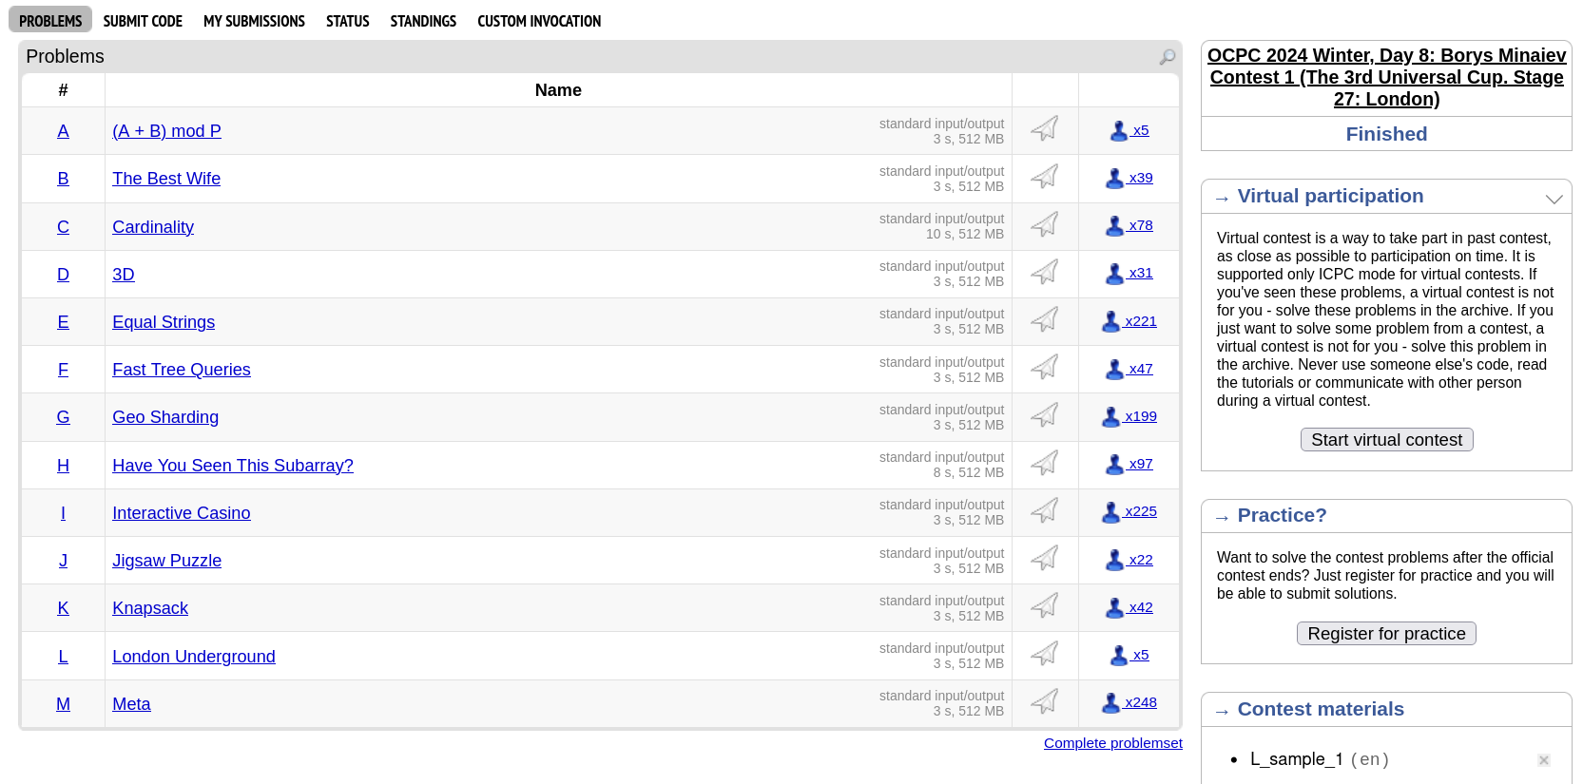
Why study this algorithm?
https://codeforces.com/gym/105699/problem/D

Slide 19
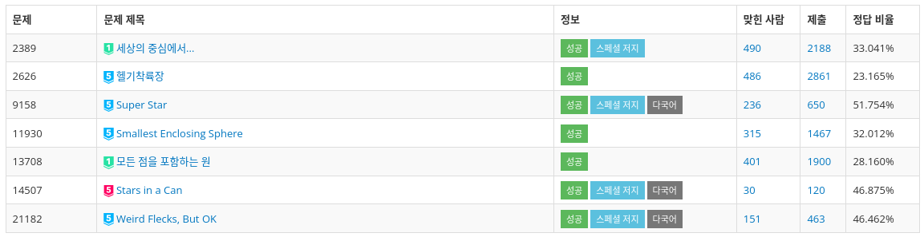
Why study this algorithm?

Slide 20
Why study this algorithm?

Slide 21
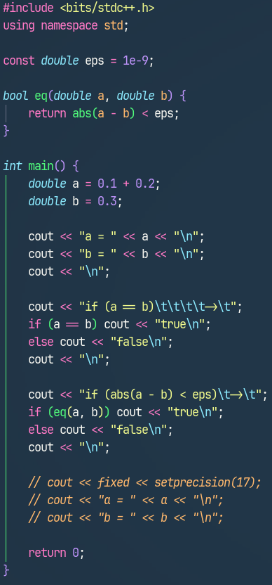
Tips for Geometry
floating-point error

Slide 22
감사합니다

