Slide 1
Smallest Enclosing Circle (최소외접원)
Subgradient Method

Slide 2
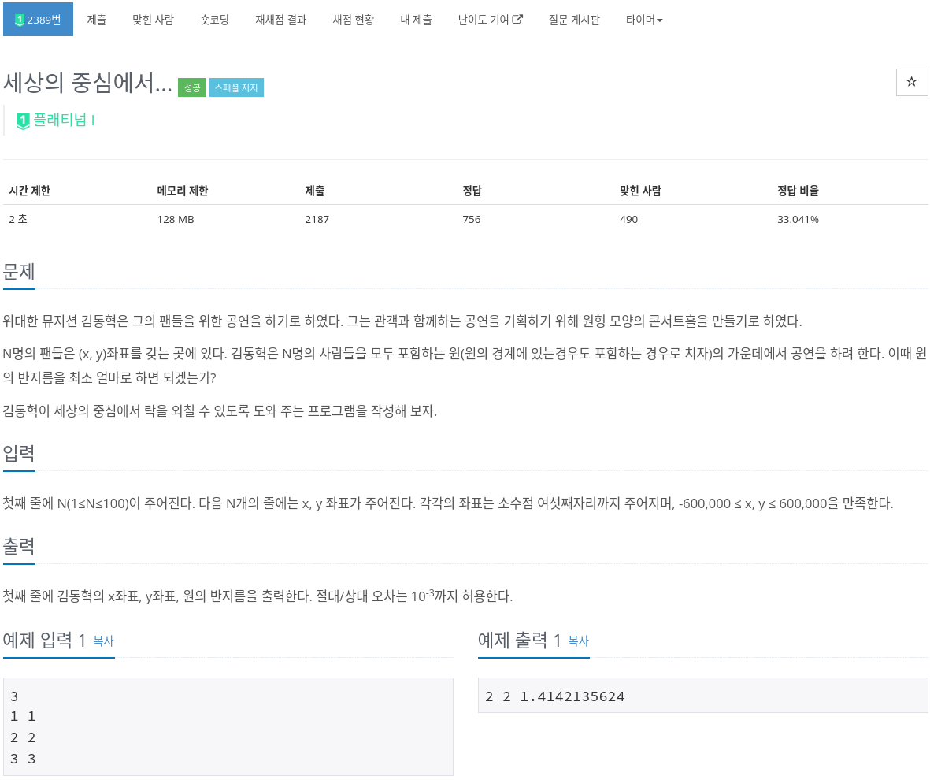

Slide 9
How to solve?

Slide 10
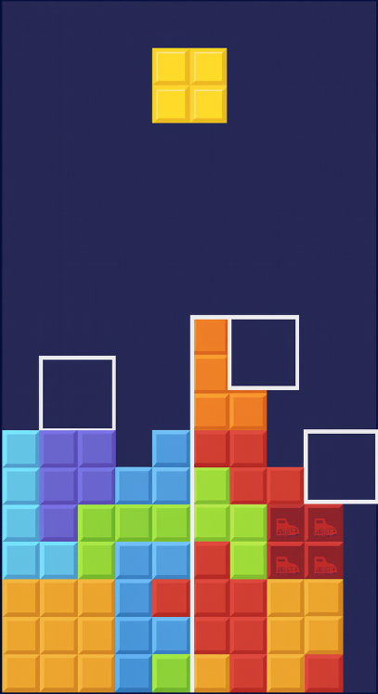
How to solve?
Heuristic....

Slide 11
How to solve?
https://simta1.github.io/Smallest-Enclosing-Circle/

Slide 12
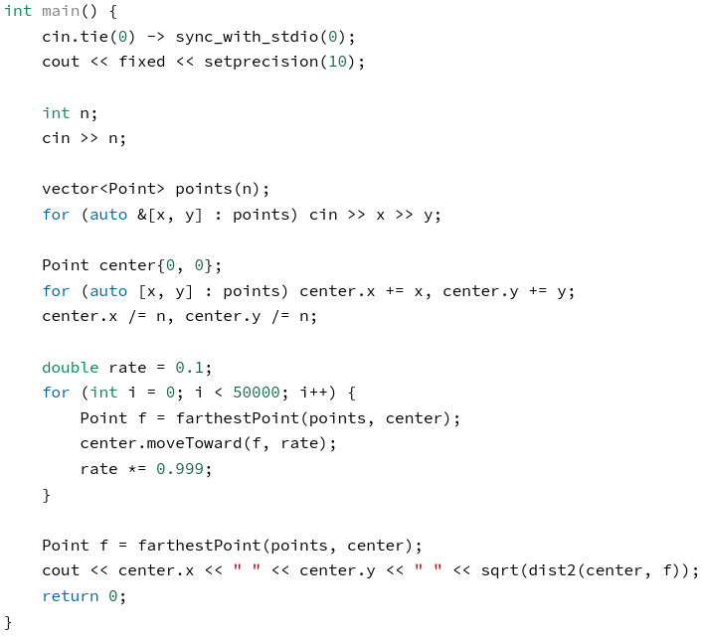
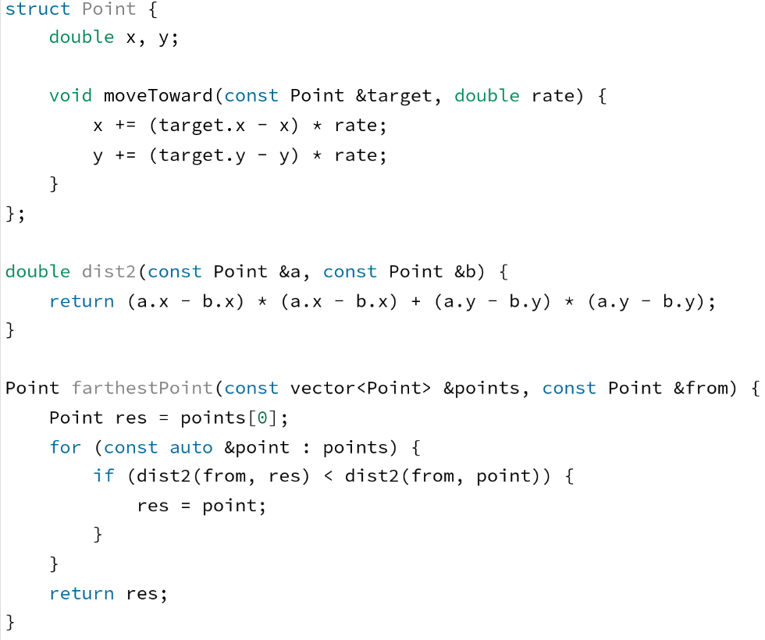
How to solve?
http://boj.kr/e9171f71b0db43e3bdb48d7e0a74d69d
https://www.acmicpc.net/problem/2389

Slide 13
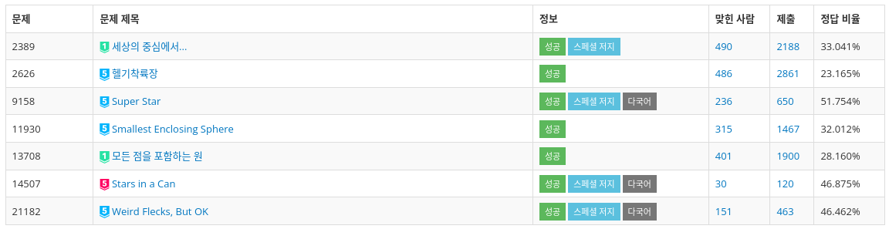
Why study this algorithm?

Slide 14
Why study this algorithm?

Slide 15
Why it works

Slide 16
Why it works
subgradient method
S. Xu, Solution Methodologies for the Smallest Enclosing Circle Problem, Tech. Rep. HPCES 024, Massachusetts Institute of Technology, 2002. [Online]. Available: https://dspace.mit.edu/bitstream/handle/1721.1/4015/HPCES024.pdf?sequence=2

Slide 17
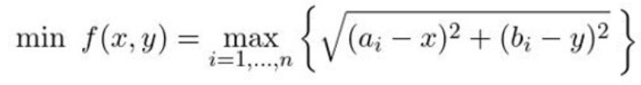
Subgradient method

Slide 18

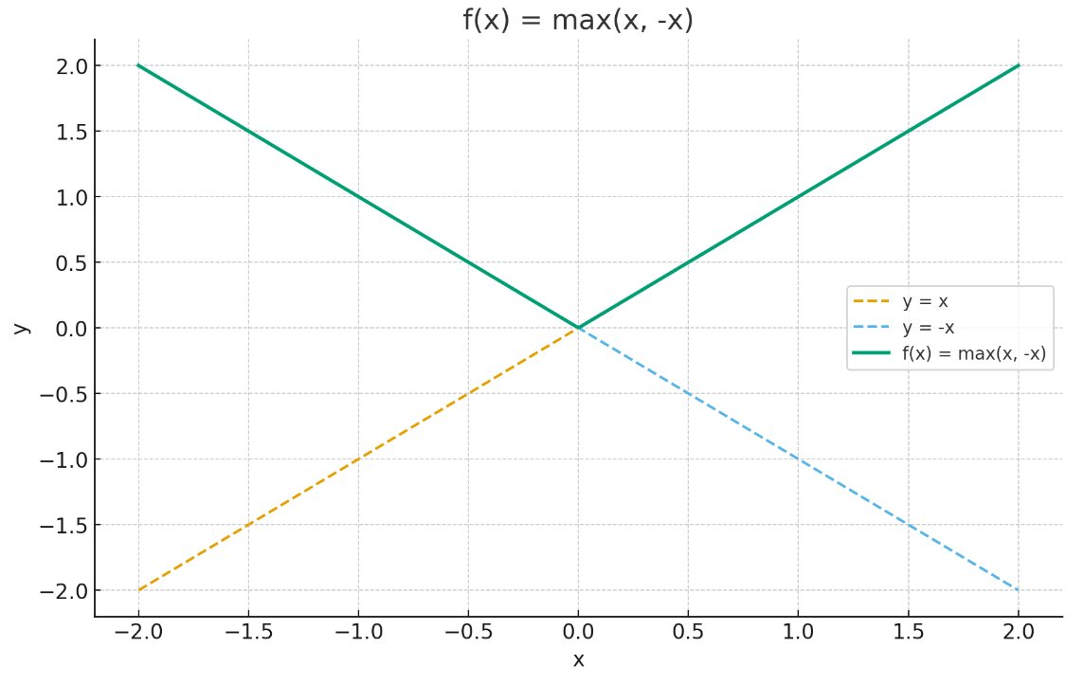
Subgradient method

Slide 19


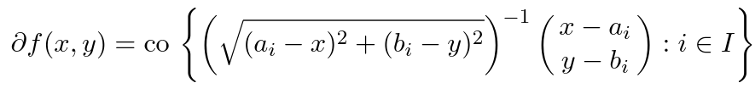
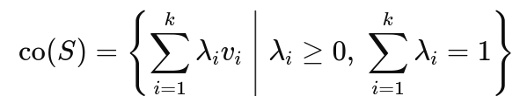

Subgradient method

Slide 20
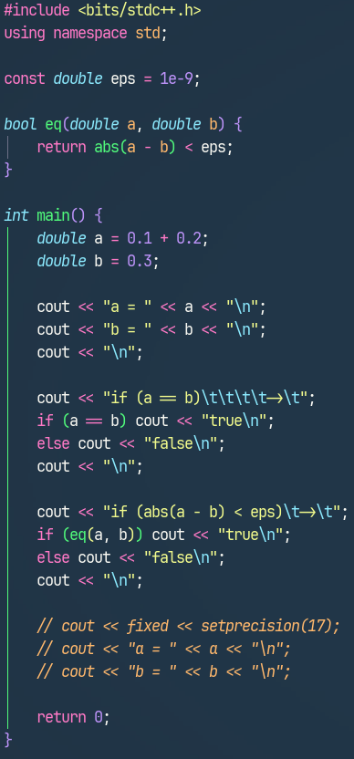
Tips for Geometry
floating-point error
Notes:
Collinear point check
Dist sq

Slide 21
감사합니다

