Slide 1
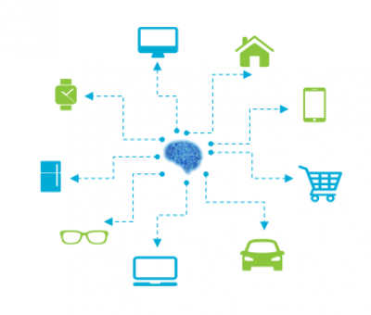
SimGen

Slide 2
The lives of nodes
The BT language
Events - interacting with Prolog

Slide 3
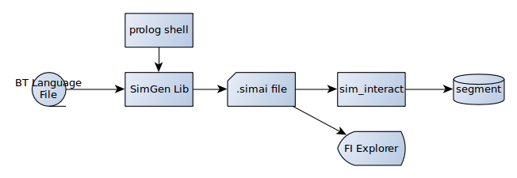

Slide 4

C-N Pair
Howdy,
I’m 1-root
create_context(1,root)
root’s definition
In .bt file

Slide 5
Think I’ll start
Some children
1-root

Slide 6
Think I’ll start
Some children
1-a
1-b

Slide 7
1-root
1-a
1-b
1-c
1-d

Slide 8
1-root
1-a
1-b
1-c
1-d
Darn, I failed

Slide 9
1-root
I’m done
1-a
1-b
1-c

Slide 10
1-root
1-b
1-d
My parent died
I’m terminated

Slide 11
1-root
1-b
Yay, I’ve succeeded
I’m ‘done’

Slide 12
1-root
Guess I’ll succeed

Slide 13
Context is no longer active

Slide 14
Behavior Tree
it’s a DAG,
actually
root
a
b
c
d

Slide 15
No Restart
1-root
1-d is already
Running,
It ignores my
restart
1-a
1-b
1-c
1-d

Slide 16
Clocks
When you start the simulation, you specify the size of one user unit in nanos
Also specify the tick duration in user units
and the start time in user units
each context gets a clock that starts at 0
master clock is named simgen
currently clocks aren’t that interesting. We can do interesting stuff with them in future

Slide 17
The BT Language

Slide 18
Syntax
<name (an atom)> <operator>
<arguments (depends on operator)>
.
% comment
/* comment */
end node with period

Slide 19
PDQ Nodes
Simulate continuous domains
First tick
Rest ticks
Failure conditions
!
action_node !
x = 0
;
x := x + 1
;
x < 10

Slide 20
PDQ
currently just 3 built in functions and + - / * ()
levy_flight - pick random number n, 1-16, flip n ls bits at random
wander - step up or down by a distance, biased so we are unlikely to step up when near upper bound and vice versa
clock - get the context clock

Slide 21
PDQ Assignment
:= right side is the previous ticks values
= right side is this tick’s values, computed by reactive programming.

Slide 22
PDQ Conditions
Tested at end of tick
Note that the second section does not run on the first tick
If a value is missing, the condition succeeds
Warning - this is ‘broken’ from how everything else on earth does loops

Slide 23
Selectors
~? run one child at random.
0.9 : most_of_time,
0.1 : rarely
.
if the weight is omitted, the weight is 1
Simulate a random event

Slide 24
parallel selector
=?
list of children
runs all until one succeeds
“Somebody get me a broom”

Slide 25
Sequences
-> sequence - run one after another unless one fails
~> same, but scramble the order
=> parallel - run at same time. if any fail, fail. if they all succeed, succeed
A series of goals to accomplish

Slide 26
=>
Do things at same time
Guard that a condition stays true “only serve tea as long as there’s tea to serve”
Coordinated action - “if any unit fails, shut down the others”

Slide 27
Decorators
have a single child whose behavior they modify
easy to write more of them
try - succeed when child succeeds or fails - eg ‘just try it’
fail - opposite- always fail after child ends
not - fail if child succeeds, succeed if it fails

Slide 28
Decorators
<> repeat until fail
<--> repeat until success
pin - generate a FI Explorer compatible pin drop event pair for the duration of the child’s run

Slide 29
Conditionals
? <atom> - Guard - fail if condition isn’t set at start
-? <atom> - Wait - wait until condition is true and succeed
set <atom> - set the condition true
reset <atom> - set the condition false

Slide 30
dur
dur <time>
run for this duration then succeed

Slide 31
Interacting with Prolog

Slide 32
Events
SimGen emits events as it runs
Prolog can monitor events
tick events to control the simulation
reading events from pdq nodes
pin events from pin decorators
starting/stopping events from nodes
control events (notably end_simulation)
call start_context to start new contexts

Slide 33
bt_example.pl
boilerplate code to run a simulation
Exports in sim_interact format
Details of how to interact on the wiki

Slide 34
Internal Uses
Software integration testing
AI Algorithm validation
Generating anomalies/signatures we don’t detect so we can improve the detection
Creating examples for tutorials and documentation
Creating sanitary data ‘like’ customer data for sales
Creating simulated data for pre-PoC presentations

Slide 35
External Uses
Parallelize schedules - as a subcontractor, we don’t have to wait for the system to be online and operate before we can gather data.
Validate failure prediction - customers can ‘prove’ we can detect failure against data generated by an explicable process.
Validate value of system before purchase and before they have data.
Understand their system - if they can model it, and see behavior like we’re seeing, they have a model of their system.
Prevent the first failure - anomalometry can “often” predict the first failure. But we can make “often” very often by simulating the system first.
Generate years of data in a few minutes.

Slide 36
Summing up
It’s all about nodes starting and stopping
Divide your domain into discrete and continuous simulations
Generate context starts externally
Gather events

