Slide 1

Held by Faragostaran Co.
Presented to Gas refinery plants of
Asalouyeh, Iran
By: Ali Akbar Eftekhari

Slide 2

Instructor’s Experiences
Commercial Process Simulators in Gas Plants: Applications, Benefits, and Problems
Aspentech HYSYS and Aspen Plus Instruction Plan

Slide 3

Education
  PhD student, Department of Geosciences, Technical University of Delft, the Netherlands
  M.Sc. (2002-2005) Transport Phenomena and Separation Processes, Chemical and Petroleum Engineering Department, Sharif University of Technology, Tehran, Iran
    Thesis Topic: Modeling and Simulation of Reactor and Process of Methyl Acetate Hydrolysis and Experimental Investigation
  B.Sc. (1998-2002) Chemical Engineering (Petrochemical Processes), Chemical Engineering Department, Shiraz University, Shiraz, Iran
    Project Topic: Simulation of Dalan Gas Refinery and Dehydration Plant (by HYSYS 2.2 and Chemcad 5.0)

Slide 4
Simulation of Dalan gas refinery plant using HYSYS 2.2 and Chemcad 5.0
  Objectives:
    Flow of liquid product from slug catcher
    Simulation of dehydration package and estimation of TEG make up
    Estimation of aromatic components flow in the overhead product of TEG regeneration column
    Calculation of hydrocarbon dew-point of output product from JT station
    RVP calculation for product of stabilizer column

Slide 5

Slug Catcher Calculations
  Problem: 100% error in prediction of liquid flow form slug catcher using HYSYS
    Problems in cracked software or EOS
    Error in gas composition
  Solution:
    Development of a home-made code to predict VLE using EOS
    A new analysis of input gas stream composition

Slide 6
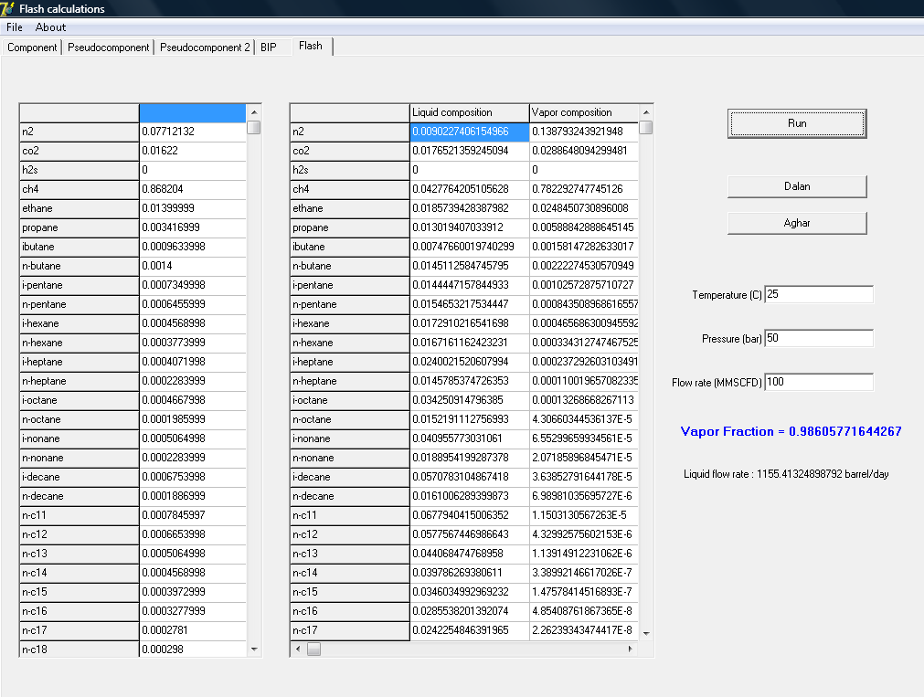

Slide 7

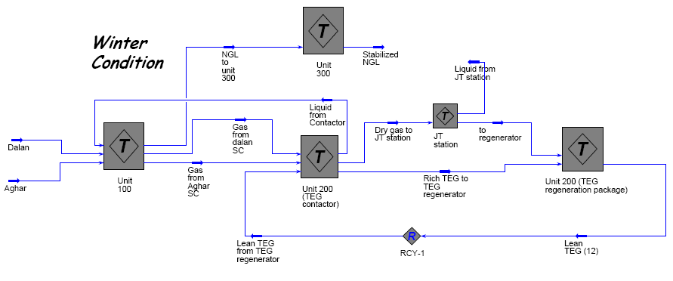

Slide 8

TEG loss
Aromatics accumulation in process
  Problem: HYSYS weakness revealed (PR EOS could not predict the aromatics solubility in TEG absorber)
  Solution: Chemcad TEG Dehydration package
  Alternative 1: Pro/II glycol dehydration package
  Alternative 2: Aspen Plus SR-Polar thermodynamic model (with some difficulties)

Slide 9
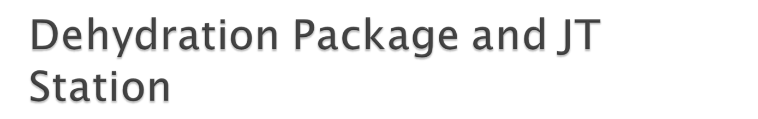
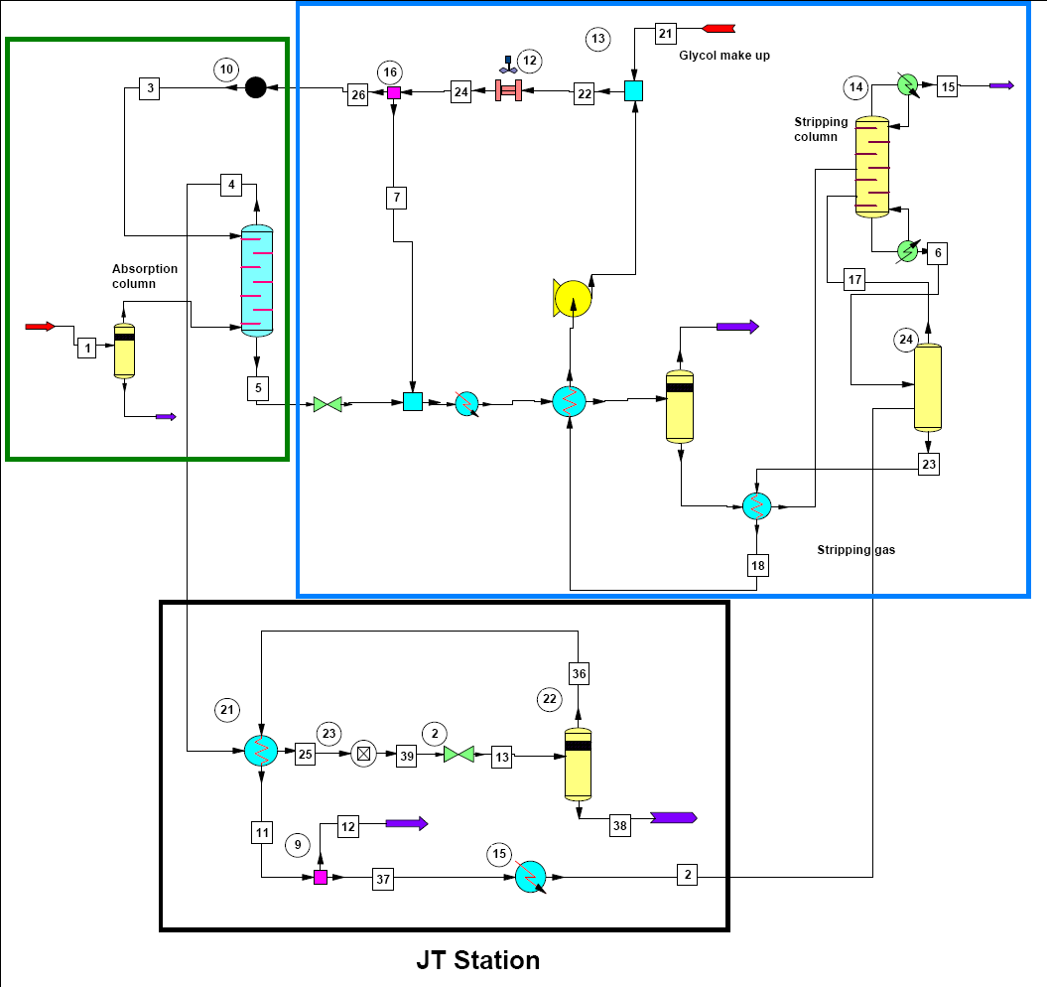

Slide 10

Problem: Hydrocarbon dew point of product
  Solution: HYSYS generates good results for hydrocarbon systems
  Both Chemcad and HYSYS generated same results, both were appropriate.

Slide 11

Problem: What’s the RVP of produced NGL?
  Solution: As was expected, HYSYS has an excellent VLE databank and column solver for HC systems.
  The working spec of stabilizer column produced a product with appropriate RVP
Problem: Kettle type reboiler had not been installed correctly to work half-full! What’s the effect of this wrong installation on the process?
  Solution: No Answer!!!

Slide 12

Simulation of a poly styrene pilot plant using Aspentech Polymers Plus
Simulation of methyl acetate hydrolysis process and experimental verification
Design of a multi purpose pilot scale packed bed distillation column
Simulation of Arak petrochemical co VAM process using Aspen Plus
Dynamic simulation of methyl acetate hydrolysis process using Aspen Dynamics
Detailed design and economic evaluation of methyl acetate hydrolysis process using Aspen Icarus Process Evaluator and Htfs+ 2006
Simulation of MTP plant and development of a package for calculation of plant reactive section

Slide 13

Instruction of Simulation Principles (Based on instructor’s experiences and the following reference)
Instruction of simulator GUI and applications (Based on software manual and workshops)
  Reference: Product and process design principles: Synthesis, Analysis, and Evaluation
By: W. D. Seider
J. D. Seader
D. R. Lewin

Slide 14
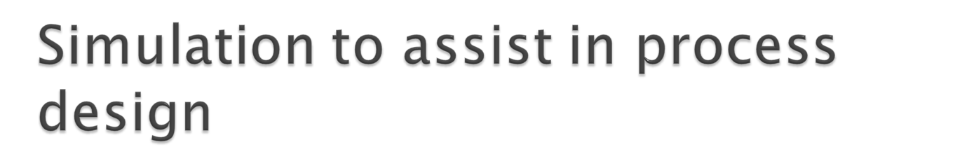
Molecular structure design
  Property estimation methods
Principles of steady-state flowsheet simulation
  Process and simulation flowsheets
  Unit subroutines
  Calculation order
  Recycle and recycle convergence methods
  Sequential modular and equation oriented architectures

Slide 15
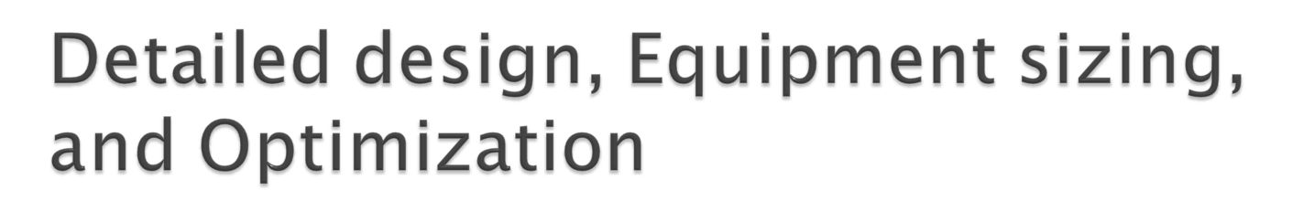
2-phase and 3-phase separation vessels
Heat exchangers
Separation towers
Pump, compressor, and expander

Slide 16

General formulation of the optimization problem
  Objective function and decision variables
  Constraints and bounds
Classification of optimization problems
Optimization algorithms
Flowsheet optimization (case studies)

Slide 17
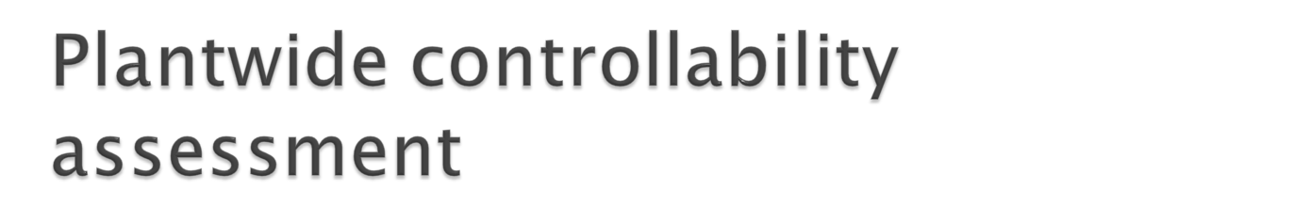
Control system configuration
  Classification of process variables
  Selection of controlled (output) variables
  Selection of manipulated variables
  Selection of measured variables
Toward automated flowsheet
  Controller loop definition and tuning
  Case studies

Slide 18

Component properties
Selection of thermodynamic calculation methods
PFD simplification
  Feed streams
  Unit specifications
Running the simulation
Report generation
Results analysis
Sensitivity analysis
Flowsheet optimization
Final standard reports

Slide 19

Calling HYSYS and/or Aspen Plus from inside other programs (i.e. Microsoft Excel and Visual Basic)
How to add not involved unit operations, thermodynamic models, and other properties to HYSYS and Aspen Plus

