Slide 1

Physical and chemical equilibrium of CO2-Water-Mineral system using Aspen Plus process simulator
Technical University of Delft
Ali Akbar Eftekhari
Hans Bruining

Slide 2
Outline
Application of thermodynamics in CO2 sequestration
Process simulators: why?
Phase equilibrium of CO2-Water mixture: How accurate are the thermodynamic models?
Tuning the parameters of thermodynamic models using experimental data
Phase and chemical equilibria of CO2-Water-mineral system
Concluding remarks

Slide 3
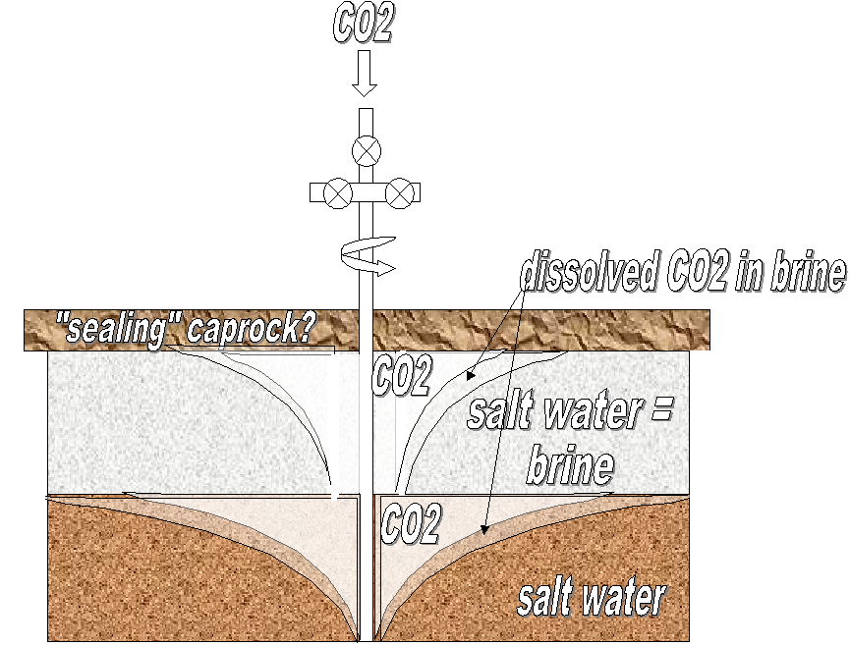
CO2 sequestration in aquifers

Slide 4
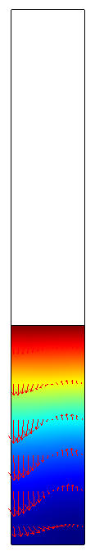
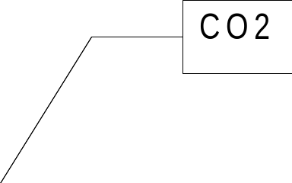
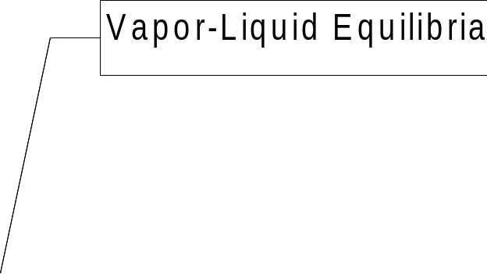

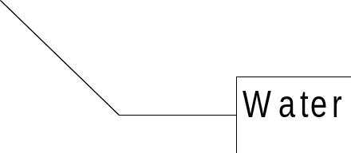
CO2 diffusion in water enhanced by natural convection

Slide 5


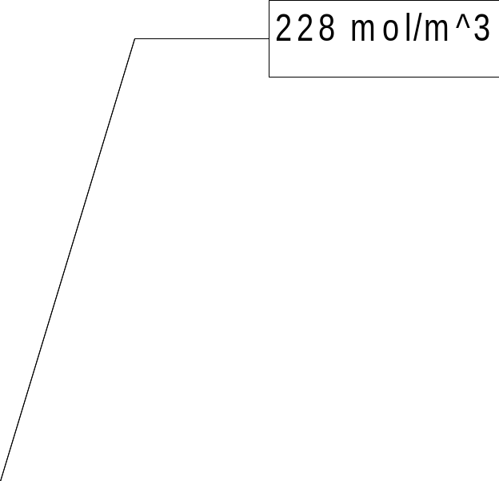
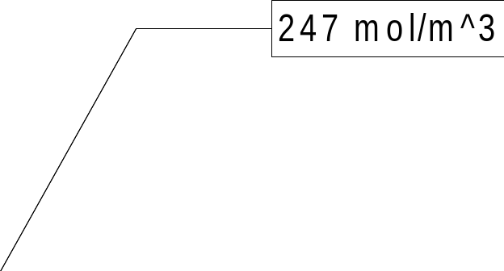
Effect of solubility prediction on the simulation results
Run time: 60000 s
Henry's constant in the right hand side
simulation is just 10 % lower than
the left hand side case.
Other assumptions:
-Ideal gas law
-Ideal liquid

Slide 6
Process Simulators
A comprehensive database:
  Physical properties of pure components and binary mixtures
Thermodynamic models
  Equation of state, activity coefficient models, etc
  Very powerful algorithms in the calculation of fluid phase equilibrium
Mathematical model
  simple mass and energy balance (not momentum)
A beautiful and user-friendly GUI

Slide 7
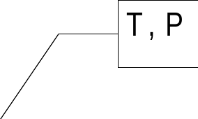
Fluid phase equilibria
Equilibrium constraint:
  Chemical potential of species i in the vapor and liquid phase are equal.
  Chemical potential can be evaluated using a thermodynamic model at known temperature and pressure.
Vapor phase (V)
y_{i}
Liquid phase (L)
x_{i}

Slide 8
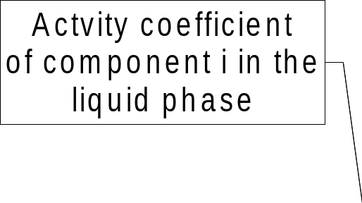
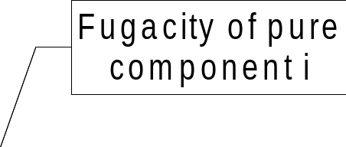
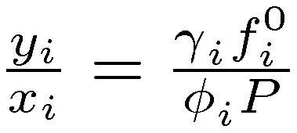
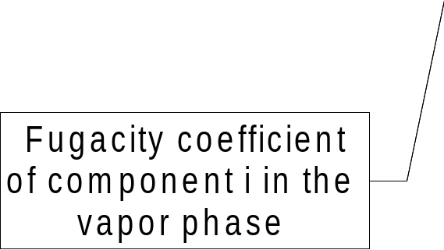

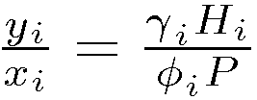
Flash calculation
Vapor phase (V)
y_{i}
Liquid phase (L)
x_{i}
For Ideal gas law:
For Henry's law:

Slide 9
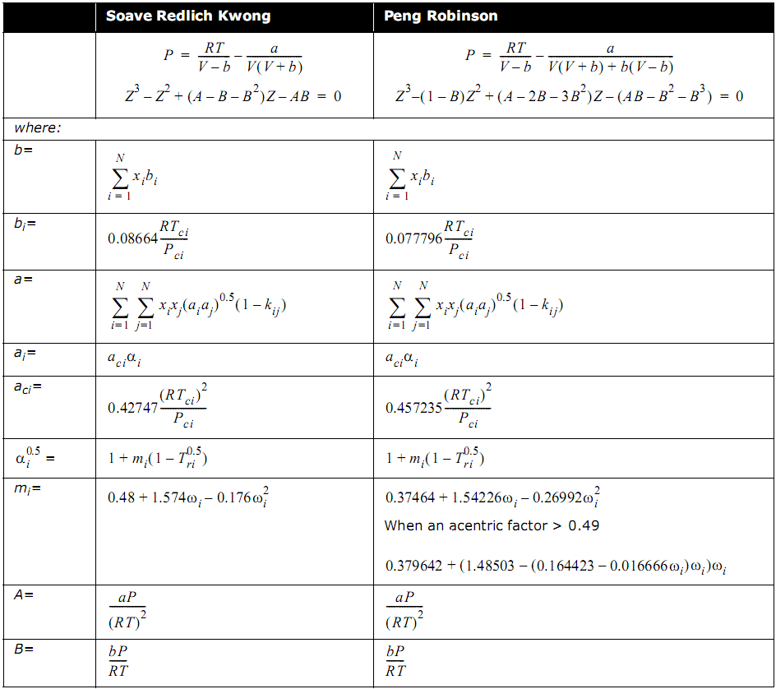

Slide 10


Flash calculation
Soave-Redlich-Kwong
Peng-Robinson

Slide 11
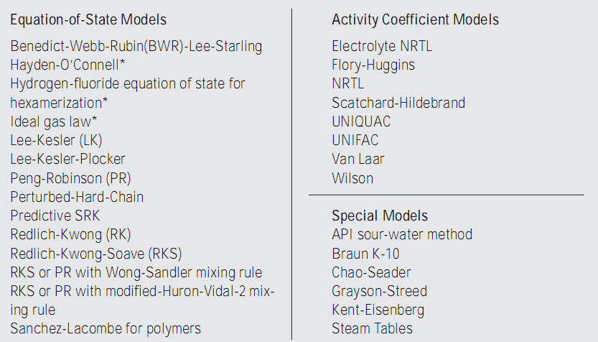
Thermodynamic property models available in a simulator
Carlson, E. C., “Don't gamble with physical properties for simulations”, Chem. Eng.
Prog., 1996

Slide 12
Process Simulators
A large set of up to date physical properties and phase equilibrium data combined with -often- old physical property models
A very well-written and debugged computer code with a user-friendly GUI
TIME

Slide 13
Process simulators
Calculation of physical properties for pure components and mixtures
Consistency tests
Data regression

Slide 14
VLE results of Aspen Plus
Error
Error
Error

Slide 15
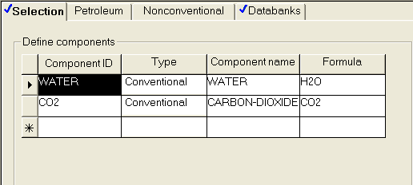
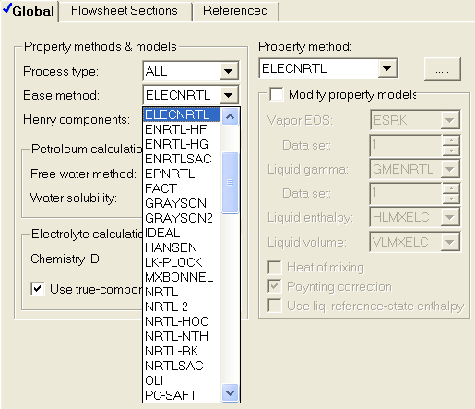
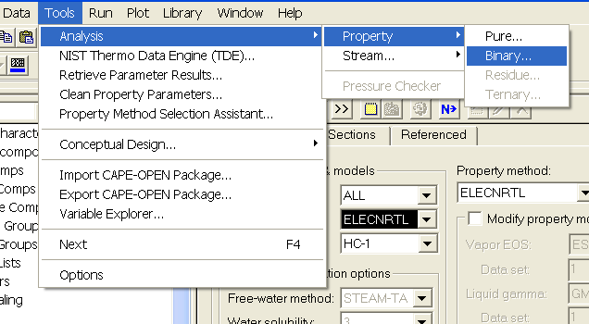
Time? How?

Slide 16
Accuracy of the models
Water-CO2 system
  Below critical temperature (T < 30 C)
    LLE
    VLE
  Over critical temperature (T > 30 C)
    VLE

Slide 17
Accuracy of the models
Peng-Robinson EOS
  Can't predict VLE and LLE data by its own parameters
  After tuning:
    Good fitting to the solubility of CO2 in liquid
    Poor fitting to the water vapor data points
    Not suitable for prediction of LLE

Slide 18
Accuracy of the models
NRTL (Non-Random Two-Liquid) with Henry's law
  Acceptable prediction of the CO2 solubility in water with deviation at higher pressures
  Cannot predict LLE by itself
    Acceptable results after tuning

Slide 19
VLE results of Aspen Plus

Slide 20
Accuracy of the models
ELECNRTL-Henry-RK
  Accurate prediction of VLE data in both phases
  Cannot predict LLE without tuning
    Acceptable results after tuning
  Very accurate results after tuning, but over a limited range of T and P

Slide 21
VLE data below the Tc

Slide 22
VLE data over the Tc

Slide 23
Combination of NRTL and PR model after the tuning

Slide 24
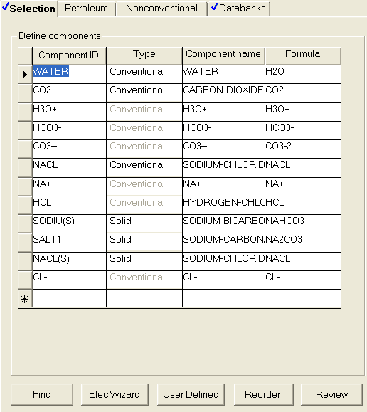
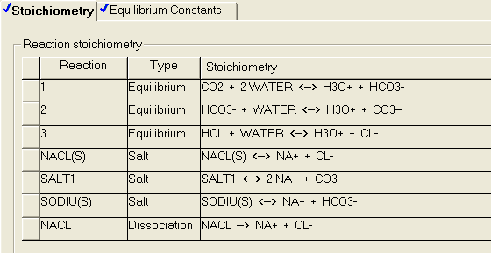
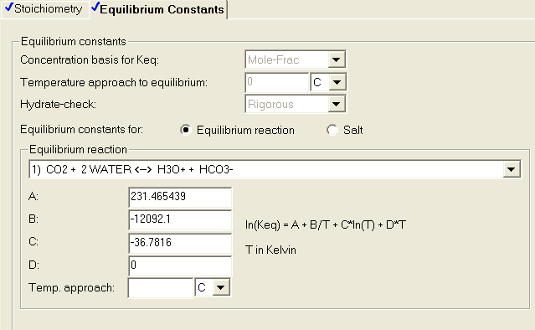
Electrolyte solutions

Slide 25
CO2 solubility in the brine solution
NaCl molality: 3.997 mole/kg water
Temperature: 40.01 C

Slide 26
Conclusion
Phase equilibrium behavior of CO2-water/brine system has a drastic effect on the simulation results of CO2 sequestration in aquifers
Aspen Plus (or other process simulators) can accelerate the procedure of property model selection, consistency test of experimental data, and tuning of the parameters
A combination of an electrolyte model, Henry's law, and a simple EOS can generate pretty accurate VLE results in the lack of experimental data
No property model can predict the VLE and LLE accurately on a very wide range of temperature and pressure

Slide 27

Thank you for you attention

