Slide 1
TEMPORAL · ENGINEERING TALK
A LIVE-CODED CASE STUDY
Lifting the Veil
How to match your use case & Temporal — one prompt, one AI coding agent, and one insurance claim.
1
prompt → full app
0
databases used
Notes:
Welcome / intro yourself. Hook: 'How many of you have looked at Temporal's docs and thought this looks powerful, but I genuinely don't know if MY problem needs it?' That's the veil we're lifting today.

Slide 2
AGENDA
Where we're headed
01 The prompt experiment — before & after
02 What actually got built (architecture + lifecycle)
03 Live demo — real failures, real recovery
04 Lessons — how to match your use case to Temporal
05 Resources & how to try this yourself
◈ Temporal · Lifting the Veil
Notes:
Quick roadmap. Keep brief.

Slide 3
THE QUESTION EVERYONE ACTUALLY HAS
"This looks powerful. But is it right for my use case?"
— every engineer's first honest reaction to Temporal
Notes:
Temporal's pitch is abstract until it touches a concrete, messy business process you own.

Slide 4
THE EXPERIMENT
I asked AI a vague prompt. Here's what happened.
Not “here is a finished spec, build it.” A genuinely rough, one-paragraph idea.
STEP 1
Write the rough idea
STEP 2
Ask AI to turn it into a real spec
STEP 3
Hand that spec to a coding agent & build it
◈ Temporal · Lifting the Veil
Notes:
Set up the three-act structure of the talk. Reproducible — anyone can do this on their own use case.

Slide 5
01
The Prompt Experiment
A concrete way to see what Temporal can do for your use case.

Slide 6
WHAT I ACTUALLY TYPED
My first prompt (verbatim)
● ● ● chat — untitled idea
> I want to see what temporal workflows can do for me. Create me a project with a UI to track workflow progress and for me to interact with the workflows. Scenario: Claim process for an insurance company. No database, just get state and progress from temporal itself. Use a local temporal instance. Implement any cool ideas you can think of. Make sure there is at lease 1 wait for signal from the UI. Use local storage so the UI persists on refresh.
◈ Temporal · Lifting the Veil
Notes:
Read it out loud, typo and all ('at lease 1').

Slide 7
WHAT IT BECAME
An excerpt from the full implementation prompt
● ● ● prompt — Temporal claims demo spec
> Create a working monorepo using:
- Temporal TypeScript SDK
- A local Temporal development server
- NestJS for the backend/API and Temporal worker
- React with TypeScript for the UI
- Docker Compose where useful
Do not use a database. Temporal must be the source of truth for workflow state and progress.
The human-review step should wait indefinitely for an adjuster to approve, deny, or request more information. The UI must clearly show that the workflow is waiting for input and provide controls for sending the appropriate signal.
◈ Temporal · Lifting the Veil
Notes:
This is the turning point: the prompt stopped being a wish list and became a set of architectural constraints, Temporal capabilities, UI requirements, and acceptance criteria.

Slide 8
READ IT AGAIN, LIKE A CODING AGENT HAS TO
What is not said
“…track workflow progress… interact with the workflows… no database… any cool ideas… at lease 1 wait for signal… local storage so it persists…”
? Which failures are transient vs. permanent?
? What must never be lost on a crash?
? Where's the API/worker/UI boundary?
? What does “interact with” mean — signals? updates?
? “Cool ideas” = infinite scope, zero acceptance criteria
None of this makes the prompt bad.
◈ Temporal · Lifting the Veil
Notes:
The point isn't 'this prompt is bad' — it under-specifies exactly the decisions that make or break a durable-execution design.

Slide 9
THE MOVE THAT ACTUALLY MATTERS
I didn't fix the prompt myself. I asked AI to fix it.
WHY NOT WRITE THE SPEC BY HAND?
Because “what should a good Temporal spec contain” is itself a question worth delegating — the model already knows the shape of retries, signals, queries, sagas, especially with a Temporal skill loaded for grounding.
WHAT I ASKED FOR
“Would this be good for a coding-agent prompt?” — the answer covered architecture, failure modes, and UI/UX explicitly.
Temporal AI skill: github.com/temporalio/skill-temporal-developer
◈ Temporal · Lifting the Veil
Notes:
Generalizable trick: use the model to interrogate its own upcoming task.

Slide 10
WHAT CAME BACK
The improved prompt (condensed)
STACK & ARCHITECTURE, NAMED EXPLICITLY
Temporal TS SDK · local dev server · NestJS API + worker · React + TS UI · Docker Compose · separate workflow/activity/client/API/UI layers
DURABILITY REQUIREMENTS, NAMED EXPLICITLY
retry policies per activity · at least one timer · a child workflow · signals for every human action · queries for state/progress · cancellation handling
THE CLAIM LIFECYCLE, SPELLED OUT
9 named stages from submission to payout — not “any cool ideas,” a concrete process to map onto primitives
DEFINITION OF DONE
README, unit tests, one integration test that signals a real workflow to completion, build/lint/test must pass
◈ Temporal · Lifting the Veil
Notes:
Full text is in the appendix. The point is the shape, not the word count.

Slide 11
THE POINT OF THIS WHOLE TALK
Don't be overwhelmed.
You don't need to spell everything out to see what Temporal can do for you.
A sharper prompt makes for a sharper demo — but retries, signals, queries and durability are primitives Temporal gives you either way.
Notes:
Slow down here. The refined prompt made this specific demo cleaner, but the takeaway isn't 'write a perfect spec or don't bother.' Even the rough first draft would have gotten a working workflow with retries and durability for free.

Slide 12
02
What Got Built
An insurance claims console where Temporal — not a database — is the source of truth.

Slide 13
ARCHITECTURE
Four pieces, one source of truth
React Dashboard
Polls the API and keeps only preferences + recent workflow IDs in localStorage.
NestJS API
REST facade that starts workflows, sends signals, and runs workflow queries.
Temporal Server
Event history, task queues, timers, visibility, and the authoritative claim state.
NestJS Worker
Runs deterministic workflow code and side-effecting activity implementations.
✗ no database, anywhere
✓ Temporal event history is the state
✓ localStorage = prefs + recent ids only
◈ Temporal · Lifting the Veil
Notes:
Walk left to right. UI never talks to Temporal directly — only through the API.

Slide 14
THE BUSINESS PROCESS
Nine stages
1. Submitted
workflow start
2. Validation
activity + retry
3. Coverage check
activity + retry
4. Damage assessment
heartbeat + cancel
5. Fraud evaluation
child workflow
6. Human review
signal · waits forever
7. Decision
saga: release/reserve
8. Payment
durable timer + activity
9. Completed
workflow result
Every chip on this rail is a query result, live, from a running Temporal workflow.
◈ Temporal · Lifting the Veil
Notes:
Exact stage list from the improved prompt. Stage 6 = the required signal, precisely specified.

Slide 15
ARCHITECTURE
Inside the three packages
WEB — DASHBOARD
API — REST FACADE
WORKER — WORKFLOWS & ACTIVITIES
src/
├── pages/
│ ├── DashboardPage.tsx
│ └── ClaimDetailPage.tsx
├── components/
│ ├── StageTimeline.tsx
│ ├── ActionPanel.tsx
│ ├── SimulationPanel.tsx
│ └── …10 more
├── hooks/
│ ├── usePolling.ts
│ └── usePreferences.tsx
└── lib/
├── api.ts
└── storage.ts
src/
├── claims/
│ ├── claims.controller.ts
│ ├── claims.service.ts
│ ├── temporal.mappers.ts
│ └── dto.ts
├── temporal/
│ └── temporal.service.ts
├── system/
│ └── system.controller.ts
└── main.ts
src/
├── workflows/
│ ├── claim.workflow.ts
│ └── fraud-check.workflow.ts
├── activities/
│ ├── claim/
│ │ ├── validate-claim.ts
│ │ ├── process-payment.ts
│ │ └── …8 more
│ ├── fraud/
│ │ ├── check-watchlists.ts
│ │ └── score-fraud-risk.ts
│ └── simulation.ts
├── temporal/
│ └── temporal-worker.service.ts
└── admin/
└── admin.controller.ts
packages/web, packages/api, packages/worker — plus packages/shared for the request/response types, stage definitions and progress math every package imports, none of them redefine.
◈ Temporal · Lifting the Veil
Notes:
Folder-level version of the architecture diagram. Each package has exactly one job: web renders and polls, api translates HTTP to Temporal client calls, worker is the only place workflow and activity code lives. Activities are one function per file, grouped by domain.

Slide 16
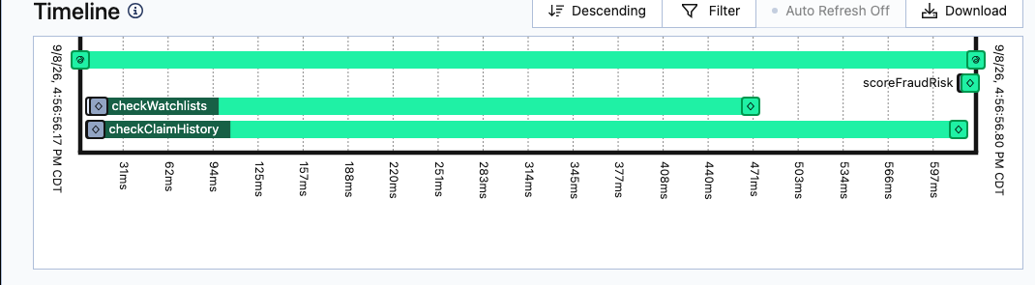
CODE → OBSERVABILITY, FOR FREE
Three activity calls. One real execution timeline.
● ● ● fraud-check.workflow.ts — simplified
const { checkClaimHistory, checkWatchlists, scoreFraudRisk } =
proxyActivities<typeof activities>({ ...retryPolicy });
export async function fraudCheckWorkflow(input: ClaimInput) {
const [history, watchlist] = await Promise.all([
checkClaimHistory(input),
checkWatchlists(input),
]);
return await scoreFraudRisk(input.claimId, [...history, ...watchlist]);
}
● ● ● Temporal Web UI — Timeline tab
No custom logging, no tracing setup, no dashboard to build — every activity call at the top shows up as a bar at the bottom the moment it runs.
◈ Temporal · Lifting the Veil
Notes:
This is the real Timeline tab for this app's fraud-check child workflow, not a mockup. The code on top is the entire body — just a proxyActivities call and three activity invocations, two of them running in parallel. That parallelism is exactly what you see as two overlapping bars below, with zero extra instrumentation code.

Slide 17
THE TEMPORAL BINGO CARD
What's actually demonstrated
RETRY POLICIES
per-stage, configurable backoff
NON-RETRYABLE FAILURES
permanent errors stop cleanly
DURABLE TIMERS
settlement hold + reminder loop
CHILD WORKFLOW
fraud check, own history
SIGNALS
approve / deny / info / recover
QUERIES
live state + progress %
UPDATE + VALIDATOR
adjuster notes, rejected inline
CANCELLATION
saga-style compensation
SEARCH ATTRIBUTES
find claims by status/type/score
WORKER-RESTART DURABILITY
kill it mid-claim, resume
HEARTBEATS
cancellable long-running activity
NO DATABASE
Temporal is the only state store
◈ Temporal · Lifting the Veil
Notes:
Let it sit as a 'yes it really does all of this' moment.

Slide 18
03
Let's See It Run
Real failures. Real recovery.

Slide 19
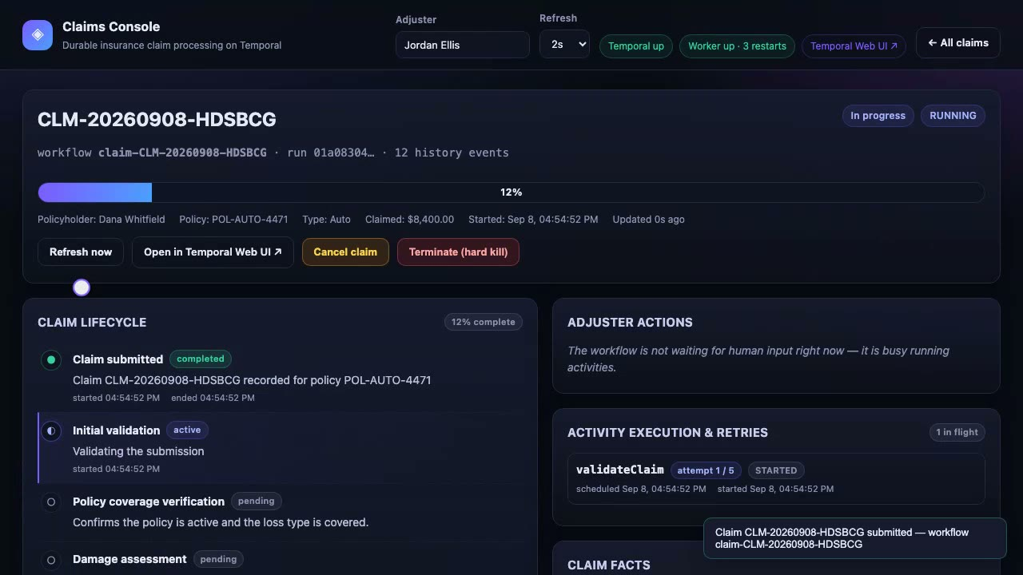
DEMO 1 / 6
Submit a claim, watch it run
submit-and-progress.mp4 — click to play
▸ Dashboard → Submit claim → live redirect
▸ Stage timeline updates via polling, no refresh
▸ Progress % computed from stage weights, not hardcoded
Notes:
Submit the Happy path preset. This whole timeline is one query, getClaimState, polled every 2s.

Slide 20
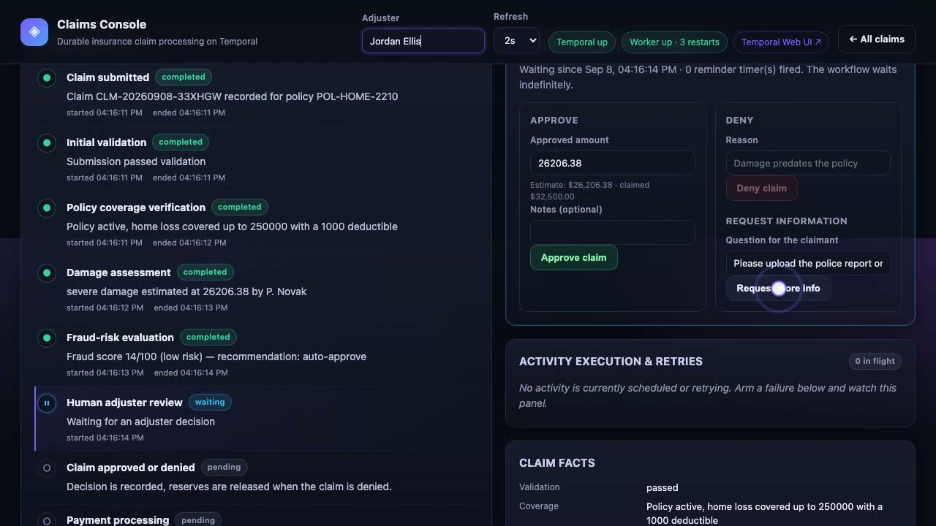
DEMO 2 / 6
The workflow waits — forever — for you
human-review-signals.mp4 — click to play
▸ Claim parks at “Human adjuster review”
▸ Request more info → provide info → back to review
▸ Approve → durable settlement timer → paid
Notes:
The required signal from the original prompt. The workflow is genuinely suspended.

Slide 21
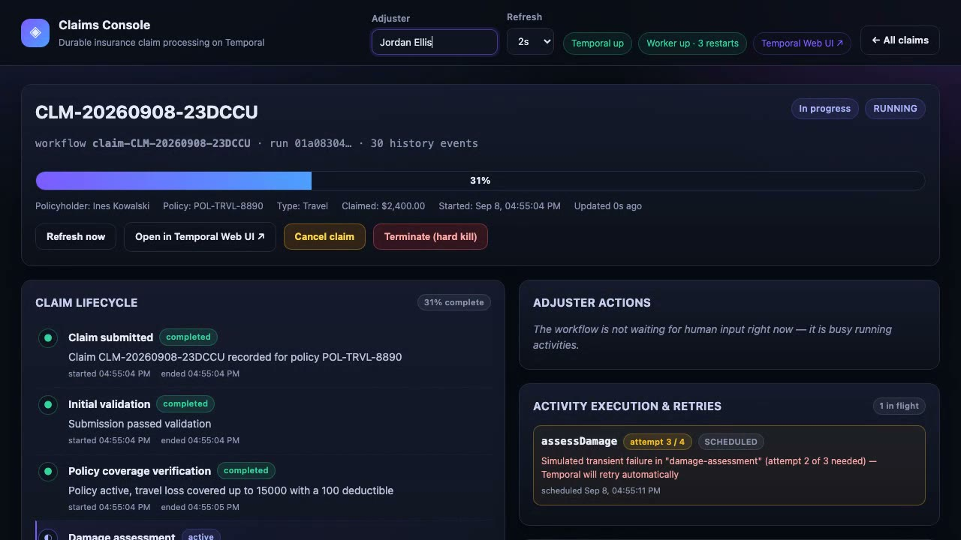
DEMO 3 / 6
Break it a little — watch it heal itself
transient-retry.mp4 — click to play
▸ Arm “transient failure” on damage assessment
▸ Activity panel shows attempt 1, 2, 3 — live
▸ Same code path, zero extra retry logic written
Notes:
Point at the Activity execution & retries panel — that's Temporal's own attempt counter.

Slide 22
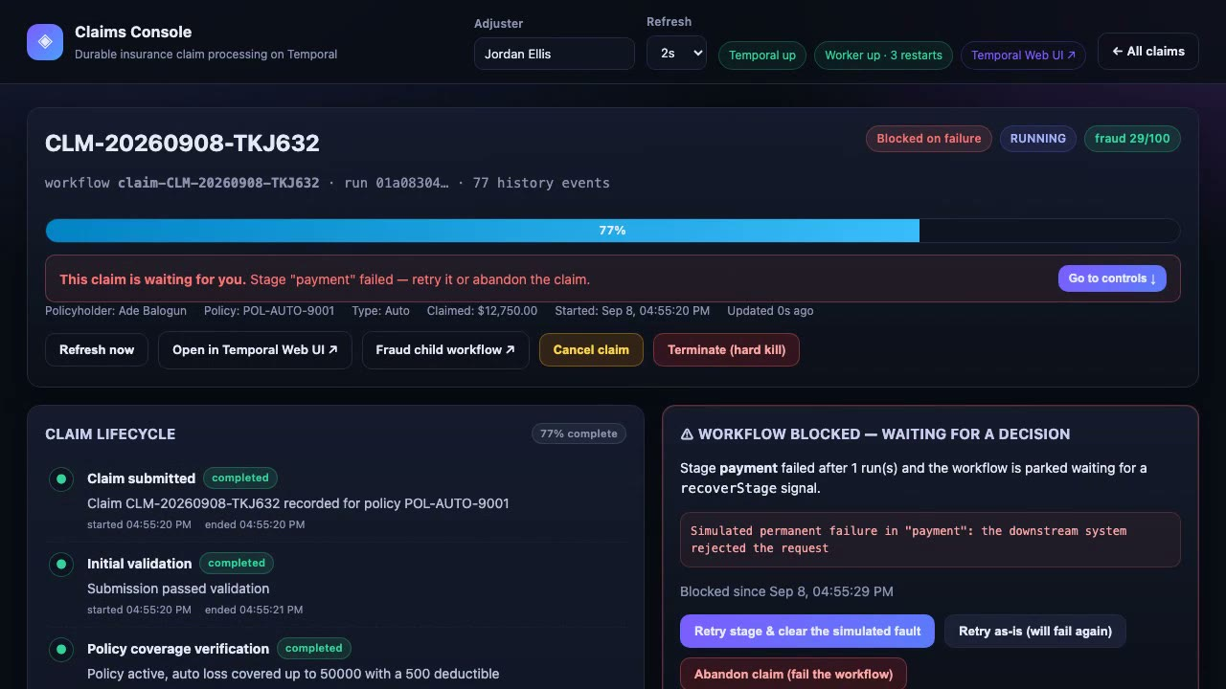
DEMO 4 / 6
Break it for real — recover it from the UI
permanent-failure-recovery.mp4 — click to play
▸ “Break payment (permanent)” → non-retryable ApplicationFailure
▸ Claim parks in “blocked on failure” — not crashed, not lost
▸ Operator clicks Retry → clears fault → claim completes
Notes:
A permanent failure doesn't kill the workflow, it parks it waiting for a human decision.

Slide 23
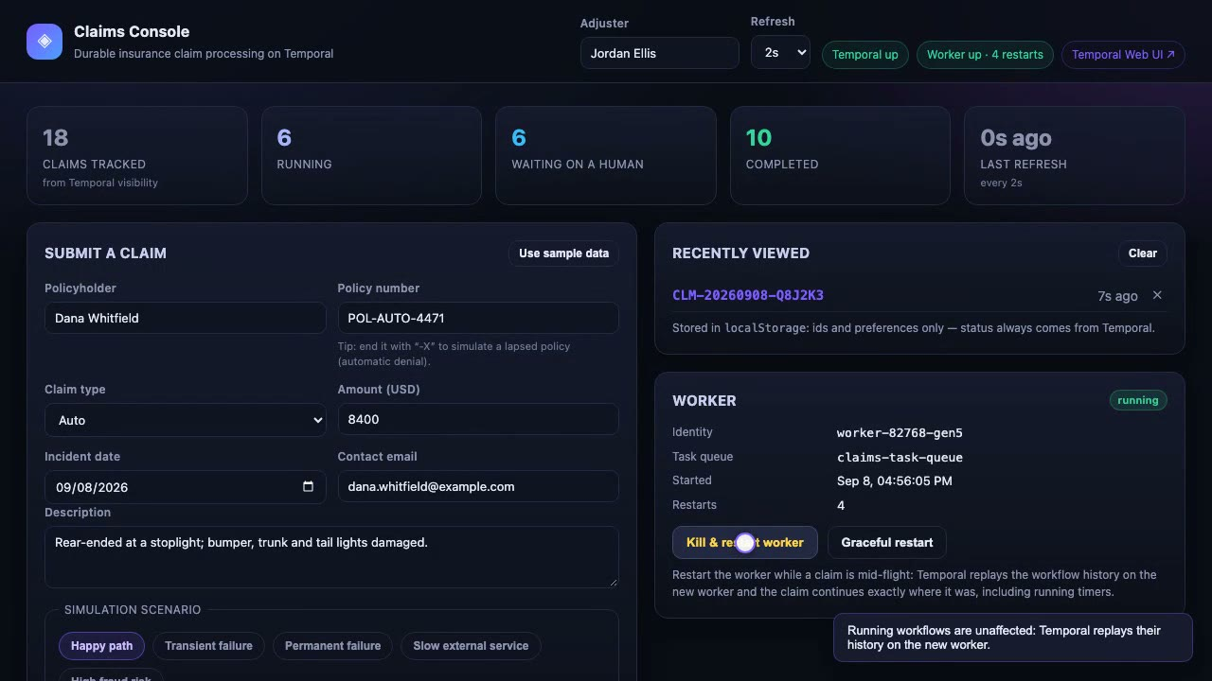
DEMO 5 / 6
Kill the worker. Mid-claim. On purpose.
worker-restart-durability.mp4 — click to play
▸ “Kill & restart worker” while a claim is blocked
▸ worker-…-gen1 dies, worker-…-gen2 comes up
▸ Claim resumes exactly where it was — timers included
Notes:
THE moment of the talk. Let this one breathe; don't rush the narration.

Slide 24
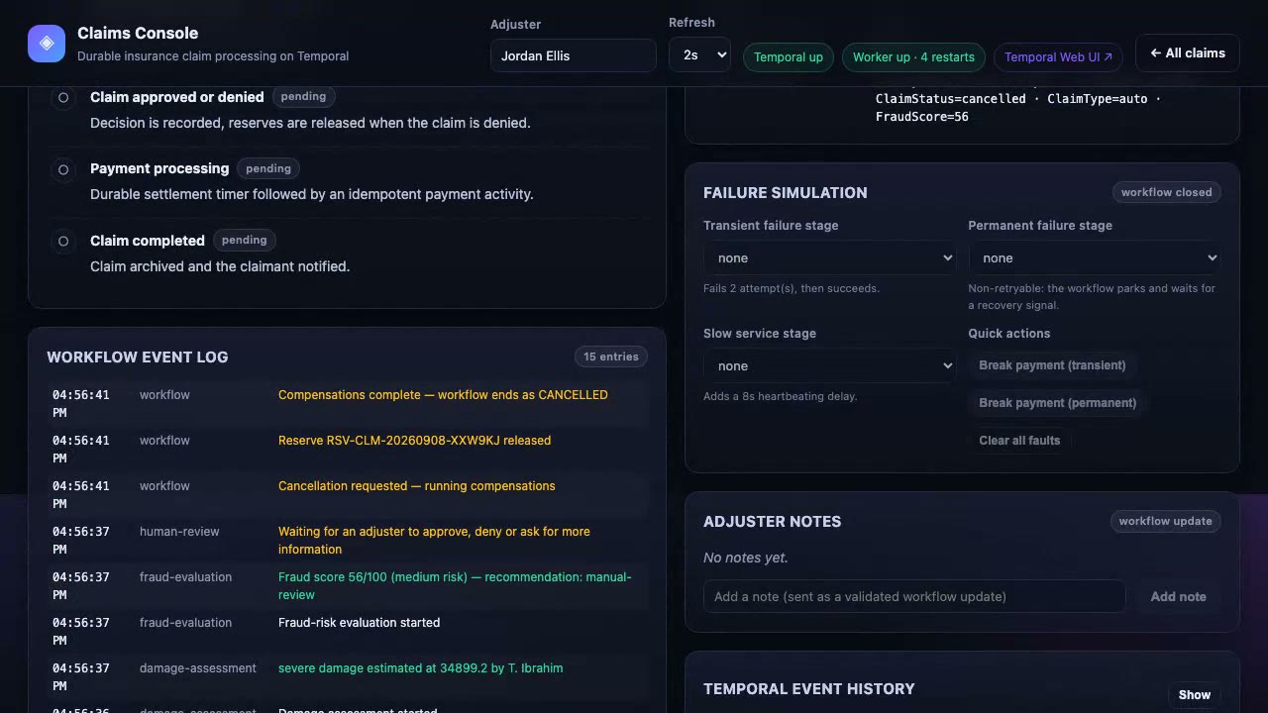
DEMO 6 / 6
Cancel mid-flight — compensations run
cancellation-saga.mp4 — click to play
▸ Cancel a running claim from the dashboard
▸ Reserve released, payment reversed, claimant notified
▸ Workflow closes CANCELED — cleanly, not abruptly
Notes:
If time is short, this is the cut candidate.

Slide 25
04
Matching Your Use Case

Slide 26
PATTERN MATCH
Signals you have a good Temporal use case
✓ A process that spans minutes, days, or months — not one request/response
✓ Short-lived workflows can still fit — milliseconds or seconds are fine when you need durability, retries, or history
✓ A human has to approve, deny, or provide info at some unknown point
✓ Steps call flaky external systems that need retries with backoff
✓ A crash mid-process must not lose or double-run anything
✓ You need an audit trail of exactly what happened, in order
✓ Multiple steps must be undone together if a later one fails (saga)
◈ Temporal · Lifting the Veil
Notes:
Ask the room how many already do 3+ of these with cron jobs and status columns.

Slide 27
THE REUSABLE CHECKLIST
Durability questions to ask yourself
ASK ABOUT FAILURE
What activities can fail transiently? What's permanent? What must be non-retryable?
ASK ABOUT WAITING
What waits on a human? For how long? What happens if nobody answers?
ASK ABOUT STATE
What must survive a crash? Who is the source of truth?
ASK ABOUT BOUNDARIES
Where does UI end and API begin? Where does API end and worker begin?
◈ Temporal · Lifting the Veil
Notes:
This slide is the payoff — a generalized checklist for deciding whether a process maps cleanly to Temporal.

Slide 28
HOMEWORK
Try this yourself, this week
● ● ● prompt-template.txt
> Here's my rough idea: [describe your process in 2-3 sentences]. Turn this into a spec for a coding agent building it on Temporal. Explicitly call out: which steps need retries and what kind of failures they should tolerate, where a human needs to approve/reject/provide input and how long we should wait, what a crash mid-process must not lose, and how the UI/API/worker boundaries should be drawn. Then build it.
◈ Temporal · Lifting the Veil
Notes:
Invite people to paste their own use case into this template tonight.

Slide 29
GO BUILD SOMETHING
Resources
THIS DEMO
Full source, README, tests — github.com/simy307/temporal-claims-demo
TEMPORAL DOCS
docs.temporal.io · TypeScript SDK samples
COMMUNITY
Temporal Slack · community forum · local meetups
THE PROMPT TEMPLATE
Previous slide — steal it, adapt it, use it on your own use case
◈ Temporal · Lifting the Veil
Notes:
Fill in your actual repo URL before the talk.

Slide 30
TEMPORAL · ENGINEERING TALK
Thank you.
Notes:
Open the floor. Be ready for: versioning, Cloud vs self-hosted, payload limits, vs Airflow/Step Functions.

