Slide 1
Predicting English Premier League Match Outcomes
57%
from squad
ratings alone
Win, draw or loss from pre-match squad statistics
UE24CS352A Machine Learning - Mini-Project
Sinchana K (PES1UG24AM405)
Sanjana Shastry (PES1UG24AM916)
Notes:
Introduce team and problem. Based on Harbola & Lee (Stanford CS229, 2019). Our headline: about 57% accuracy from squad ratings alone, versus 46.2% for always guessing a home win.

Slide 2
The problem and the bar to beat
Given only pre-match information, classify a Premier League game as home win, draw or home loss.
33.3%
random guess
Why it is hard
Three overlapping classes
Draws are the rarest outcome (24.8%)
Football has high inherent randomness
46.2%
always predict home win
~57%
our best models
EPL Match Prediction | 2
Notes:
The real baseline is not 33%: home teams win 46.2% of the time, so a model must beat 46.2% to add value. Draws are the hardest class because they sit between wins and losses.

Slide 3
Dataset: 3,791 matches, 3 feature sets
F1
F2
F3
2 features
10 features
280 features
Home and away overall roster rating
F1 + GK / DEF / MID / ATT average ratings
Every player: rating, pass %, passes, shots, key passes, blocks, interceptions
EPL Match Prediction | 3
Notes:
Scraped from whoscored.com by the paper's authors, seasons 2009/10 to 2018/19. No missing values. Features are season-level so the model is treated as time-independent. We use their public data; the modelling and evaluation pipeline is our own.

Slide 4
Approach: a leakage-free pipeline
1
2
3
4
5
Stratified 80/20 split
Standardise features
5-fold CV on train only
Score test once
Repeat on 5 more splits
Models compared
Beyond the paper
Hyper-parameters never see the test set
Mean and spread over random splits
Class-weight balancing for draws
Gaussian discriminant analysis (GDA)
SVM: linear, degree-5 polynomial, RBF
SoftMax regression: linear and quadratic
Neural network, one hidden layer
EPL Match Prediction | 4
Notes:
The paper picks the best number from a single split. Differences of about 1% are within split-to-split noise, so we tune with cross-validation on train only and report mean and spread across splits.

Slide 5
Implementation
data.py
Loads CSVs, builds F1-F3, splits
Stack
Python 3, scikit-learn
pandas, matplotlib, seaborn
Private GitHub repo with README
GDA is scikit-learn QDA
F3 quadratic SoftMax skipped (39k features)
models.py
Pipelines and hyper-parameter grids
run_experiments.py
Tune, evaluate, robustness, balanced run
make_figures.py
Figures and results tables
demo.py
Live demo with class probabilities
EPL Match Prediction | 5
Notes:
Walk through the repo layout. Everything reproduces with pip install -r requirements.txt then python src/run_experiments.py. Be ready to explain any file.

Slide 6
Result: ~57% with simple models
57.0%
SoftMax linear on F2, best mean over splits
Good models differ by ~1%, within split noise (sd 0.7-1.8%). SoftMax quad on F3 not run.
EPL Match Prediction | 6
Notes:
About 10 points above the home-win baseline. A linear model is as good as a neural network. The poly-5 SVM is the weak point in our pipeline; the paper's 58.89% for it came from a single split and we could not reproduce it (about 52% here). The zero bar for SoftMax quad on F3 means not run.

Slide 7
More features means more overfitting
Averaged over models
F1 test 56.5%
F2 test 55.4%
F3 test 51.9%
F3 has 280 features for about 3,000 training rows. Training accuracy climbs to 78% while test accuracy falls.
EPL Match Prediction | 7
Notes:
This matches the paper's finding: high-variance regime with the larger feature sets. Using the 2-feature set gives the same accuracy as anything larger.

Slide 8
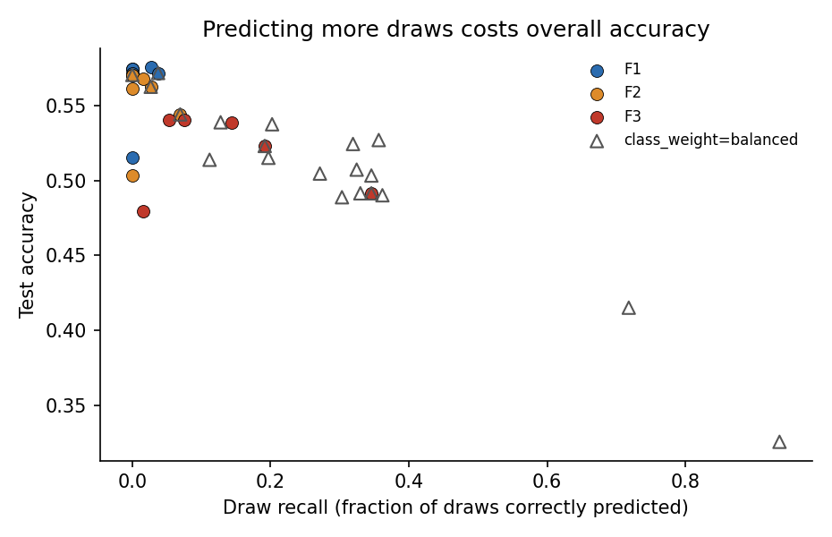
Draws are the bottleneck
Well-generalising models (F1, F2) almost never predict a draw: recall at most 7%.
F3 predicts more draws (recall up to 35%) but by overfitting, so accuracy drops.
Class balancing lifts draw recall to 20-36% but accuracy falls to about 50-54%.
EPL Match Prediction | 8
Notes:
Every point is one model and feature set. Points further right predict more draws; they sit lower, meaning overall accuracy is lost. Draws sit between wins and losses in rating space, so ratings alone cannot separate them.

Slide 9
Conclusions
Ratings work
Simple wins
56-57% vs 46.2% baseline
Linear models match complex ones
Overfit risk
Draws remain hard
280 features: train 78%, test 54%
Need new features or models
Reproduction note: the paper's 58.89% (poly-5 SVM) was not reproduced under a leakage-free protocol; its qualitative conclusions were.
Future work: form and head-to-head features, two-stage win-vs-draw models, calibration, gradient boosting.
EPL Match Prediction | 9
Notes:
Be upfront about the reproduction gap: it strengthens the credibility of the rest of the work.

Slide 10
Live demo
$ python src/demo.py --random 8
$ python src/demo.py --home 7.15 --away 6.70
$ python src/demo.py --interactive
Random unseen test matches: predicted vs actual, with class probabilities
Custom match from home and away roster ratings
Model trained on the 80% split only, so test matches are truly unseen
EPL Match Prediction | 10
Notes:
Run the three commands live. Point out that draws are rarely the top prediction even when their probability is around 25-30%. Then take questions.

