Slide 1
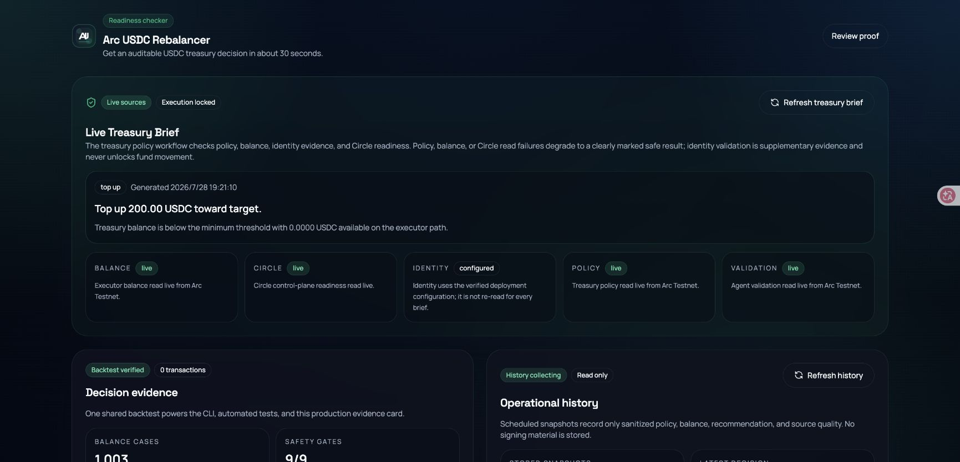
DeFi Track | Arc Testnet
Arc USDC
Rebalancer
Policy-bound treasury decisions before execution.
Arc + USDC + Circle Wallets + Gateway
Public MVP is read-only. No treasury transaction has been submitted.
Notes:
Open with the DeFi Track and the public read-only boundary.

Slide 2
Treasury teams need a defensible decision before moving USDC.
LIVE INPUTS
Arc policy and executor balance
Circle control-plane readiness
Source quality on every read
THE BOUNDARY
The MVP produces evidence and a bounded recommendation. It does not expose a signer or treasury write path.
ARC USDC REBALANCER
02

Slide 3
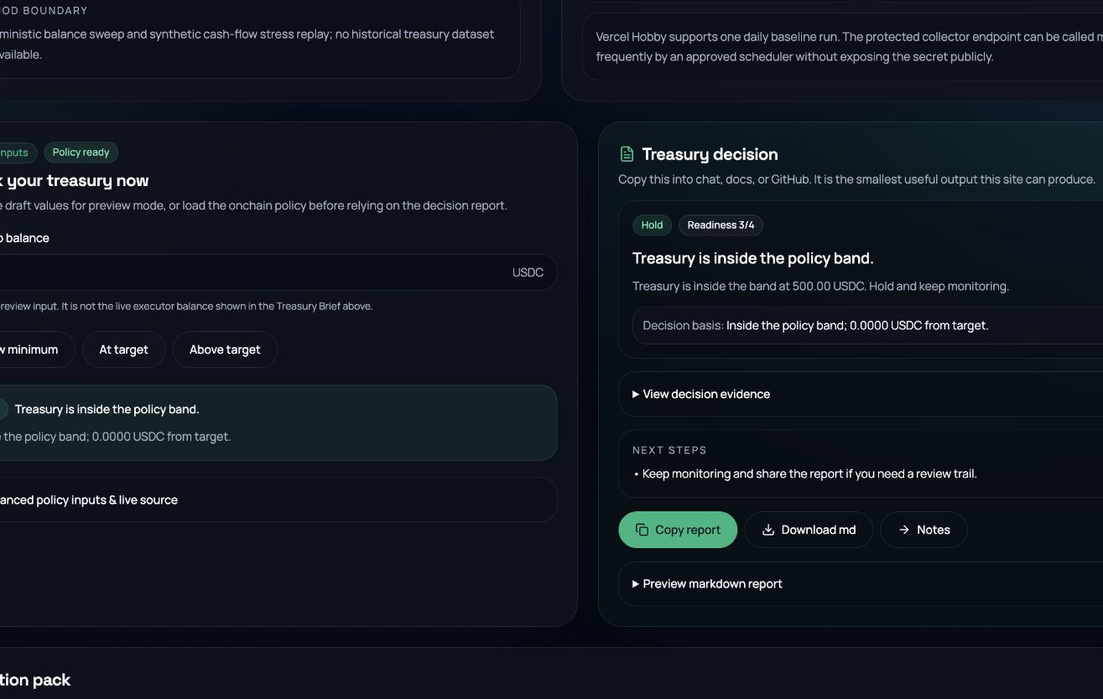
One Arc policy produces three bounded outcomes.
Policy: minimum 100 USDC | target 500 USDC | cap 200 USDC
75
TOP UP 200
500
HOLD
700
TRIM 200
Every amount is capped by policy and exported for review.
ARC USDC REBALANCER
03

Slide 4
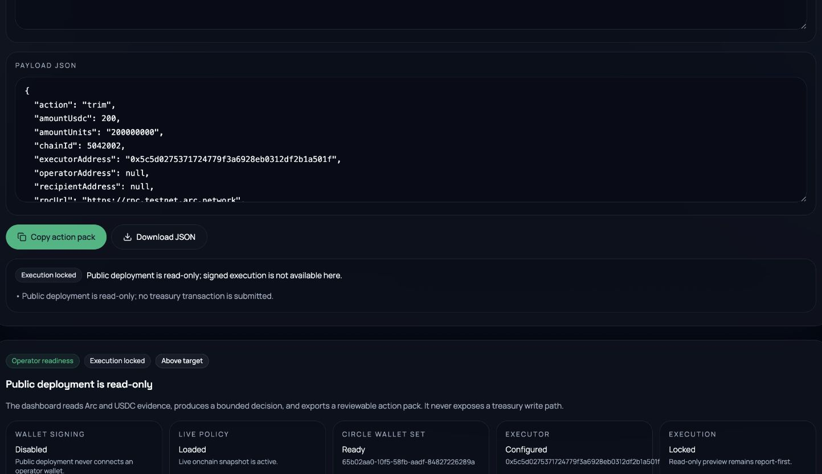
The output is reviewable, not executable.
ACTION PACK
Canonical USDC units
Arc chain ID 5042002
Operator and recipient unset
Receipt marked not published
EXECUTION LOCKED
The public deployment exposes no private key, approval, transfer command, or signed execution flow.
ARC USDC REBALANCER
04

Slide 5
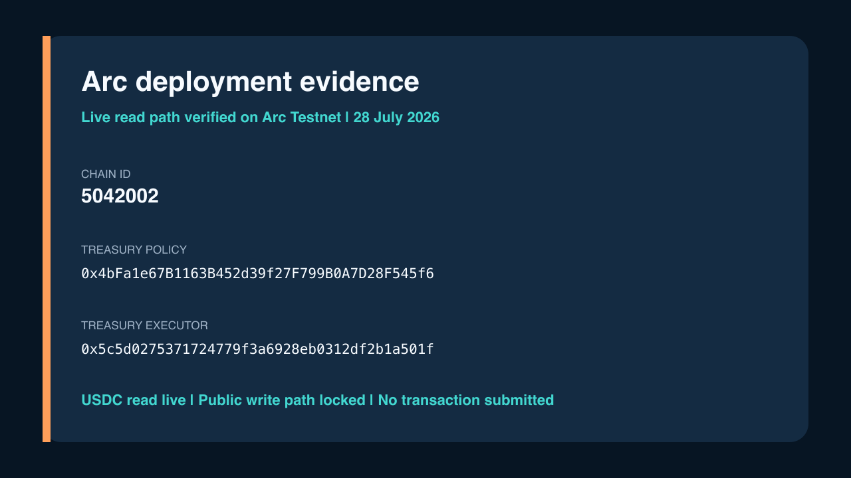
ARC TESTNET EVIDENCE
05
Notes:
[Sources]
https://web-eight-chi-99.vercel.app/architecture
https://rpc.testnet.arc.network

Slide 6
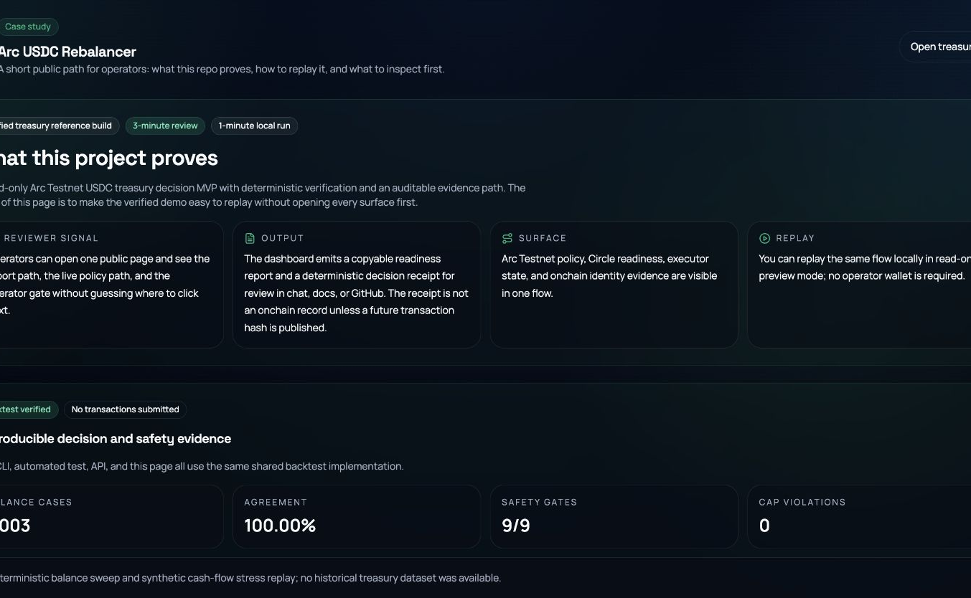
The control loop is reproducible, and the transfer count is zero.
1,003
deterministic balance cases
100.00%
expected-action agreement
0
transactions submitted
Synthetic stress replay, not a historical treasury performance claim.
ARC USDC REBALANCER
06

Slide 7
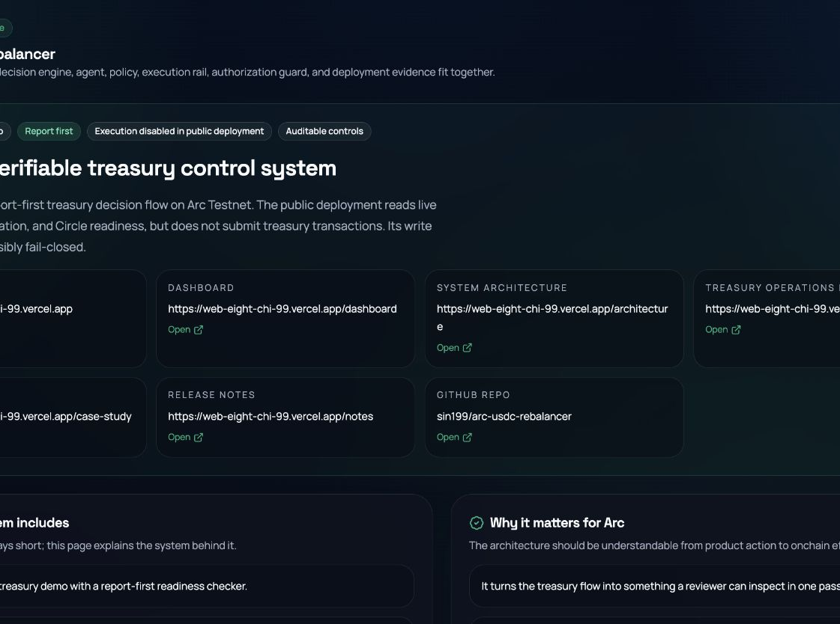
A natural fit for the DeFi Track.
MEANINGFUL ARC + USDC
Live policy and executor-balance reads drive every recommendation.
TREASURY WORKFLOW
Top up, hold, or trim is bounded by policy and exported as evidence.
CIRCLE PRODUCTS
Developer-controlled Wallets and Gateway are live readiness signals, not proof of transfer.
DEFI TRACK ONLY
07
Notes:
[Sources]
https://www.encodeclub.com/my-programmes/arc-hackathon

Slide 8
Proof before execution.
Open the dashboard. Verify the policy. Replay the decision.
Dashboard
web-eight-chi-99.vercel.app/dashboard
Repository
github.com/sin199/arc-usdc-rebalancer
No completed treasury transfer is claimed.
DEFI TRACK | ARC TESTNET
08

