Slide 1
Git / Github

Slide 2
VCS (Version control systems)
Keep track of software
Work on the same source code in a team
Keep track of different versions of the software

Slide 3
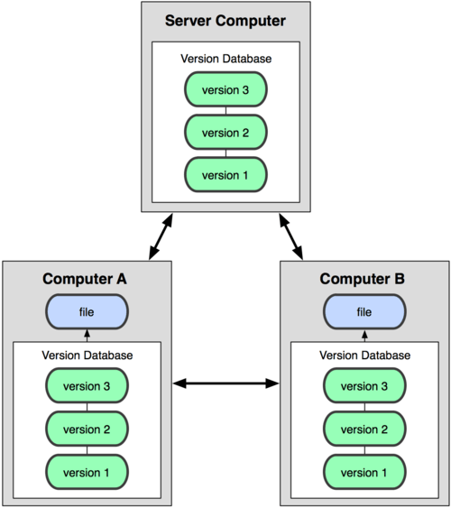

Git
Distriubted (decentralized) version control system

Slide 4
Git
Founded in 2005
High speed
Simple design
Support thousands of branches
Fully distributed
Able to handle very large projects

Slide 5
Git Doesn’t delete
Git generally only adds data
If you mess up you can always go back and recover older codes
All the relevant information like the users, changes, dates and etc. will be logged

Slide 6
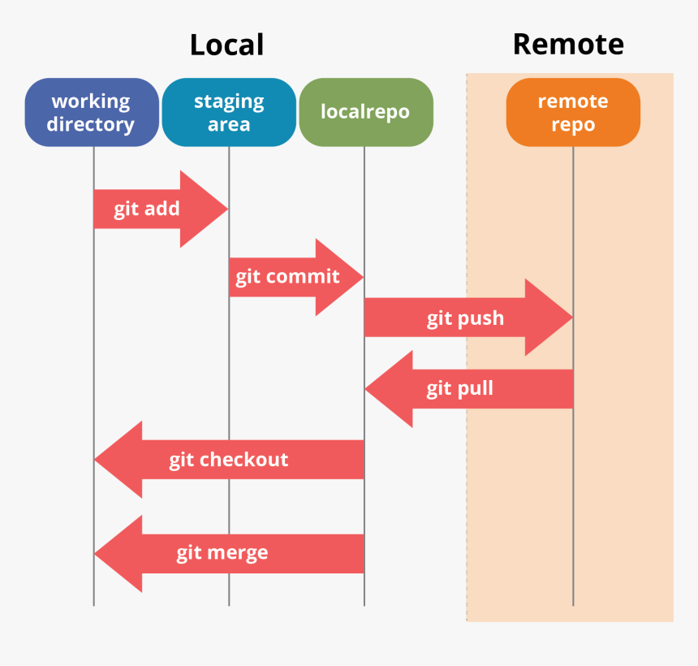
WorkFlow

Slide 7
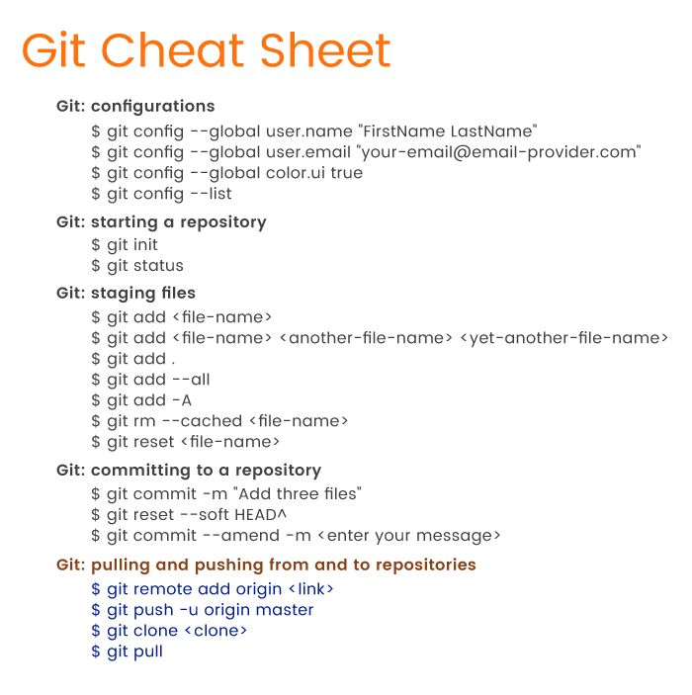
Common commands

Slide 8
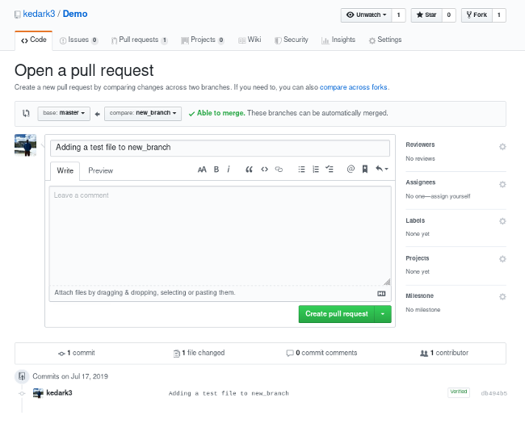
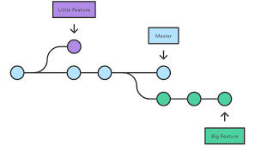
Branches/Merge/Pull Request

Slide 9
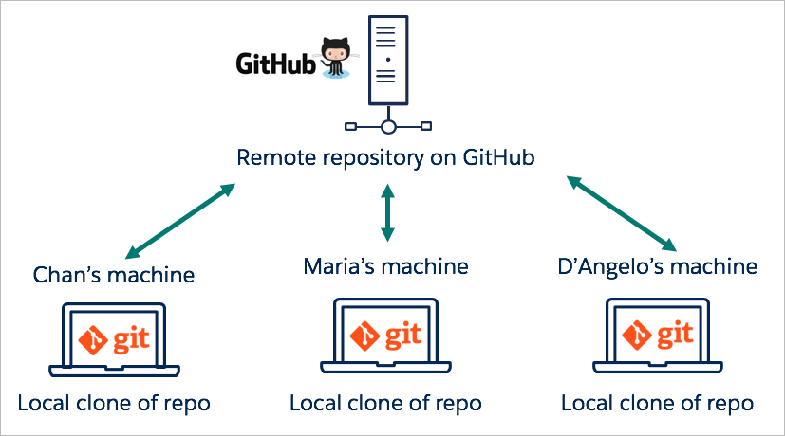
Github

