Slide 1
Many-body localization in a driven-dissipative cavity mode
Koki Chinze, Saeed Rahmanian Koshkaki, Mohsen Yarmohammadi, Michael Kolodrubetz

Slide 2
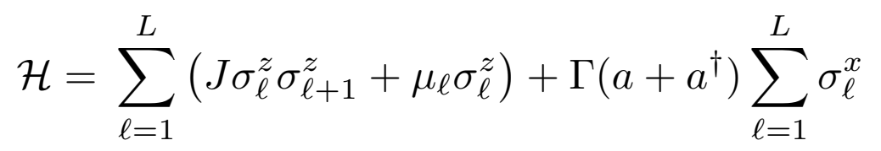
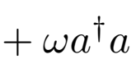
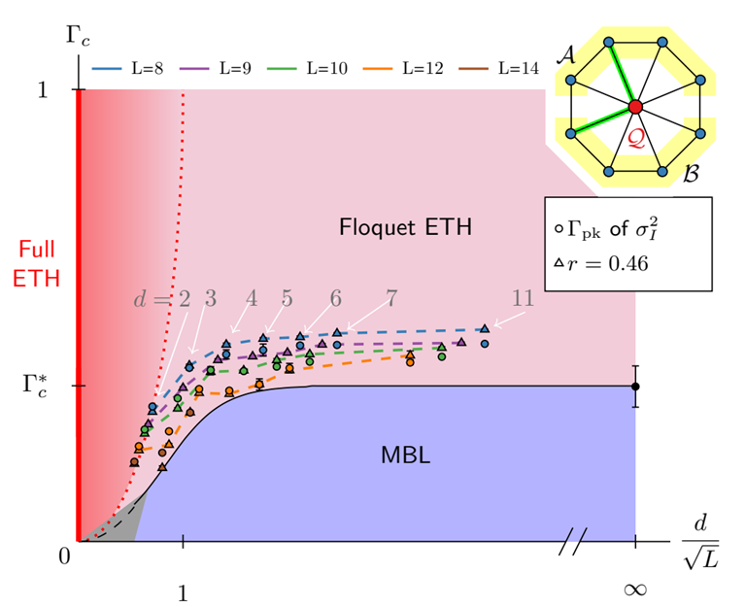
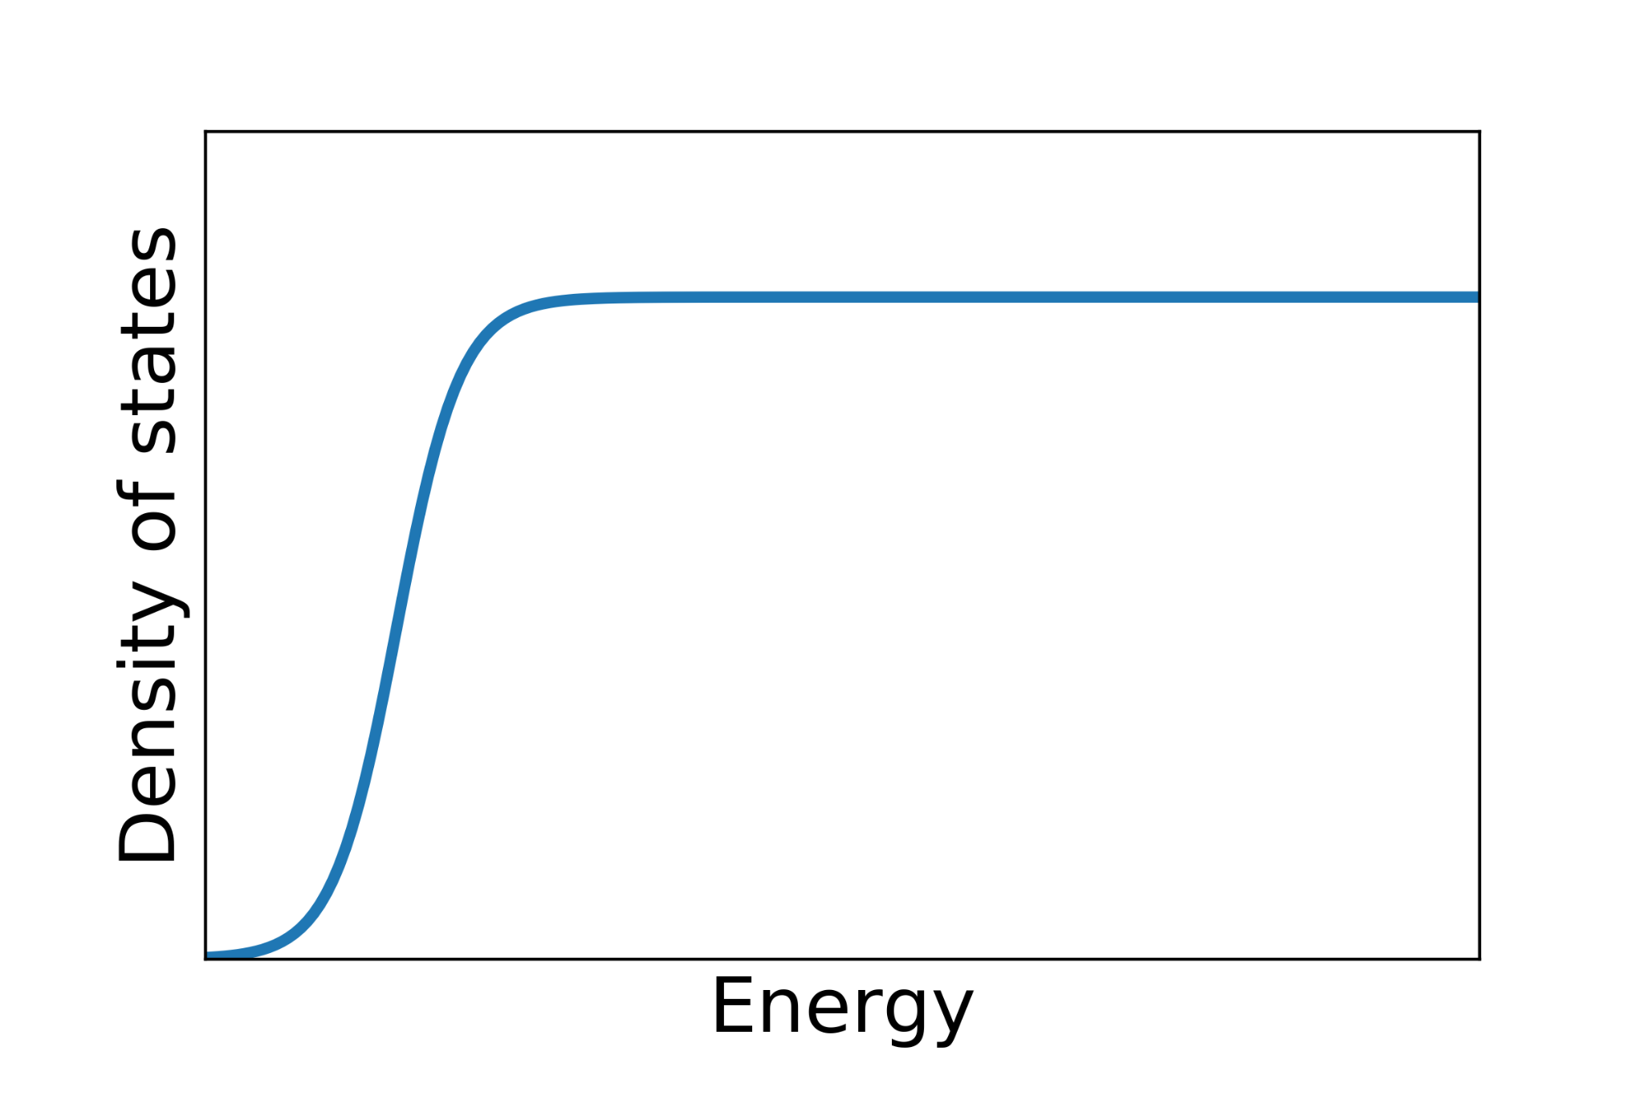

Motivation
cavity-matter coupling
Many body localization in cavity QED systems
In our recent works [PRL 122 (24) 240402 (2019), PRB 103 (13)134201(2021), PRB 105 (6) L060303 (2022)] we showed that MBL can scurvies long range interaction induced by a cavity. In these systems we used high frequency expansion to microscopically describe the localization dynamic. If we assume large $ω$ (But not too large so different photon sectors have finite overlap), the density of state is given as the front figure. In this model, for cavity photons $a(a^{+})$, we showed that MBL phase survives up to a finite value of $Γ$. This regime we studied was a weak coupling regime between cavity and matter.

Slide 3
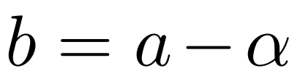
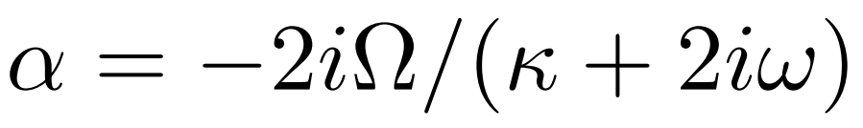
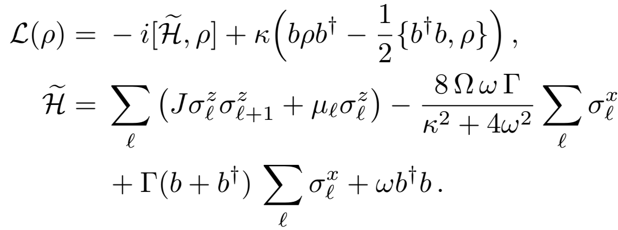
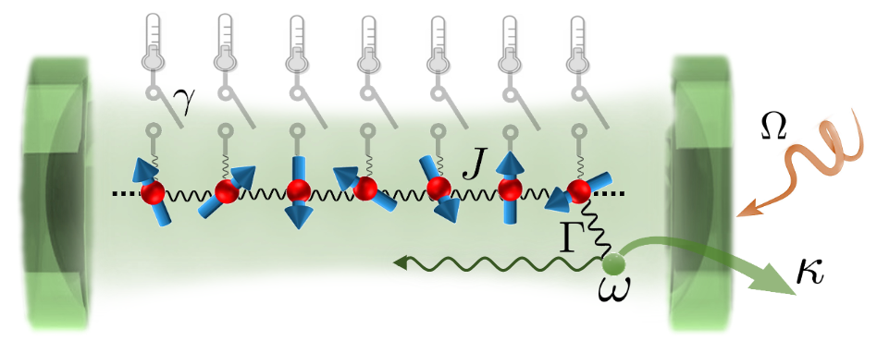

Open cavity model
Photon displacement
Many body localization in open cavity QED
In our next attempt, we tried to expand our model to include photon loss. In this mode, we have a transverse field Ising spin coupled to a single mode cavity. The coupling is through $σ_{x}$, and we don’t use rotating wave approximation. In this model as it is shown in the figure, cavity is coupled to a cold bosonic bath ($κ$) but spin are not coupled to any sort of bath. The cavity is also pumped at rate ($Ω$) but displacing photon by $b=a−α$, we can eliminate pumping term. Final form of the Hamiltonian is given above. In this model we are investigating, the possibility of
𝜅: Coupling to a cold bosonic bath 𝜔: Cavity transition frequency ꭥ: Pumping rate to the cavity 𝛾: coupling to the virtual thermometer

Slide 4
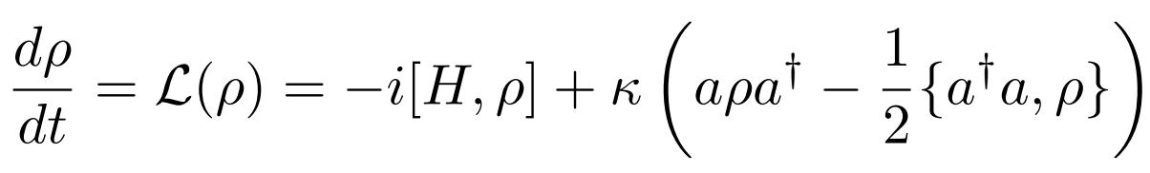

Open cavity model
Photon displacement
Many body localization in open cavity QED
stability of the MBL phase, even if the cavity can loose particles. For this model, Lindblad master equation is given by
where ρ is the density matrix of the full cavity and spin system, and $a(a^{+})$ are collapse operators. To check the stability of the MBL phase, we measure the local temperature of spins by connecting each site to a virtual thermometer ($γ$). Then by calculating temperature fluctuation
$⟨δT/T⟩$ we study the following regimes
𝜅: Coupling to a cold bosonic bath 𝜔: Cavity transition frequency ꭥ: Pumping rate to the cavity 𝛾: coupling to the virtual thermometer

Slide 5

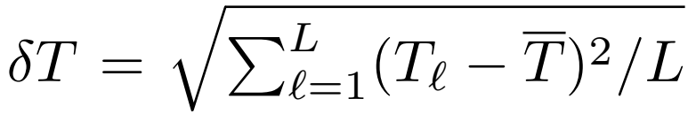
Open cavity model
Photon displacement
Many body localization in open cavity QED
Small coupling to the bath (perturbative) (𝜅→0⁺)
Large coupling to the bath (𝜅 ≫ 0)
Infinite coupling to the bath (𝜅→∞)
In calculation of tempreture fluctuation
We use
Mean temperature
Standard deviation of temperature
𝜅: Coupling to a cold bosonic bath 𝜔: Cavity transition frequency ꭥ: Pumping rate to the cavity 𝛾: coupling to the virtual thermometer

Slide 6
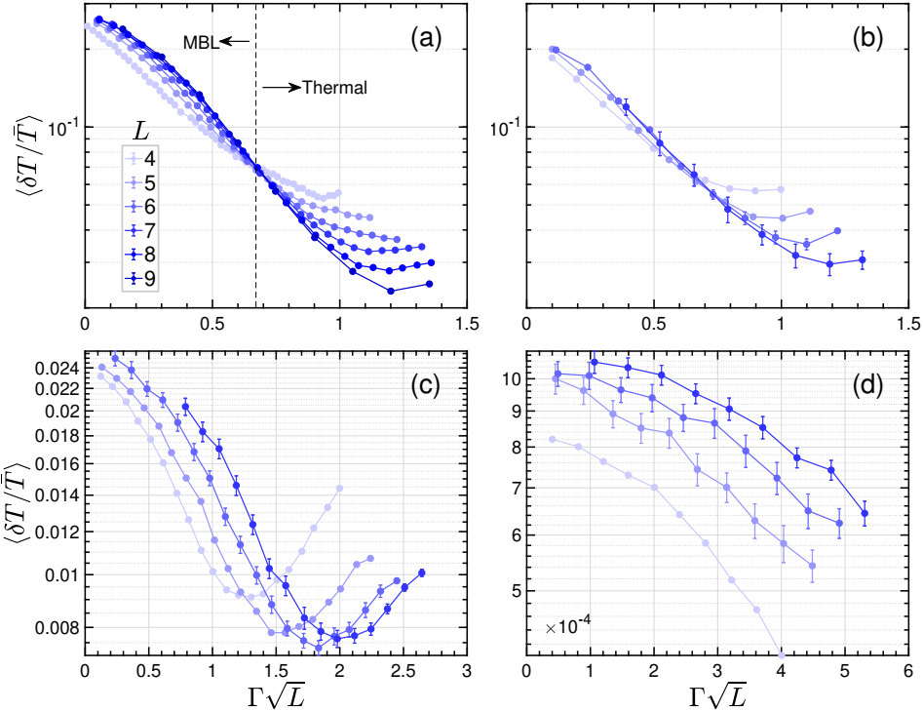

Results
Numerical results for temperature fluctuation
Here you can see the numerical results for perturbative regime (𝜅→0⁺) and finite coupling to bath $(κ>0)$
Take out messages:
For $κ→0^{+}$ case, we see that plots for different systems sizes crosses at a single point. On the left side of this crossing we have possible saturation and finite value of $⟨δT/T⟩$ which is expected for small $Γ$, since we expect the system to be MBL for small $Γ$.
For the same regime after crossing (large $Γ$), the data shows a system size dependent, and $⟨δT/T⟩$ gets lower for larger system sizes. This is also a good signature of thermal phase
The coupling ($Γ$) seemingly is scales as $\sqrt{Γ}$, according to this numeric for $κ→0^{+}$
𝜅 → 0⁺
𝜅 = 1
𝜅 = 10
𝜅 = 100

Slide 7

Results
Numerical results for temperature fluctuation
Here you can see the numerical results for perturbative regime (𝜅→0⁺) and finite $(κ>0)$
Take out messages:
For finite and large 𝜅 we neither have crossing of data point nor saturating $⟨δT/T⟩$. For $κ=1$, we see same magnitude of temperature fluctuation as in (𝜅→0⁺) but since the crossing is absent, we expect this effect is just a finite size effect, and in the thermodynamics limit, for even small value of $Γ$ the system will be immediately thermalized.
As evident from data, when we go to larger $κ$ temperature fluctuation tends to get smaller which indicate the absence of localization.
𝜅 → 0⁺
𝜅 = 1
𝜅 = 10
𝜅 = 100

Slide 8

Challenges
In theoretical description we are facing difficulties in addressing the non-zero fluctuation in the thermal and MBL/Thermal phase when ($κ→0^{+}$). Our analytical approaches so far were to use high frequency expansion and perturbation theory to find the density matrix (Section S3 in “cavityMBL_SM.pdf” file), which has some ambiguity. The same description cannot justify the non-zero fluctuation on thermal phase.
We have been trying to use different method, but we like to hear your opinion on this problem. Our analytics, can justify ($κ→∞$), but we the same ide doesn’t apply to ($κ→0^{+}$)
𝜅 → 0⁺
𝜅 = 1
𝜅 = 10
𝜅 = 100

