Slide 1
Structural & Community Analysis of the Wiki-Vote Network
Term Project – Social Network Analysis
150123821 – Mehmet Sina Çağlar

Slide 2
Dataset Overview
Dataset: Wiki-Vote (Wikipedia Administrator Elections)
Nodes: Wikipedia users & admins
Edges: Votes cast for adminship
Type: Directed, Unweighted
Key Stats:
Nodes: 7,115
Edges: 103,689

Slide 3
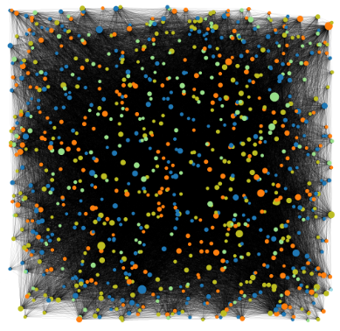
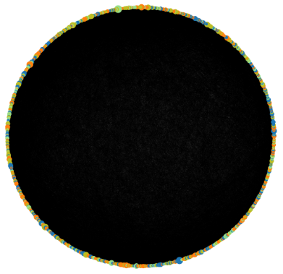
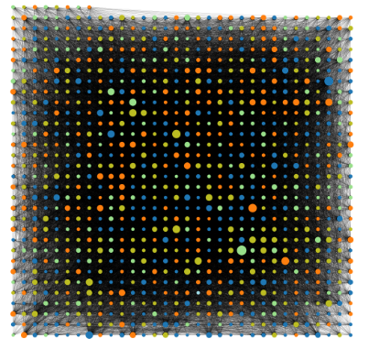
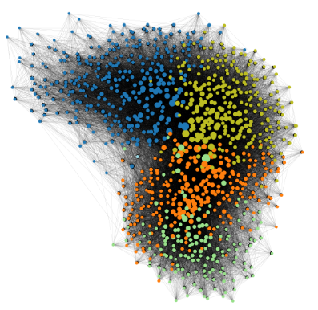
Layout Comparison
Random
Circular
Grid
Force-Directed

Slide 4
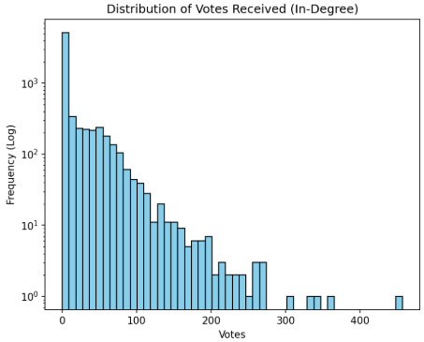
In-Degree Distribution
In-Degree represents popularity. How many votes a candidate received.
Many people received little to no votes.
Getting votes is hard. The maximum value in in-degree is lower than the maximum value in out-degree.
Heavy-Tailed distribution
Most users in the network have very low activity. They received few votes and cast few votes.
There is existence of a few outliers who are extremely active.
Scale-Free Network

Slide 5
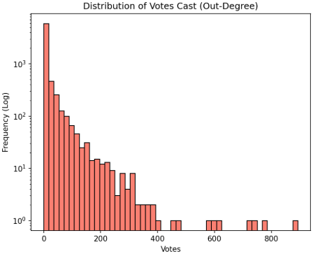
Out-Degree Distribution
Out-Degree represents participation. How many times a user voted.
Majority is passive.
These high out-degree nodes represent the "activists" of Wikipedia, the people who spend a significant amount of time reviewing and voting on admin candidates.

Slide 6
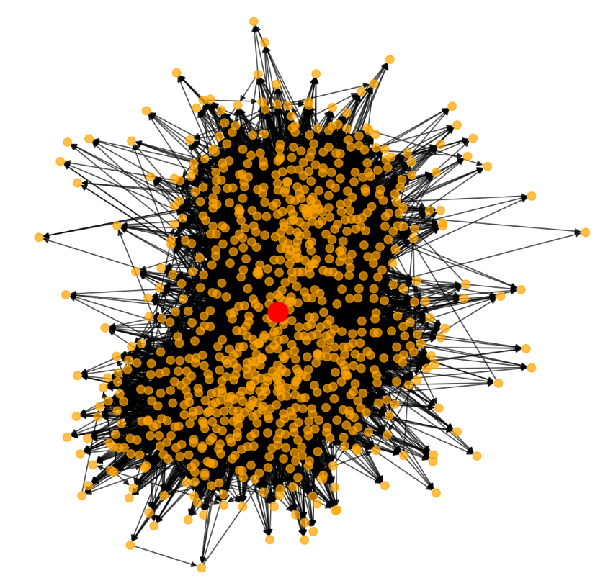
Ego Net 1.5 Radius
Red Node in the middle represents the user with the highest degree.
Orange Nodes are the immediate neighbors of this user. They either voted for the Red Node or were voted for by the Red Node.
It is a Dense Cluster. The Black lines connecting the orange dots means the neighbors know each other.
High Local Clustering Coefficient.
Their supporters likely know each other and have voted for each other in the past.
It proves the existence of Triadic Closure. A knows B, B knows C, so A likely knows C.

Slide 7
Network Metrics
Nodes in LSCC: 1300
Only 18% of users are part of the strongly connected component
Diameter (LSCC): 9
Longest shortest path.
Network is relatively compact, despite having over 7,000 users.
Average Path Length (LSCC): 2.88
Information spreads fast.
Tight world.
Giant Component (WCC): 7066
99.3% Coverage
Although the graph is sparse, almost everyone is connected.
Density: 0.002
Proves the graph is sparse.
Reciprocity: 5.6%
Very Low
Users vote for admins, but admins rarely vote back.
Assortativity: -0.08
Disassortative.
Regular users tend to connect to popular hubs rather than each other.

Slide 8
Centrality & Power Structure
Node ID | Role | PageRank | Degree | Betweenness
4037 | The Hub | #1 (0.0046) | 0.066 | Low (0.003)
15 | The Bridge | #2 (0.0036) | 0.057 | Highest (0.012)
6634 | Rising | #3 (0.0035) | 0.029 | Low (0.001)
2625 | Isolate Member | #4 (0.0033) | 0.046 | No Control (0.0)
2398 | Core Member | #5 (0.0026) | 0.056 | Mod (0.003)
PageRank & Degree are highly correlated.
Betweenness is less correlated: Some users act as bridges
The most popular does not have to be the most strategic bridge.
Target the Node 4037 to break down the network.
Target the Node 15 to spread information.

Slide 9
Small-World Analysis
Clustering Coefficient
Real (0.082) vs. Random (0.002)
Path Length
Real (2.88) vs. Random (2.63)
Despite having strong local clusters, information still travels across the network incredibly fast.
YES, It is a Small-World!
Sigma
Value: 36.01
36.01 > 1, hence small-world.

Slide 10
Community Detection
Louvain Method (Optimization-based)
Found 29 communities.
Modularity: 0.42 (Indicates strong, meaningful structure)
Avg. Conductance: 0.08
Label Propagation (Flow-based)
Found 38 communities.
Modularity of nearly zero (0.001)
Avg. Conductance: 0.13

Slide 11
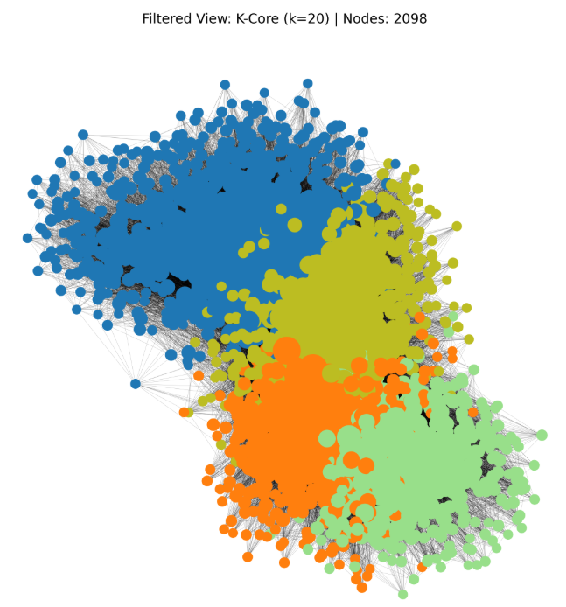
Filtered View (K-Core Analysis, k=20)
Inner Circle is a coalition of different subgroups.
Started with 7,115 nodes, left with 2,098 nodes.
30% of the users act as the Inner Circle.
These are the highly active users who sustain the voting ecosystem.

Slide 12
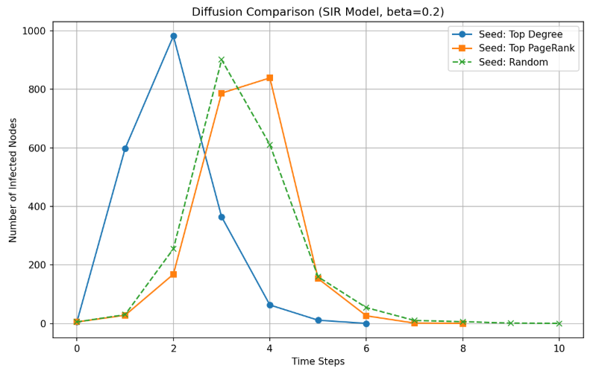
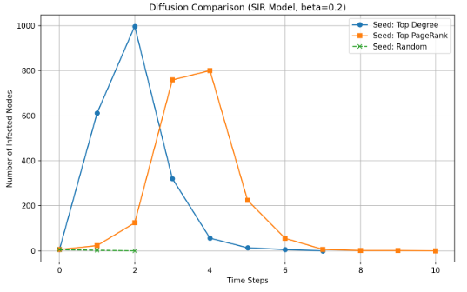
Diffusion Simulation
Targeting Admins guarantees instant spread. ~1,000 users by Step 2.
High influence leads to a large spread, but with a 2-step lag.
The average user is very powerless.

Slide 13
Conclusion & Top Insights
A few super-voters dominate the network. Heavy-tailed distribution.
31 distinct communities exist.
Low reciprocity and negative assortativity confirm a “User->Admin” voting flow.
Information travels very fast in ~3 steps. (Small-World)

