Slide 1
Proteomic data analysis: fold change and p-value calculation
Sina
NETLAB

Slide 2
Outline
Motivation behind this presentation
Fold change
p-value
Start doing the analysis together
Further analysis (network reconstruction, GO, etc.)

Slide 3
Motivation behind this presentation
Proteomics generates large data sets that become meaningless if not analyzed properly.
Goal: finding the best way to extract the most significant proteins with biological relevance in an experiment.
Dedicated scripts and software have a higher level of sophistication (Perseus/MaxQuant, MSstats, ASAPRatio, DAnTE/InfernoRDN, DiffProt58 and map- DIA)
But here the aim is to familiarize basic proteomics data analysis steps so that it become immediately accessible to every scientist, in other words, give you the power to extract the meaningful info from your raw data as comfortable as an excel sheet.
Key steps of data transformation, normalization and statistics to those who are not familiar with the math behind these workflows that a proteomics dataset can be processed.

Slide 4


Fold change

Slide 5
Fold change
Protein fold change is a measure of the ratio of protein expression levels between two conditions.
It is calculated by taking the ratio of the expression level of a protein in the experimental condition to its expression level in the control condition
Gene | Treated1 | Treated2 | Treated3 | Control1 | Control2 | Control3
A | 51 | 49 | 50 | 24 | 26 | 25
B | 13 | 11 | 12 | 35 | 37 | 36

Slide 6
p-value

Slide 7
p-value
Is a measure of the statistical significance of the observed differences in protein expression.
It represents the probability that the observed differences occurred by chance.

Slide 8
Let's start with downloading data
Visit : github.com/sinadadmand
Go to: Repositories –> Heterotopia_proteomics -> code -> download zip
Open: Excel file

Slide 9
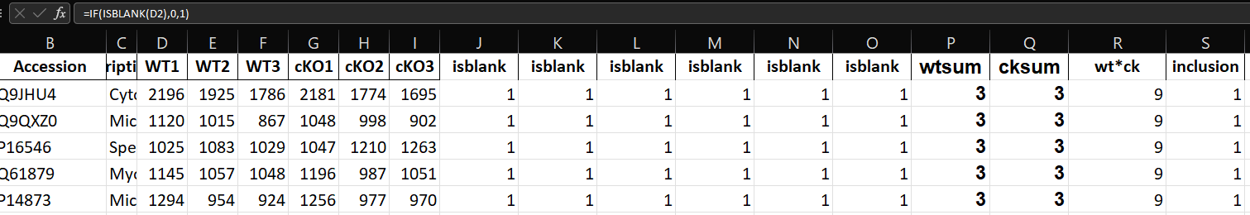
Filter (Inclusion criteria)
J =if(isblanc(D2),0,1)
P=SUM(J2:L2)
Wt * cKO =P2*Q2
inclusion=IF(R2>3.5,1,0)
And add also 3-0, 0-3

Slide 10
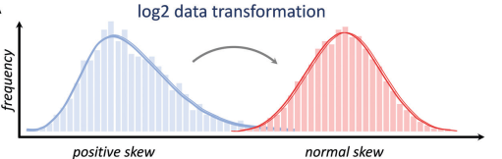
Log transform
Proteomics datasets, like most other –omics data, have a positively skewed distribution.
This means that values are concentrated in a low abundance range and few values have high abundance.
Transforming data in logarithm helps make the variances more constant and transform the data into a normal distribution
L =IFERROR(LOG(D2,2),"")

Slide 11
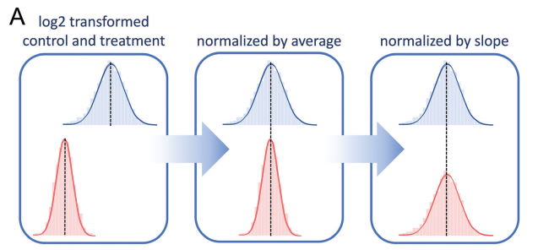
Normalization 1
Data normalization is a fundamental step of data processing
corrects artificial biases in sample pipetting or injection.
Normalization assumes that the different samples are injected at comparable amounts; the results aim to compare relative abundances of individual proteins, but the total protein content for the two conditions compared is the same.
Normalizing the abundances across all the proteins from each sample can be done by scaling each value against the average or the median of all the proteins in a given sample
S =IF(L2="","",L2-AVERAGE(L:L))

Slide 12
Normalization 2
Data may be further normalized by their distribution width.
two sets of data have different distribution widths if they were acquired with a different dynamic rang (max-min)
Y =AVERAGE(S2:X2)
AA =SLOPE(Y:Y,S:S)
AC=IF(S2="","",S2/AA$2)

Slide 13
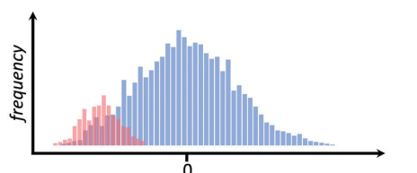
Imputation
Presence of missing values is inevitable in any proteomics dataset.
On one hand, a signal can be identified, but not necessarily quantified;
On the other hand, low abundance signals can be missed by the stochastic sampling of the mass spectrometer
It is not possible to calculate a ratio if one of the two values is missing.
Imputation of missing values is therefore performed by replacing them with estimated ones:
1. replace missing values with zeroes or a constant representing the limit of detection
2. Replace missing values with normal distribution
empty cells are replaced with an artificial distribution of values close to the limit of detection but with a variability comparable to the valid values. This way, fold changes can be estimated even if a protein is not detected in one of the two conditions
AJ =IF(AC2="",RAND()*0.3-STDEV(AC:AC)*2,AC2)

Slide 14
Fold Change
At this step of the processing, the table is ready for data analysis.
The two first basic information to extrapolate from this dataset is the relative ratio of each protein between the two conditions (fold change) and the reproducibility of this observation (p-value)
AR =AVERAGE(AM2:AO2)-AVERAGE(AJ2:AL2)

Slide 15
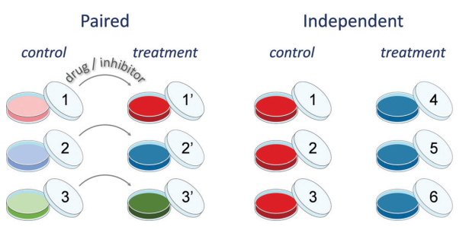
p-value

Slide 16
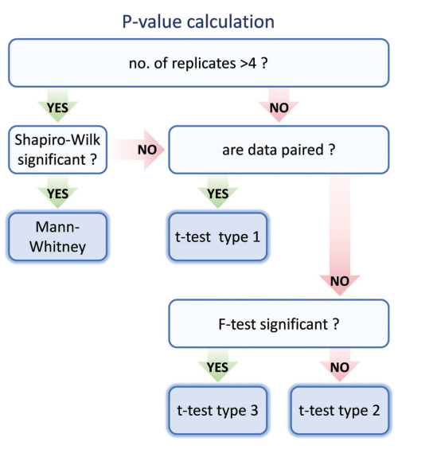
p-value
AP =FTEST(AJ2:AL2,AM2:AO2)
AS=-LOG(IF(AP2<0.05,TTEST(AJ2:AL2,AM2:AO2,2,3),TTEST(AJ2:AL2,AM2:AO2,2,2)),2)

Slide 17
p-value correction (adjusted p)
In experimental research a scientific conclusion is always drawn from the statistical testing of hypothesis, in which an acceptable cutoff of probability, such as 0.05 is used for decision-making.
However, the probability of committing false statistical inferences would considerably increase when more than one hypothesis is simultaneously tested (namely the multiple comparisons), which therefore requires proper adjustment.
Proteomics is still a large-scale technology with a limited reproducibility compared to e.g. RNA-sequencing.
Therefore, using correction for multiple testing has a high risk of generating false negatives.
Bonferroni (most conservative)
Benjamini-Hochberg

Slide 18
Ratio rather than raw values
If the table displays ratios rather than raw intensities, (SILAC or TMT/iTRAQ labeling) the fold change is just the average of the replicates.
This is because data are already displayed as fold changes and the significance should be assessed by comparing the array of ratios with zero (0), equivalent to no change for log ratios.
In that case, the t-test is always to be considered as heteroscedastic, as the array of zeroes has no variability as opposed to the array of sample ratios

Slide 20
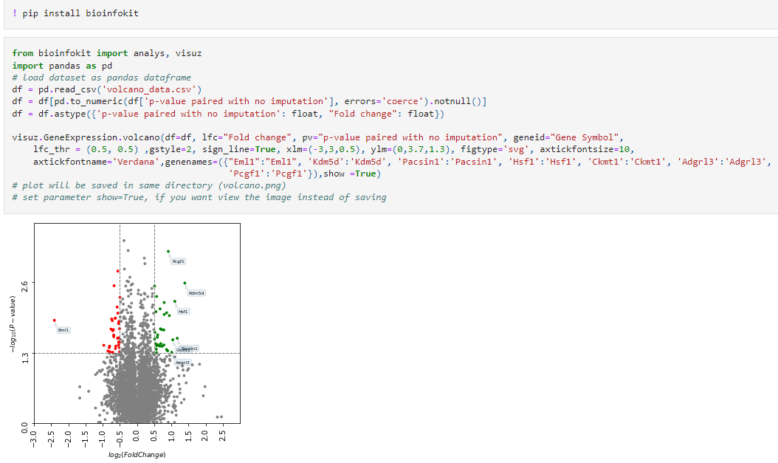
Python volcano plot

Slide 21
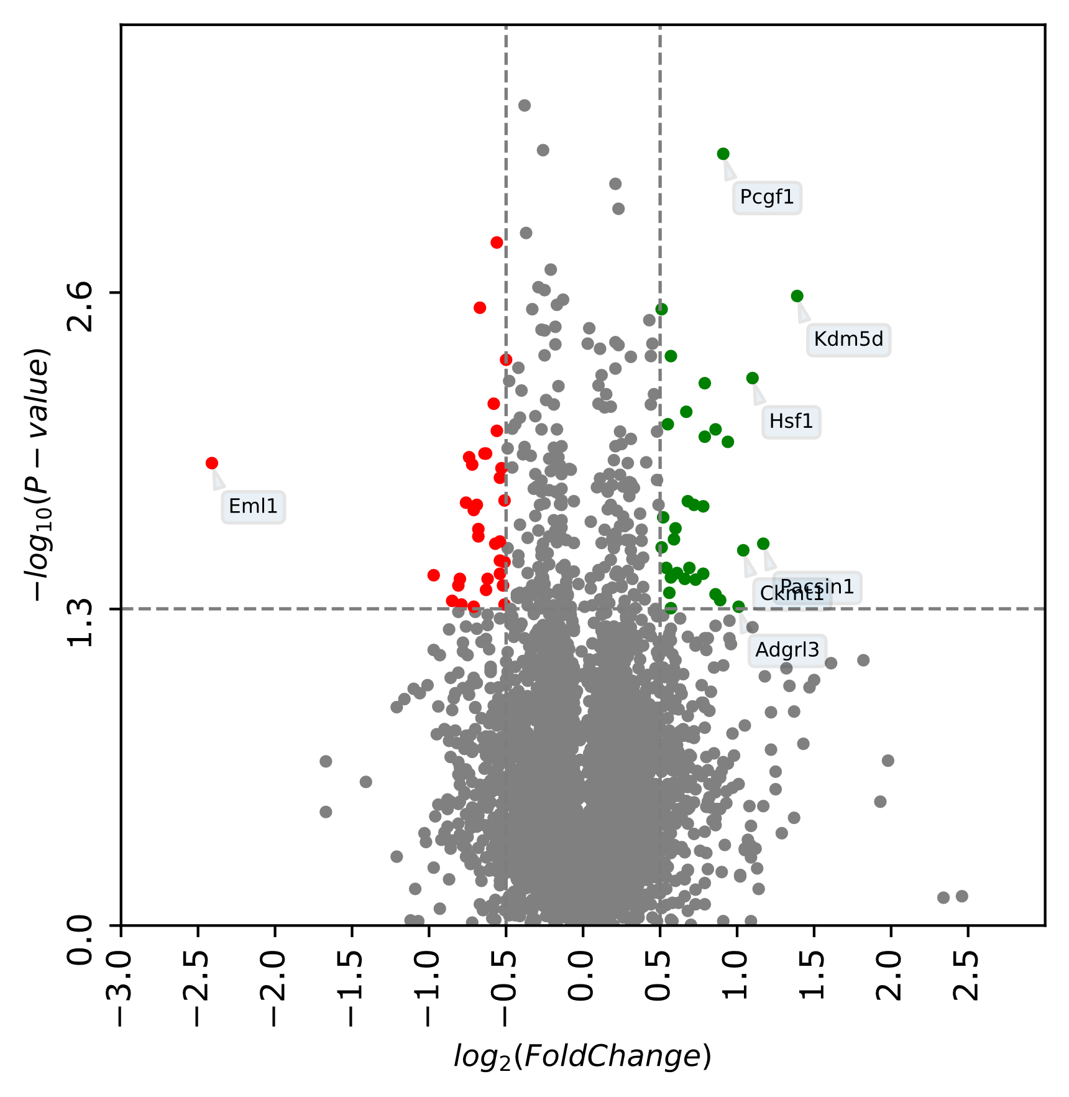
Python volcano plot

Slide 22
Community 1
Community 2
Community 3
Community 4
Community 5
Community 6
Cilium Assembly
Determination of bilateral symmetry
Neural tube development
Embryonic morphogenesis
Response to lipid
Regulation of neuron death
Cellular responses to stress
Establishment of localization
Protein binding
Axon guidance
Neuron projection
Hippocampal mossy fiber to CA3 synapse
Synapse organization
Cell junction organization
Cellular localization
Ion transport
Encephalopathy
Regulation of neuronal synaptic plasticity
Apolipoprotein A-I-mediated signaling pathway
Elastic fibre formation
Integrin cell surface interactions
Transcription preinitiation complex assembly
Protein ubiquitination
Proteasomal protein catabolic process
Membrane
Cytoplasm Organelles
Nucleus
Protein complex
Others
Network analysis
Upregulated protein
Downregulated protein
Steiner node

Slide 23
Ref:
1.
Pascovici, et al., Multiple testing corrections in quantitative proteomics: a useful but blunt tool, Proteomics, 2016.
2.
Guide for protein fold change and p-value calculation for non-experts in proteomics
3.
Multiple Hypothesis Testing in Proteomics:
A Strategy for Experimental Work

Slide 24
Thank You!

