Slide 1
Computing Protein Sequence Features Using CUDA
Sina ghadermarzi

Slide 2
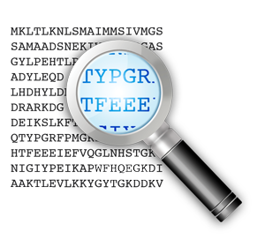
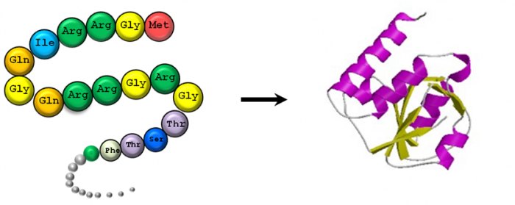
Proteins
Important biomolecules
Studied in:
Sequence (Primary structure)
Combination of amino acids and their arrangement
Easy available
Secondary structure
Local shapes
3-D structure (Tertiary structure)
Expensive to obtain

Slide 3
Protein sequence
20 aminoacids make proteins
Each of them represented in one letter
Sequence: a string of these letters

Slide 4
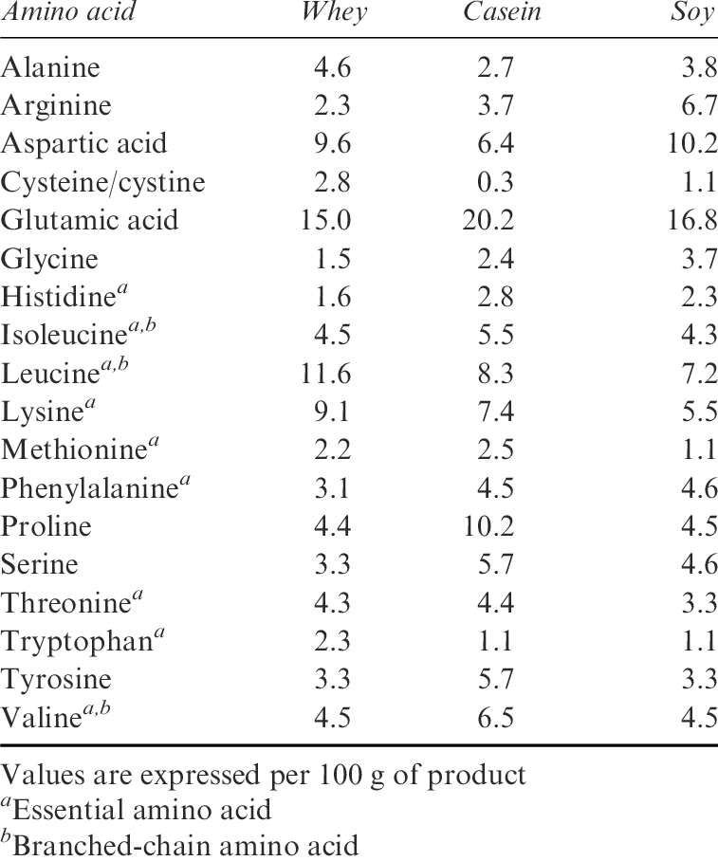
Sequence level features
The combination of 20 amino acids

Slide 5
Sequence level features
Sliding window:
Count the number of occurrence of an amino acid
to see if there is areas of overrepresentation
Sum of an index in the window
E.g. Flexibility index
to see local overrepresentation of a property
LDFKLSDFKLJHIONIRUBAOIERGUDIFGBGIUAOINFI

Slide 6
Parallelization using GPU
Each sequence: a cuda thread
They are independent
A Kernel is written for each feature

Slide 7
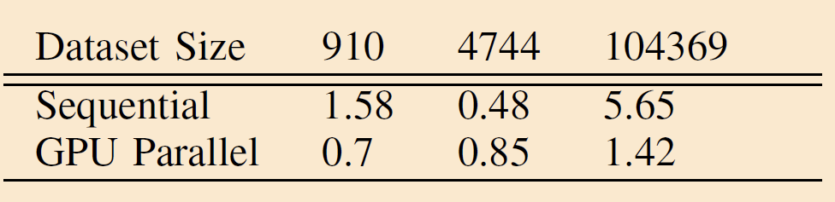
Results
On maple server

Slide 8
Conclusion
Need more optimization
The gpu overhead may be too high

