Slide 1
TRANSFER ENTROPY — FLOATING OFFSHORE WIND
Directional Causality
between Load and Response Variables of a Floating Offshore Wind Turbine,
via Time-Domain Transfer Entropy
Sina Hadadi, Ph.D.
Research Assistant · Laboratory of Autonomous Maritime Systems (LAMS)
Dept. of Naval Architecture & Ocean Engineering · Kunsan National University
Supervisor — Prof. Jackyou Noh
KWEA 2026
2026.06.22

Slide 2
02
MOTIVATION · RL CONTEXT
Design optimization as reinforcement learning
AGENT
action aₜ
ENVIRONMENT
Actor — policy π(a | s)
Critic — value V(s)
actor–critic, TD-error updates
7 design variables (D_MCol, D_OCol, R_MO, …)
RAFT coupled simulator
aero · hydro · servo · moor
evaluates each design
state sₜ₊₁ reward rₜ₊₁
THE REWARD · rₜ₊₁
The reward is the one signal the agent maximizes — it encodes the design objectives (mass ↓, resonance avoidance, peak-response ↓). Its weights decide which objective wins — exactly what we examine next.
RL-based FOWT substructure optimization · Jeon, Lee & Noh (2025) — LAMS / KSNU
02 / 31

Slide 3
03
MOTIVATION · THE PROBLEM
Why these weights? From hand-set to data-driven
Reward = X₁ · ΔMass + X₂ · ΔResonance + X₃ · ΔPitch_{peak} + X₄ · ΔHeave_{peak}
The weights X₁…X₄ are set by hand in our RL substructure design optimization (cost, power, constraint priority) — not from data. LAMS, KSNU.
THE GAP
A DATA-DRIVEN BASIS
Weights rank variable importance by hand. No objective basis for which responses matter most — or how strongly each is driven by the environment.
Transfer entropy — which environmental drivers causally drive each response.
Sobol sensitivity — which design parameters move each response.
Together — a data-driven basis for the weights.
Variable-importance weighting for FOWT design optimization
03 / 31

Slide 4
04
MOTIVATION
From association to directed causation
Correlation / coherence
Transfer entropy
Symmetric and undirected — quantifies association. γ²(f) tells you wind and a load share power at a frequency, not which drives which.
Directed, nonlinear, model-free. Measures information that a source's past adds about a target's future, beyond the target's own past.
THE QUESTION
Which environmental driver — wind or wave — causally drives each structural response, and which coupling pathways do linear methods miss?
TE causal discovery on a FOWT (IEA-15MW on UMaine VolturnUS-S) · preliminary, 11 m/s
04 / 31

Slide 5
05
WHY CAUSALITY
Correlation is not causation
The trap
What direction needs
Ice-cream sales and drownings rise together — both driven by summer heat. Strong correlation, zero causation. corr(A,B) = corr(B,A) carries no arrow.
A real cause must precede its effect in time, and the link must survive once the target's own history and shared drivers are accounted for.
IN A COUPLED SYSTEM
In turbulence or a floating turbine, dozens of channels move together. Eyeballing what drives what is hopeless — we need a directed, model-free measure.
TE causal discovery on a FOWT (IEA-15MW on UMaine VolturnUS-S) · preliminary, 11 m/s
05 / 31

Slide 6
06
INFORMATION THEORY
The building blocks: entropy and information
Shannon entropy
Mutual information
H(X) = −Σ p(x) log p(x)
Average uncertainty — the “surprise” in a signal. Zero when the outcome is certain, maximal when all outcomes are equally likely.
I(X;Y) = H(X) + H(Y) − H(X,Y)
The information shared between X and Y — how much knowing one reduces uncertainty about the other.
THE CATCH
Mutual information is symmetric: I(X;Y) = I(Y;X). It cannot say which variable drives which — the gap that transfer entropy is built to close.
TE causal discovery on a FOWT (IEA-15MW on UMaine VolturnUS-S) · preliminary, 11 m/s
06 / 31

Slide 7
07
TRANSFER ENTROPY
Transfer entropy, defined
The definition
The conditioning trick
TE(X→Y) = H(Y_f | Y_p) − H(Y_f | Y_p, X_p)
Y_f = target's future · Y_p = target's past · X_p = source's past. How much the source's past sharpens the prediction of the target's next step, beyond its own history.
Conditioning on Y's own past removes self-prediction and shared history — only genuinely new information from X survives. That is what makes TE directed: TE(X→Y) ≠ TE(Y→X).
KEY PROPERTIES
TE ≥ 0 always, and TE = 0 means no transfer. Asymmetric by design — and for linear-Gaussian signals reduces exactly to Granger causality (Barnett et al. 2009). Definition: Schreiber (2000).
TE causal discovery on a FOWT (IEA-15MW on UMaine VolturnUS-S) · preliminary, 11 m/s
07 / 31

Slide 8
08
ESTIMATION
Estimating TE without binning
Nearest neighbours, not bins
Why it suits our data
TE is a conditional mutual information. The Kraskov–Stögbauer–Grassberger (KSG) estimator counts k nearest neighbours (k = 4) in the joint space — no histogram, and no bin count to choose.
Adaptive resolution on continuous signals; captures nonlinear dependence that Gaussian methods miss. Reported in nats (natural log), not bits — the same quantity. Kraskov et al. (2004).
IN THE PIPELINE
We run KSG with k = 4 and a non-uniform embedding (max_lag = 150 ≈ one slow-drift cycle), GPU-accelerated through IDTxl (Wollstadt et al. 2019).
TE causal discovery on a FOWT (IEA-15MW on UMaine VolturnUS-S) · preliminary, 11 m/s
08 / 31

Slide 9
09
EMBEDDING
Time delay τ and the embedding window
Delay vectors
Our settings
TE represents the recent past as a delay vector: Y_past = [ y(t−τ), y(t−2τ), …, y(t−max_lag) ]. The delay τ sets the spacing between lags; max_lag sets how far back the test looks.
max_lag = 150 samples ≈ 30 s at 5 Hz — one full platform slow-drift cycle. τ = 1 keeps every lag and a greedy search picks the few that matter; τ = 5 thins ~150 candidates to ~30.
WHY BOTH MATTER
Too short a window misses the slow-drift dynamics; too fine a lag grid makes the greedy search explode. Together τ and max_lag decide which lags the causal test can even see.
TE causal discovery on a FOWT (IEA-15MW on UMaine VolturnUS-S) · preliminary, 11 m/s
09 / 31

Slide 10
10
EMBEDDING
τ is not a free knob
A tempting shortcut
…that breaks TE
A common heuristic sets τ from the first minimum of a signal's self-mutual-information (the AIS-optimal delay). It preserves self-predictability (AIS) well.
But a self-MI τ = 10 zeroed the strongest Wave→PtfmPitch edge. Directed couplings live at specific lags that self-prediction heuristics miss — optimal for AIS is not optimal for transfer.
TWO ROLES FOR τ
τ is both a modelling choice (which lags the test sees) and a compute lever — the slow-drift platform channels only finish at τ = 5. We validate any τ > 1 against the τ = 1 baseline.
TE causal discovery on a FOWT (IEA-15MW on UMaine VolturnUS-S) · preliminary, 11 m/s
10 / 31

Slide 11
11
SIGNIFICANCE
Is the transfer real? Surrogate testing
The null hypothesis
Circular-shift surrogates
KSG TE is never exactly zero — finite-sample noise leaves a small positive value. So we ask: is the measured TE larger than chance, if there were no coupling?
Rotate the source in time (n = 200), destroying its timing with the target while keeping its spectrum. p = fraction of surrogates beating the real TE; keep edges with p < 0.05.
WHY CIRCULAR
A circular shift keeps the source's own spectrum and amplitude intact and removes only the X→Y timing — a strict, honest null that avoids false positives.
TE causal discovery on a FOWT (IEA-15MW on UMaine VolturnUS-S) · preliminary, 11 m/s
11 / 31

Slide 12
12
INTUITION
A toy example: who drives whom?
Setup
What TE recovers
X[i] = 0.5·X[i−1] + noise (autonomous). Y[i] = 0.5·X[i−1] + noise (responds to X's past).
Both look like random noise to the eye.
TE(X→Y) ≫ TE(Y→X). The asymmetry correctly flags X as the driver — something a symmetric correlation could never reveal.
THE TAKEAWAY
Direction emerges from the conditioning, not from the raw signals — exactly the test we run on wind, wave and structural channels.
TE causal discovery on a FOWT (IEA-15MW on UMaine VolturnUS-S) · preliminary, 11 m/s
12 / 31

Slide 13
13
FROM CORRELATION TO CAUSATION
Three ways to measure dependence
Correlation
Granger causality
Transfer entropy
Strength of linear association. corr(X,Y) = corr(Y,X) — symmetric.
Directional ✗ Nonlinear ✗
Does X's past improve a linear forecast of Y? Directed, but assumes a linear (VAR) model. Granger 1969 · Nobel 2003.
Directional ✓ Nonlinear ✗
Does X's past reduce uncertainty about Y's future? Model-free, no distributional assumption. Schreiber 2000.
Directional ✓ Nonlinear ✓
KEY INSIGHT
Transfer entropy is the only one that is both directed and nonlinear. For linear-Gaussian processes it reduces exactly to Granger causality (Barnett et al. 2009) — so it earns its keep precisely where the dynamics are nonlinear or non-Gaussian.
TE causal discovery on a FOWT (IEA-15MW on UMaine VolturnUS-S) · preliminary, 11 m/s
13 / 31

Slide 14
14
TE vs GRANGER
Transfer entropy and Granger causality
Granger causality
Transfer entropy
Linear autoregressive (VAR) model. Fast and well-understood, but assumes linearity and (often) Gaussian statistics — misses nonlinear coupling.
Model-free, no distributional assumption, captures any nonlinearity. Costlier (k-NN estimation) and hungrier for data.
WHEN THEY AGREE
For linear-Gaussian processes the two are exactly equivalent (Barnett et al. 2009). TE earns its keep only where the dynamics are nonlinear or non-Gaussian — which is why we run both.
TE causal discovery on a FOWT (IEA-15MW on UMaine VolturnUS-S) · preliminary, 11 m/s
14 / 31

Slide 15
15
WHEN TO USE TE
When does transfer entropy pay off?
Linear / Gaussian
Nonlinear / non-Gaussian
Very high-dimensional
TE = Granger causality exactly (Barnett 2009). No added value — use the simpler method.
TE captures directed structure that linear methods cannot see. This is its sweet spot.
Many coupled modes degrade the k-NN estimate — curse of dimensionality, data starvation.
KEY INSIGHT
A floating turbine in irregular waves with a nonlinear ROSCO controller sits squarely in the middle regime — nonlinear and non-Gaussian — where transfer entropy adds the most.
TE causal discovery on a FOWT (IEA-15MW on UMaine VolturnUS-S) · preliminary, 11 m/s
15 / 31

Slide 16
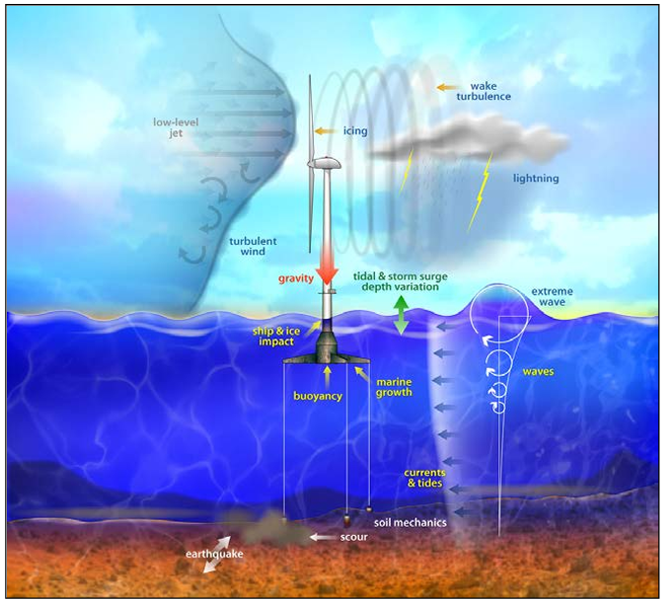
16
THE SYSTEM
A coupled wind–wave–
structure–mooring system
Every channel — aerodynamic, hydrodynamic, servo and elastic — moves together. Which couplings are causal?

Slide 17
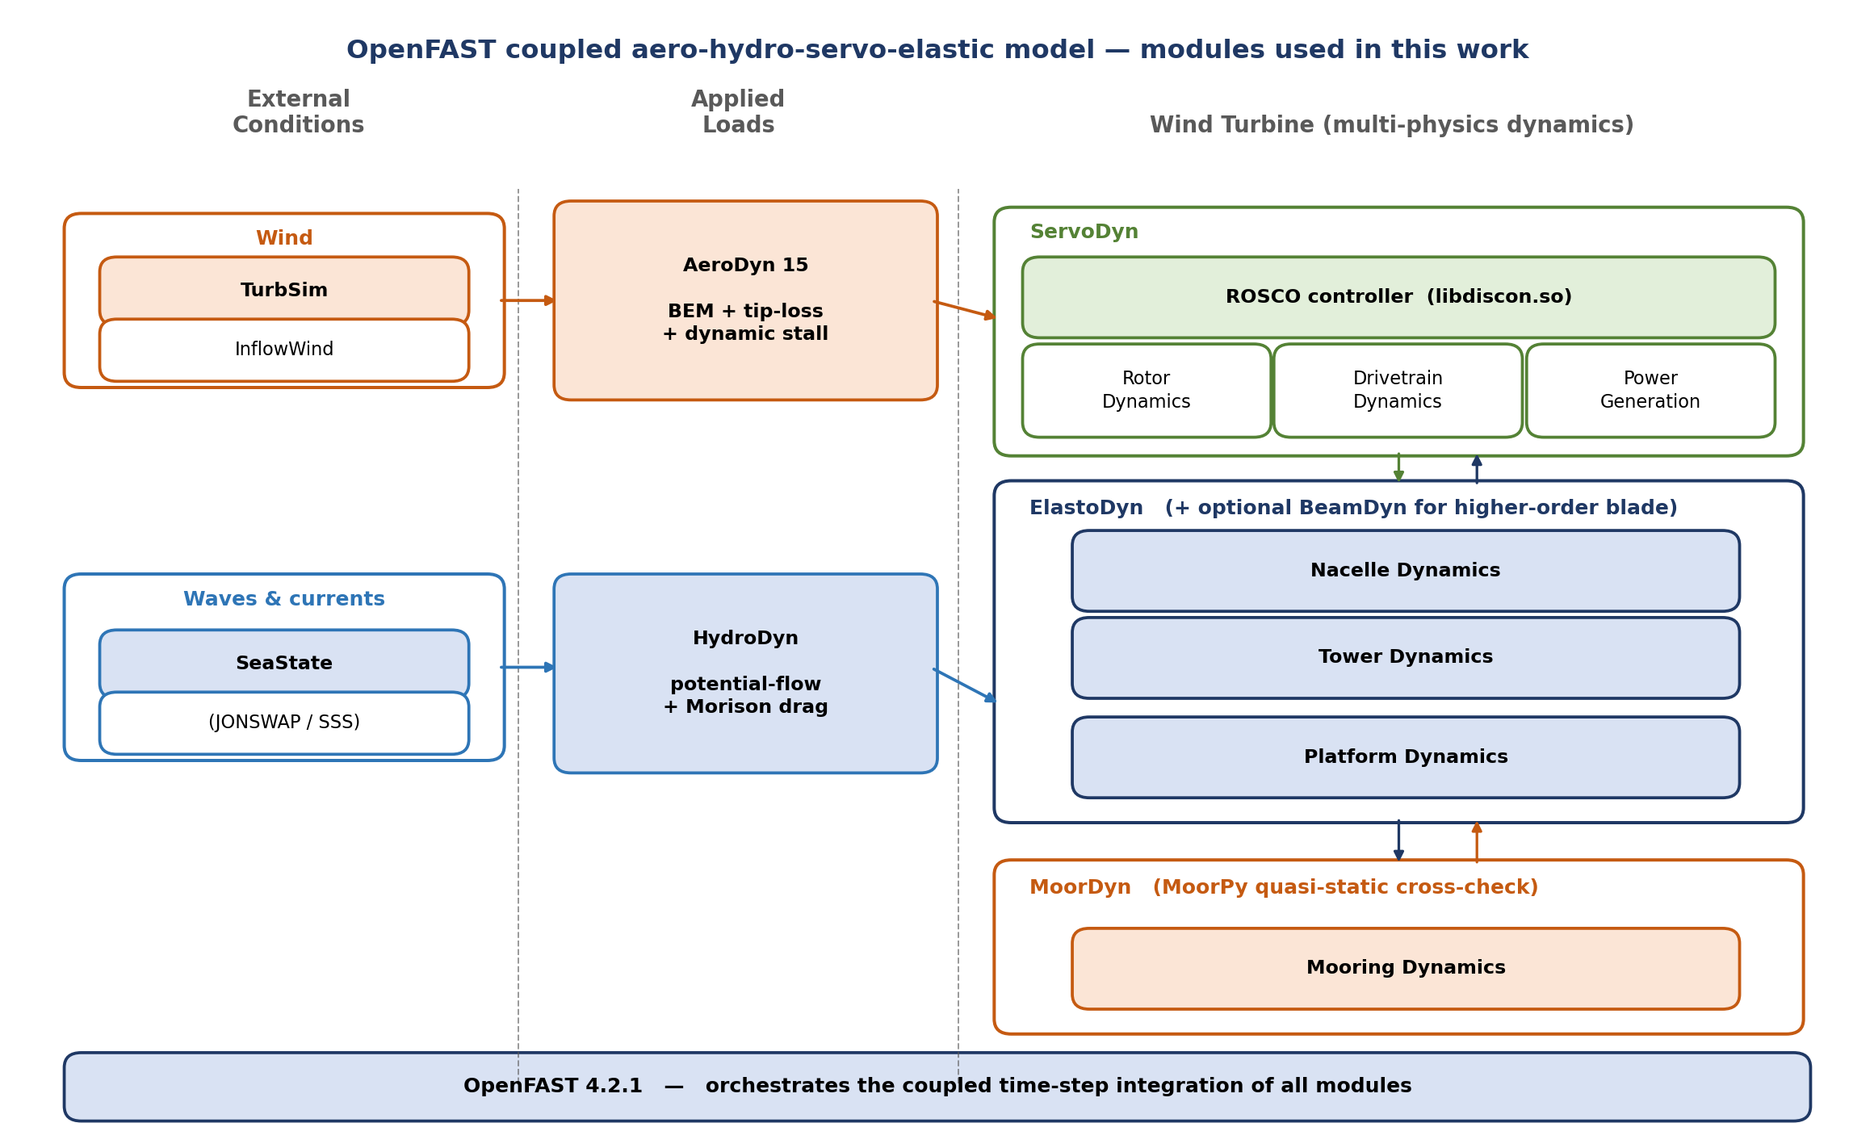
17
SYSTEM & DATA
IEA-15MW FOWT, simulated in OpenFAST
PLATFORM
IEA-15-240-RWT on the UMaine VolturnUS-S semisubmersible; coupled aero-hydro-servo-elastic OpenFAST model.
SIGNALS
3600 s simulation · drop 600 s transient · decimate to 5 Hz.
CHANNELS
2 sources — Wind1VelX, Wave1Elev → 9 responses: RootMyc1, RootMxc1, TwrBsMyt, PtfmHeave / Surge / Pitch, FAIRTEN1 / 2 / 3.
OpenFAST — coupled aero-hydro-servo-elastic modules
TE causal discovery on a FOWT (IEA-15MW on UMaine VolturnUS-S) · DLC-1.6 (11 m/s, severe sea)
17 / 31

Slide 18
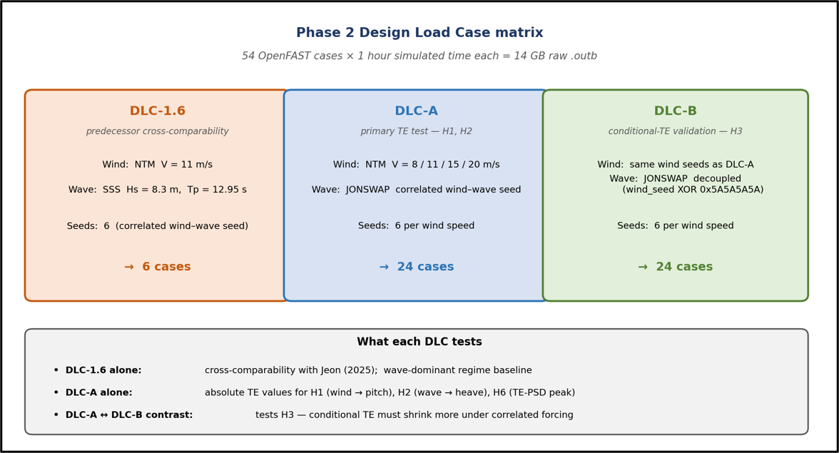
18
DESIGN LOAD CASES
The simulation campaign
DLC-A / DLC-B / DLC-1.6 across the operating-point sweep
TE causal discovery on a FOWT (IEA-15MW on UMaine VolturnUS-S) · full campaign: DLC-A / DLC-B / DLC-1.6
18 / 31

Slide 19
19
ENVIRONMENTAL CONDITIONS
Wind and wave inputs
Wind — TurbSim
Waves — JONSWAP
IEC Kaimal (IECKAI) spectrum, Normal Turbulence Model, class B, power-law shear, referenced at hub height. URef = 8 / 11 / 15 / 20 m/s.
Irregular JONSWAP sea (SeaState module). Hs / Tp scale with wind: (3.5 m, 9 s) → (8.0 m, 13 s). DLC-1.6 severe sea: Hs = 8.3 m, Tp = 12.95 s.
ON THE RANDOM SEEDS
DLC-A / DLC-1.6 reuse the wind seed for the wave generator; DLC-B draws an independent one. In OpenFAST, wind (TurbSim) and waves (HydroDyn) are generated separately, so the seed fixes reproducibility — not wind–wave correlation.
TE causal discovery on a FOWT (IEA-15MW on UMaine VolturnUS-S) · full campaign: DLC-A / DLC-B / DLC-1.6
19 / 31

Slide 20
20
PREPROCESSING
Why 5 Hz is enough
Environment & platform
Rotor & structure
Slow-drift platform motion — 0.01–0.1 Hz
Wave first-order band — 0.05–0.3 Hz (JONSWAP peak 0.077 Hz)
Platform eigenmodes — pitch 0.0345, heave 0.05, surge 0.01 Hz
Wind low-frequency turbulent eddies — 0.01–1 Hz
1P / 3P rotor harmonics — ~0.15 / 0.45 Hz
Tower fore-aft natural mode — ~0.5 Hz
Blade-flap natural mode — ~0.6 Hz
BOTTOM LINE
We down-sample 40 Hz → 5 Hz (×8). Nyquist = 2.5 Hz sits well above the highest band (~0.6 Hz), so every causal signal is preserved while the KSG sweep drops ~8×.
TE causal discovery on a FOWT (IEA-15MW on UMaine VolturnUS-S) · DLC-1.6 (11 m/s, severe sea)
20 / 31

Slide 21
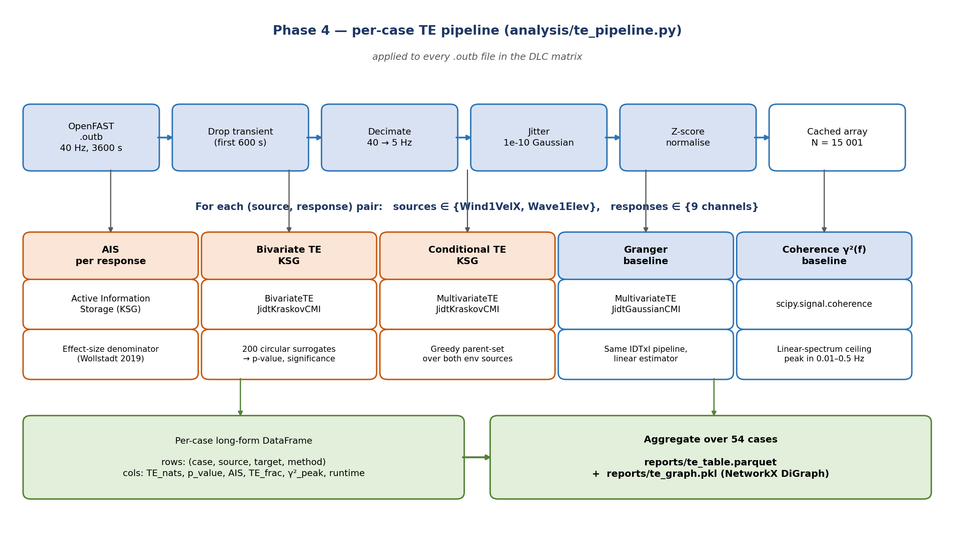
21
METHOD
Directed transfer, with linear baselines
1
KSG transfer entropy
Kraskov estimator (k = 4), non-uniform embedding, max_lag = 150 (30 s — one slow-drift cycle).
2
Significance & effect size
Circular-shift surrogates ×200, p < 0.05 (max-stat). Normalized: te_frac = TE / (H(Y) − AIS(Y)).
3
Linear baselines, same pipeline
Gaussian / Granger (estimator swap) + magnitude-squared coherence γ²(f).
4
Compute
OpenCL on 2× A100; GPU validated vs CPU (AIS RootMyc1 1.50 vs 1.49).
the TE pipeline
TE causal discovery on a FOWT (IEA-15MW on UMaine VolturnUS-S) · DLC-1.6 (11 m/s, severe sea)
21 / 31

Slide 22
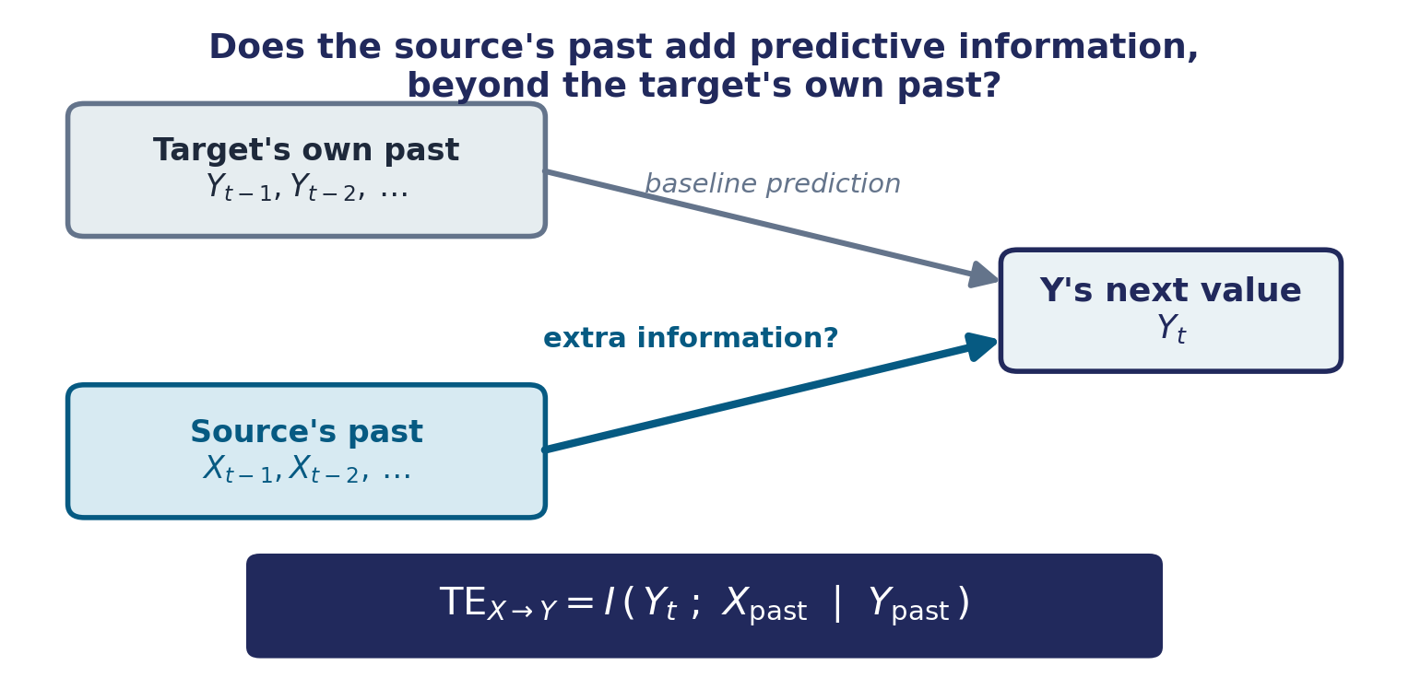
22
METHOD
What transfer entropy measures
In one line — if the source's past sharpens the prediction of the target beyond the target's own history, information flows source → target. Directed (X→Y ≠ Y→X) and nonlinear — what correlation and coherence cannot see.
TE causal discovery on a FOWT (IEA-15MW on UMaine VolturnUS-S) · DLC-1.6 (11 m/s, severe sea)
22 / 31

Slide 23
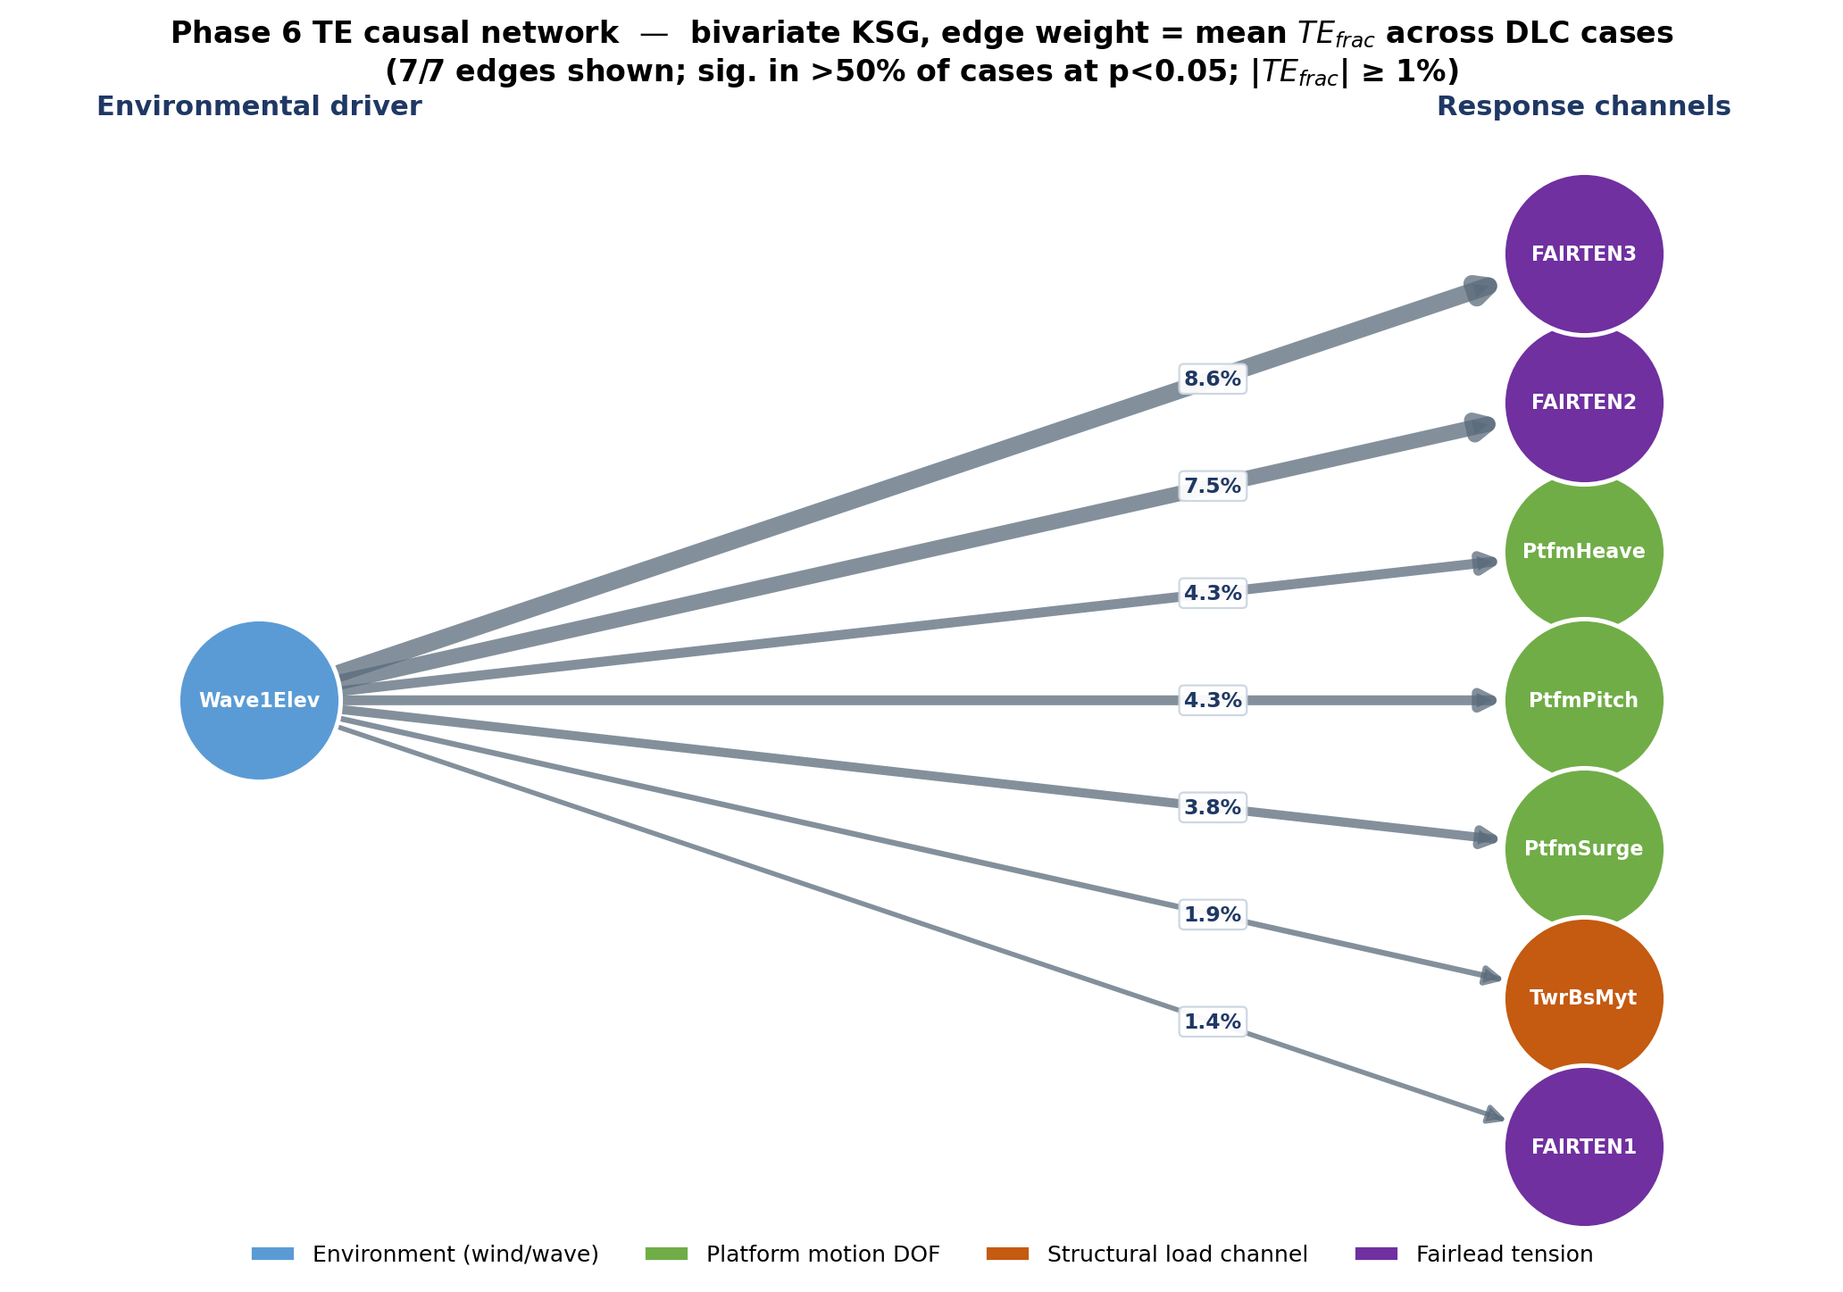
23
RESULT
A wave-dominated causal graph
READING
Wave elevation drives every significant response — pitch, heave, surge, tower base and mooring. Wind shows no significant directed transfer to the structure.
7 / 7
significant edges — every one originates from wave
0
significant wind → structure edges
TE causal network · bivariate KSG, edge weight = mean te_frac across all 54 DLC cases
TE causal discovery on a FOWT (IEA-15MW on UMaine VolturnUS-S) · full campaign: DLC-A / DLC-B / DLC-1.6
23 / 31

Slide 24
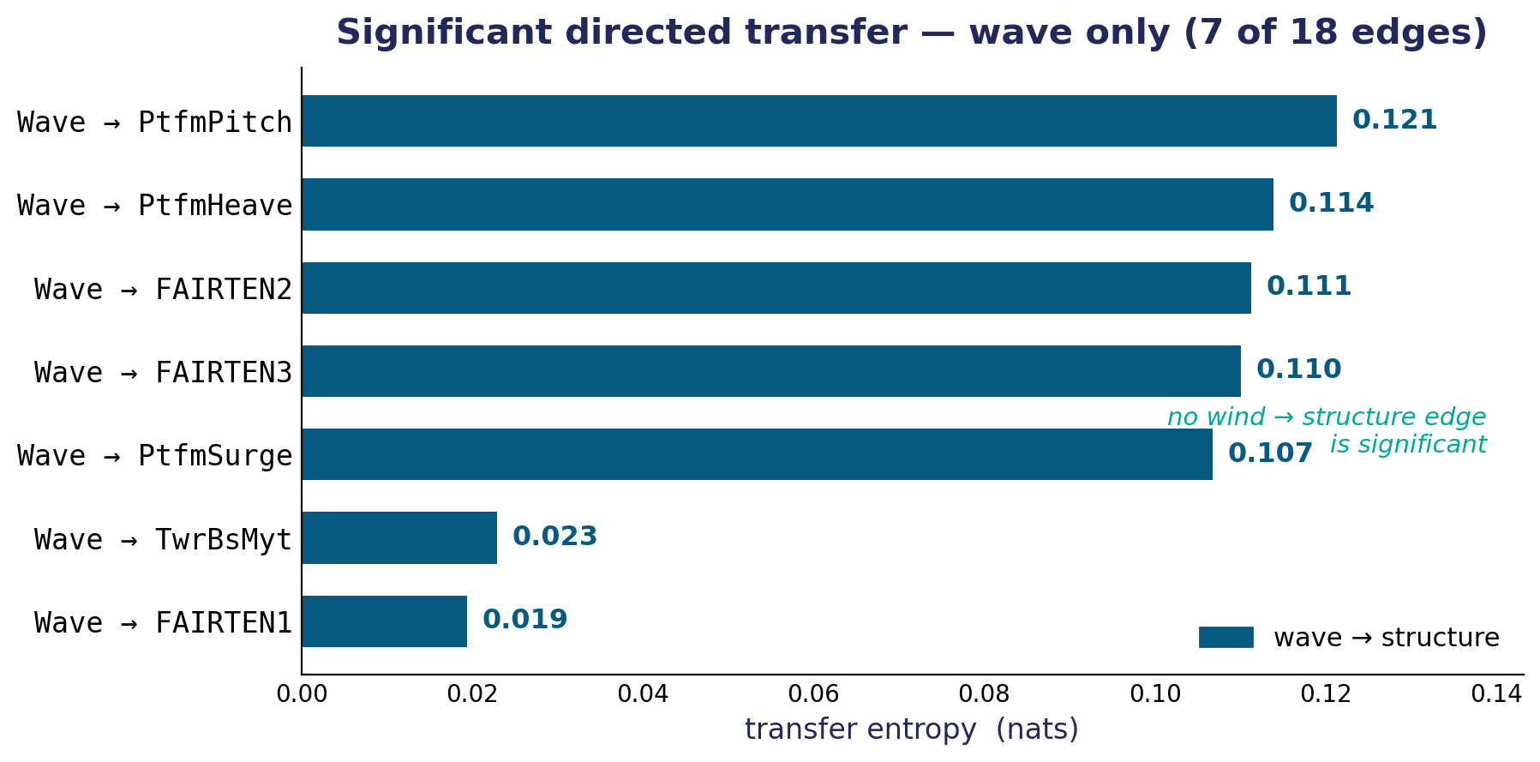
24
RESULT
The significant edges — 7 of 18
WAVE DRIVES THE STRUCTURE
The five strongest edges — pitch, heave, the forward fairleads and surge — cluster at 0.11–0.12 nats. No wind → structure edge is significant anywhere in the campaign.
0 / 18
significant wind → structure edges — wave drives all seven
Significant directed transfer (nats) — wave only, mean across 54 cases
TE causal discovery on a FOWT (IEA-15MW on UMaine VolturnUS-S) · full campaign: DLC-A / DLC-B / DLC-1.6
24 / 31

Slide 25
25
TRIANGULATION
TE vs. coherence vs. Granger
Coherence γ²(f)
Gaussian / Granger
Transfer entropy
Undirected spectral ceiling. Shared power, no direction.
Directional but linear. Over-detects under correlated wind–wave.
Directed AND nonlinear. Catches couplings the others miss.
READING THE TRIANGLE
Where TE is significant but the linear baselines are not = nonlinear directed coupling unique to TE (e.g. the wave 2nd-order difference-frequency forcing of pitch). Where all three agree, the embedding is validated.
TE causal discovery on a FOWT (IEA-15MW on UMaine VolturnUS-S) · DLC-1.6 (11 m/s, severe sea)
25 / 31

Slide 26
26
OPEN QUESTION
The wind paradox
THE PUZZLE
NOT AN ARTIFACT
Wind → structure ≈ 0 across 8–20 m/s — yet wind is what drives the turbine. Counter-intuitive, and it holds at every operating point.
Wind decorrelates at ~11.6 s — well inside the 30 s embedding window. The wind signal is sampled; it simply isn't transferring information to the structure.
HYPOTHESIS — A CONTROLLER “FIREWALL”
The blade-pitch controller (ROSCO) regulates rotor thrust so tightly that wind fluctuations are rejected before they reach the platform. The controller acts as a causal firewall — wind energizes the rotor, not the structure.
TE causal discovery on a FOWT (IEA-15MW on UMaine VolturnUS-S) · DLC-1.6 (11 m/s, severe sea)
26 / 31

Slide 27
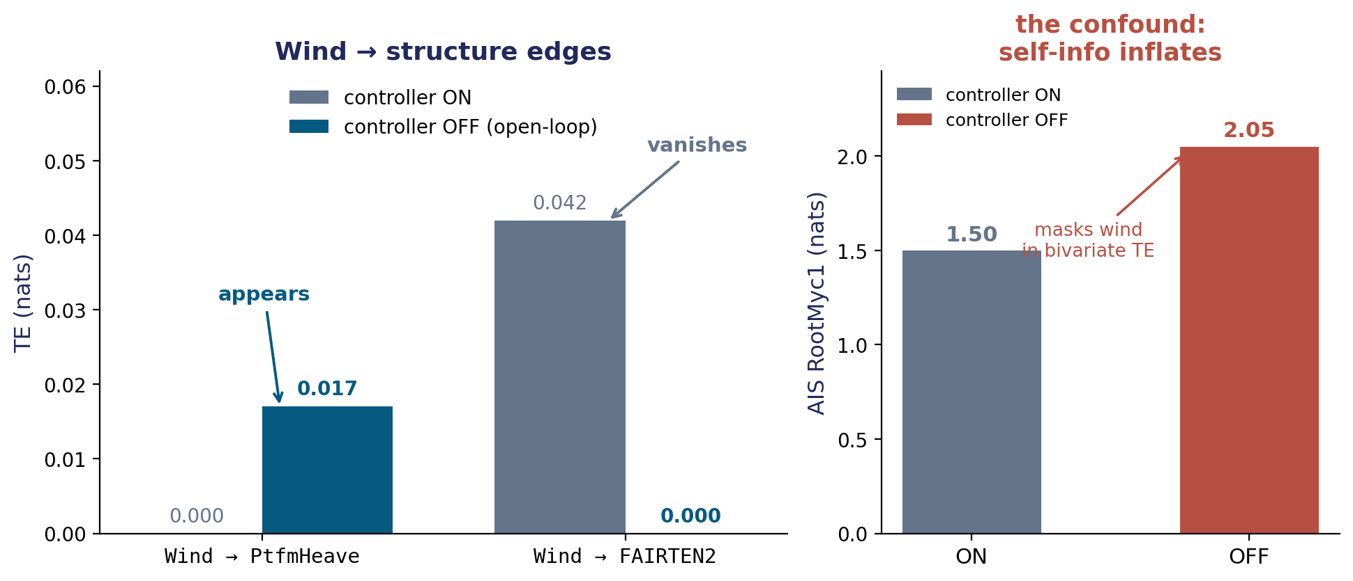
27
OPEN QUESTION
Testing the firewall — controller-off ablation
VERDICT
Suggestive but inconclusive. The wind→heave edge appears, but open-loop overspeed inflates AIS and masks wind in bivariate TE.
next
conditional TE TE(wind→Y | wave) + a non-overspeeding ablation
Re-ran the same case with blade-pitch control frozen (open-loop)
TE causal discovery on a FOWT (IEA-15MW on UMaine VolturnUS-S) · DLC-1.6 (11 m/s, severe sea)
27 / 31

Slide 28
28
METHODS LESSONS
What made it work — and what nearly broke it
GPU MADE THE SWEEP TRACTABLE
CAUTION — EMBEDDING DELAY MATTERS
~35 h
0.12 → 0
per case on a single A100-batched run. The OpenCL KSG estimator (validated vs CPU) is what brings the full DLC sweep into reach.
A data-driven τ from self-MI preserved AIS but collapsed the TE edges (τ = 10 zeroed the strongest Wave→PtfmPitch edge). Directed couplings live at specific lags — AIS heuristics don't transfer to TE.
TE causal discovery on a FOWT (IEA-15MW on UMaine VolturnUS-S) · DLC-1.6 (11 m/s, severe sea)
28 / 31

Slide 29
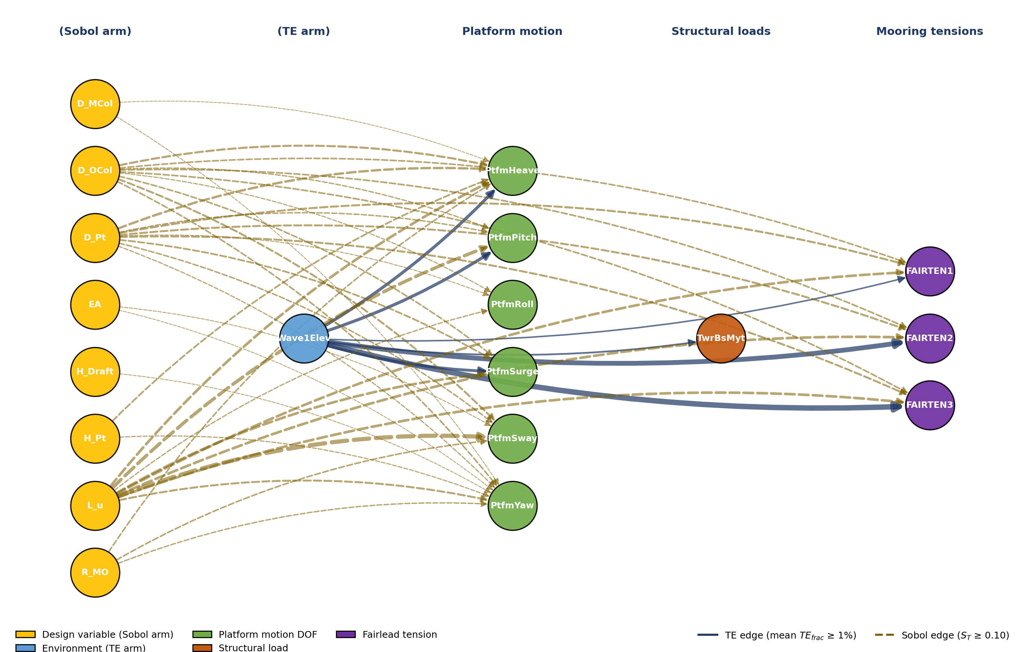
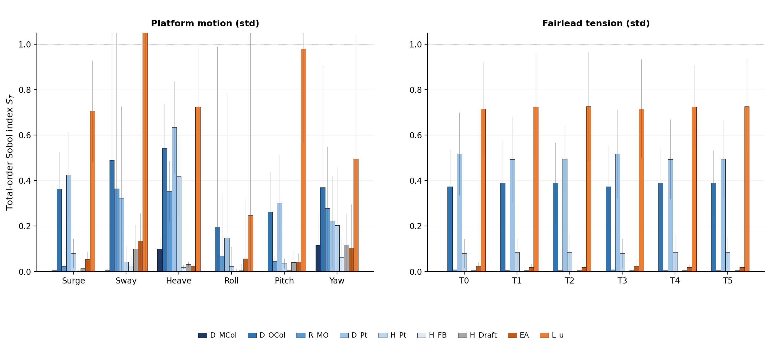
29
OUTLOOK · HYBRID METHOD
Closing the loop: TE + Sobol → data-driven weights
SOBOL Sₜ — DESIGN SENSITIVITY
Mooring length (L_u) and stiffness (EA) dominate fairlead tensions and several motions. Column geometry (D_OCol, R_MO) drives surge, sway and heave.
COMBINED GRAPH — TE + SOBOL
Two directed importance maps in one graph — TE for environment-driven dynamics, Sobol for design sensitivity — a data-driven basis for the optimization weights (proposed next step).
Hybrid TE + Sobol · RAFT Saltelli ensemble (Sobol) + IDTxl (TE)
29 / 31

Slide 30
30
LIMITATIONS & FUTURE
Where this goes next
LIMITATIONS
NEXT STEPS
— Single platform (UMaine VolturnUS-S), simulation-only — no field validation.
— max_lag = 150 (30 s) may be short for PtfmSurge (decorrelates ~24.6 s).
— Firewall mechanism (controller) is preliminary and confounded — the wind decoupling is shown, its cause is not.
— Conditional TE — TE(wind→Y | wave) — to test the firewall beyond the bivariate estimate.
— A non-overspeeding controller-off ablation to settle the firewall mechanism.
— Hybrid graph: add Sobol design-parameter sensitivity.
— Feed the ranked TE driver→load pathways into structural/fatigue load weighting for design optimization.
TE causal discovery on a FOWT (IEA-15MW on UMaine VolturnUS-S) · DLC-1.6 (11 m/s, severe sea)
30 / 31

Slide 31
31
CONCLUSION
Transfer entropy reveals a wave-dominated causal structure in FOWT response that linear methods only partially capture.
— Wave drives platform pitch, heave, surge, tower base and mooring; no wind → structure edge is significant across the 54-case campaign.
— The wind decoupling is robust and non-obvious — holding across 8–20 m/s — yet whether the controller causes it is an open, testable question.
— Conditional TE and a non-overspeeding controller-off ablation are the path to settle it.
— Next: pair this ranking with Sobol design sensitivities to set data-driven weights for design optimization.
IEA-15MW · UMaine VolturnUS-S · OpenFAST + IDTxl · github.com/sinahdme/fowt-te-causal

