Slide 1
80th Anniversary Commemorative Academic Conference
**Optimization of Design Variables for Floating Offshore Wind Turbine Substructures
Based on Reinforcement Learning**
December 12, 2025 High1 Grand Hotel Convention Tower (Gangwon Land)
Affiliation: Innovation Research Center for Ultra-Large-Capacity Wind Power Generation Systems, Kunsan National University
Authors: Hae-Myung Jeon*, Ik-Su Lee, Jae-Gyu Noh

Slide 2
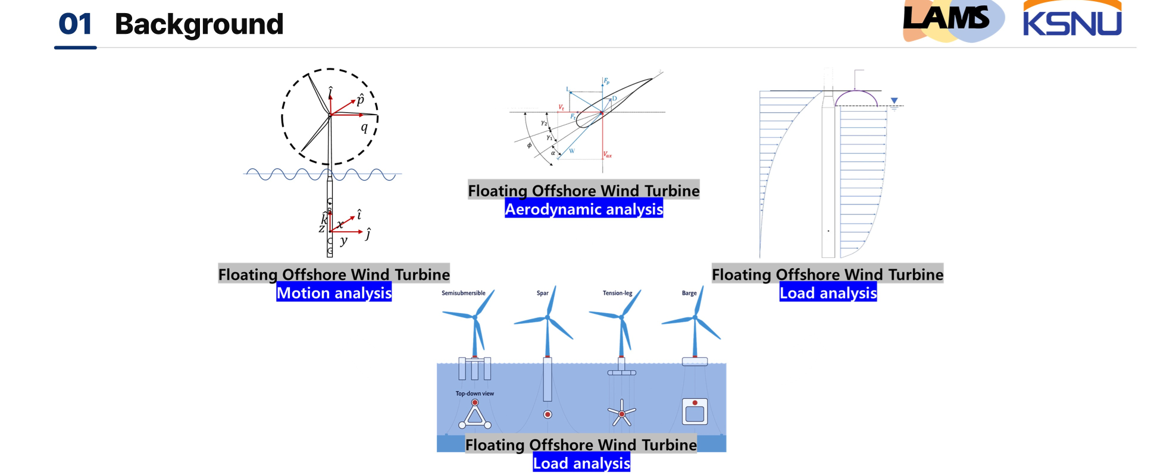
Design Complexity Due to Upscaling of FOWTs and the Need for Coupled Analysis
The upscaling of wind turbines is being accelerated to increase power generation per unit installation and to reduce the levelized cost of energy (LCOE).
As turbine size increases, inter-system coupling effects become more significant, leading to more complex dynamic behavior.
Floating offshore wind turbines (FOWTs) are influenced by various types of loads (Aero–Hydro–Servo–Elasto–Mooring).
To properly account for these interactions, a coupled-analysis-based design approach is required.

Slide 3
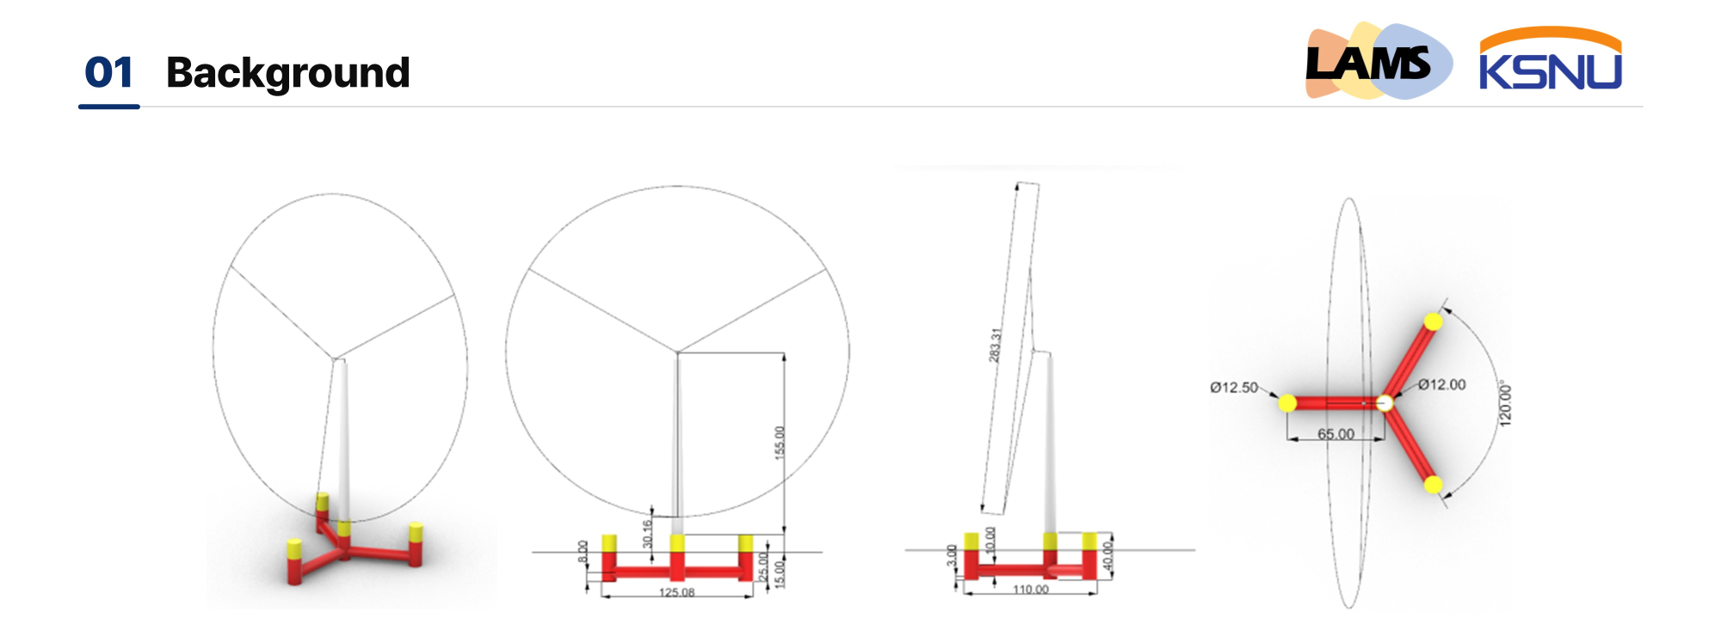
Necessity of Optimal Design Based on Coupled Analysis
Multiple design variables: column spacing, diameter, draft, pontoon size, mooring line length, etc.
Multiple objective functions: stability, loads, cost, AEP, etc.
Multi-physics coupling: wind, waves, control, and mooring systems all interact with each other.
Nonlinearity: nonlinear characteristics of structures, fluid dynamics, and mooring systems make direct prediction difficult.
Large design space: due to the enormous number of possible combinations, manual exploration by designers is impractical.
→ Optimization serves as a systematic tool that automatically identifies the most promising design candidates among tens of thousands of possible configurations

Slide 4
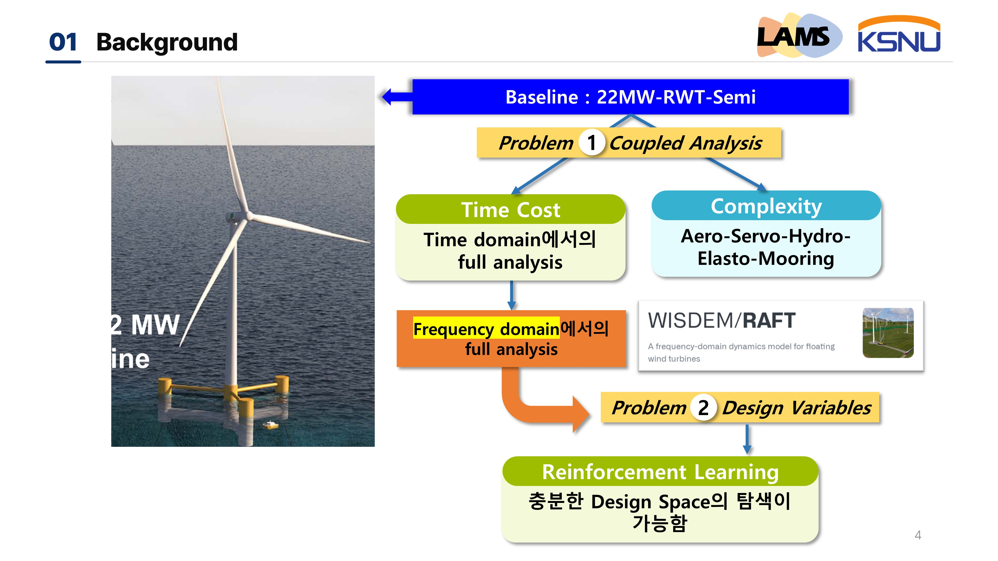

Slide 5
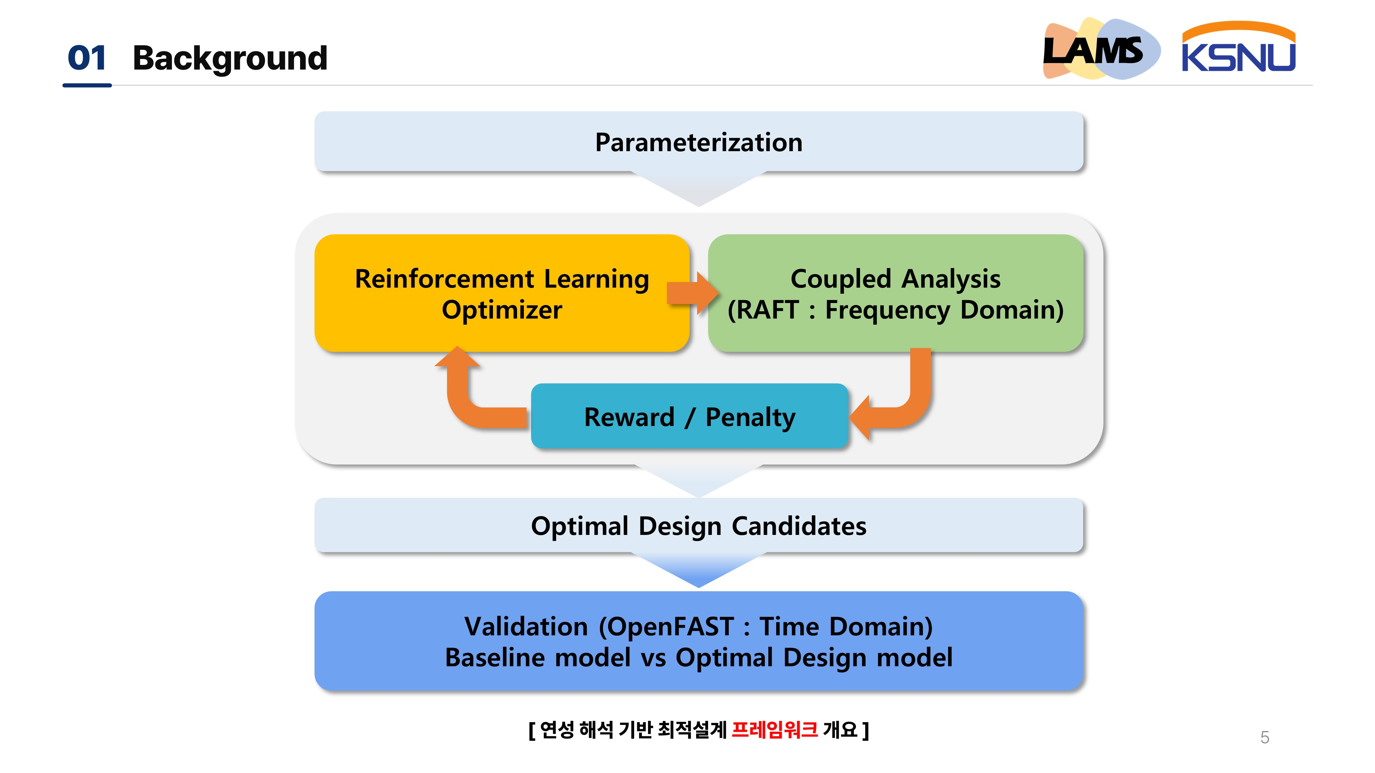

Slide 6
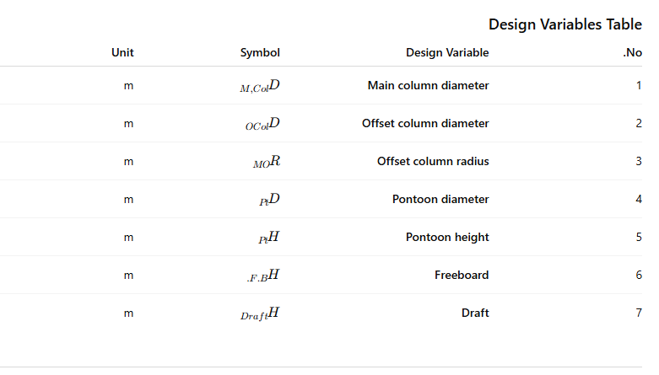
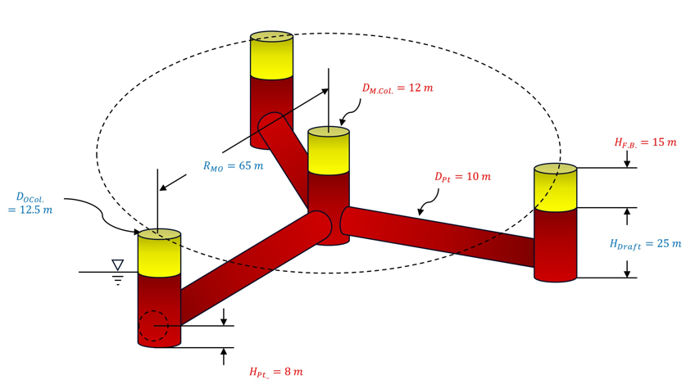
02 Research Method [Design Variables]
The geometry of the floating substructure is defined using seven design variables

Slide 7
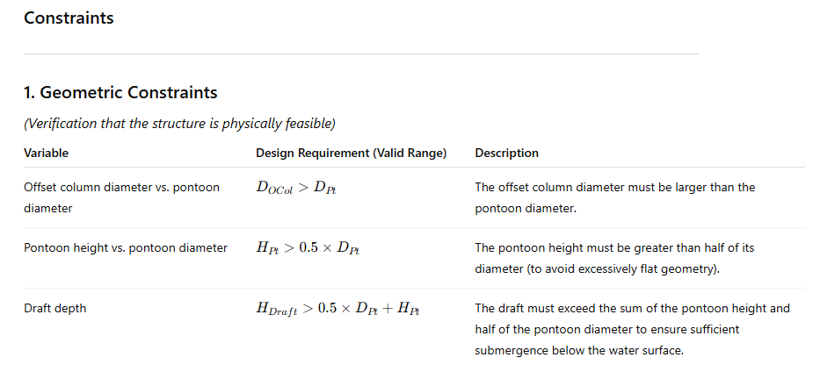
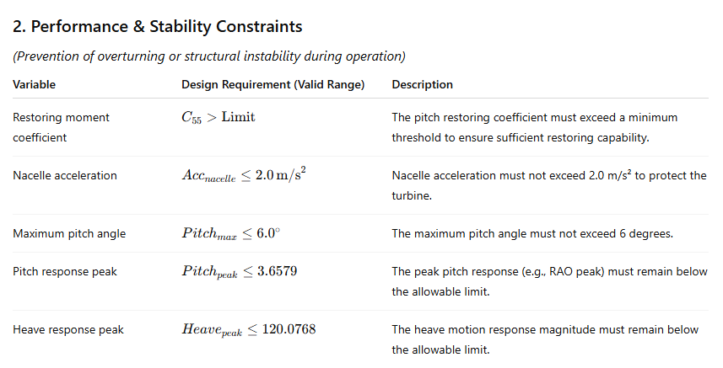
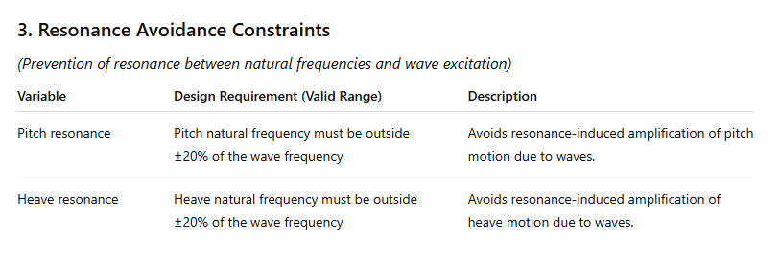

Slide 8
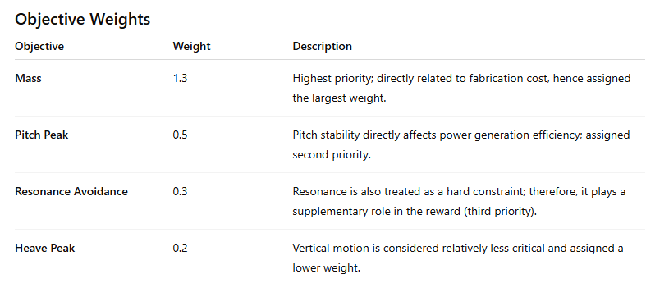

Objective Functions
Mass Minimization: A reward is given when the structural mass is reduced compared to the baseline design.
Resonance Avoidance: A reward is given as the distance between the structural natural frequencies and the dominant wave frequency increases.
Peak Response Minimization: A reward is given when the maximum wave-induced motion peaks are reduced compared to the baseline.

Slide 9
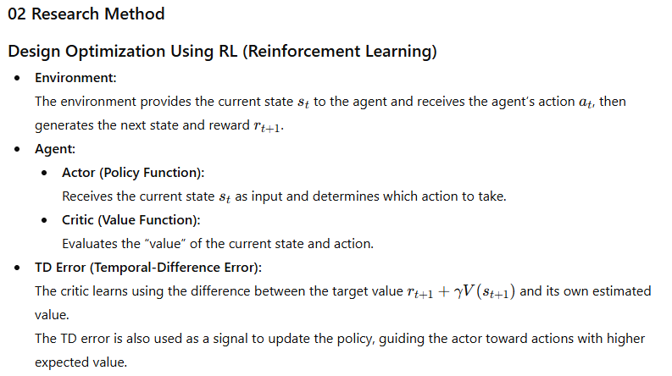
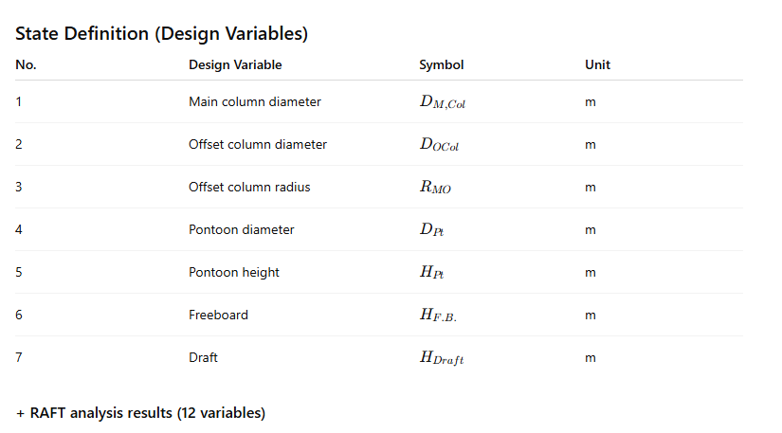
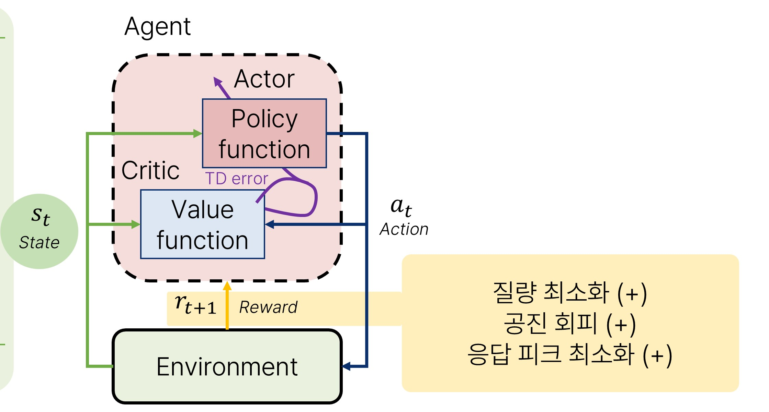
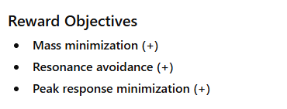

Slide 10
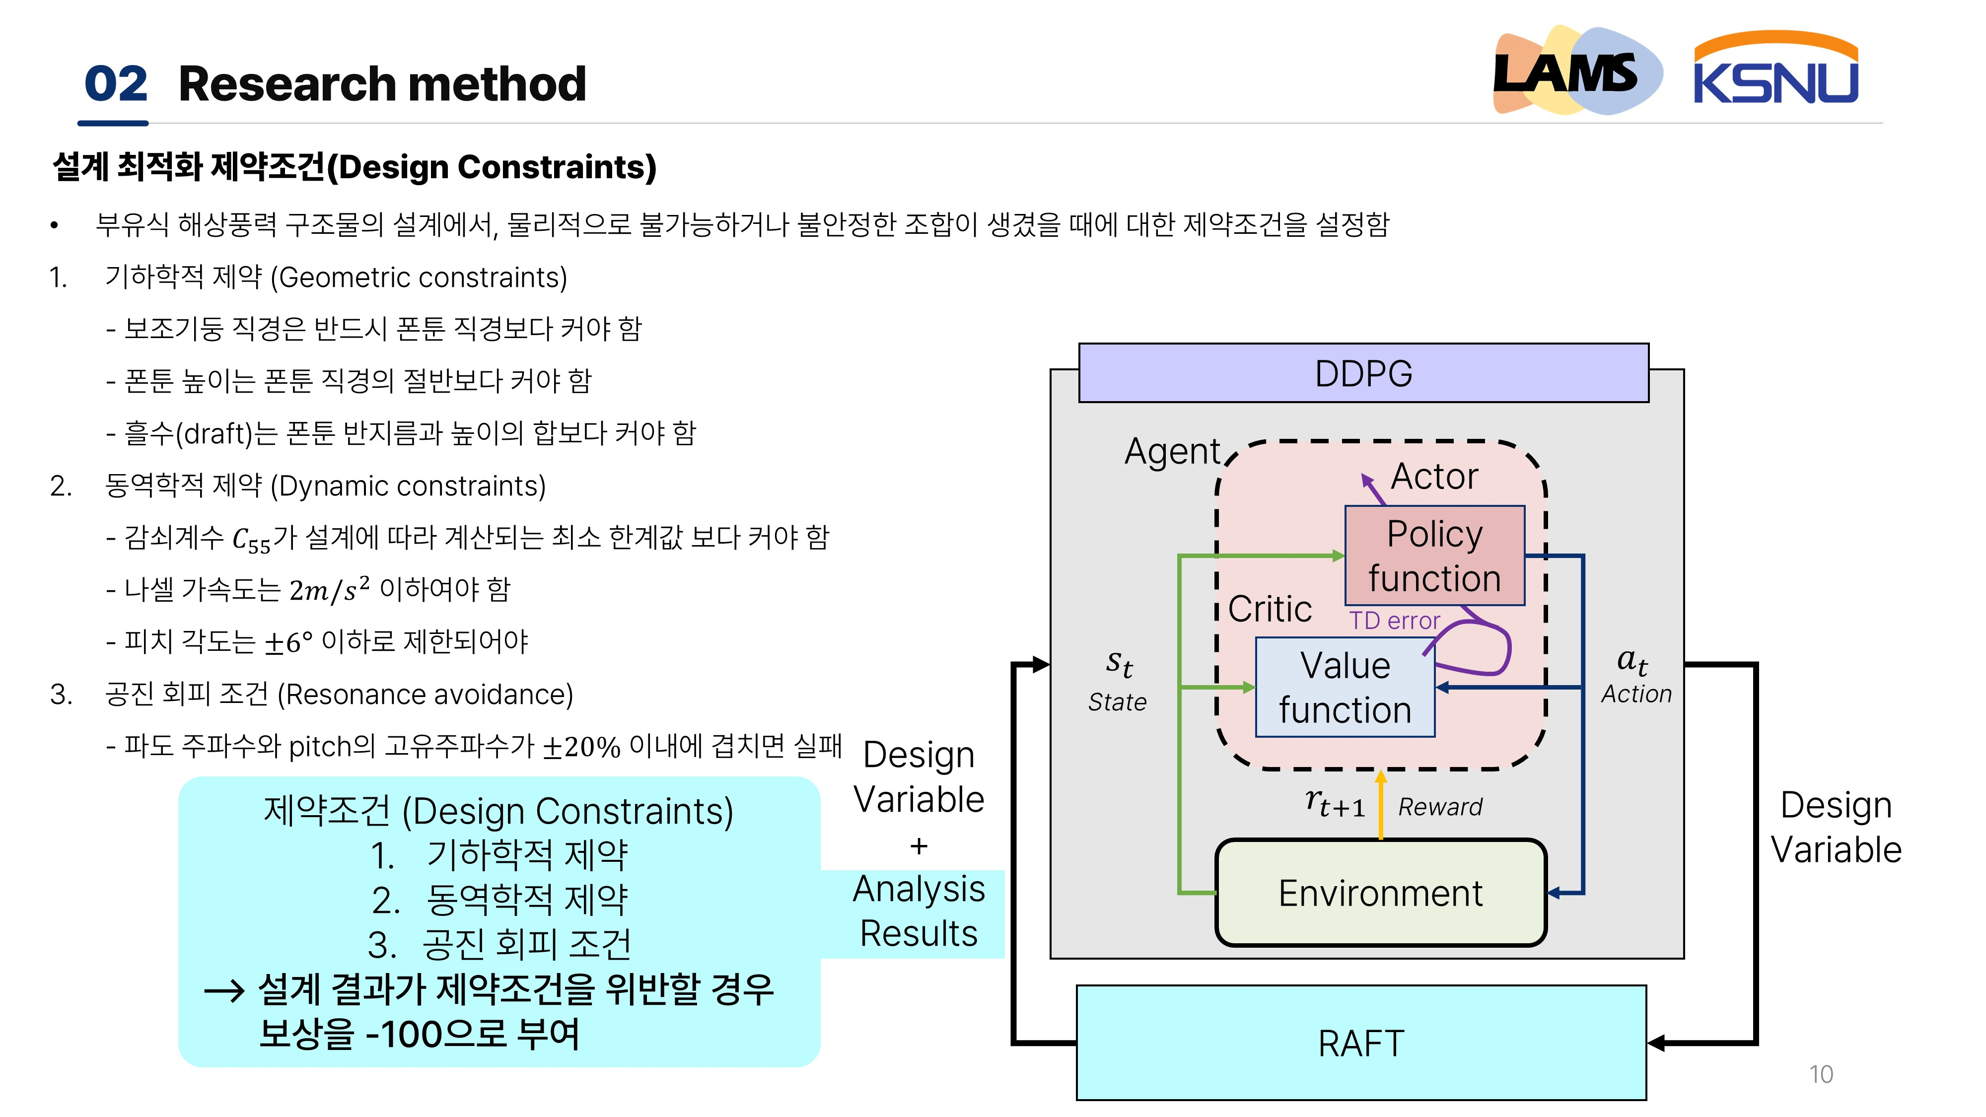

Slide 11
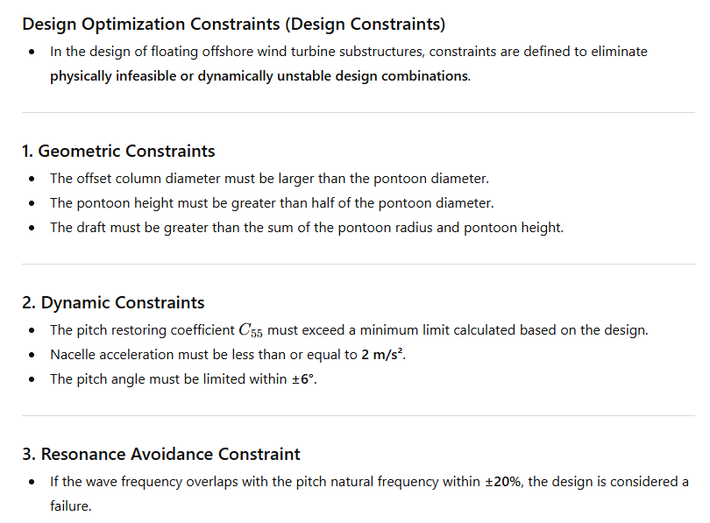
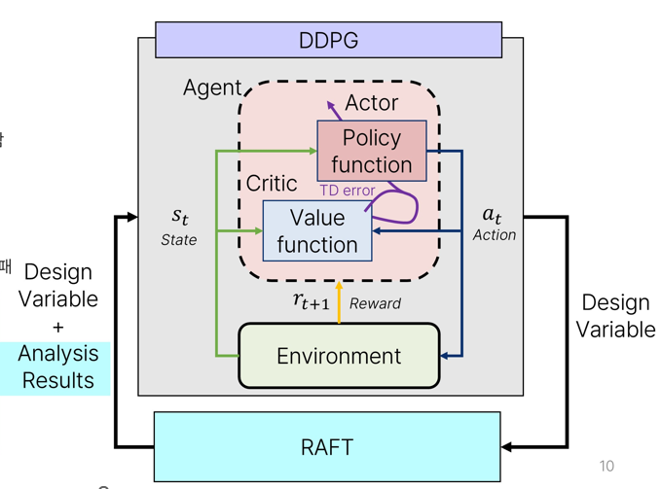
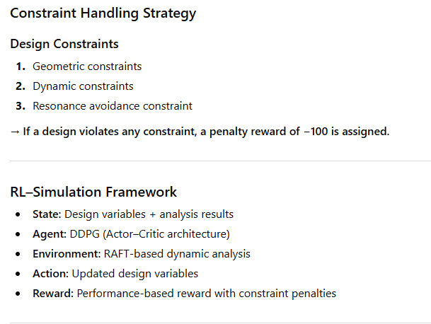

Slide 12
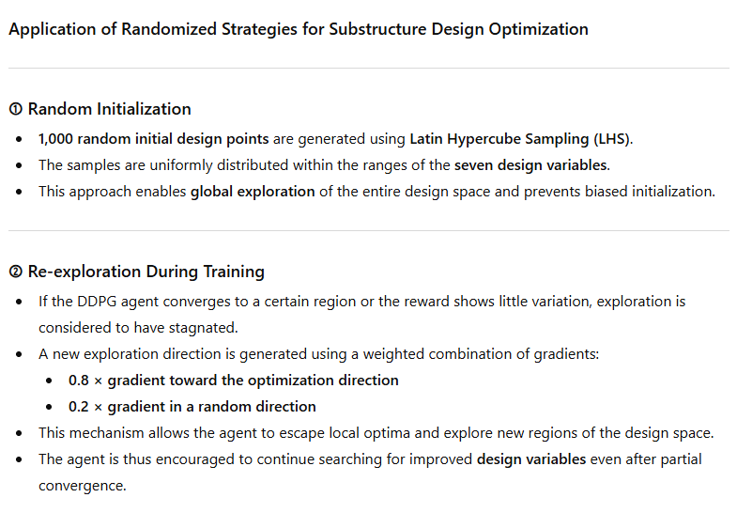
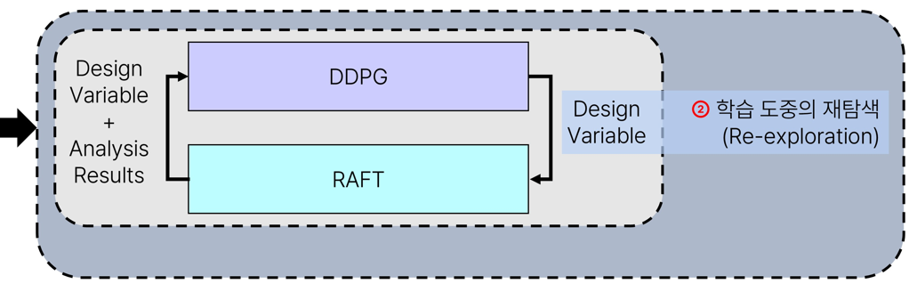
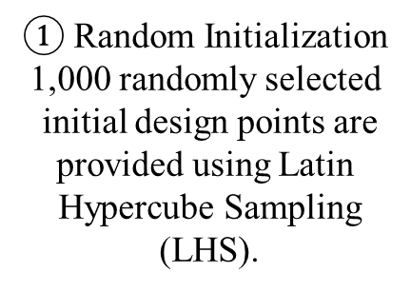
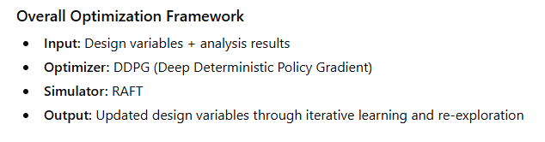

Slide 13
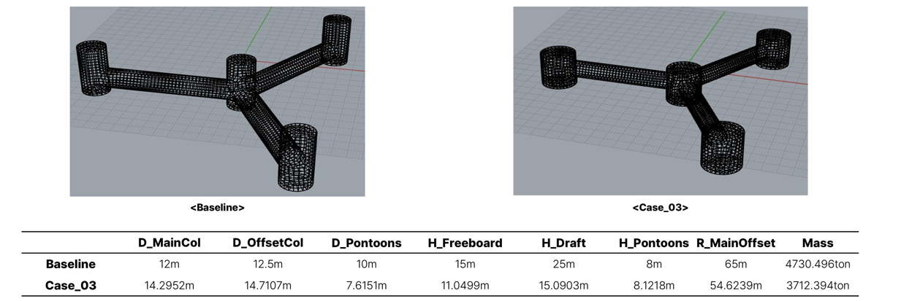
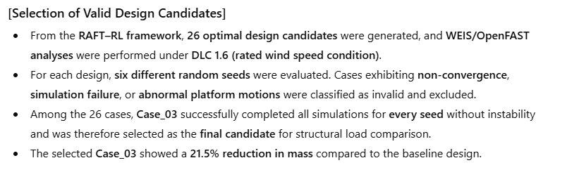
03 Results & Conclusion

Slide 14
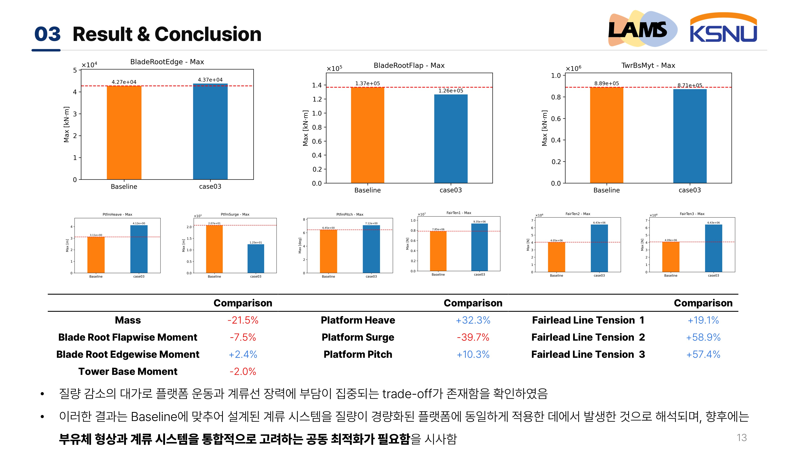
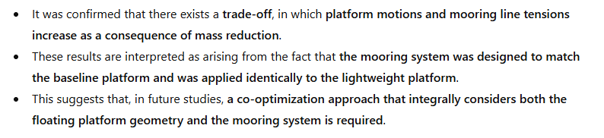

Slide 15


Slide 16
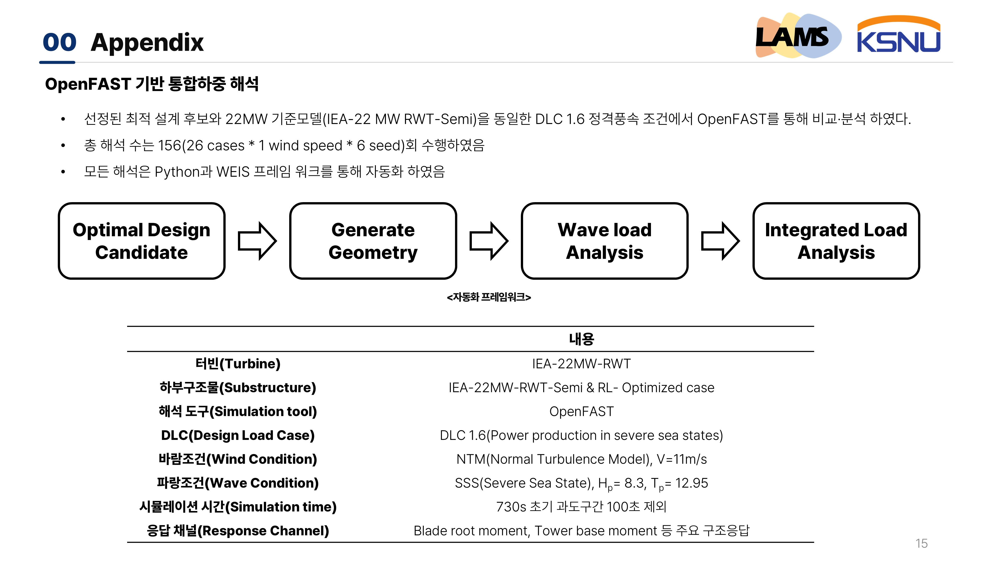

Slide 17
