Slide 1
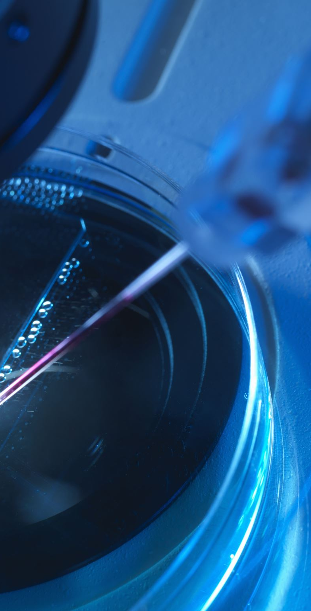
Research Spotlight: Image Captioning with Deep Learning
Sina
Sumon
Lovely
March 27, 2025

Slide 2

Introduction to the Problem
Automatically generating captions for images is a complex task at the intersection of computer vision and NLP.
It requires understanding visual content and generating coherent natural language.
Applications include accessibility tools, AI assistants, and image search engines.

Slide 3

Data Overview
Dataset: Flickr8k (Available on Kaggle)
8,000 images from various real-world scenes
Each image is annotated with 5 human-written captions
Preprocessing: image resizing, normalization, caption tokenization, vocabulary building

Slide 4
Methodology
Model Architecture:
Encoder: InceptionV3 CNN pretrained on ImageNet
Decoder: LSTM RNN with pretrained word embeddings
Combined via CNN2RNN module in PyTorch
Evaluation: BLEU, METEOR, CIDEr metrics

Slide 5
Objectives & Goals
Project Aims:
Automatically generate human-like captions for unseen images
Build a robust, end-to-end deep learning model
Evaluate performance using standard NLG metrics

Slide 6
Team Contributions
Sina :
Sumon: Sole contributor
Lovely:

Slide 7
Next Steps
Future Work:
Train and validate the model on the Flickr8k dataset
Fine-tune hyperparameters and test on unseen data
Generate and visualize sample captions
Address challenges like overfitting, small dataset size, and vocabulary limitations

Slide 8
References
P. Wagner, N. Strodthoff, R.-D. Bousseljot, D. Kreiseler, F. I. Lunze, W. Samek, and T. Schaeffter, “PTB-XL, a large publicly available, electrocardiography dataset,” Scientific Data, vol. 7, p. 154, 2020.
P. Wagner, N. Strodthoff, R.-D. Bousseljot, D. Kreiseler, F. I. Lunze, W. Samek, and T. Schaeffter, “PTB-XL, a large publicly available, electrocardiography dataset,” Scientific Data, vol. 7, p. 154, 2020.
P. Wagner, N. Strodthoff, R.-D. Bousseljot, D. Kreiseler, F. I. Lunze, W. Samek, and T. Schaeffter, “PTB-XL, a large publicly available, electrocardiography dataset,” Scientific Data, vol. 7, p. 154, 2020.
P. Wagner, N. Strodthoff, R.-D. Bousseljot, D. Kreiseler, F. I. Lunze, W. Samek, and T. Schaeffter, “PTB-XL, a large publicly available, electrocardiography dataset,” Scientific Data, vol. 7, p. 154, 2020.

