Slide 1

Context Aware Image Caption Generation Using Deep Learning Algorithms Mohammad Sina Hassannia , Sumon Kanti Dey and Lovely Yeswanth Panchumarthi April 24, 2025

Slide 2
Introduction to the Problem
Image captioning is the task of describing the content of an image in natural language.
Traditional image captioning focuses on describing objects and actions in an image.
Context-aware captioning requires:
Understanding visual content (objects, scenes, actions).
Captures intent, interactions, and background details
Importance:
Facilitates Dataset Annotation
Helps visually impaired users understand image content through descriptive text
Enables Visual Question Answering (VQA)
Enables Cross-lingual Applications.
Improves E-commerce Experience
Application
Social Media Automation
Human-Robot Interaction
Education and Assistive Tools
Introduction
Data Overview
Methodology
Objective & Goals
Teams Contribution
Next Steps

Slide 3
Why do need Captioning?
Image captioning closely related to Visual Question Answering
If good descriptions of images can be generated. Then likely a variety of questions can be answered
It seems there should be a strong relationship between scene-graph generation & caption generation.
Then the benefits of SG generation we saw last time (image retrieval etc.) can be gained
Long term goal perhaps commentary on a video frame-by-frame
Introduction
Data Overview
Methodology
Objective & Goals
Teams Contribution
Next Steps

Slide 4
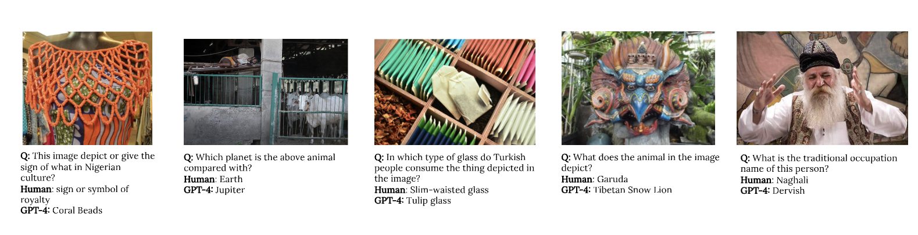
Why it is important
Nayak, Shravan, Kanishk Jain, Rabiul Awal, Siva Reddy, Sjoerd Van Steenkiste, Lisa Anne Hendricks, and Aishwarya Agrawal. "Benchmarking vision language models for cultural understanding." arXiv preprint arXiv:2407.10920 (2024).
Introduction
Data Overview
Methodology
Objective & Goals
Teams Contribution
Next Steps

Slide 5
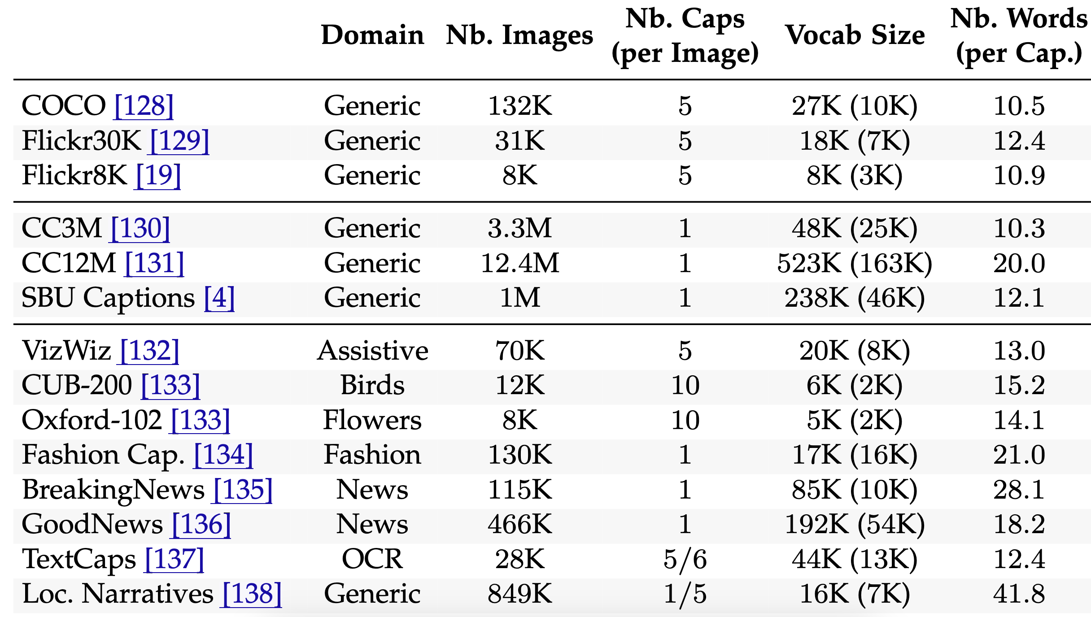
Sample of Existing Dataset Challenges
Stefanini et al. From Show to Tell: A Survey on Deep Learning-based Image Captioning. arXiv 2021
Introduction
Data Overview
Methodology
Objective & Goals
Teams Contribution
Next Steps

Slide 6
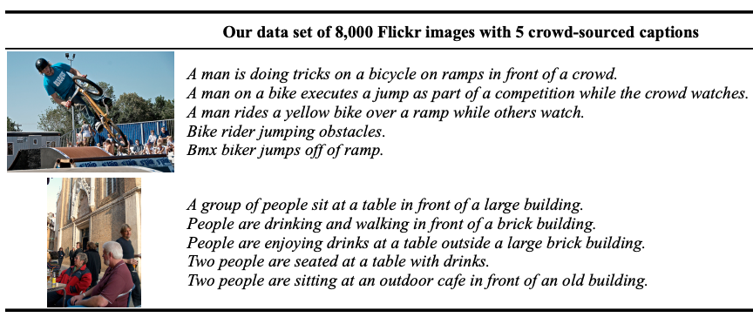
Data Overview
Flickr8k Dataset Overview
Benchmark dataset for image-to-text description tasks.
8,000 real-world images, each paired with 5 human-annotated captions.
Captions focus on events, actions, and scenes.
Exclude famous people and landmarks – ensuring general applicability.
Split details:
6K training, 1K validation, 1K test images
Preprocessing:
Text Preprocessing : Remove special characters, Convert all captions to lowercase.
Image Preprocessing: Resize images - Normalize pixel values
Hodosh, Micah, Peter Young, and Julia Hockenmaier. "Framing image description as a ranking task: Data, models and evaluation metrics." Journal of Artificial Intelligence Research 47 (2013): 853-899.
Introduction
Data Overview
Methodology
Objective & Goals
Teams Contribution
Next Steps

Slide 7
Preprocessing & Embedding
Image Preprocessing:
Resize to 299 x 299
Center crop
Normalize using ImageNet stats
Text Preprocessing:
Remove punctuation and digits
Remove single-letter words
Convert all text to lowercase
Tokenize and numericalize with special tokens:
<BEG>, <END>, <PAD>, <UNK>
Build vocabulary from training captions
Keep words with frequency ≥ threshold (e.g., 10)
Create mappings:
word2idx (word → index)
idx2word (index → word)
Word Embeddings for Captioning
GloVe (42B, 300D)
Pretrained GloVe vectors trained on 42 billion tokens
Each word is represented as a 300-dimensional vector
Words not found are randomly initialized or zeroed
Used to initialize embedding layer of decoder
Introduction
Data Overview
Methodology
Objective & Goals
Teams Contribution
Next Steps
Notes:
Resize to 299 × 299
Many deep learning models (like Inception) expect a fixed input size.
299×299 is standard for some models pretrained on ImageNet.
Center Crop
Helps focus on the most important part of the image — usually the subject in the middle.
Also ensures consistency in shape after resizing.
Normalize using ImageNet stats
Models trained on ImageNet expect the image to have similar pixel value distributions.
Normalizing means adjusting the pixel values to have the same mean and standard deviation as the training data (ImageNet).
Remove single-letter words
Words like "a", "I", etc., are often removed unless important.
Tokenize and numericalize with special tokens
Tokenize = Split the sentence into words.
Numericalize = Convert each word into a number using a dictionary.
Add special tokens:
<BEG>: Marks the beginning of a caption
<END>: Marks the end of a caption
<PAD>: Padding for fixed-length sequences
<UNK>: Unknown words not in the vocabulary

Slide 8
Methodology
Image captioning is a multimodal task, requiring the integration of visual and textual data.
We drew inspiration from autoencoder-like architectures, where:
Encoder processes the visual input and extracts high-level features.
Techniques used:
CNN-based models (e.g., ResNet)
U-Net-based architecture
Vision Transformer (ViT)
EfficientNetB3
InceptionV3
Decoder generates a caption word-by-word based on the encoded image features.
Common models: LSTM, Transformer
These setups bridges vision and language modalities by compressing visual content and decoding it into human-readable text.
Introduction
Data Overview
Methodology
Results
Teams Contribution
Next Steps

Slide 9
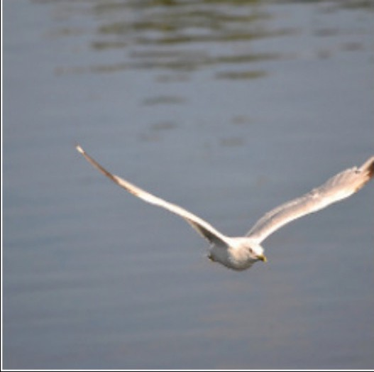
Encoder Decoder Pipeline
Image
Caption
Encoder
Decoder
A bird flying over a body of water.
Introduction
Data Overview
Methodology
Results
Teams Contribution
Next Steps

Slide 10
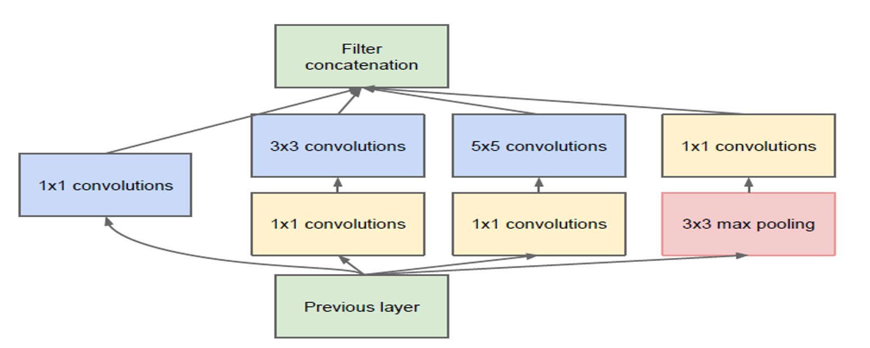
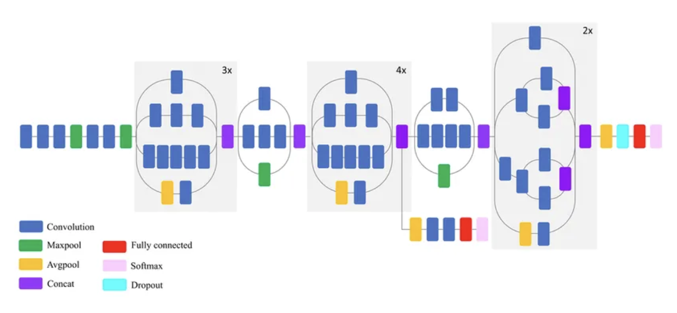
Inception V3
The Inception-v3 model is a deep convolutional neural network that was designed and trained to perform image classification tasks.
Inception-v3 is a successor to the earlier Inception models and incorporates several key features such as:
Factorized convolution
Inception modules
Auxiliary classifiers
https://medium.com/@792/the-inceptionv3-experiment-a-shallow-sight-on-transfer-learning-74e8ef4a4533
https://datascience.stackexchange.com/questions/15328/what-is-the-difference-between-inception-v2-and-inception-v3
Introduction
Data Overview
Methodology
Results
Teams Contribution
Next Steps
Notes:
The key idea behind Inception V3 is to make the network both deeper and more efficient. It builds on earlier versions of the Inception model and introduces several innovations.
🔹 First, we have factorized convolutions. Instead of large, computationally expensive filters, Inception V3 breaks them down into smaller, more efficient operations. For example, a 5x5 convolution is replaced with two 3x3 convolutions. This reduces the number of parameters and speeds up training.
🔹 Second, the architecture uses Inception modules—as shown in the diagram on the right. These modules allow the network to capture information at multiple scales by combining filters of different sizes in parallel and then concatenating the results.
🔹 Third, it includes auxiliary classifiers, which are like mini-networks that branch out from intermediate layers. They serve two purposes:
they help with gradient flow during training,
they act as regularizers to prevent overfitting.
On the left, you can see a visual breakdown of the architecture across stages—each color representing a different type of layer like convolution, pooling, or dropout.

Slide 11
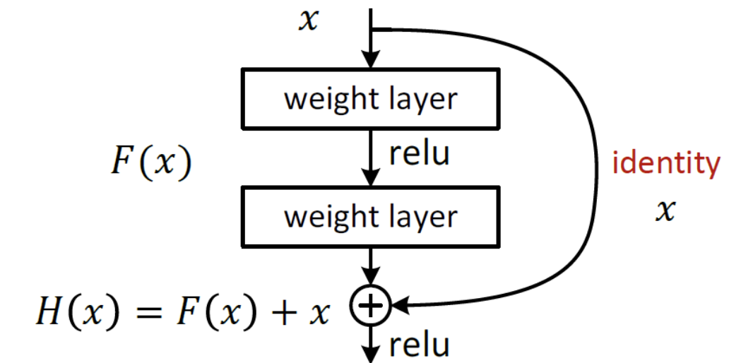
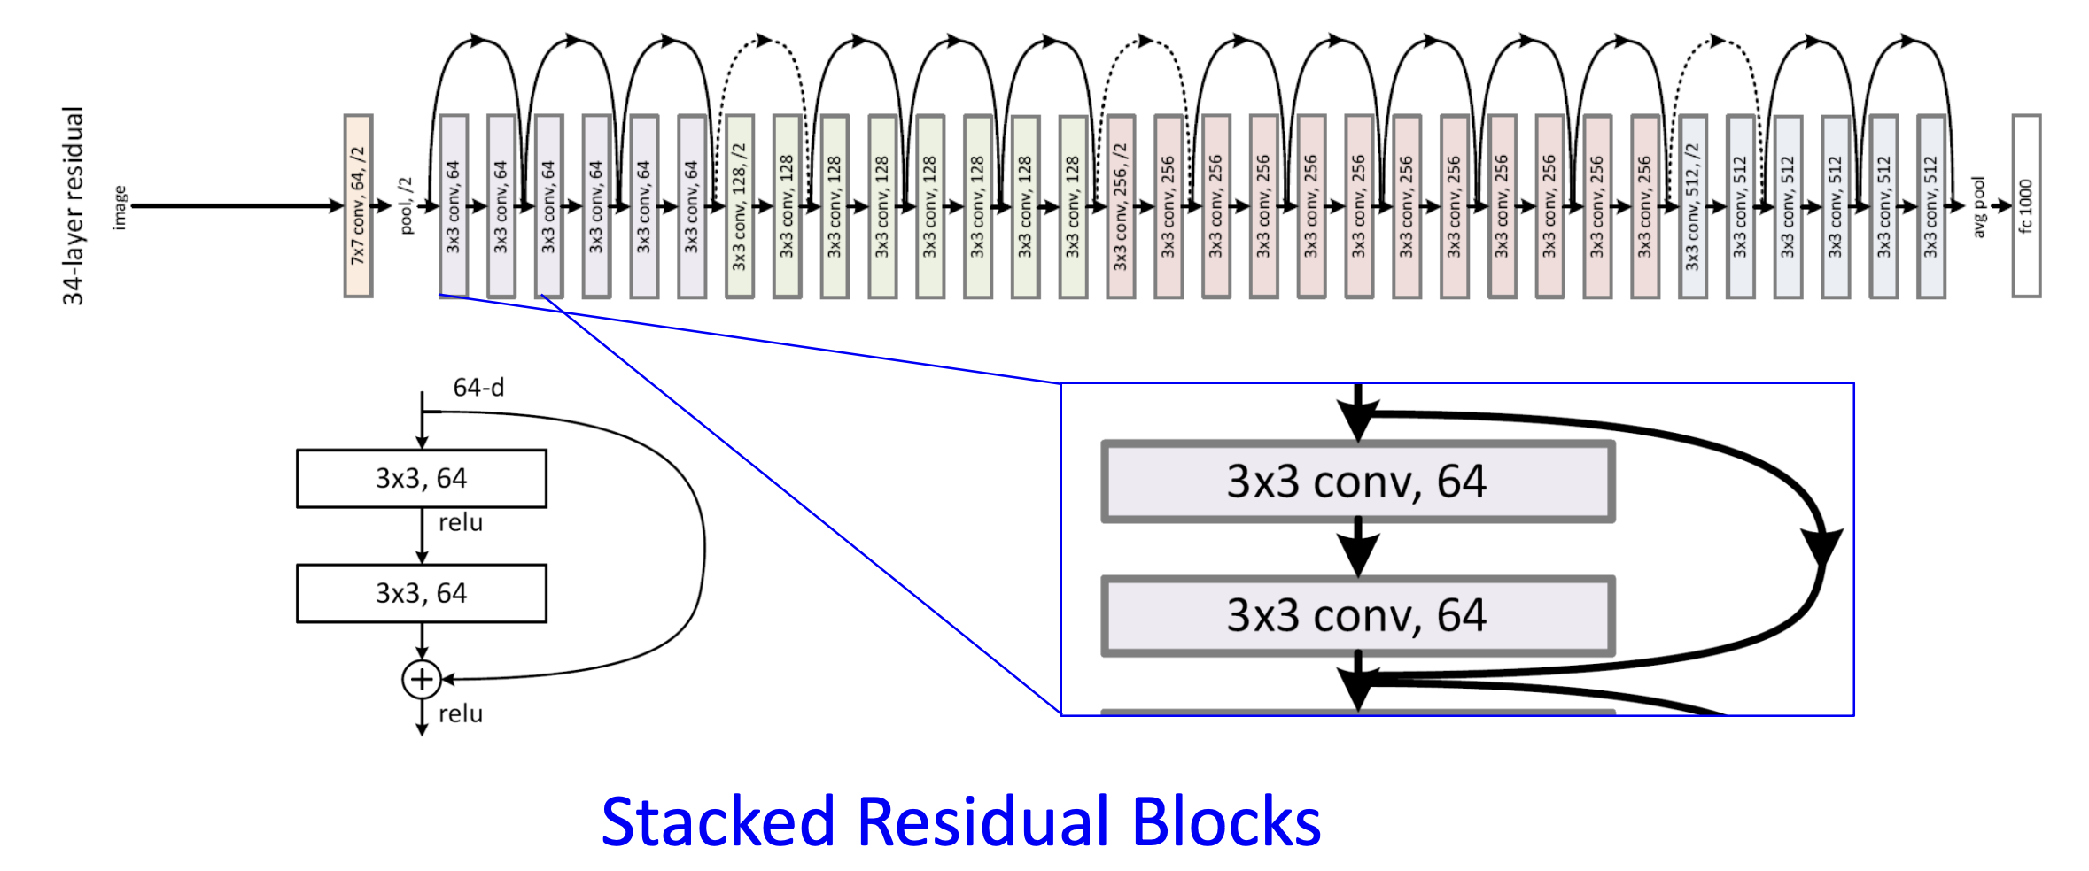
ResNet
Skipping immediate connections!
Referred to as residual part of the network.
Such residual part receives the input as an amplifier to its output
The dimensions usually are the same.
Another option is to use a projection to the output space.
Either way – no additional training parameters are used.
https://www.geeksforgeeks.org/residual-networks-resnet-deep-learning/
https://www.geeksforgeeks.org/residual-networks-resnet-deep-learning/https://www.geeksforgeeks.org/residual-networks-resnet-deep-learning/
Introduction
Data Overview
Methodology
Results
Teams Contribution
Next Steps

Slide 12
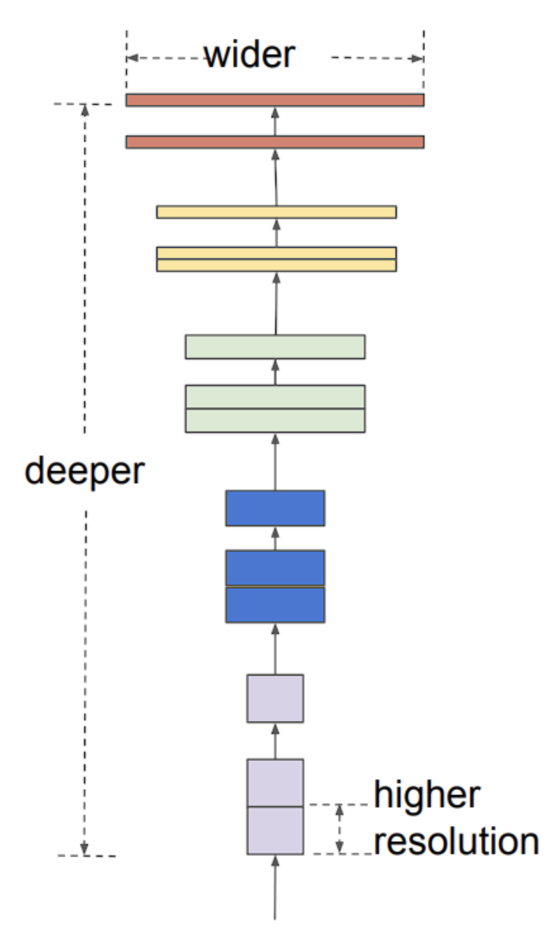
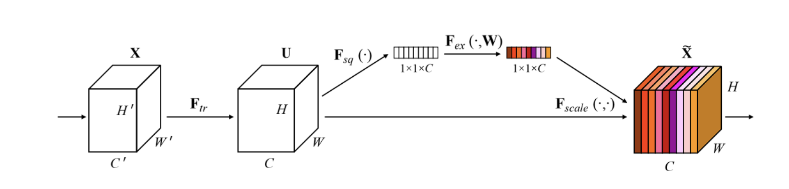
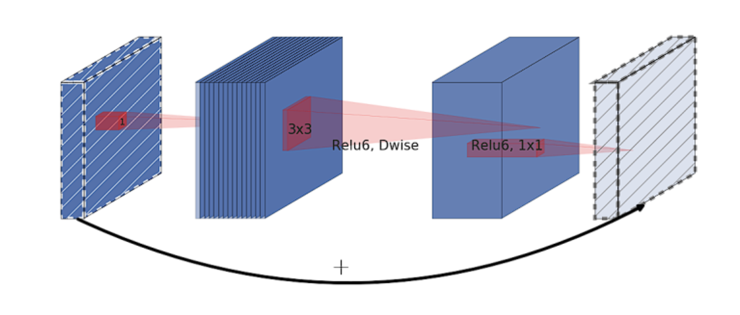
EfficientNet(B3)
MBConv Block (Mobile Inverted Bottleneck Convolution)
Inverted residual structure.
Step 1: 1×1 Conv → expands input to higher-dimensional space.
Step 2: Depth wise convolution → spatial filtering.
Step 3: 1×1 Conv → projects back to lower-dimensional space.
Squeeze-and-Excitation Optimization
Purpose: Enhances focus on important features.
Squeeze:
Global Average Pooling across spatial dimensions (W × H).
Excitation:
Fully connected layer produces per-channel weights.
Weights are applied channel-wise to scale features based on importance.
https://viso.ai/deep-learning/efficientnet/
Introduction
Data Overview
Methodology
Results
Teams Contribution
Next Steps
Notes:
The main components of the architecture are:
MBConv block (Mobile Inverted Bottleneck Convolution)
The MBConv block is an evolved inverted residual block inspired by MobileNetv2.
inverted residual block starts by expanding the input feature map into a higher-dimensional space using a 1×1 convolution
applies a depthwise convolution in this expanded space
finally uses another 1×1 convolution that projects the feature map back to a lower-dimensional space
Squeeze-and-excitation optimization
allows the model to emphasize useful features
Squeeze: This phase aggregates the spatial dimensions (width and height) of the feature maps across each channel into a single value, using global average pooling
Excitation: In this step, the model using a full-connected layer applied after the squeezing step, produces a collection of per channel weight (activations or scores). The final step is to apply these learned importance scores to the original input feature map, channel-wise, effectively scaling each channel by its corresponding score.

Slide 13
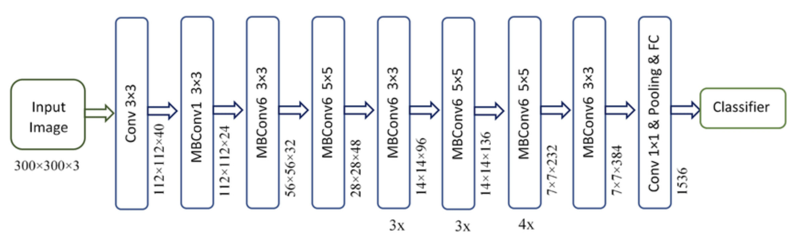
EfficientNet(B3)
https://www.researchgate.net/figure/Schematic-representation-of-EfficientNet-B3_fig2_359449935
Introduction
Data Overview
Methodology
Results
Teams Contribution
Next Stepseff
Notes:
The main components of the architecture are:
MBConv block (Mobile Inverted Bottleneck Convolution)
The MBConv block is an evolved inverted residual block inspired by MobileNetv2.
inverted residual block starts by expanding the input feature map into a higher-dimensional space using a 1×1 convolution
applies a depthwise convolution in this expanded space
finally uses another 1×1 convolution that projects the feature map back to a lower-dimensional space
Squeeze-and-excitation optimization
allows the model to emphasize useful features
Squeeze: This phase aggregates the spatial dimensions (width and height) of the feature maps across each channel into a single value, using global average pooling
Excitation: In this step, the model using a full-connected layer applied after the squeezing step, produces a collection of per channel weight (activations or scores). The final step is to apply these learned importance scores to the original input feature map, channel-wise, effectively scaling each channel by its corresponding score.

Slide 14
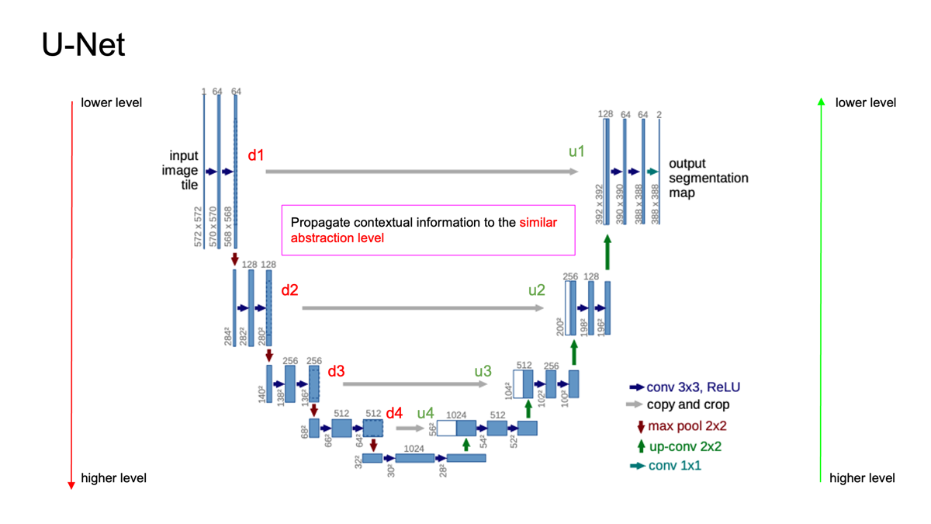
U-Net
Final convolutional layers capture high-level contextual features.
Segmentation requires dense, low-level predictions.
Direct mapping from high-level features to segmentation maps is ineffective.
Key Solutions
FCN (Fully Convolutional Networks):
Introduced skip connections using summation.
Help reuse spatial information from earlier layers.
U-Net:
Utilizes a U-shaped architecture.
Implements skip connections via concatenation.
Effectively combines low-level and high-level features.
Ronneberger, Olaf, Philipp Fischer, and Thomas Brox. 2015. "U-Net: Convolutional Networks for Biomedical Image Segmentation.
Introduction
Data Overview
Methodology
Results
Teams Contribution
Next Steps
Notes:
U-Net is a convolutional neural network (CNN) architecture designed for semantic segmentation, originally proposed for biomedical image segmentation.
The encoder in U-Net works by processing the image through a series of convolutional layers and downsampling steps.
512x512 pixel image—and applies convolutional operations to capture local patterns like edges or textures.
As we move deeper into the encoder, we downsample the image using max-pooling layers, typically reducing the spatial dimensions by half at each step.
512x512 to 256x256, and so on, until we reach a much smaller size, like 32x32.
With each downsampling step, the number of feature channels increases—say, from 64 to 128, then to 256, and so on.
This allows the network to capture more complex, high-level features, such as shapes or objects, while reducing the spatial resolution.
By the time we reach the bottom of the U-Net encoder—often called the bottleneck—we have a compact representation of the image that encodes rich, high-level contextual information.

Slide 15
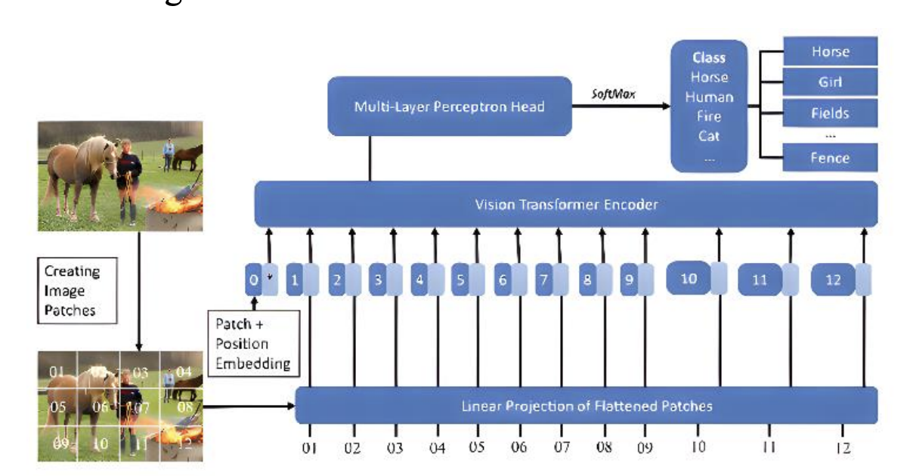
Vision Transformers (VITs)
ViTs treat images as sequences of patches (e.g., 16x16 pixels), allowing transformer models to process visual data like text.
Encoder-Decoder Architecture:
ViT Encoder extracts global visual features using self-attention.
Transformer Decoder (e.g., GPT-2 or custom decoder) generates natural language captions based on those features.
Advantages of ViTs over CNNs:
Capture long-range dependencies and global context in images.
Better for scenes with multiple objects and complex relationships.
Mishra, Swapneel, et al. "Image Caption Generation Using Vision Transformer and GPT Architecture." 2024 2nd International Conference on Advancement in Computation & Computer Technologies
Introduction
Data Overview
Methodology
Results
Teams Contribution
Next Steps
Notes:
Unlike traditional convolutional neural networks, ViT takes a completely different approach by treating an image as a sequence of patches, similar to how transformers process text in natural language tasks.
We start with an input image—say, a 224x224 pixel image.
ViT splits this image into smaller patches, typically 16x16 pixels each, which gives us a sequence of patches.
For a 224x224 image, that’s 196 patches. Each patch is then flattened into a vector and passed through a linear projection layer to convert it into a fixed-size embedding
We also add positional embeddings to these patch embeddings
These patch embeddings are then fed into the ViT encoder, which consists of multiple layers of transformer blocks.
Inside each block, the self-attention mechanism allows the model to look at all patches simultaneously and capture relationships between them.
we can use the embeddings of all patches, depending on the task. In our case, for image captioning, we typically use the [CLS] token’s output or a pooled representation of the patch embeddings,
which gives us a single feature vector that encodes the image’s overall content.

Slide 16
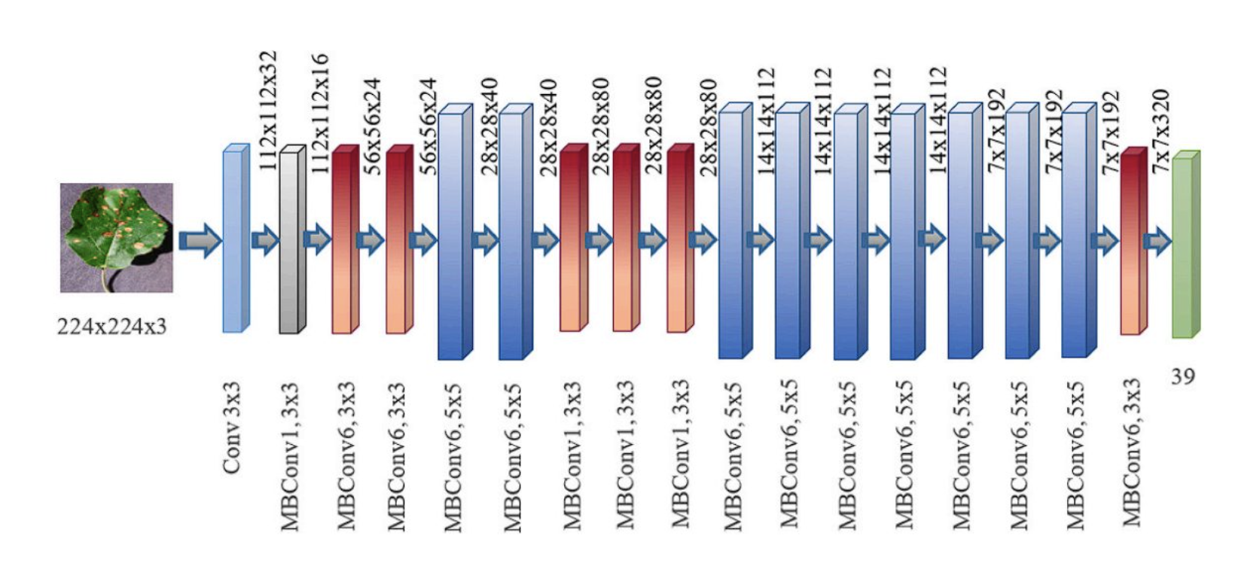
EfficientNet(B3)
The main components of the architecture are:
MBConv block (Mobile Inverted Bottleneck Convolution)
The MBConv block is an inverted residual block.
Expands the input feature map into a higher-dimensional space using a 1×1 convolution
Applies a depthwise convolution in this expanded space
Uses another 1×1 convolution that projects the feature map back to a lower-dimensional space
Squeeze-and-excitation optimization
allows the model to emphasize useful features
Squeeze:
Aggregates the spatial dimensions (width and height) of the feature maps across each channel using global average pooling
Excitation:
the model using a full-connected layer applied after the squeezing step, produces a collection of per channel weight (activations or scores).
Apply these learned importance scores to the original input feature map, channel-wise, effectively scaling each channel by its corresponding score.
Introduction
Data Overview
Methodology
Objective & Goals
Teams Contribution
Next Steps
Notes:
The main components of the architecture are:
MBConv block (Mobile Inverted Bottleneck Convolution)
The MBConv block is an evolved inverted residual block inspired by MobileNetv2.
inverted residual block starts by expanding the input feature map into a higher-dimensional space using a 1×1 convolution
applies a depthwise convolution in this expanded space
finally uses another 1×1 convolution that projects the feature map back to a lower-dimensional space
Squeeze-and-excitation optimization
allows the model to emphasize useful features
Squeeze: This phase aggregates the spatial dimensions (width and height) of the feature maps across each channel into a single value, using global average pooling
Excitation: In this step, the model using a full-connected layer applied after the squeezing step, produces a collection of per channel weight (activations or scores). The final step is to apply these learned importance scores to the original input feature map, channel-wise, effectively scaling each channel by its corresponding score.

Slide 17
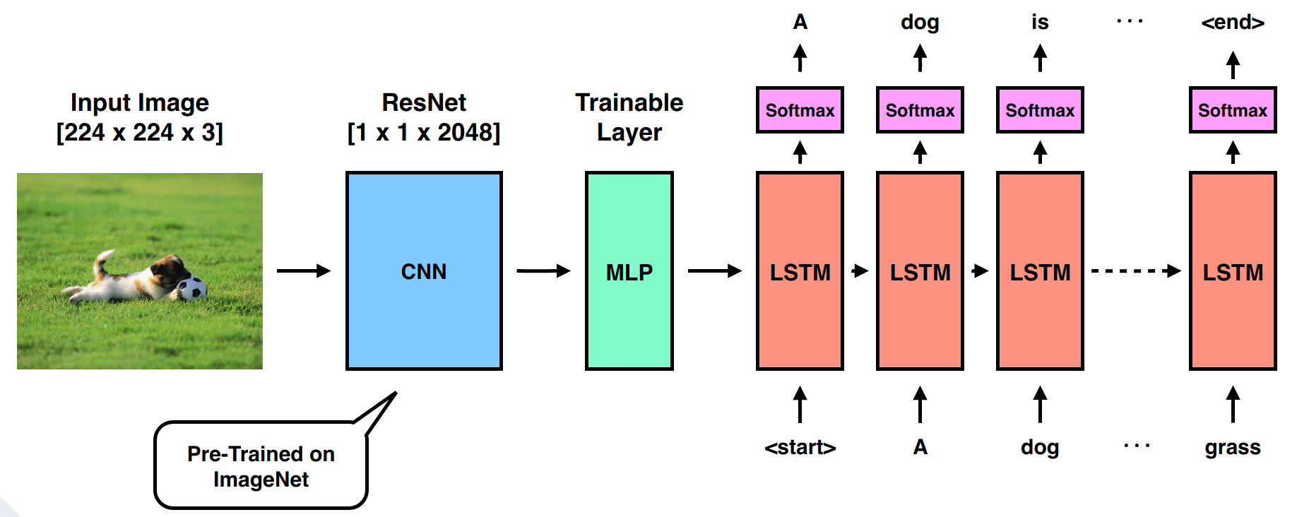
Decoder
Inputs image embedding + tokenized caption
GloVe-initialized embedding layer
LSTM processes the sequence
Linear layer outputs logits over vocabulary
*https://th.bing.com/th/id/OIP.d4aezvnXZkVzGZblRhwX2AHaC8?rs=1&pid=ImgDetMain
Introduction
Data Overview
Methodology
Results
Teams Contribution
Next Steps
Notes:
This feature vector acts as the initial context for the LSTM. To start, we typically pass this vector into the LSTM to set its initial hidden state and cell state. Think of these states as the LSTM’s memory, which will guide it as it generates the caption.
The LSTM then generates the caption in a sequential manner, one word at a time. At the first time step, we feed the LSTM a special ‘start’ token, which tells it to begin generating the sentence. The LSTM processes this token along with the image features stored in its hidden state, and it outputs a probability distribution over all possible words in our vocabulary—say, 10,000 words. We pick the word with the highest probability, or sometimes sample from the distribution to add variety. For example, it might output the word ‘A’ as the first word of the caption.
The LSTM updates its hidden and cell states based on this input and the previous state, which allows it to keep track of what it’s already generated and the overall context from the image.

Slide 18
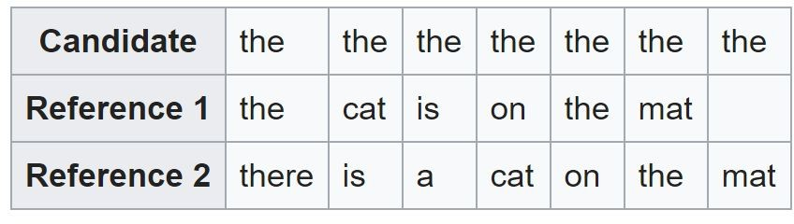
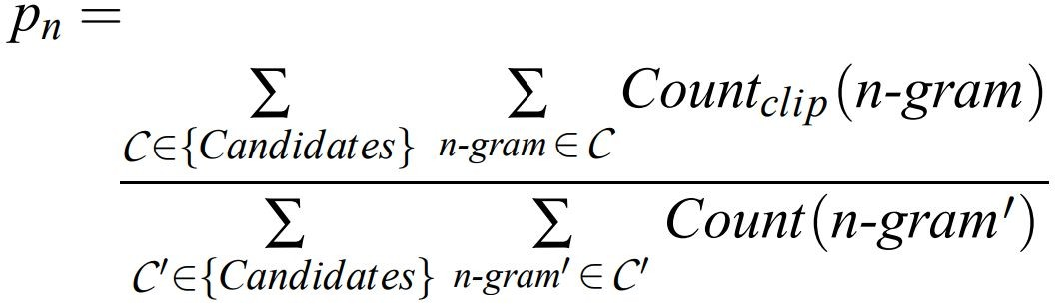
Evaluation Metrices
BLEU (Bilingual Evaluation Understudy)
Measures n-gram overlap between generated and gold captions.
Captures precision: how many words in the generated caption match reference captions.
Common variants: BLEU-1 to BLEU-4 (unigram to 4-gram).
Higher BLEU scores indicate closer similarity to human-written captions.
Precision = 7/7
Modified precision= 2/7
Definition:
Output is the geometric mean of n-gram score with a brevity penalty to discourage shorter translation.
Ref: Papineni, Kishore, et al. "BLEU: a method for automatic evaluation of machine translation." Proceedings of the 40th annual meeting on association for computational linguistics. Association for Computational Linguistics, 2002.
Introduction
Data Overview
Methodology
Results
Teams Contribution
Next Steps
Notes:
The brevity penalty (BP) is used in the BLEU (Bilingual Evaluation Understudy) score to penalize overly short candidate translations or captions.
The brevity penalty ensures that shorter-than-reference translations get a lower score.
Count Clip: Maximum number of times that word appears in the reference (limit)
BLEU Check: (Do not check position)
Exact token matches (case-sensitive or case-insensitive depending on implementation)
n-gram precision (unigrams, bigrams, trigrams, etc.)
Clipping for overused tokens
Brevity penalty if the candidate is too short

Slide 19
Evaluation Metrices
ROUGE (Recall-Oriented Understudy for Gisting Evaluation)
Measures n-gram and sequence overlap between generated and reference captions.
Focuses on recall — how much of the reference is captured.
ROUGE-N: N-gram recall between the candidate and the reference summaries. (e.g., ROUGE-1, ROUGE-2).
ROUGE-L: based on Longest Common Subsequence (LCS).
Useful for evaluating content coverage and fluency in captions.
Ref: Lin, Chin-Yew. "Rouge: A package for automatic evaluation of summaries." Text Summarization Branches Out (2004).
Introduction
Data Overview
Methodology
Results
Teams Contribution
Next Steps

Slide 20
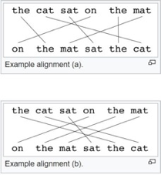

Evaluation Metrices
METEOR (Metric for Evaluation of Translation with Explicit ORdering)
Considers precision, recall, and word alignment using stemming and synonyms.
More sensitive to word order and meaning than BLEU.
Rewards semantic similarity even when wording differs.
Designed to better align with human judgment.
Ref: Banerjee, Satanjeev, and Alon Lavie. "METEOR: An automatic metric for MT evaluation with improved correlation with human judgments." Proceedings of the acl workshop on intrinsic and extrinsic evaluation measures for machine translation and/or summarization. 2005.
Introduction
Data Overview
Methodology
Results
Teams Contribution
Next Steps
Notes:
Calculate mapping between the candidate and reference caption. In conflict, mapping between least crosses is selected.
Unigram Matching: Both examples have all the same words, so METEOR gives credit for matching words.
Alignment Crossing Penalty:
Example (a) has more criss-crossing lines, indicating worse alignment.
Example (b) has fewer crosses, indicating better word order preservation.
METEOR penalizes fragmentation and poor word order by applying a penalty to the final score.

Slide 21
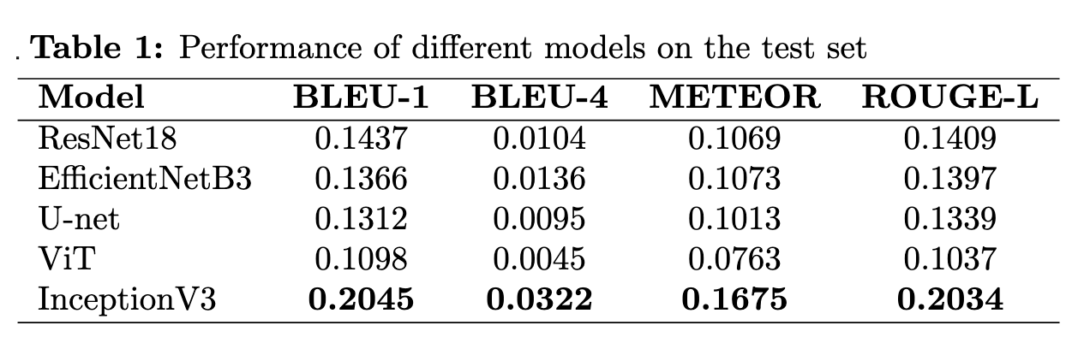
Results – Metrics
Introduction
Data Overview
Methodology
Results
Teams Contribution
Next Steps

Slide 22
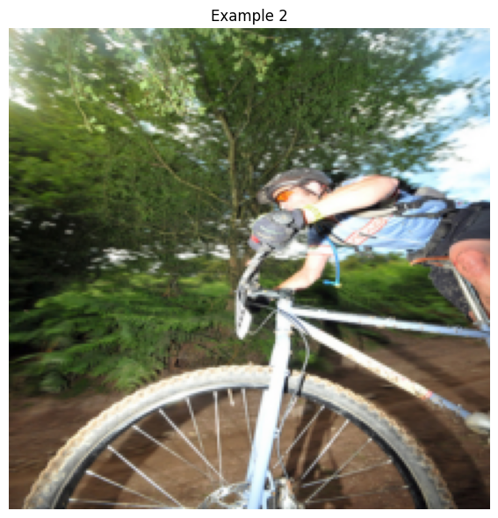
Results – Images
Original Caption:
cyclist leaning forward as he rides his bike
Predicted Caption:
Efficientnetb3: man in blue shirt and khaki pants is riding bike
Resnet18: man in red shirt is jumping off of rock into the water
Unet: man in blue shirt is standing on the shore of the ocean
ViT : man in red shirt and blue pants is climbing rock wall
Inceptionv3: man in blue shirt riding bike on dirt track
Introduction
Data Overview
Methodology
Results
Teams Contribution
Next Steps
Notes:
cyclist is leaning forward as he rides his bike.

Slide 23
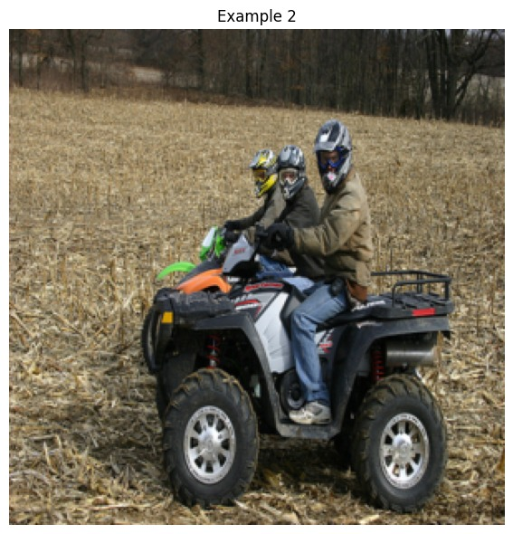
Results – show the weakness of the algorithm
Original caption:
three people on four wheel atv in field
Predicted Caption:
Efficientnetb3: man in blue shirt and khaki pants is riding bike
Resnet18: man in red shirt is jumping off of rock into the water
Unet: man in red shirt is standing on the shore of the ocean
ViT : man in red shirt and blue pants is climbing rock wall
Inceptionv3: two people are riding on atv atv
Introduction
Data Overview
Methodology
Results
Teams Contribution
Next Steps

Slide 24
Teams Contribution
Mohammad Sina Hassannia
Collected relevant data for the project
Data preprocessing
Designed the methodology framework
Implemented the model
Contributed to proposal writing
Created slides for presentations
Sumon Kanti Dey
Refined the problem statement
Designed the research methodology
Implemented the model
Assisted in writing the proposal
Designed presentation slides
Data preprocessing
Lovely Yeswanth Panchumarthi
Data Preprocessing.
Designed the research methodology
Implemented the model
Assisted in writing the proposal
Designed presentation slides
Introduction
Data Overview
Methodology
Objective & Goals
Teams Contribution
Next Steps

Slide 25
Next Steps
Model Optimization
Fine-tune encoder (e.g., ResNet) and decoder (e.g., LSTM/Transformer) for improved accuracy.
Experiment with advanced architectures (e.g., attention mechanisms) to enhance context awareness.
Dataset Expansion
Incorporate larger datasets (e.g., MS COCO) to improve generalization.
Add diverse image-caption pairs to capture varied contexts and intents.
Handling Challenges
Address bias in dataset captions and improve fairness.
Optimize the model for efficiency and scalability.
Challenges and Considerations
Overfitting on limited data (Flickr8k’s 8K images).
Balancing computational cost with performance on resource-heavy models.
Ensuring captions reflect nuanced interactions and cultural contexts.
Introduction
Data Overview
Methodology
Objective & Goals
Teams Contribution
Next Steps

Slide 26
Thank you for your Attention
Any Questions ?

Slide 27
References
Hodosh, Micah, Peter Young, and Julia Hockenmaier. "Framing image description as a ranking task: Data, models and evaluation metrics." Journal of Artificial Intelligence Research 47 (2013): 853-899.

