Slide 1
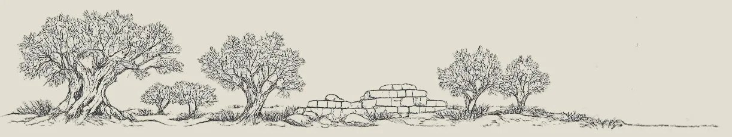
OCR/HTR FOR UNDER-RESOURCED LANGUAGES REDUX · VIENNA
Winding Workflows: Editors, Artificial Agents
and Specialist ATR Models
Two registers from Mandate Palestine, 1930s–40s. One solved, one not.
Sinai Rusinek · Haifa University, Open University DH-Dev · Austrian Academy of Sciences, 10 September 2026
Notes:
Session 2: Workflows & Systems, 10:50–12:10 (~20 min + Q&A).
Framing note: the through-line is that no stage of this work belongs to one kind of reader — the title's three actors each fail at something the others catch.

Slide 2
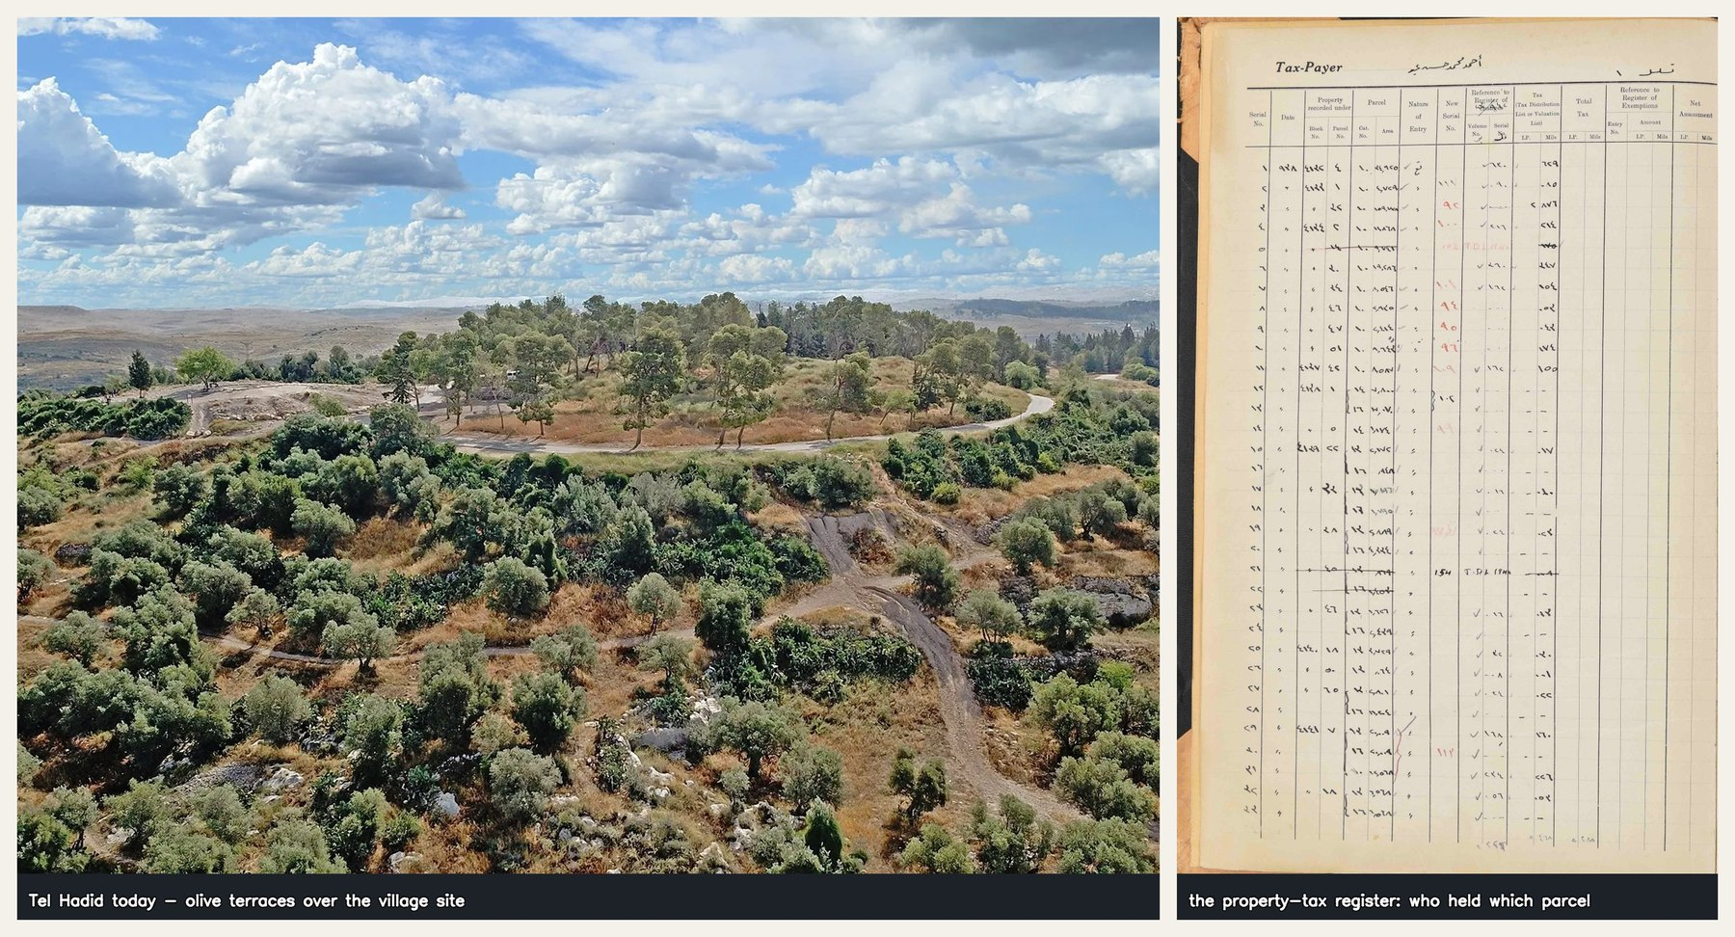
THE PLACE
Al-Haditha
— The village near Tel Hadid — Lydda, Ramla, Jaffa. Ottoman origins, destroyed 1948.
— The Hadid Expedition (Alon & Koch, ISF 1316/22) reconstructs it from archaeology, oral history, Ottoman and Mandate records.
— 102 pages · 19 columns · 3,069 rows · 58,122 cells
— Handwritten Arabic under printed English headers. Shelfmark TAX 1-85.
Tel Hadid today, and the register that records who held which parcel.
Notes:
The property-tax register is one of the few surviving documents of who held which parcel. Entries reference Tax Distribution Lists, 1938–1945.
This is the 'why it matters' slide — the register is evidence for a village that no longer exists.

Slide 3
TWO PHASES
The register that did work
— Haifa Government Hospital, 1930–1948. 33 notebooks · 2,548 images · 29,879 admissions.
— Phase 1, Transkribus: 10 notebooks, ~6,000 records, 95 human training pages, CER 4.30% → 3.51%.
— Phase 2, Gemini: 33 notebooks, 29,879 records, 0 training pages, structured TSV in one pass.
— Not a pure upgrade — the slow phase built the knowledge the fast phase runs on.
Notes:
CAVEAT TO STATE ALOUD: no head-to-head accuracy was ever computed. The comparison is scope and architecture, not CER.
This slide sets up the contrast. The audience should be thinking 'so apply phase 2 to the other register' — and the next slide shows why that fails.

Slide 4
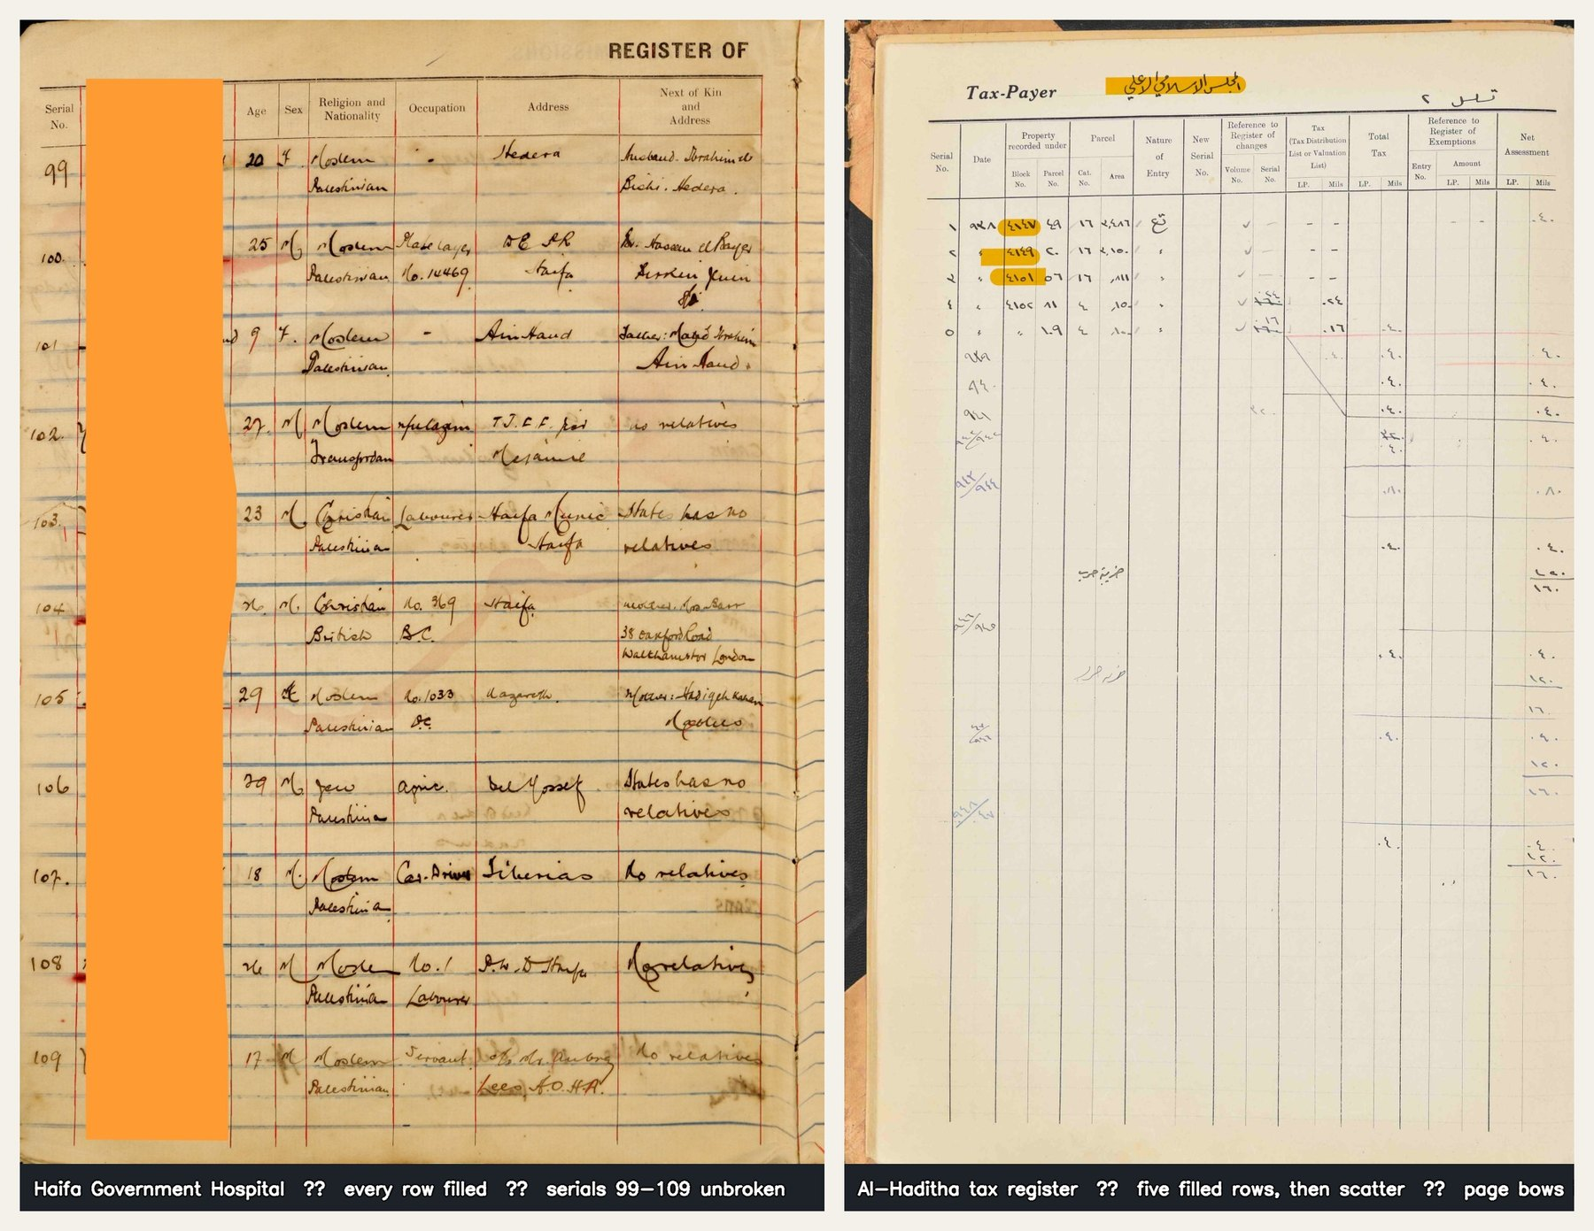
SLIDE 6 · WHY THIS ONE IS HARD
Two registers, side by side
— Same technology. One yields, one does not.
— The difference is not the script — it is the genre: a sparse, numeric, ruled table.
Left — Haifa: every row filled, rules crisp, page flat, serials 99–109 unbroken (names redacted). Right — Hadita: five filled rows then a scatter, ruling almost invisible, page bowing into the gutter.
Notes:
This is the single most important image in the talk. Let it sit.
Left: nb01_p003. Right: Hadita page 9.
Point at the bottom third of the right-hand page: that is where every later problem lives.

Slide 5
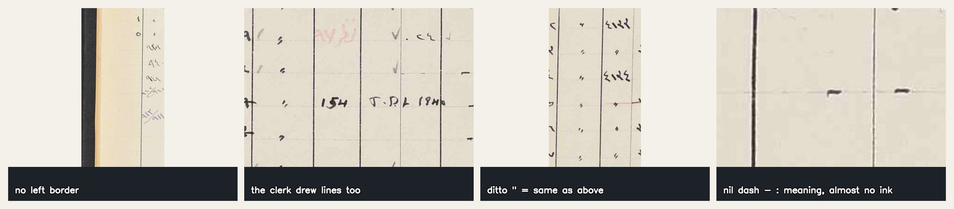
SLIDE 6 · WHY THIS ONE IS HARD
Four failure modes
— Photographed bound pages — column boundaries deviate −49px to +57px down a single page.
— The rules are faint, and on a sparse page nothing else marks a row.
— The left border line is missing — paper edge and binding shadow read as printed rules.
— The clerk drew lines too. Morphology cannot tell those from printed ruling.
Missing left border · clerk-drawn lines · ditto marks · nil dashes.
Notes:
PHYSICAL problems on this slide; content and semantics on the next.
The narrow money columns on the right are the next worst after the left border.

Slide 6
SLIDE 6 · WHY THIS ONE IS HARD
Content and semantics
— 32% of cells carry ink (18,718 of 58,122).
— Cells hold 1–4 glyphs, mostly Eastern Arabic numerals. No lexicon, no redundancy: every stroke is load-bearing.
— Two digit systems coexist, both authentic — ٠-٩ in most columns, 0-9 in New_Serial_No and T.D.L. references. Not normalised.
— Ditto marks and nil dashes carry meaning. 97 reference cells hold text with essentially zero ink.
— A row is not always an entry — sub-totals, carry-forwards, tax-year breakdowns.
Notes:
The ditto/nil point matters twice over: once here, and again at the ink gate, where 'meaning with no ink' is exactly the class the gate costs us.
On page 9 the serials stop after row 5 while dated entries continue below.

Slide 7
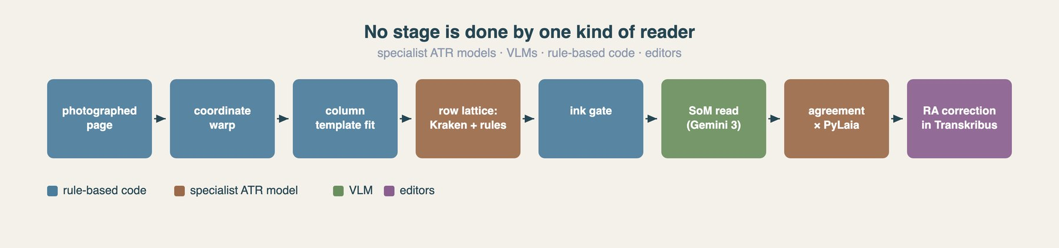
SLIDE 7 · THE CAST
Who is actually reading?
— Specialist ATR models · VLMs · rule-based code · editors.
— The title was too short to name them all — and “agents” was already doing double duty for two of them.
The pipeline, coloured by who does each stage rather than by what it computes.
Notes:
MAY FOLD INTO SLIDE 8 (your note in SLIDES.md).
The argument: no stage belongs to one kind of reader. The colouring is the point — this is the talk's through-line in one picture.
Two players not yet named at this stage: the community, and the chat that relayed what the community knew and experimented alongside me toward the pipeline.

Slide 8
PART TWO
Getting the geometry right
Notes:
Optional divider. Delete if the talk runs long.

Slide 9
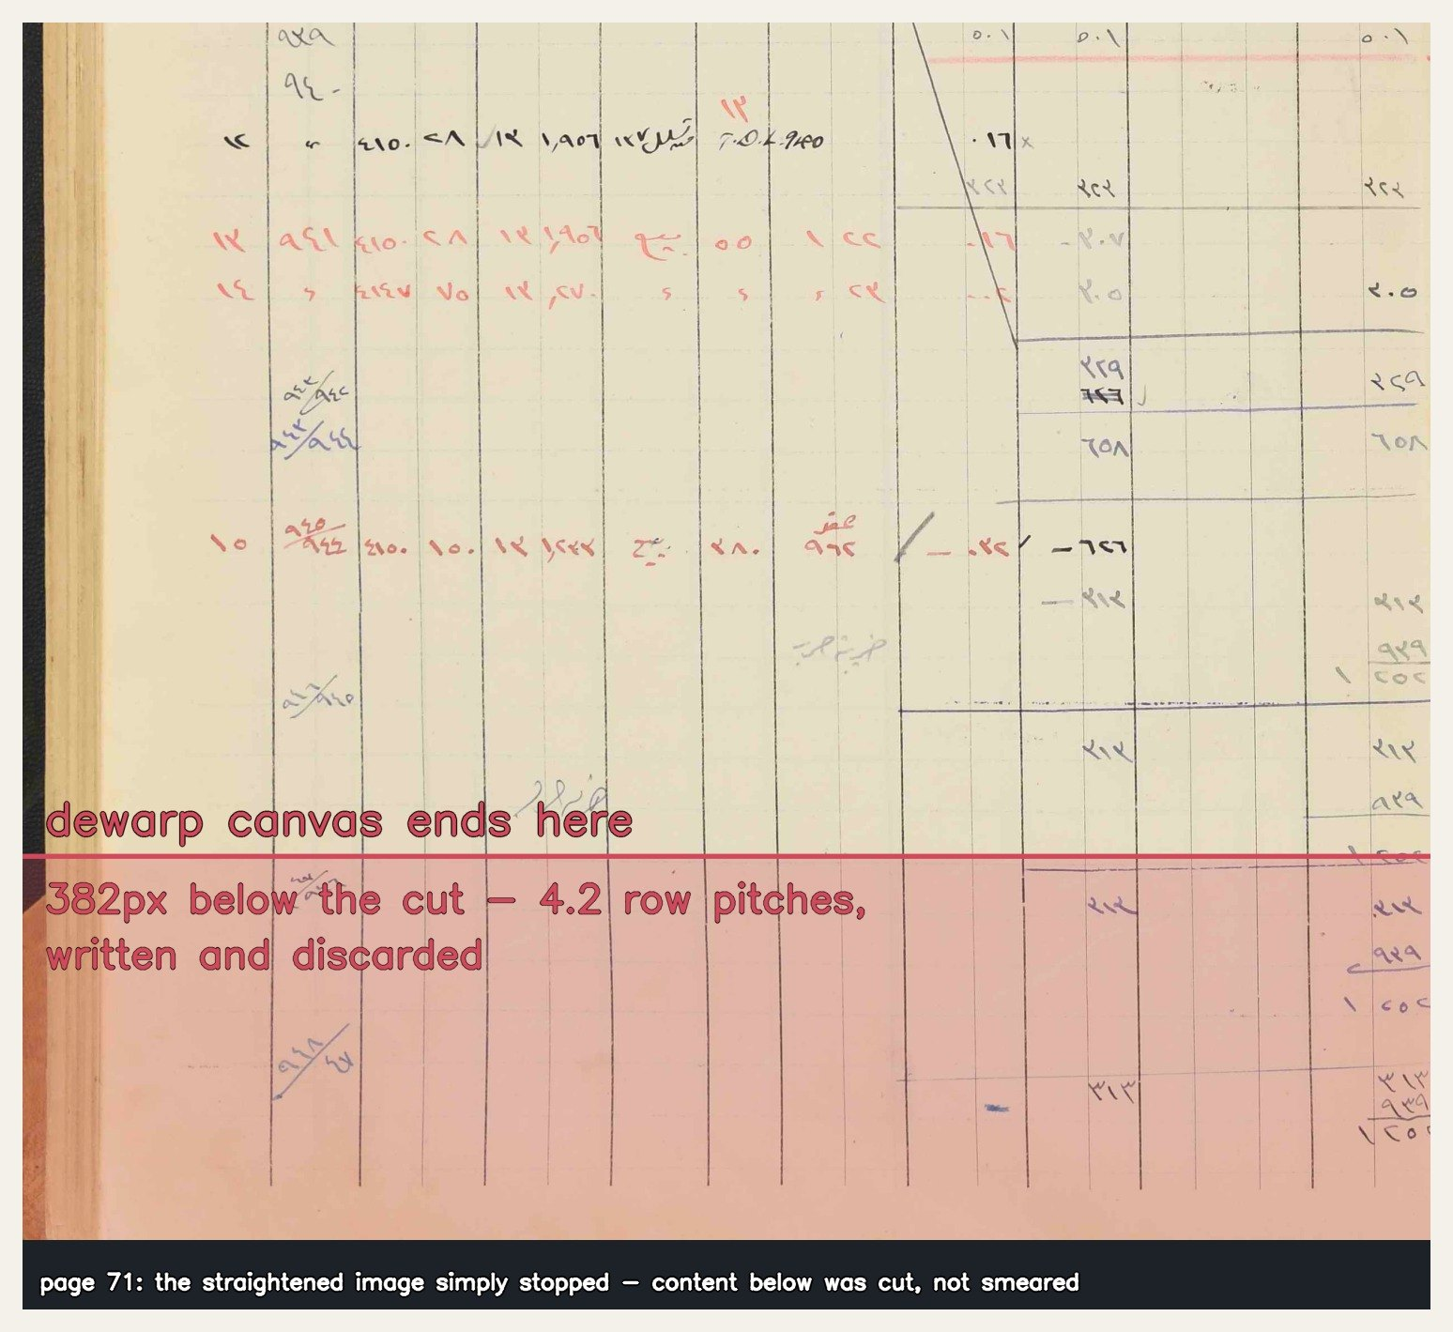
SLIDE 8 · THE LOSSY CONVENIENCE
Dewarping destroyed the pages
— The pipeline straightened the image. The canvas ended at last_row_center + ½ pitch.
— Content below the last detected row was cut, not smeared — a missed row was silently discarded.
— 98 of 98 pages damaged. 25 lost a whole written row; 92 had the bottom-cut geometry.
Fix: warp the coordinates, not the image.
Page 71: 382px — 4.2 row pitches — written and discarded.
Notes:
Recovered 35 rows. Structural validation 37/98 → 95/98.
Upload the undamaged page; push the cell polygons through the inverse remap. PAGE XML polygons can bow — the format could always express this.
THE LESSON: the lossy step was CONVENIENCE. Flattening the image made every later stage simpler, and paid for it by destroying data invisibly. Nothing errored. The corpus just quietly lost rows.

Slide 10
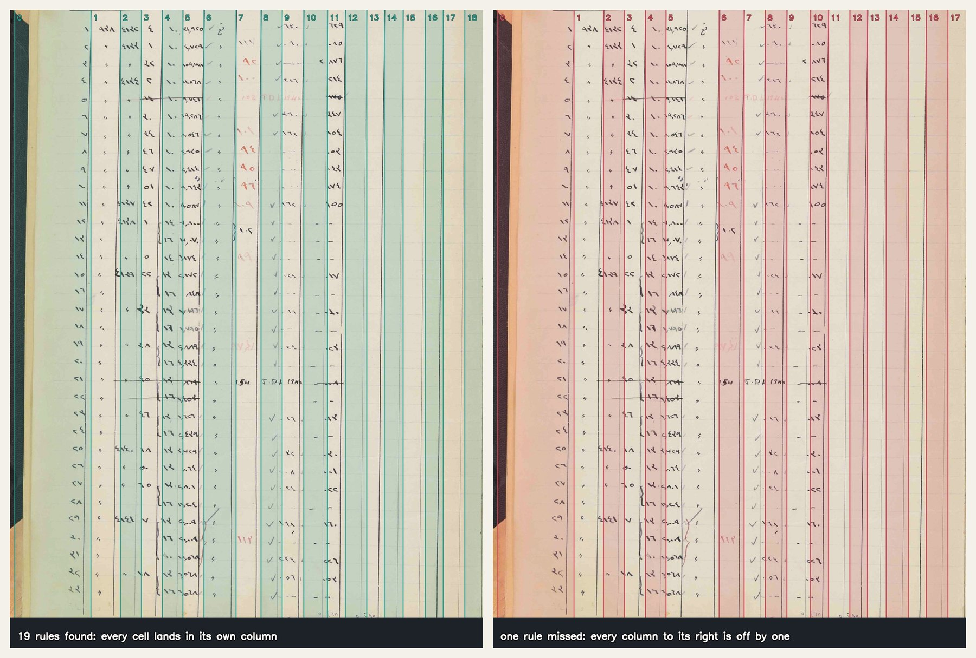
SLIDE 9 · COLUMNS
One miss is the whole problem
— Detecting 19 rules one by one cannot work: faint, crossed by handwriting, false verticals from the binding, and the page bows.
— Text is placed into cells by column index — a slightly misdrawn line is cosmetic, a dropped one mislabels every cell to its right.
Left: 19 rules found. Right: one rule dropped — every column index to its right shifts, and the page ends at 17 instead of 18.
Notes:
This is the slide that justifies the template approach. The audience has to feel that near-miss geometry is not 'nearly right' — it is wrong in a way that silently corrupts the data.

Slide 11
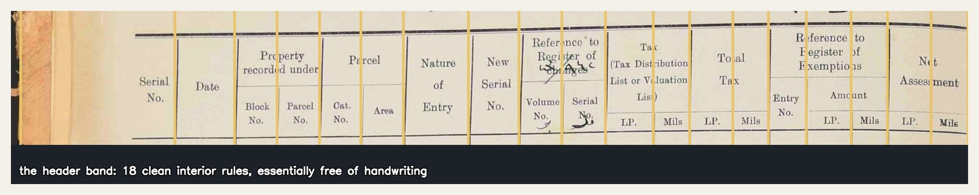
SLIDE 9 · COLUMNS
Stop detecting nineteen lines; fit one known form
— The printed form is constant, so the 19 relative widths are a template.
— The header band is print-only and carries all 18 interior rules as short clean strokes.
— Fit the template to those, with two free parameters: right edge and scale.
— The left edge is derived, never detected — whatever lies left of the Serial/Date rule is the Serial column.
“Stop detecting 19 lines; fit ONE known form.”
The header band — the cleanest column anchors on the page, because the scribe never wrote there.
Notes:
Deriving the left edge is what removes the binding shadow from the problem entirely.
RESIDUAL CLASS: pages where the scribe wrote across the printed columns. No line detector can fix that — it needs content-level flagging and RA judgment.
The full-page version of this figure is fig09_column_template.jpg if you want to show the template carried down the page.

Slide 12
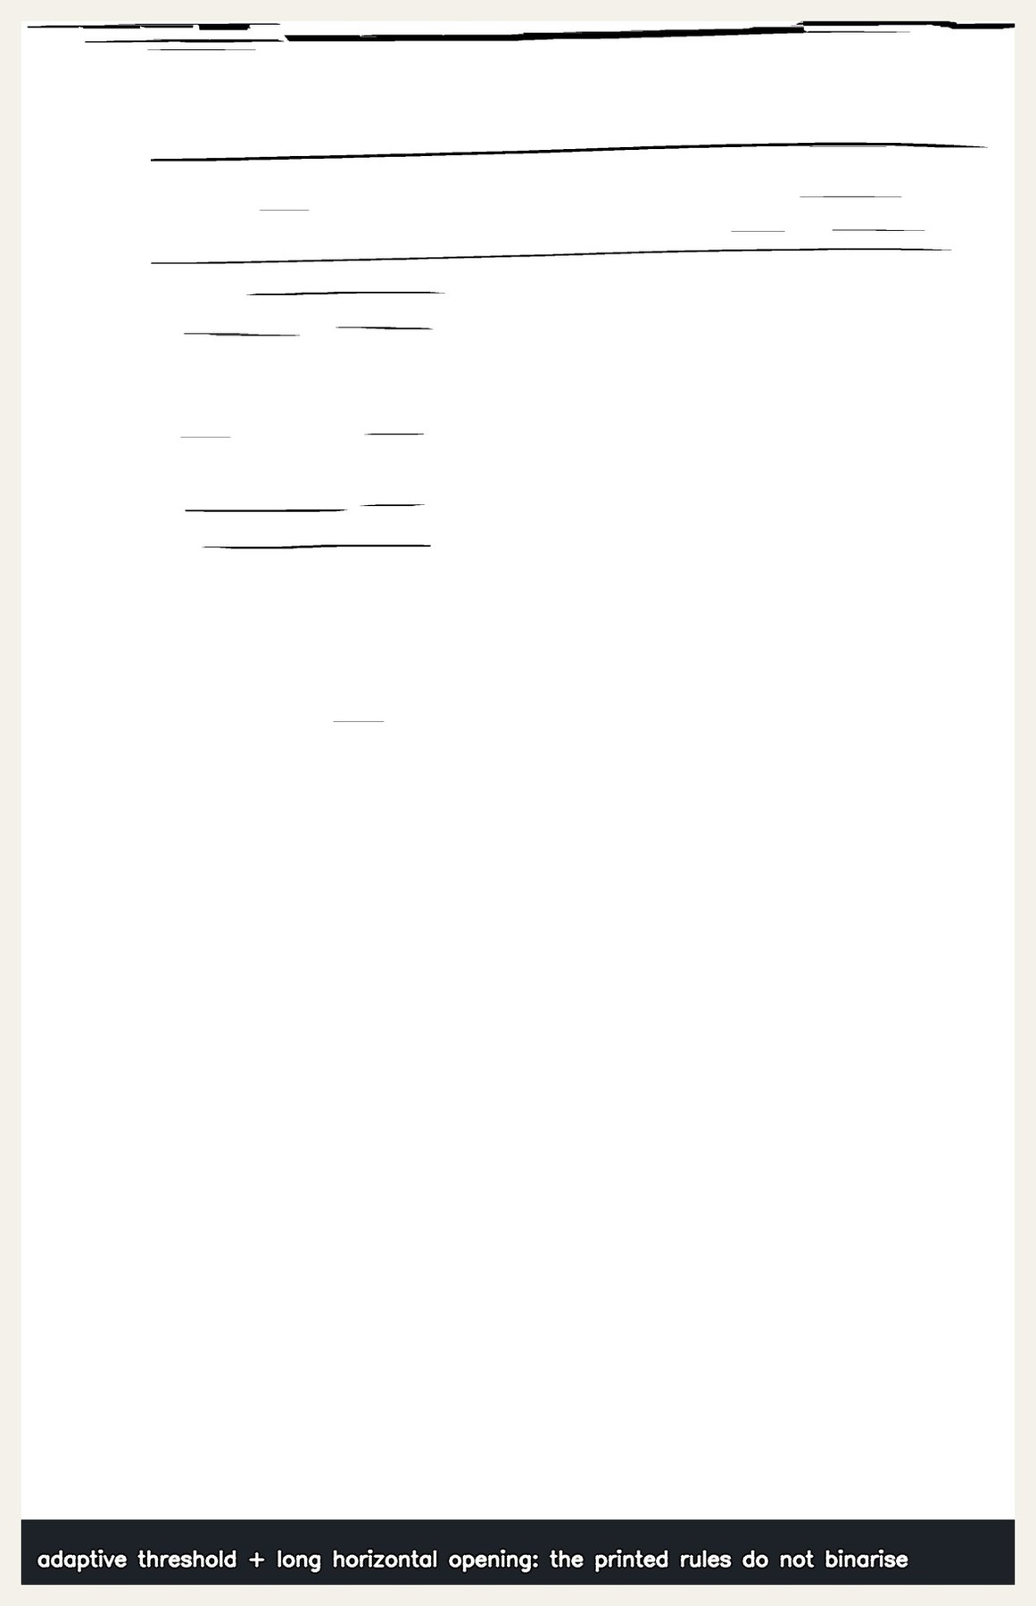
SLIDE 10 · ROWS
Where the same move failed
— Columns worked by ignoring the writing and fitting the printed form. The obvious next step was to do it again for rows.
— It did not survive contact with the scribe.
— The horizontal rules are printed 1–3% darker than the paper, and dashed. The faint dashes do not binarise; what survives is handwriting.
Adaptive threshold + long horizontal opening — the standard table-extraction recipe. This is all it returns.
Notes:
Note the irony worth saying aloud: this is the SAME recipe that works on the verticals. The method is not wrong in general — it is wrong here.

Slide 13
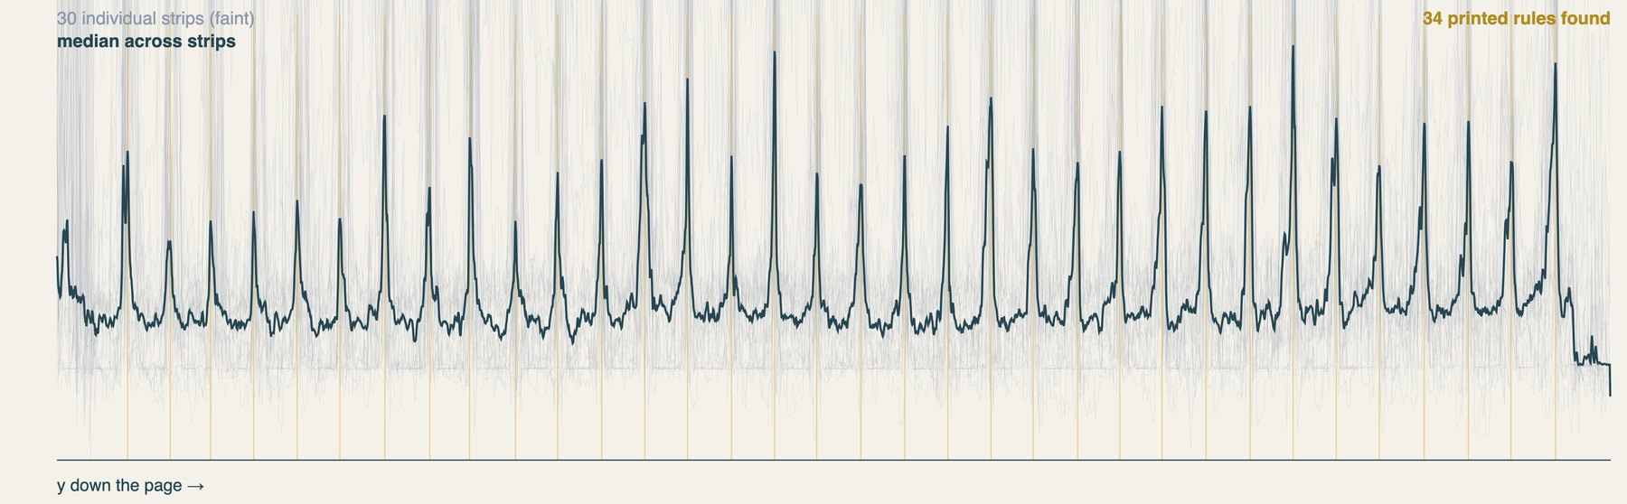
SLIDE 10 · ROWS
A median across strips does find them
— Cut the page into 30 vertical strips; take each strip's darkness profile.
— Take the median across strips. A printed rule crosses every strip and survives; a written line touches a few and is suppressed.
The signal was always there — it needed a statistic robust to ink, not a stronger filter.
30 individual strips (faint) and their median. On the densest page: 33 of 33 rules, within 6px of a perfectly regular ladder.
Notes:
This is the methodological heart of the geometry half of the talk. Worth dwelling on: the failure was not sensitivity, it was the wrong estimator.

Slide 14
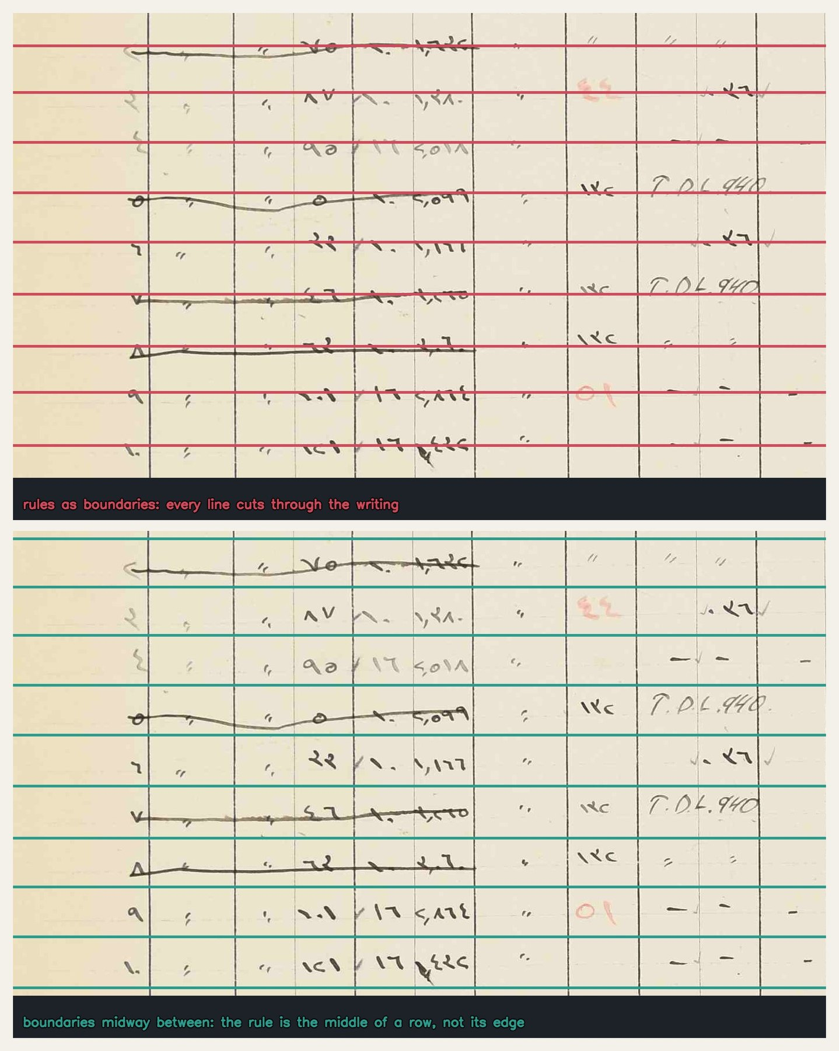
SLIDE 10 · ROWS
And then the scribe
— Building the grid on those rules gave 34 rows on every preview page — the printed form's own row count, right for the first time.
— On visual review, every boundary cut straight through a line of handwriting.
— Measured: the written lines sit within 1–7px of the printed rules, on a form whose rules are 93px apart.
The scribe writes ON the rule, not between the rules. A rule is not the edge of a row — it is the middle of one.
Top: printed rules used as row boundaries — every line cuts through the writing. Bottom: boundaries midway between.
Notes:
Reading the ruling as a set of boundaries put every boundary half a row out of place: geometrically flawless, and useless for reading.

Slide 15
SLIDE 10 · ROWS
Two sources, two jobs
— The grid is built on Kraken baselines — a generic segmenter, no Arabic, no notion of a table — which finds where the writing is. Boundaries go midway between.
— The printed rules stay in, demoted to one job: they measure the spacing, which they do better than handwriting can, because a printed form is regular and a scribe is not.
— Where a gap is wide enough for two rows, a row is inserted: blank rows are found by arithmetic, not by vision.
The printed form knows the spacing. Only the ink knows where the rows actually fall.
Notes:
AND THE MEASUREMENT WAS THE REAL FAILURE. The bad grid was scored by asking what fraction of the writing fell inside its rows — writing measured against lines derived from that same writing. It read 0.97 while sitting half a row off.
NEVER SCORE GEOMETRY WITH A METRIC DRAWN FROM THE SOURCE IT CAME FROM.
This is probably the most transferable lesson in the talk. Consider giving it its own slide.

Slide 16
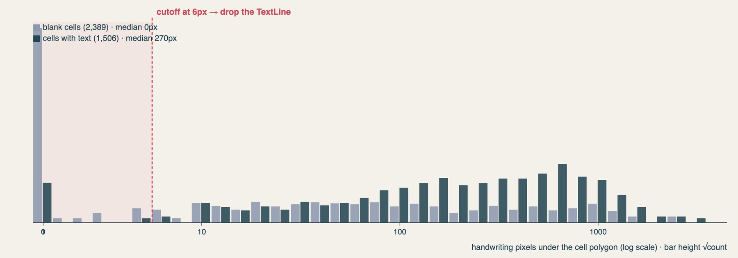
SLIDE 11 · INK-GATING
PyLaia has no “empty” prediction
— Our XML placed a TextLine in all 58,122 cells — so on page 11 PyLaia returned text in 416 of 532 blank cells.
— The fix is not a model: measure ink per cell, emit a TextLine only where there is some. Cutoff at 6px.
— 39,404 of 58,122 lines dropped. Inventions: zero.
Measured on the six proxy-GT pages with the shipped gate's own masks. Cells with text: median 270px. Blank cells: median 0.
Notes:
NOTE: the cutoff is 6px, not the 12 in the older draft — gate_textlines.py lowered it because user-labelled cells sat at 9px.
COST: 16.5% of remaining disagreements are now cells the model left empty that the reference fills — the near-invisible ones. A pink-pencil second chance on the green channel recovers most of that class (the pigment absorbs green, so strokes darken G relative to nearby paper).

Slide 17
PART THREE
Who can actually read the cells?
Notes:
Optional divider. Delete if the talk runs long.

Slide 18
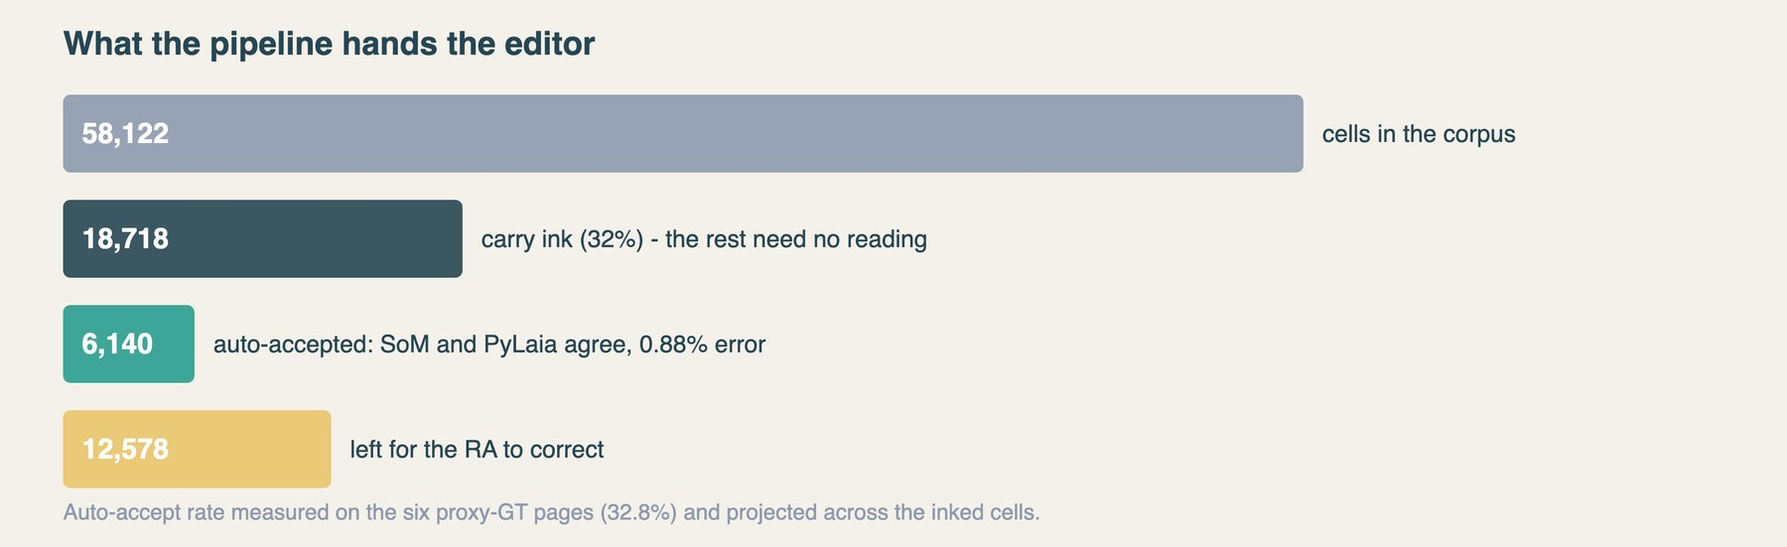
SLIDE 12 · WHO CAN READ THE CELLS?
Nobody reads them well
— hadid02 (PyLaia fine-tuned on this hand, 6 GT pages): 45.8% perfect cells, ~1,084 RA keystrokes/page.
— Gemini 3: 56–70% perfect cells, 720 keystrokes/page.
— Baseer/NAKBA (competition winner, CER 0.079 on Palestinian manuscripts): 1.8× more keystrokes.
What the pipeline hands the editor. Cross-family agreement auto-accepts about a third of inked cells at 0.88% substantive error.
Notes:
CAVEATS: hadid02 overfits because there are only 6 pages of GT; Baseer is a single run on isolated cell crops.
The agreement result is the constructive finding: a same-model rerun agrees twice as often and is wrong 17% of the time. Correlated errors are not evidence. Cross-family disagreement is.

Slide 19
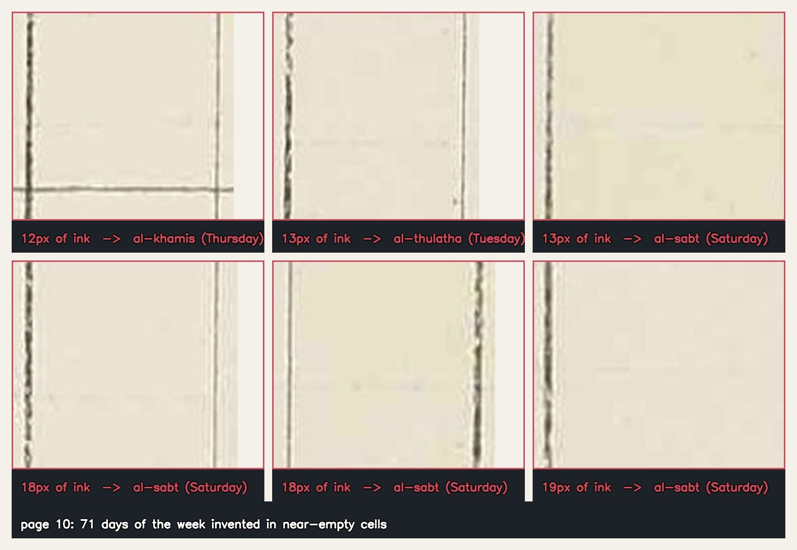
SLIDE 13 · WHY THE SPECIALISTS LOSE
Genre, not script
— Baseer: base model trained on 500k pairs with zero handwriting, and tables with >25% empty cells explicitly discarded — our exact distribution. Fine-tuned on memoir prose.
— Every Arabic Kraken model is trained on prose lines. CTC needs horizontal context that a 2-glyph cell denies it.
— Digits are a rounding error in every training set — so ٢/٣ and ٤/٦ are exactly the classes no model had pressure to separate.
Baseer's hallucinations in blank cells: السبت · الخميس · الاربعاء — days of the week, in a tax ledger. Every cell shown holds under 20px of ink.
Notes:
This is the slide that generalises beyond this project: the specialist models lose not because the script is under-resourced but because the GENRE is. Sparse numeric tables are excluded from the training data by construction.
The day-name hallucination usually gets a laugh. Let it.

Slide 20
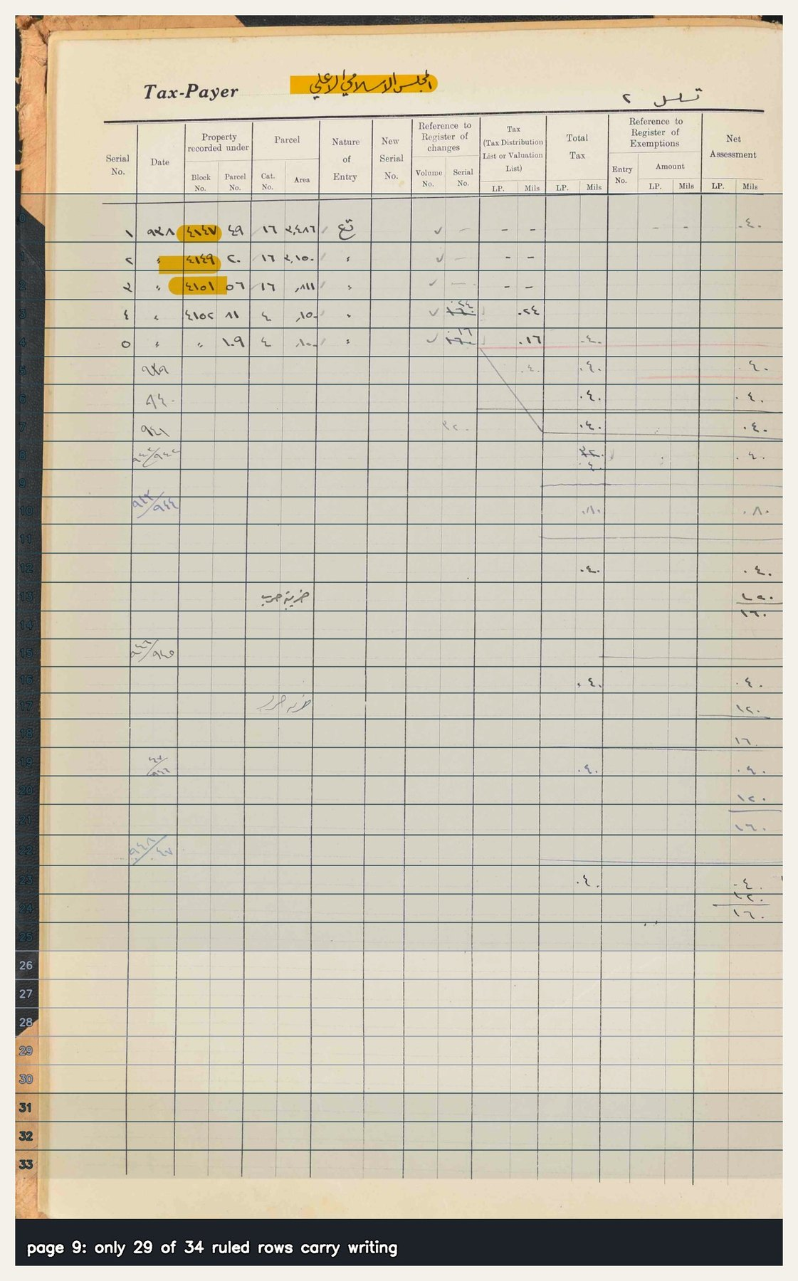
SLIDES 14–15 · THE COUNTING PROBLEM
The model returns a flat list; PAGE XML needs (row, column)
— No guarantee the model's row N is the grid's row N.
— On a sparse page it cannot tell a blank ruled row from a faint written one, so it drops rows — and everything below shifts. Page 9: 21 of 24 rows.
— Everything that gave the model less context failed: banded crops, column strips (Block_No 71.4% → 0.0%), cell crops.
— Even feeding it perfectly correct geometry did not help.
Page 9: dense entries at the top, then scattered faint ones, then ruled blanks. Nothing tells the model how many rows it has passed.
Notes:
The column-strip result is worth stating: giving the model a cleaner, more focused crop made it dramatically WORSE. That is counter-intuitive and worth the audience's attention.

Slide 21
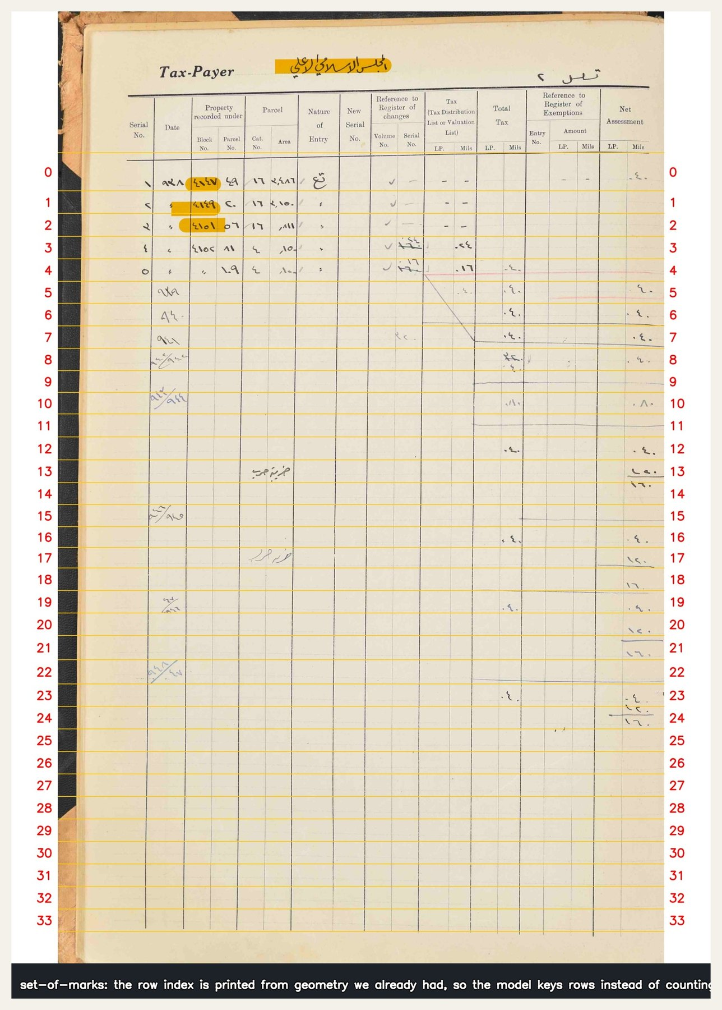
SLIDE 15 · TWO FIXES, DIFFERENT IN KIND
Delete the task
— The measurement was wrong. The scorer assumed a constant row offset, so one dropped row charged every row below it as a misread. Needleman–Wunsch alignment recovered 20–28% — with zero API calls.
— Then: delete the task. Print the row index into the margin, from geometry we already had, and ask the model to key each row to the number.
— Missed rows 23 → 1–4. ~$0.011/page.
Not a better model. No counting task.
Set-of-marks: the indices come from the grid we already computed. The model is no longer counting anything.
Notes:
MEASURED NOISE: ±1 row/page, so ±2–3 over six pages. The improvement is ~6–8 sd. '0 missed on 5 of 6 pages' is the best run, not the expected value — say this aloud.
Also worth saying: bigger models and more thinking made this WORSE, not better. The fix was structural, not a matter of capability.

Slide 22
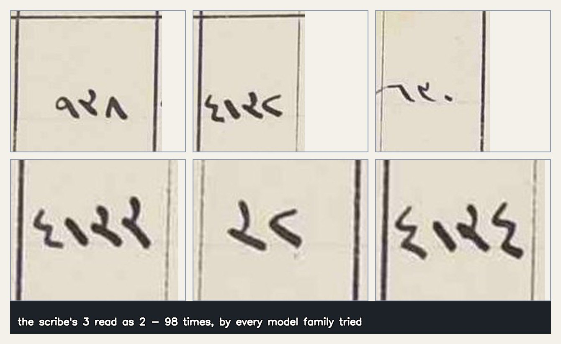
SLIDE 16 · WHERE I WOULD LIKE HELP
٣ → ٢
— Top substitution for Gemini (135), Baseer (67), and Claude alike.
— Three model families, three architectures, one scribe's hand.
Not model-fixable. This is where I would like help.
The scribe's ٣ at reading size. Recomputed against the proxy GT: 98 instances across the six pages.
Notes:
Close on this. It is the honest ending: the remaining error is in the source, not the system.
The 135 figure is Gemini's own count over a different comparison set; 98 is the recount on the six proxy-GT pages. Either is defensible — just be consistent about which you quote.
Invite the room to try reading them.

Slide 23
OPEN QUESTIONS
What is still unsettled
— Sparse-row skipping is improved but not solved; pages 9 and 10 remain the hard cases.
— Framing / through-line not yet fixed.
— Yiddish vocalization (YiDraCor) case not included — no room without cutting something load-bearing.
— Pending: row-strip variant of the Baseer test, to separate model deficit from crop deficit.
— Pending: rerun of gen2_sc_clean on the rebuilt corpus for a fair-footing number.
Notes:
Keep or cut depending on time. If the Q&A is likely to be strong, this slide seeds it well.

